Slide 1


BUS 243
Lecture 6: Introduction to Neural Net

Slide 2
Neural Net Frenzy
You may hear “AI, Deep learning, Neural net” almost everywhere
Why?
Is it better than any type of traditional approach?
Neural Net is a model or a classifier
Input, output, and parameters

Slide 3
What is a better model?

Slide 4
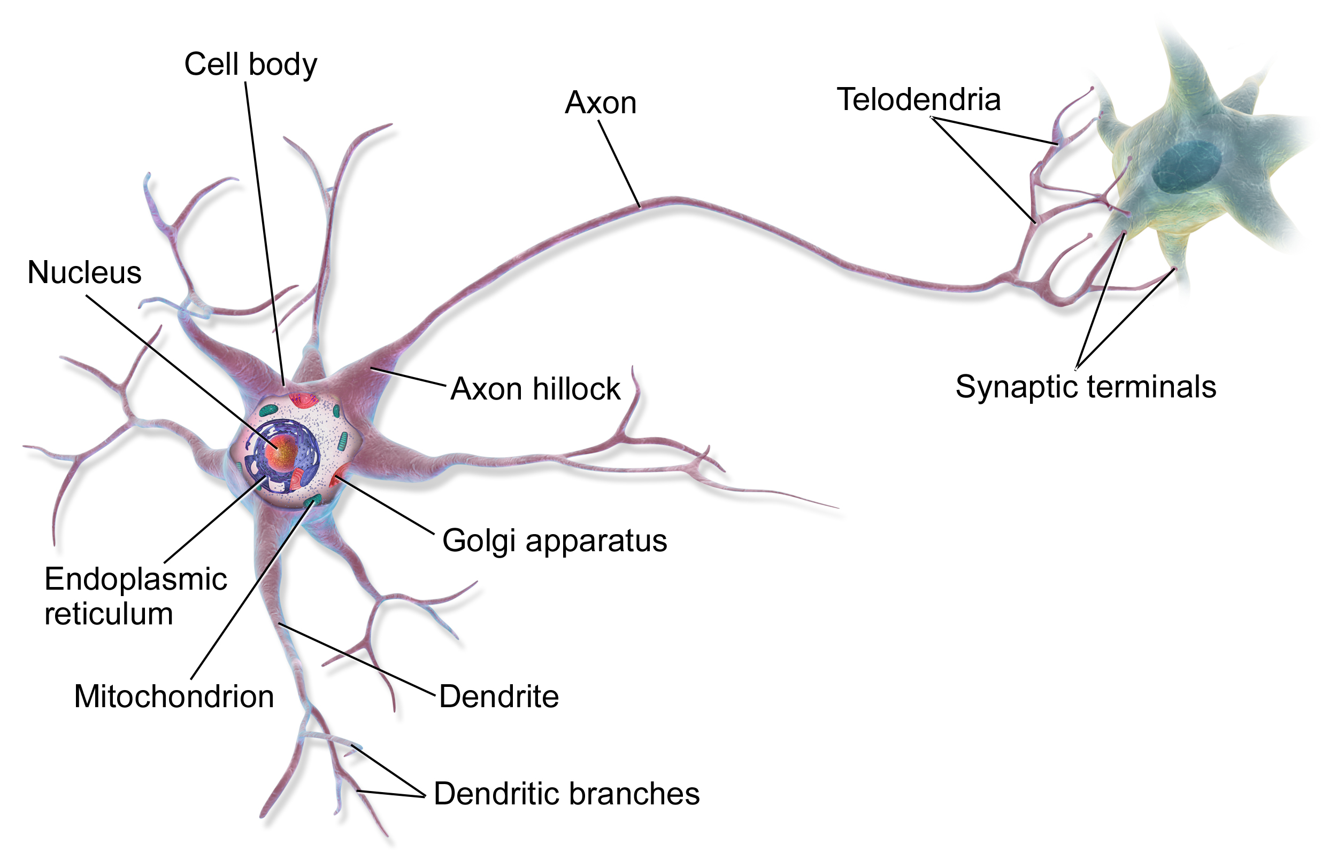
By BruceBlaus - Own work, CC BY 3.0, https://commons.wikimedia.org/w/index.php?curid=28761830
Notes:
Neural networks are called neural because their origins lie in the McCulloch-Pitts neuron, which was a 1943 simplified model of the human neuron as a kind of computing element that could be described in terms of propositional logic. But the modern use in language processing no longer draws on these early biological inspirations and the name neural is really just a kind of historical remnant.

Slide 5
Output value
Non-linear transform
Weighted sum
bias
Weights
Input layer
Notes:
Instead, a modern neural network is a network of small computing units, each of which takes a vector of input values and produces a single output value.
Over the next few lectures we'll introduce these units and see how they connect together into feedforward networks, so called because the computation proceeds iteratively from one layer of units to the next. The use of modern neural nets is often called deep learning, because modern networks are often deep (have many layers).
The building block of a neural network is a single computational unit. A unit takes a set of real valued numbers as input, performs some computation on them (combining with weights and biases and a non-linear transform), and produces an output. Let's see this in more detail.

Slide 6
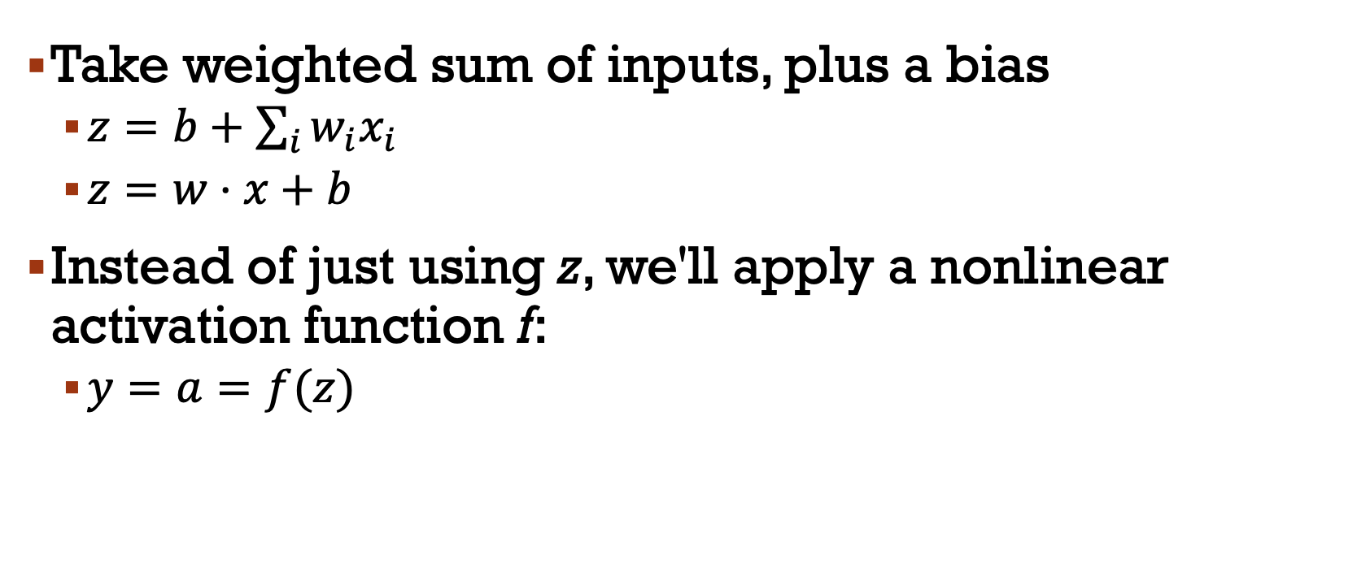
A neural unit
Take weighted sum of inputs, plus a bias
$z=b+\sum_{i}{w_{i}x_{i}}$
$z=w⋅x+b$
Instead of just using z, we'll apply a nonlinear activation function f:
$y=a=f(z)$

Slide 7
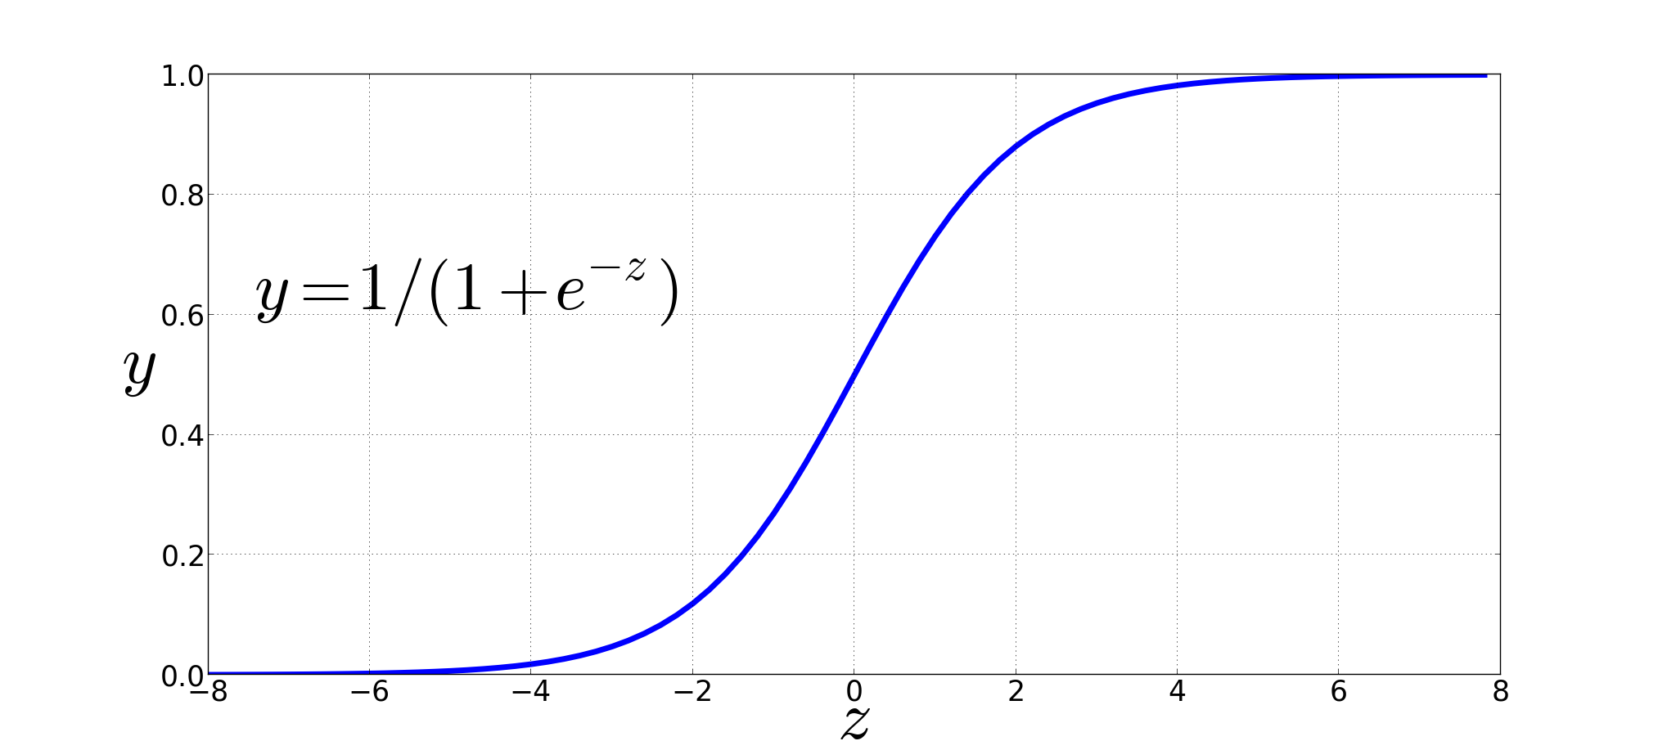
Non-Linear Activation Functions
Sigmoid
Notes:
We're already seen the sigmoid for logistic regression: 1 over 1 plus exp (-z).
The sigmoid has a number of advantages; it maps the output into the range [0,1], which is useful in squashing outliers toward 0 or 1. And it’s differentiable, which as we saw is handy for learning

Slide 8
Final function the unit is computing
Notes:
So here's the function that a simple unit with a sigmoid activation function is computing from an input x, a weight vector w, and a bias term b

Slide 9
Output value
Non-linear activation function
Weighted sum
bias
Weights
Input layer
Notes:
And here's our picture of the unit again, showing the pieces

Slide 10
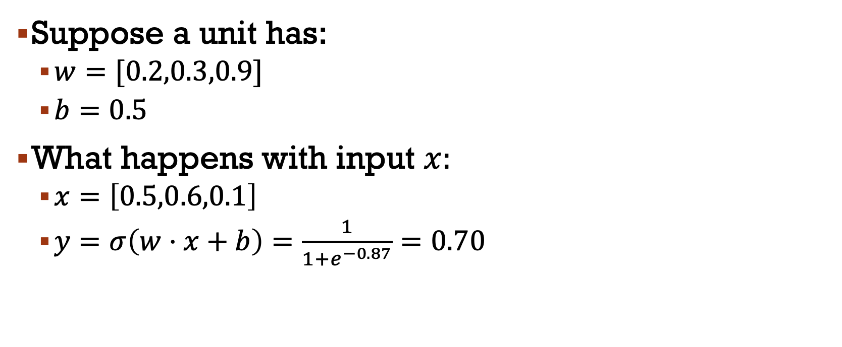
example
Suppose a unit has:
$w=[0.2,0.3,0.9]$
$b=0.5$
What happens with input $x:$
$x=\left[0.5,0.6,0.1\right]$
$y=σ\left(w⋅x+b\right)=\frac{1}{1+e^{−0.87}}=0.70$

Slide 11
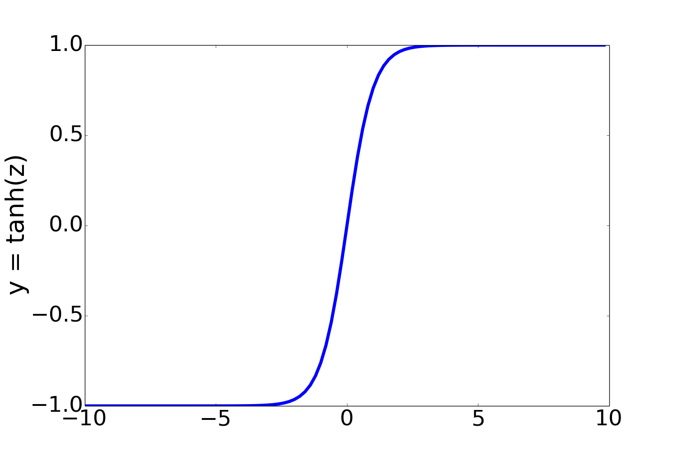
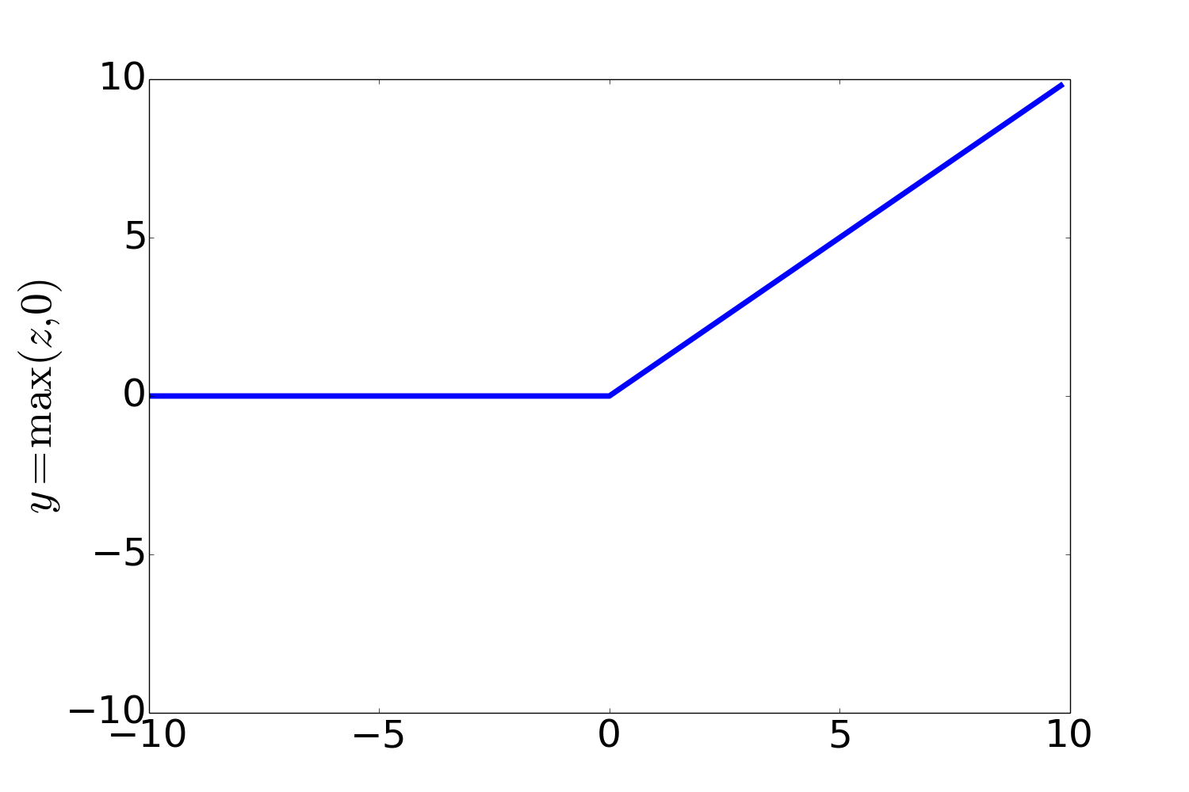
Non-Linear Activation Functions besides sigmoid
Most Common:
ReLU
Rectified Linear Unit
tanh
Notes:
In practice, the sigmoid is not commonly used as an activation function. A function that is very similar but almost always better is the tanh function; tanh is a variant of the sigmoid that ranges from -1 to +1:
The tanh function has the nice properties of being smoothly differentiable and mapping outlier values toward the mean.
The simplest activation function, and perhaps the most commonly used, is the rectified linear unit, also called the ReLU,. It’s just the same as z
when z is positive, and 0 otherwise:
The Rectified Linear Unit function, has nice properties that result from it being very close to linear. In the sigmoid or tanh functions, very high values of z result in values of y that are saturated, i.e., extremely close to 1 and have derivatives very close to 0. Zero derivatives cause problems for learning: gradients that are almost 0 cause the error signal to get smaller and smaller until it is too small to be used for training, a problem called the vanishing gradient problem. Rectifiers don’t have this problem, since the derivative of ReLU for high values of z is 1 rather than very close to 0.

