Slide 1

Introduction to Natural Language Processing
BUS 243 F: Spring 2023
Yeabin Moon
Lecture 2

Slide 2
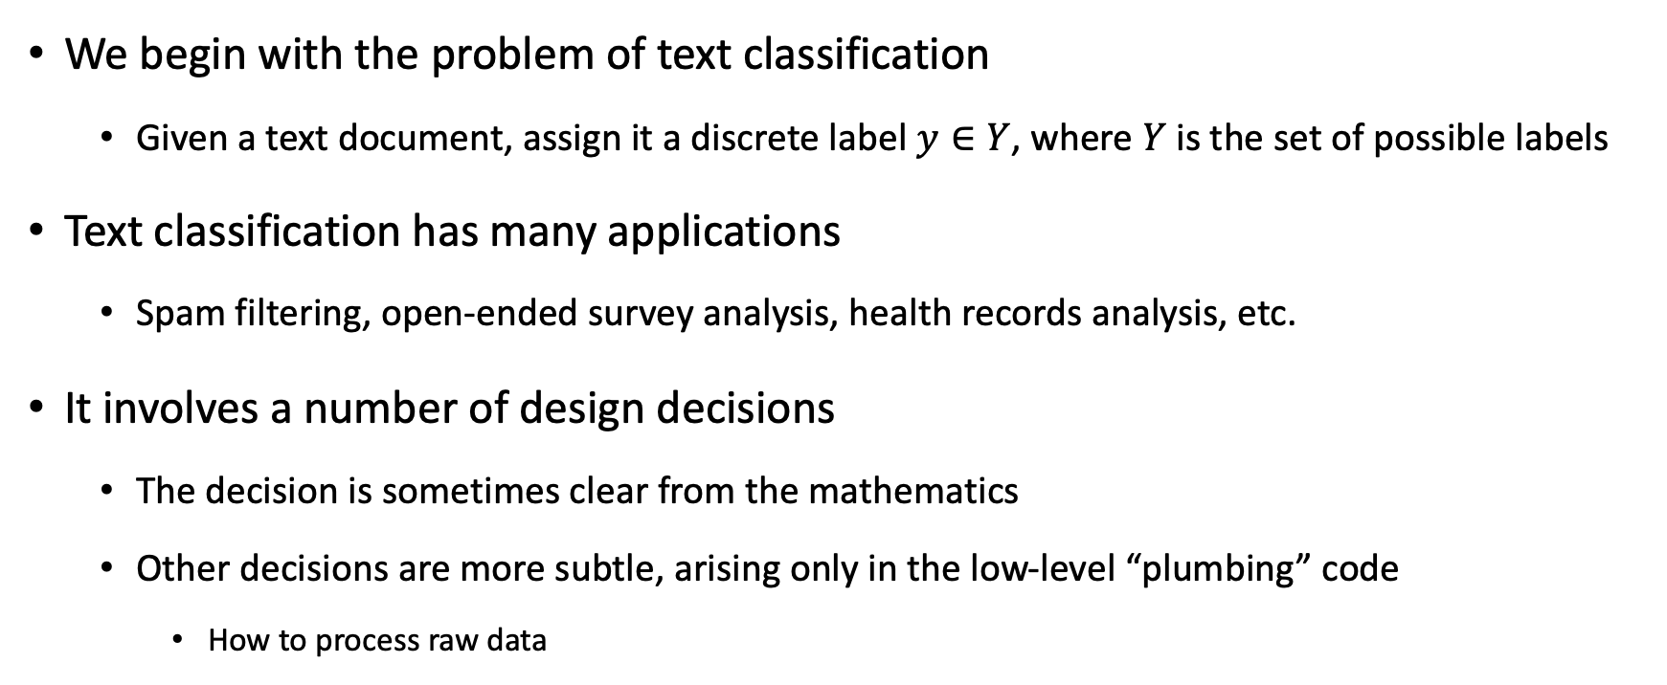
Text Classification
We begin with the problem of text classification
Given a text document, assign it a discrete label $y∈Y$, where $Y$ is the set of possible labels
Text classification has many applications
Spam filtering, open-ended survey analysis, health records analysis, etc.
It involves a number of design decisions
The decision is sometimes clear from the mathematics
Other decisions are more subtle, arising only in the low-level “plumbing” code
How to process raw data

Slide 3
Goal of the lecture
Understand a numerical representation of text
One-hot vectors
Bag-of-words representation
How to recognize a word?
Tokenization
Understanding Normalization
Exercise: Naïve Bayes

Slide 4
Some Keywords
Tokenization is a particular kind of document segmentation
Break up text into smaller chunks
Document → paragraphs → sentences → phrases → tokens
Tokenization is the first step in an NLP pipeline
turns an unstructured string (text document) into a numerical data structure suitable for machine learning
The distribution of tokens can be used directly
Counts imply the meanings
They also used in a ML pipeline as features
Let’s see the code

Slide 5
Terminology alert: one-hot vectors
One-hot vectors representation
Definition
Characteristics
Let’s see the code
This representation of a sentence in one-hot word vectors retains all the detail, grammar, and order of the original sentence.

Slide 6
Need another approach
What’s the downside?
Storing all those zeros, and trying to remember the order of the words in all your documents, doesn’t make much sense
You’d like to compress your document down to a single vector rather than a big table
Trade-off: need to give up something
We will revisit this representation later (sentence-base analysis)
Essential input for CNN (Convolution Neural net)
Let’s go back to the code

Slide 7
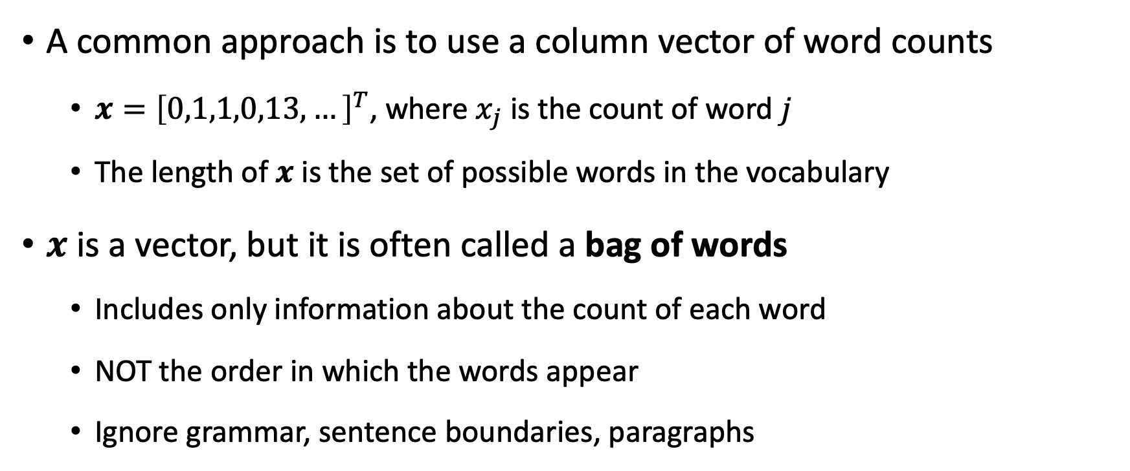
Bag of words
A common approach is to use a column vector of word counts
$x={\left[0,1,1,0,13,…\right]}^{T}$, where $x_{j}$ is the count of word $j$
The length of $x$ is the set of possible words in the vocabulary
$x$ is a vector, but it is often called a bag of words
Includes only information about the count of each word
NOT the order in which the words appear
Ignore grammar, sentence boundaries, paragraphs

Slide 8
BOW: Everything but words
The BOW model is surprisingly effective for text classification
If you see the word whale in a document, is it fiction or nonfiction?
For many labeling problems, individual words can be strong predictors
We need to discuss some steps here

Slide 9
What is a word?
The BOW representation presupposes that extracting a vector of word counts from text is unambiguous
However, text documents are generally represented as a sequences of characters, and the conversion to bag of words presupposes a definition of the “words” that are to be counted

Slide 10
Tokenization
The first subtask for constructing a BOW vector is tokenization
A sequence of characters → a sequence of word tokens
Note whitespace-based tokenization is not ideal
Tokenization is typically performed using regular expressions, with modules designed to handle each cases
Go back to the code example

Slide 11
Token Improvement
See the text for the regular expressions
See a number of tokenizers in the code examples
Social media researchers have found that emoticons and other forms of orthographic variation pose new challenges for tokenization, leading to the development of special purpose tokenizers to handle them
O’Connor, B., M. Krieger, and D. Ahn (2010). Tweetmotif: Exploratory search and topic summarization for twitter. In Proceedings of the International Conference on Web and Social Media (ICWSM), pp. 384–385.

Slide 12
Tokenization is hard?
Tokenization is a language-specific problem
Each language poses unique challenges
Chinese does not include spaces between words, nor any other consistent orthographic markers of word boundaries
German does not include whitespace in compound nouns
Social media raises similar problems for English and other languages
#TrueLoveInFourWords
Decomposition analysis (Brun and Roux, 2014)

Slide 13
Extending your vocabulary with n-grams
Now we consider a sequence of words
Ice cream
Boston Red Sox
N-gram is simply a sequence of n words
N-gram could denote characters, but focus on words now
We have tokenized sentences using 1-gram only thus far
Using 2-gram or 3-gram words means adding more tokens in the vocabulary
Not difficult to add (see the codes)
N-gram tokens are pretty rare → need some ways to handle them properly

Slide 14
What if only use 1-gram tokens?
What is the problem of rare 2-grams when we add them in the vocab?
Again, they are so rare. Why is this a problem?
If use 1-gram tokens only, the stop words are usually counted the most
The, a, an, …
If they are removed:
Mark reported to the CEO
Suzanne reported as the CEO to the board
Lack of information about the professional hierarchy
If not, the length of vocabulary would be the problem
Let’s dig this issue a little bit deeper

Slide 15
Text normalization
After splitting the text into tokens, the next question:
Which tokens are really distinct
Complete elimination of case distinction will result in a smaller vocab
Necessary to distinguish great, Great and GREAT?
How about apple and Apple?
Text normalization refers to string transformation that remove distinctions that are irrelevant to downstream applications
Also include standardization of numbers (1,000 → 1000) or dates
Social media (e.g. coooooooool)

Slide 16
Inflections matter?
A more extreme form of normalization is to eliminate inflectional affixes (e.g. -ed and –s suffixes)
Whale, whales, whaling all refer to the same underlying concept
A stemmer is a program for eliminating affixes
Apply a series of regular expression substitutions
Character-based stemming algorithms are necessarily approximate
Original | The | Williams | sisters | are | Leaving | This | Tennis | centre
Porter stemmer | the | william | sister | are | leav | thi | tenni | centr
Lancaster stemmer | the | william | sist | ar | leav | thi | ten | cent
WordNet lemmatizer | The | Williams | sister | are | leaving | this | tennis | centre

Slide 17
Inflections matter?
Lemmatizers are systems that identify the underlying lemma of a given wordform
Geese → Goose
Generalization would matter
Even inaccurate stemming can improve bag-of-words classification
merging related strings and thereby reducing the vocabulary size
However, need to avoid the over-generalization errors
Both stemming and lemmatization are language-specific
English stemmer or lemmatizer is of little use on a text in another language

Slide 18
Normalization is kind of smoothing
The value of normalization depends on the data and the task
Normalization reduces the size of the feature space
Can help in generalization
There is always the risk of merging away meaningful distinctions
In supervised machine learning, regularization and smoothing can play a similar role to normalization
Mitigate overfitting to rare (language-specific) features
In unsupervised learning, such as topic modeling, normalization is even more critical

Slide 19
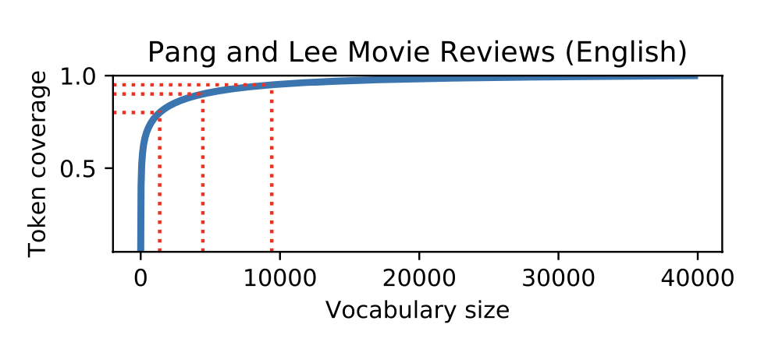
How many words?
Limiting the size of the feature vector reduces the memory and increases the speed of prediction
Normalization can help to play this role, but a more direct approach is simply to limit the vocabulary to the N most frequent words in the dataset

Slide 20
Stopwords
Another way to reduce the size is to eliminate stopwords (the, to,…)
Typically done by creating a stoplist (nltk stopwords) and ignoring all terms that match the list
However, seemingly inconsequential words can offer surprising insights about the author or nature of the text (Biber 1991)
High-frequency words are unlikely to cause overfitting in discriminative classifiers
As with normalization, stopword filtering is more important for unsupervised problems, such as term-based document retrieval

Slide 21
Count or binary?
Consider whether we want to our vector to include the count of each word or its presence
Pang et al. (2002) shows binary indicators performs better in some case
Words tend to appear in clumps: if a word has appeared once in a document, it is likely to appear again
These subsequent appearances can be attributed to this tendency towards repetition
Counts provide little additional information about the class label document

Slide 22
Sentiment (opinion) analysis
A popular application of text classification is to automatically determine the sentiment or opinion polarity of documents
product reviews and social media posts
Numerous application both in academia and practice
Macro-finance indicators from news or policy statements
Mood change by the weather reports
Assume reliable labels can be obtained
In simple case, it is a two or three-class problem
Positive, negative, or neutral

Slide 23
Popular annotations
Tweets containing happy emoticons can be marked as positive, sad emoticons as negative (Read, 2005; Pak and Paroubek, 2010).
Reviews with four or more stars can be marked as positive, three or fewer stars as negative (Pang et al., 2002).
Statements from politicians who are voting for a given bill are marked as positive (towards that bill); statements from politicians voting against the bill are marked as negative (Thomas et al., 2006)

Slide 24
VADER
VADER, Valence Aware Dictionary for sEntiment Reasoning
Never has beat Darth Vader
Easy to use
Limitations are so obvious
Its intuition would help for understanding distributed semantics (lecture 6)
Let’s review the code

Slide 25
Sentiment analysis with the bag-of-words
A Naive Bayes model tries to find keywords in a set of documents that are predictive of your target (output) variable
When your target variable is the sentiment, the model will find words that predict that sentiment
The nice thing about a Naive Bayes model is that the internal coefficients will map words or tokens to scores just like VADER does

Slide 26
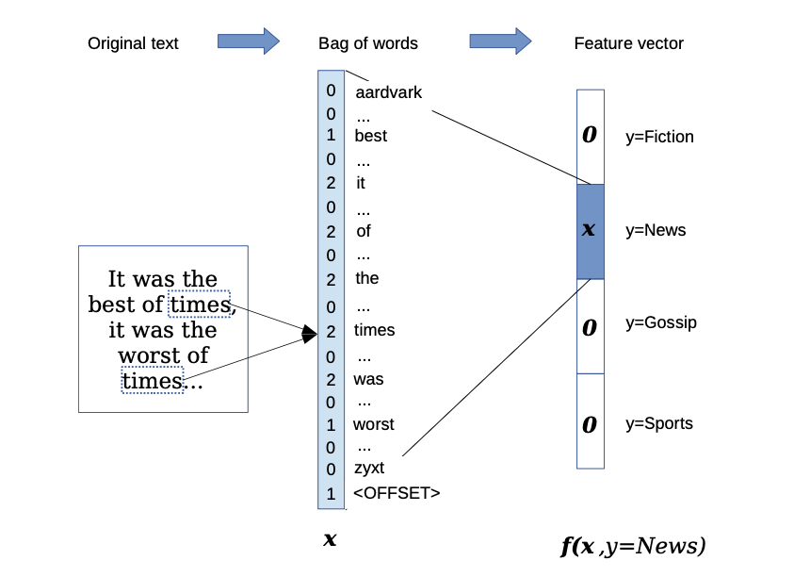
The bag-of-words for text classification task

Slide 27
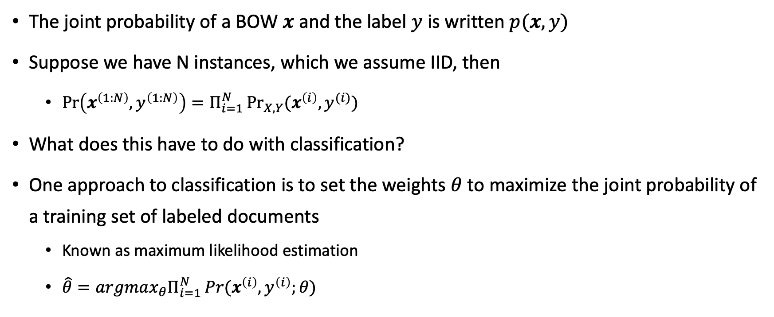
Naïve Bayes
The joint probability of a BOW $x$ and the label $y$ is written $p(x,y)$
Suppose we have N instances, which we assume IID, then
$Pr\left(x^{\left(1:N\right)},y^{\left(1:N\right)}\right)=Π_{i=1}^{N}\underset{X,Y}{Pr}{(x^{\left(i\right)},y^{(i)})}$
What does this have to do with classification?
One approach to classification is to set the weights $θ$ to maximize the joint probability of a training set of labeled documents
Known as maximum likelihood estimation
$\hat{θ}=argmax_{θ}Π_{i=1}^{N}\operatorname{Pr}{(x^{\left(i\right)},y^{\left(i\right)};θ)}$

Slide 28
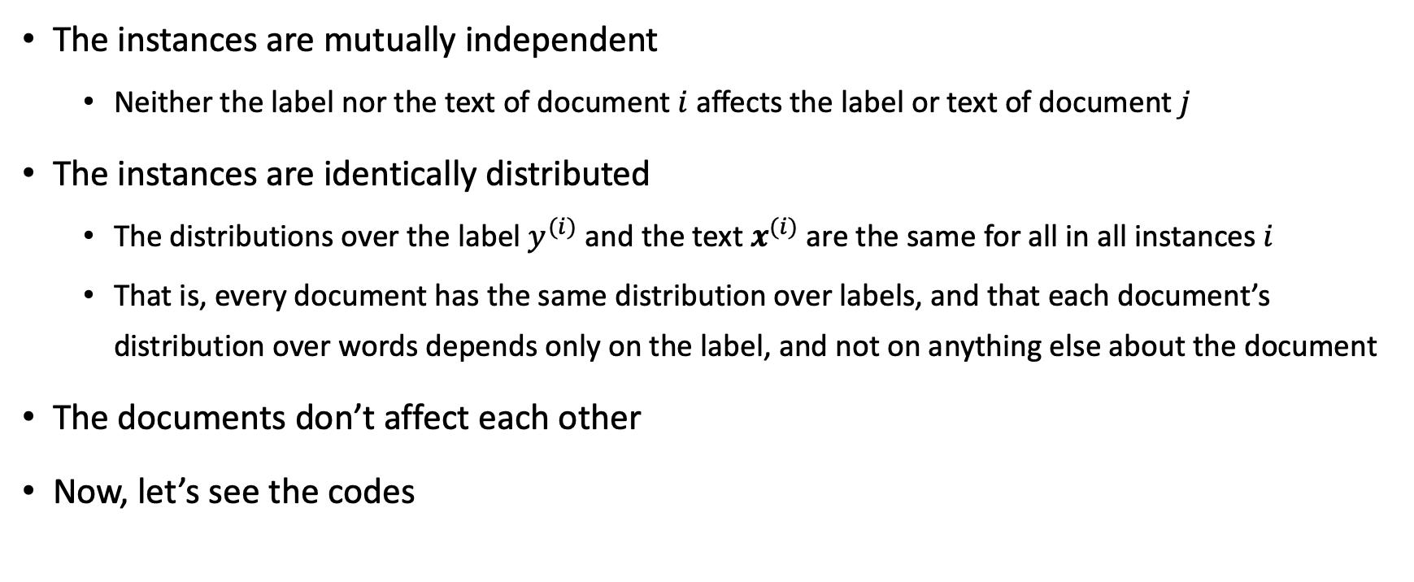
Assumptions in words
The instances are mutually independent
Neither the label nor the text of document $i$ affects the label or text of document $j$
The instances are identically distributed
The distributions over the label $y^{(i)}$ and the text $x^{(i)}$ are the same for all in all instances $i$
That is, every document has the same distribution over labels, and that each document’s distribution over words depends only on the label, and not on anything else about the document
The documents don’t affect each other
Now, let’s see the codes

Slide 29
Discussion
The bag-of-words model is a good fit for sentiment analysis at the document level
If the document is long enough, we would expect the words associated with its true sentiment to overwhelm the others
But it is less effective for short documents, such as single-sentence reviews or social media posts
Linguistic issues like negation are inevitable

Slide 30
Guess sentiment
That’s not bad for the first day
This is not the worst thing that can happen
It would be nice if you acted like you understood
This film should be brilliant. The actors are first grade. It should like a great plot, however, the film is a failure. (Pang et al., 2002)

Slide 31
Discussion
A minimal solution is to move from a bag-of-words model to a bag-of-bigrams model, where each base feature is a pair of adjacent words
(that’s, not), (not, bad), (bad, for),…
Bigrams can handle relatively straightforward cases, such as when an adjective is immediately negated
But this approach will not scale to more complex examples
Smoothing would be another option
Naïve Bayes use Laplace smoothing
What’s the reasoning behind smoothing in ML?
Let’s see the code

