Slide 1

Introduction to Natural Language Processing
BUS 243 F: Spring 2023
Yeabin Moon
Lecture 2

Slide 2
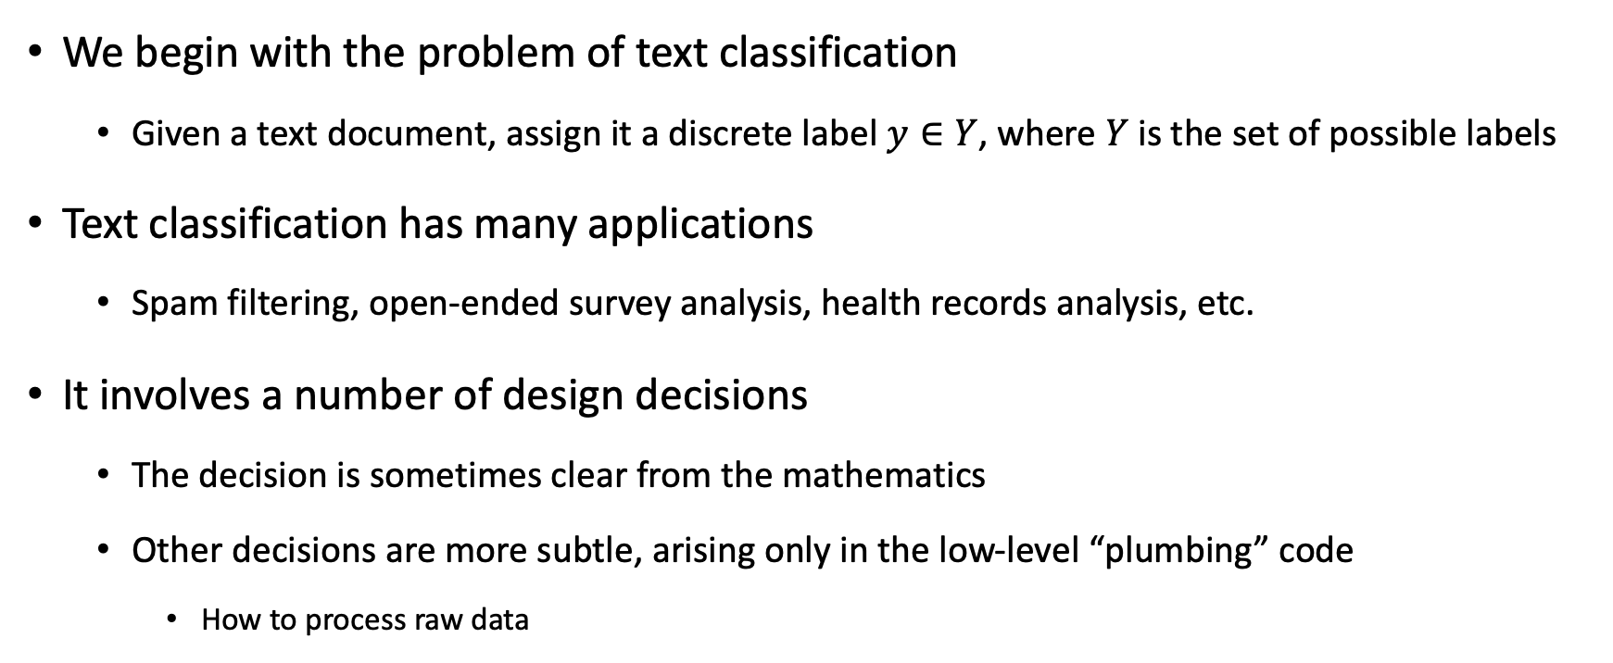
Text Classification
We begin with the problem of text classification
Given a text document, assign it a discrete label $y∈Y$, where $Y$ is the set of possible labels
Text classification has many applications
Spam filtering, open-ended survey analysis, health records analysis, etc.
It involves a number of design decisions
The decision is sometimes clear from the mathematics
Other decisions are more subtle, arising only in the low-level “plumbing” code
How to process raw data

Slide 3
Goal of the lecture
Understand a numerical representation of text
One-hot vectors
Bag-of-words representation

Slide 4
Some keywords
Tokenization is a particular kind of document segmentation
Break up text into smaller chunks
Document → paragraphs → sentences → phrases → tokens
Tokenization is the first step in an NLP pipeline
turns an unstructured string (text document) into a numerical data structure suitable for machine learning
The distribution of tokens can be used directly
Counts imply the meanings
They also used in a ml pipeline as features

Slide 5
Terminology alert: one-hot vectors
One-hot vectors representation
Definition
Characteristics
What tokenizer used in the example?
This representation of a sentence in one-hot word vectors retains all the detail, grammar, and order of the original sentence.

Slide 6
Need another approach
What’s the downside?
Storing all those zeros, and trying to remember the order of the words in all your documents, doesn’t make much sense
You’d like to compress your document down to a single vector rather than a big table
Trade-off: need to give up something
We will revisit this representation later
Essential input for CNN (Convolution Neural net)

Slide 7
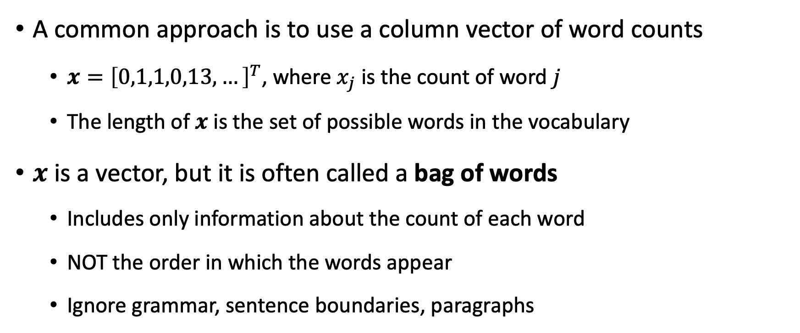
Bag of words
A common approach is to use a column vector of word counts
$x={\left[0,1,1,0,13,…\right]}^{T}$, where $x_{j}$ is the count of word $j$
The length of $x$ is the set of possible words in the vocabulary
$x$ is a vector, but it is often called a bag of words
Includes only information about the count of each word
NOT the order in which the words appear
Ignore grammar, sentence boundaries, paragraphs

Slide 8
BOW: Everything but words
The BOW model is surprisingly effective for text classification
If you see the word whale in a document, is it fiction or nonfiction?
For many labeling problems, individual words can be strong predictors
Let’s see the code example

Slide 9
What is a word?
The BOW representation presupposes that extracting a vector of word counts from text is unambiguous
However, text documents are generally represented as a sequences of characters, and the conversion to bag of words presupposes a definition of the “words” that are to be counted

Slide 10
Tokenization
The first subtask for constructing a BOW vector is tokenization
A sequence of characters → a sequence of word tokens
Note whitespace-based tokenization is not ideal
Tokenization is typically performed using regular expressions, with modules designed to handle each cases
Go back to the code example

Slide 11
Token Improvement
See the text for the regular expressions
See a number of tokenizers in the code examples
Social media researchers have found that emoticons and other forms of orthographic variation pose new challenges for tokenization, leading to the development of special purpose tokenizers to handle them
O’Connor, B., M. Krieger, and D. Ahn (2010). Tweetmotif: Exploratory search and topic summarization for twitter. In Proceedings of the International Conference on Web and Social Media (ICWSM), pp. 384–385.

Slide 12
Tokenization is hard?
Tokenization is a language-specific problem
Each language poses unique challenges
Chinese does not include spaces between words, nor any other consistent orthographic markers of word boundaries
German does not include whitespace in compound nouns
Social media raises similar problems for English and other languages
#TrueLoveInFourWords
Decomposition analysis (Brun and Roux, 2014)

Slide 13
Extending your vocabulary with n-grams
Now we consider a sequence of words
Ice cream
Boston Red Sox
N-gram is simply a sequence of n words
N-gram could denote characters, but focus on words now
We have tokenized sentences using 1-gram only thus far
Using 2-gram or 3-gram words means adding more tokens in the vocabulary
Not difficult to add (see the codes)
N-gram tokens are pretty rare → need some ways to handle them properly

Slide 14
What if only use 1-gram tokens?
What is the problem of rare 2-grams when we add them in the vocab?
Again, they are so rare. Why is this a problem?
If use 1-gram tokens only, the stop words are usually counted the most
The, a, an, …
If they are removed:
Mark reported to the CEO
Suzanne reported as the CEO to the board
Lack of information about the professional hierarchy
If not, the length of vocabulary would be the problem
Let’s dig this issue a little bit deeper

Slide 15
Text normalization
After splitting the text into tokens, the next question:
Which tokens are really distinct
Complete elimination of case distinction will result in a smaller vocab
Necessary to distinguish great, Great and GREAT?
How about apple and Apple?
Text normalization refers to string transformation that remove distinctions that are irrelevant to downstream applications
Also include standardization of numbers (1,000 → 1000) or dates
Social media (e.g. coooooooool)

Slide 16
Inflections matter?
A more extreme form of normalization is to eliminate inflectional affixes (e.g. -ed and –s suffixes)
Whale, whales, whaling all refer to the same underlying concept
A stemmer is a program for eliminating affixes
Apply a series of regular expression substitutions
Character-based stemming algorithms are necessarily approximate
Original | The | Williams | sisters | are | Leaving | This | Tennis | centre
Porter stemmer | the | william | sister | are | leav | thi | tenni | centr
Lancaster stemmer | the | william | sist | ar | leav | thi | ten | cent
WordNet lemmatizer | The | Williams | sister | are | leaving | this | tennis | centre

Slide 17
Inflections matter?
Lemmatizers are systems that identify the underlying lemma of a given wordform
Geese → Goose
Generalization would matter
Even inaccurate stemming can improve bag-of-words classification
merging related strings and thereby reducing the vocabulary size
However, need to avoid the over-generalization errors
Both stemming and lemmatization are language-specific
English stemmer or lemmatizer is of little use on a text in another language

Slide 18
Normalization is kind of smoothing
The value of normalization depends on the data and the task
Normalization reduces the size of the feature space
Can help in generalization
There is always the risk of merging away meaningful distinctions
In supervised machine learning, regularization and smoothing can play a similar role to normalization
Mitigate overfitting to rare (language-specific) features
In unsupervised learning, such as topic modeling, normalization is even more critical

Slide 19
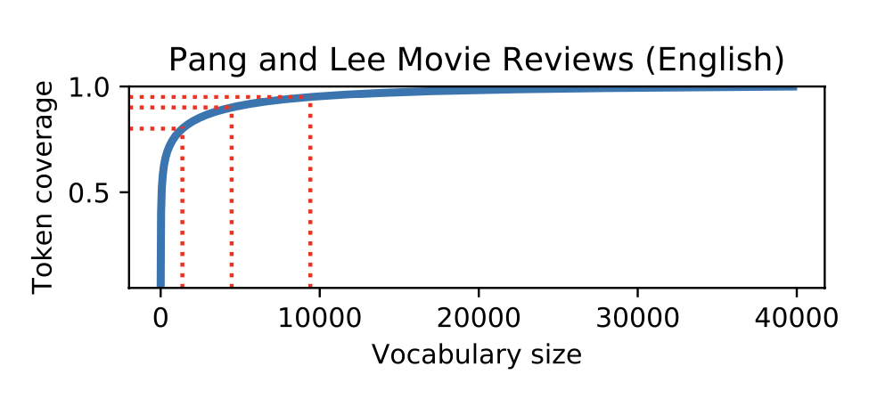
How many words?
Limiting the size of the feature vector reduces the memory and increases the speed of prediction
Normalization can help to play this role, but a more direct approach is simply to limit the vocabulary to the N most frequent words in the dataset

Slide 20
Eliminating rare words is not always ad

Slide 21
Presence vs. count

Slide 22
Precision, recall, and F (Jacob)

