Slide 1

Introduction to Natural Language Processing
BUS 243 F: Spring 2023
Yeabin Moon
Lecture 5

Slide 2
Questions in homework 2
Some discussions…
Homework2

Slide 3
Hmm. So where are we?
Text classification and topic modeling may seem like all we need for natural language processing
You can handle most natural language problems
Detail might matter
Mathematically represent language units - frequency

Slide 4
Individual Frequency based approach
The BOW representation is inherently high dimensional
Usually possible to find a linear classifier that perfectly fits the training data
even to fit any arbitrary labeling of the training instances
In general, it really works well
Word frequencies are meaningful in isolation
Can offer independent evidence about the instance label
NLP has historically focused on linear classification

Slide 5
Now what?
But in recent years, nonlinear classifiers have swept through NLP, and are now the default approach for many tasks (Manning, 2015)
You can see many NLP textbooks dedicated to “Deep learning”
There are at least three reasons for this change

Slide 6
Technological progress: method
There have been rapid advances in deep learning
a family of nonlinear methods that learn complex functions of the input through multiple layers of computation
Goodfellow et al., 2016

Slide 7
Technological progress: resource
While CPU speeds have plateaued, there have been rapid advances in specialized hardware called graphics processing units (GPUs) thanks to gaming industry
which have become faster, cheaper, and easier to program
Many deep learning models can be implemented efficiently on GPUs, offering substantial performance improvements over CPU-based computing

Slide 8
Text representation breakthrough
Deep learning facilitates the incorporation of word embeddings
Dense vector representations of words
Dense vector?
Word embeddings can be learned from large amounts of unlabeled data, and enable generalization to words that do not appear in the annotated training data
Kind of unsupervised learning
Let’s learn Distributed representations

Slide 9
How do we represent the meaning of a word?
Definition: meaning
What is meant by a word, text, concept, or action
Commonest linguistic way of thinking of meaning:
Signifier (symbol) ←→ signified (idea or thing)
Denotational semantics
What’s the problem?

Slide 10
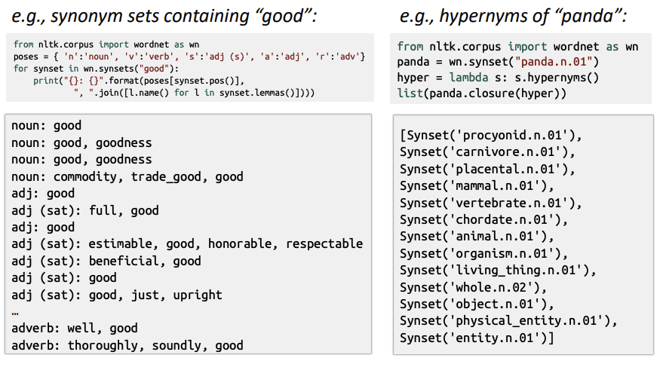
How do we have usable meaning in a machine?
Previously commonest NLP solution: Use, e.g. WordNet, a thesaurus containing lists of synonym sets and hypernyms

Slide 11
Problems with resources like WordNet
A useful resource but missing nuance:
Proficient is listed as a synonym for good
Only correct in some contexts
Missing new meanings of words
Subjective
Requires human labor to create and adapt
Can’t be used to accurately compute word similarity

Slide 12
Representing words as discrete symbols
In traditional NLP, we regard words as discrete symbols
Such symbols for words can be represented by one-hot vectors
Hotel, conference, motel
motel: [0 0 0 0 1 0 0 0]
hotel: [0 0 1 0 0 0 0 0]
a localist representation
Hard to represent synonym
Vector dimension issue
Challenging in vector reasoning

Slide 13
Problem with words as discrete symbols
E.g: in web search, if a user searches for “Seattle motel”, we’d like to match documents containing “Seattle hotel”
But see: [0 0 0 0 1 0 0 0] , [0 0 1 0 0 0 0 0]
Theses two vectors are orthogonal
No natural notion of similarity for one-hot vectors
Could try to rely on WordNet’s list of synonyms to get similarity?
But it is well-known to fail badly

Slide 14
Distributed Representations
To overcome these limitations, methods to learn low-dimensional representations were devised
use neural network architectures to create dense, low-dimensional representations of words and texts
The meaning of a word can be understood from the context in which the word appears
Connotation: meaning is defined by context
Opposed to denotation: the literal meaning of any word

Slide 15
Representing words by their context
Distributional semantics: A word’ meaning is given by the words that frequently appear close-by
J. R. Firth 1957: You shall know a word by the company it keeps
One of the most successful ideas of modern statistical NLP
When a word w appears in a text, its context is the set of words that appear nearby
Within a fixed-size window

Slide 16
Context, context, context
We use the many contexts of w to build up a representation of w
The following context words will represent banking
…government debt problems turning into banking crises as happened in 2009…
…saying that Europe needs unified banking regulation to replace the hodgepodge…
…India has just given its banking system a shot in the arm…

Slide 17
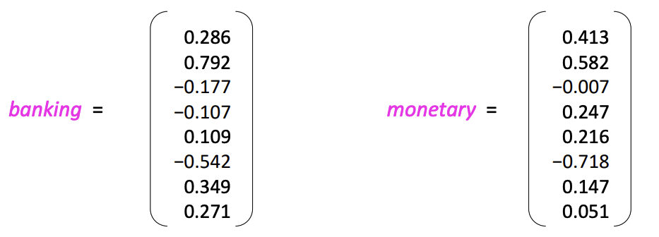
Word vectors (embeddings)
We will build a dense vector for each word, chosen so that it is similar to vectors of words that appear in similar contexts, measuring similarity as the vector dot (scalar) product
Note: word vectors are also called (word) embeddings or (neural) word representations
They are a distributed representation

Slide 18
What is Neural Network?
This is an extremely active field of artificial computer intelligence often referred to as deep learning
Super popular these days, but many fail to understand this correctly
What is your understanding?
What kind of problems can this solve in particular?
Linear regression vs. neural net?
What is a linear regression by the way?

Slide 19
Limits of Traditional Computer Programs
Why exactly are certain problems so difficult for computers to solve?
Machines are good
Performing arithmetic really fast
Following explicitly a list of instructions
Suppose need to do some heavy financial number crunching
You cannot beat the machine at all!

Slide 20
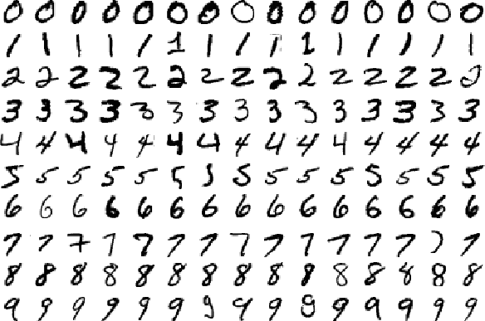
Can we beat the machine for image recognition?

Slide 21
How to recognize zero?
Suppose we want to know how to recognize 0 image
What rules could we use to tell one digit from another?
We might state that we have a zero if our image has only a single, closed loop
Is this sufficient condition?

Slide 22

How about this: zero or six

Slide 23
Don’t know how it’s done by our brains
Establish some cutoff between the starting and ending point of the loop?
How about threes and fives? Fours and nines?
We can add more and more rules, or features, through careful observation and months of trial and error
But it’s quite clear that this isn’t going to be an easy process
Wait, how did we learn?
Did you ever learn those rules?
Did you ever learn…?

Slide 24
Mechanics of Machine Learning
A lot of the things we learn in school growing up have much in common with traditional computer programs
learn how to multiply numbers, solve equations, and take derivatives by internalizing a set of instructions
But the things we learn at an extremely early age, the things we find most natural, are learned by example, not by formula
How did you recognize a zero, dog, …?

Slide 25
Learning process
When we were born, our brains provided us with a model that described how we would be able to see the world
I am just saying…
As we grew up, that model would take in our sensory inputs and make a guess about what we were experiencing.
If that guess was confirmed by our parents, our model would be reinforced.
If our parents said we were wrong, we’d modify our model to incorporate this new information.
Over our lifetime, our model becomes more and more accurate as we assimilate more and more examples

Slide 26
continue
Deep learning is a subset of a more general field of AI called machine learning, which is predicated on this idea of learning from example
In machine learning, instead of having rules
we give it a model with which it can evaluate examples,
and a small set of instructions to modify the model when it makes a mistake
We expect that, over time, a well-suited model would be able to solve the problem accurately

Slide 27
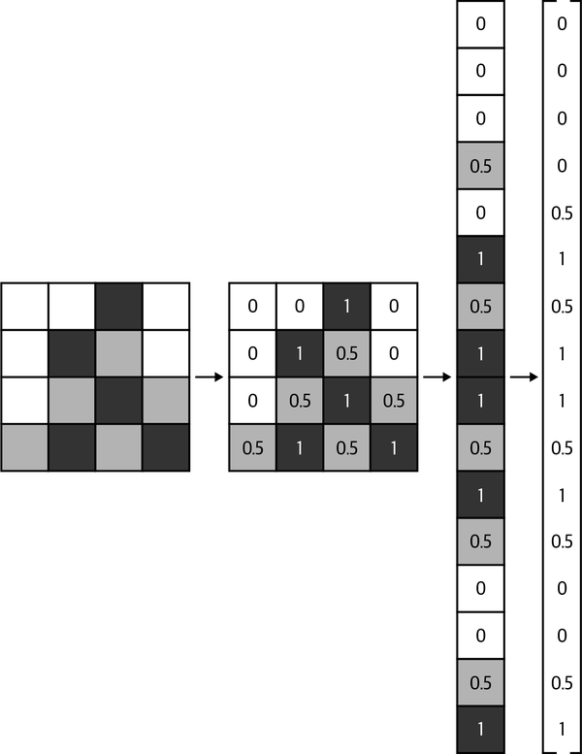

Little math
Let’s define our model as $h\left(x,θ\right)$
$x$: input vector
If it were a grayscale image, express it like:
The input $θ$ is a vector of the params
Machine learning program tries to
perfect the values of these params
as it is exposed to more and more
examples

Slide 28
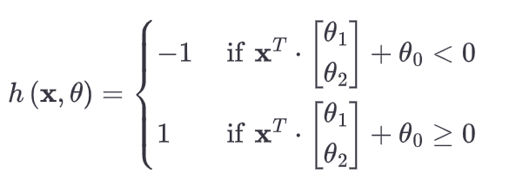

Quick example: predict exam performance
$x={\left[x_{1} x_{2}\right]}^{T}$ where $x_{1}$ is hours of sleep and $x_{2}$ is hours of studying
Want to know whether we perform above or below the class average
Our goal might be to learn a model $h(x,θ)$ with $θ={\left[θ_{0},θ_{1},θ_{2}\right]}^{T}$

Slide 29

continue
Want to learn $θ$ such that the model makes the right predictions
This is called a linear perceptron

Slide 30
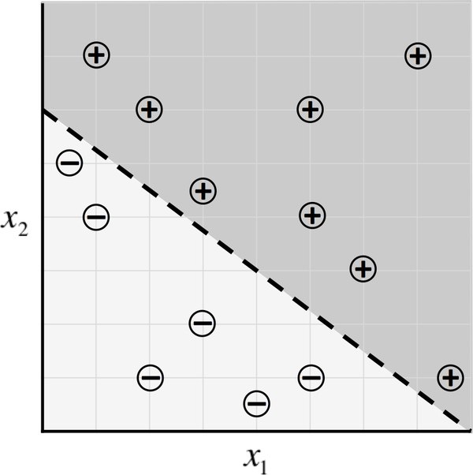
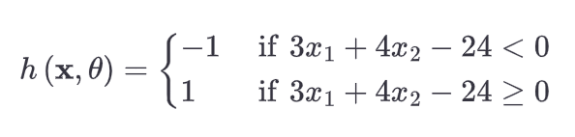
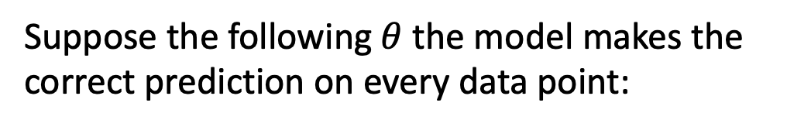
Sample data for our exam predictor algorithm and a potential classifier
Suppose the following $θ$ the model makes the correct prediction on every data point:
Note that this model classifies perfectly

Slide 31
Limitations?
How do we come up with an optimal value for the parameter vector in the first place?
Called optimization
An optimizer aims to maximize the performance of a machine learning model by iteratively tweaking its parameters until the error is minimized
Gradient descent, SGD, …
What if the data looks ugly?

Slide 32
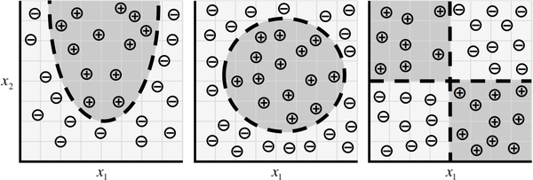
Linear is just a linear
To accommodate this complexity, try to build models that resemble the structures utilized by our brains – deep learning

Slide 33
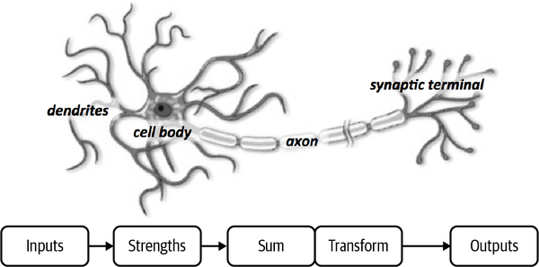
The Neuron
Still believe that the names are terrible
Neural net, neuron, …

Slide 34
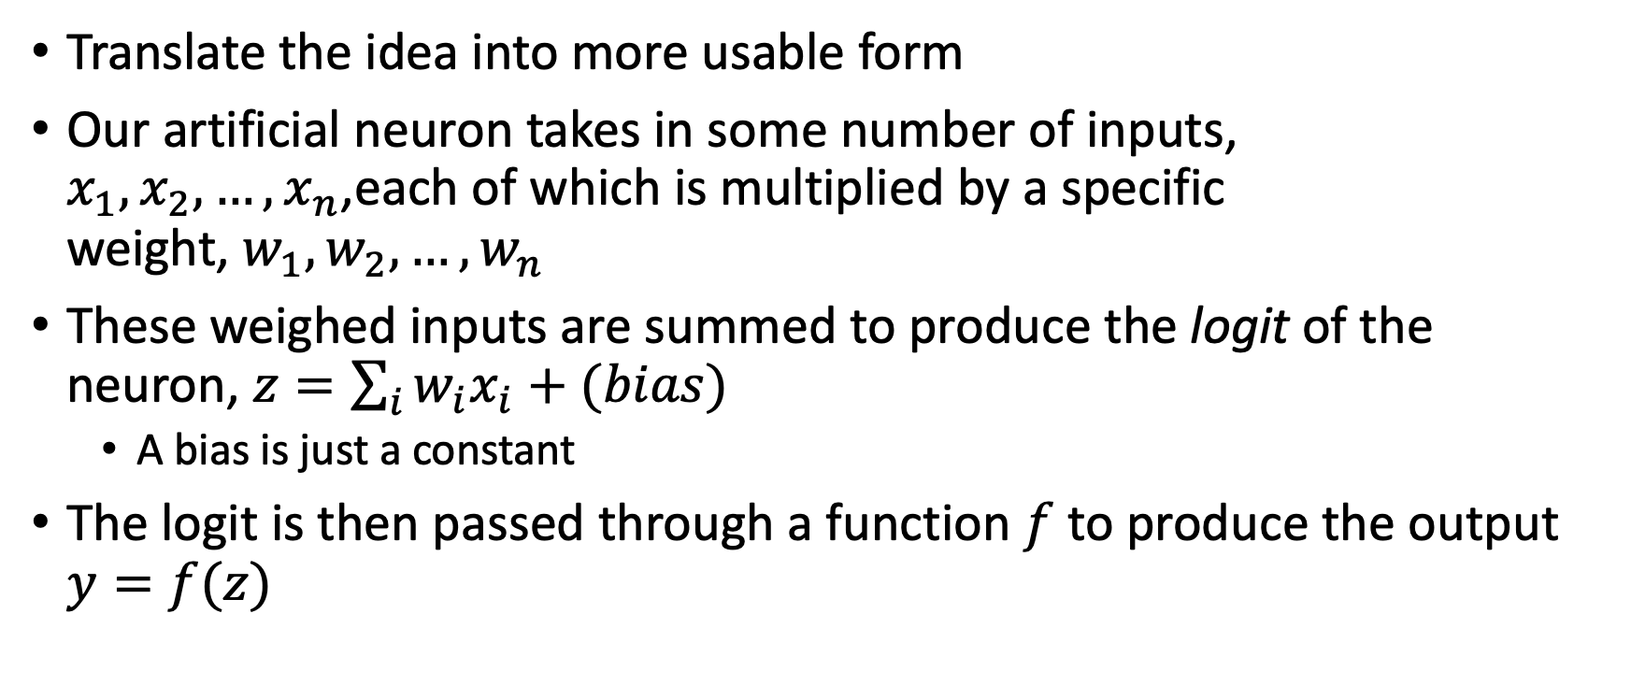
Terminology associated with neuron
Translate the idea into more usable form
Our artificial neuron takes in some number of inputs, $x_{1},x_{2},…,x_{n}$,each of which is multiplied by a specific weight, $w_{1},w_{2},…,w_{n}$
These weighed inputs are summed to produce the logit of the neuron, $z=\sum_{i}{w_{i}x_{i}}+(bias)$
A bias is just a constant
The logit is then passed through a function $f$ to produce the output $y=f(z)$

Slide 35
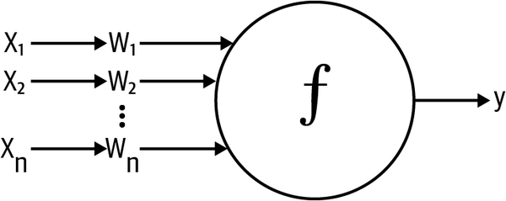
Schematic for a neuron in a neural net

Slide 36
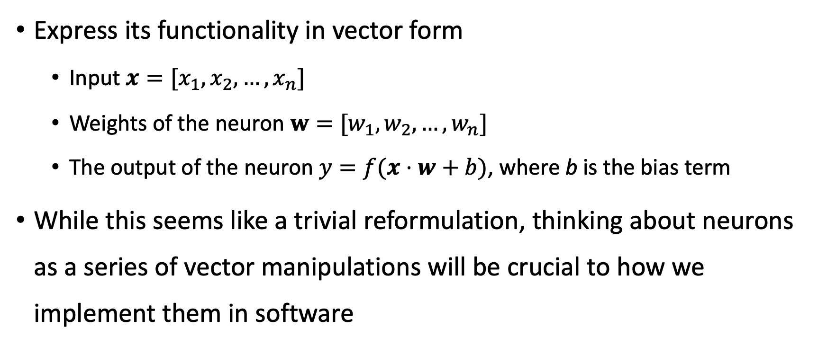
Formulation
Express its functionality in vector form
Input $x=[x_{1},x_{2},…,x_{n}]$
Weights of the neuron $w=[w_{1},w_{2},…,w_{n}]$
The output of the neuron $y=f(x⋅w+b)$, where b is the bias term
While this seems like a trivial reformulation, thinking about neurons as a series of vector manipulations will be crucial to how we implement them in software

Slide 37
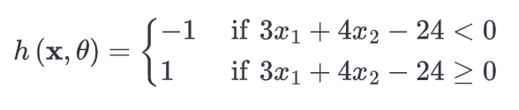
Expressing Linear Perceptrons as Neurons
Talked about using machine learning models to capture the relationship
Here, we show that our model h is easily using a neuron

Slide 38
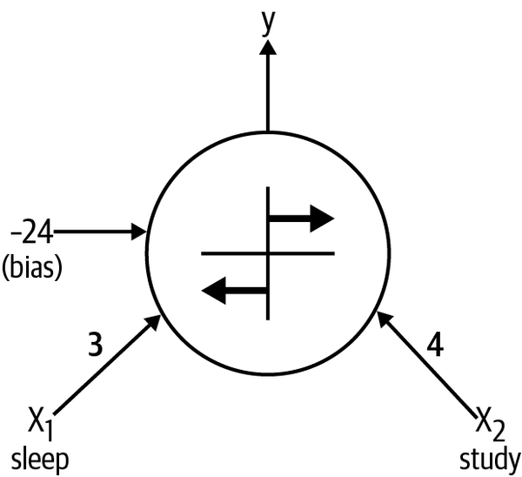

Slide 39
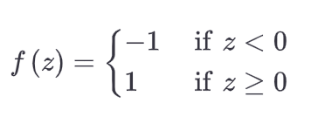
The neuron has two inputs, a bias, and uses:

Slide 40
Discussion
It’s easy to show that our linear perceptron and the neuronal model are perfectly equivalent
In general, it’s quite simple to show that singular neurons are strictly more expressive than linear perceptrons
Every linear perceptron can be expressed as a single neuron, but single neurons can also express models that cannot be expressed by any linear perceptron

Slide 41
Better together: network
Although single neurons are more powerful than linear perceptrons, they’re not enough
XOR problems
Note that our brain is made of more than one neuron
Consider the meaning of multiple neurons

Slide 42
Neurons are organized in layers
Human cerebral cortex (the structure responsible for most of human intelligence) is made up of six layers
Information flows from one layer to another until sensory input is converted into conceptual understanding
I am just saying… please don’t ask
Borrowing from these concepts, we can construct an artificial neural network

Slide 43
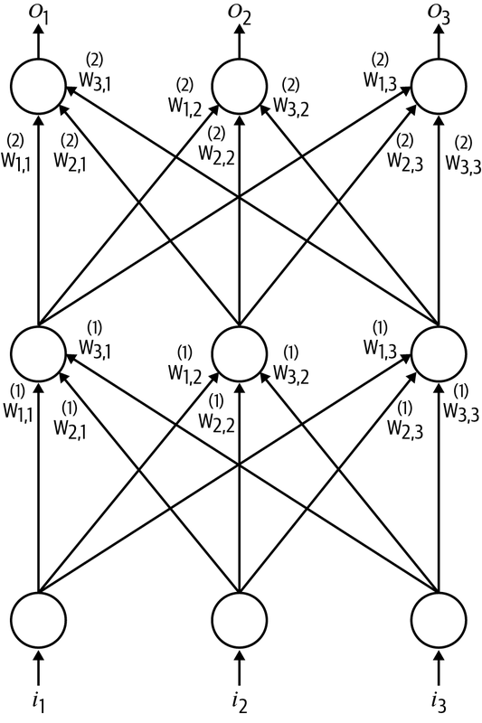
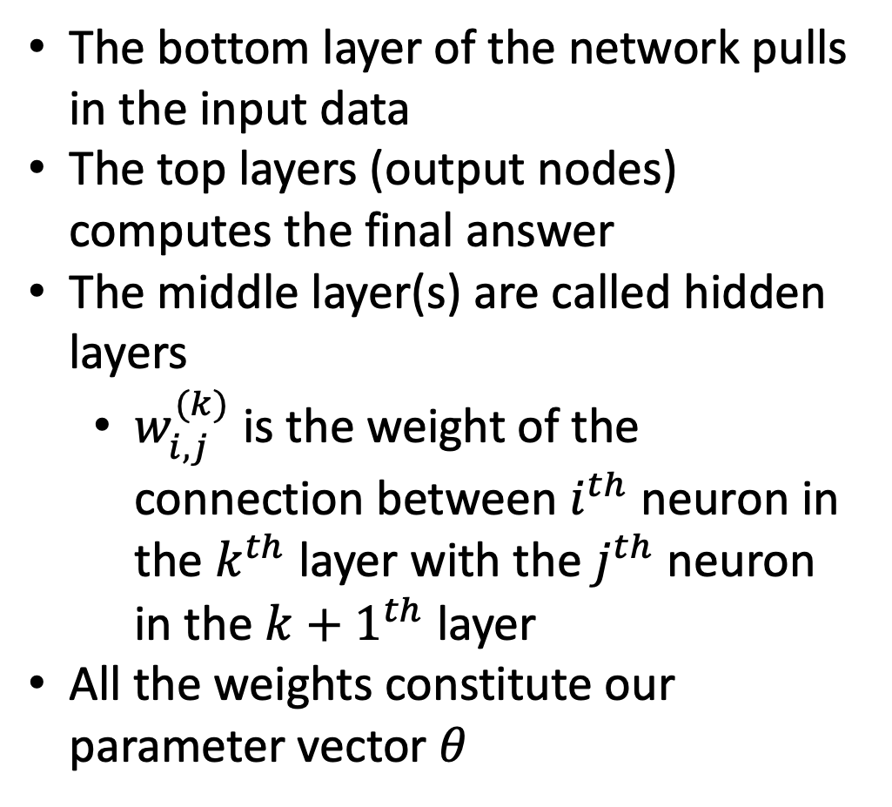
The bottom layer of the network pulls in the input data
The top layers (output nodes) computes the final answer
The middle layer(s) are called hidden layers
$w_{i,j}^{(k)}$ is the weight of the connection between $i^{th}$ neuron in the $k^{th}$ layer with the $j^{th}$ neuron in the ${k+1}^{th}$ layer
All the weights constitute our parameter vector $θ$

Slide 44
These neural networks are called feed-forward networks
Most simple form
Connections traverse only from a lower layer to a higher layer
No connections between neurons in the same layer

Slide 45
Note
Hidden layer is where most of the magic is happening when the neural net tries to solve problems
Whereas we would previously have to spend a lot of time identifying useful features, the hidden layers automate this process for us.
Oftentimes, taking a look at the activities of hidden layers can tell you a lot about the features the network has automatically learned to extract from the data
In fact, here we get the word embeddings

Slide 46
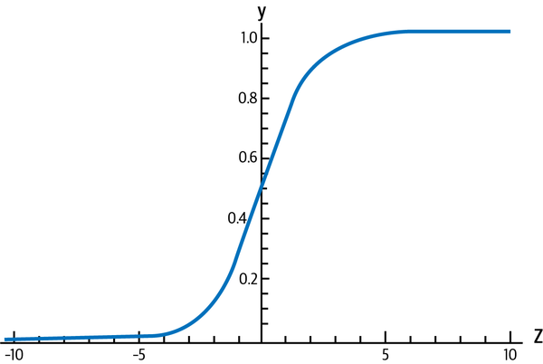

Sigmoid, Tanh, and ReLU Neurons
Three major types of neurons are used in practice that introduce nonlinearities in their computations
The sigmoid neuron uses the function $f\left(z\right)=\frac{1}{1+\exp{(−z)}}$

Slide 47
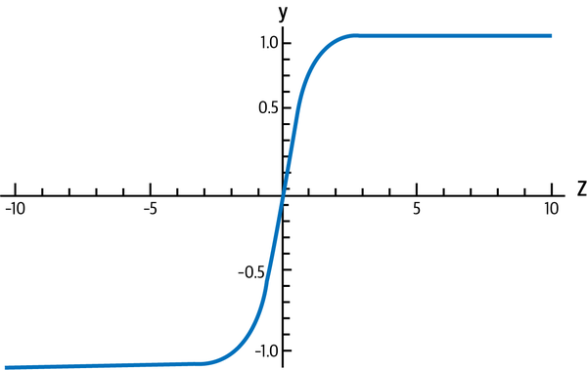

$$f\left(z\right)=tanh⁡(z)$$

Slide 48
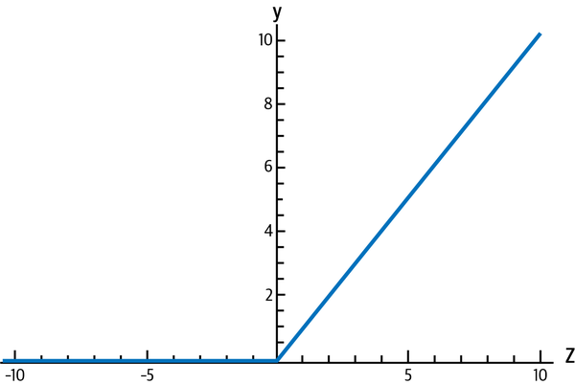
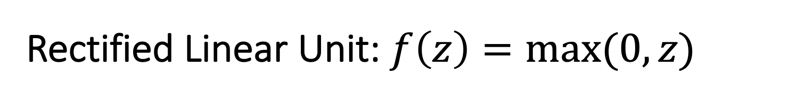
Rectified Linear Unit: $f\left(z\right)=max⁡(0, z)$

Slide 49
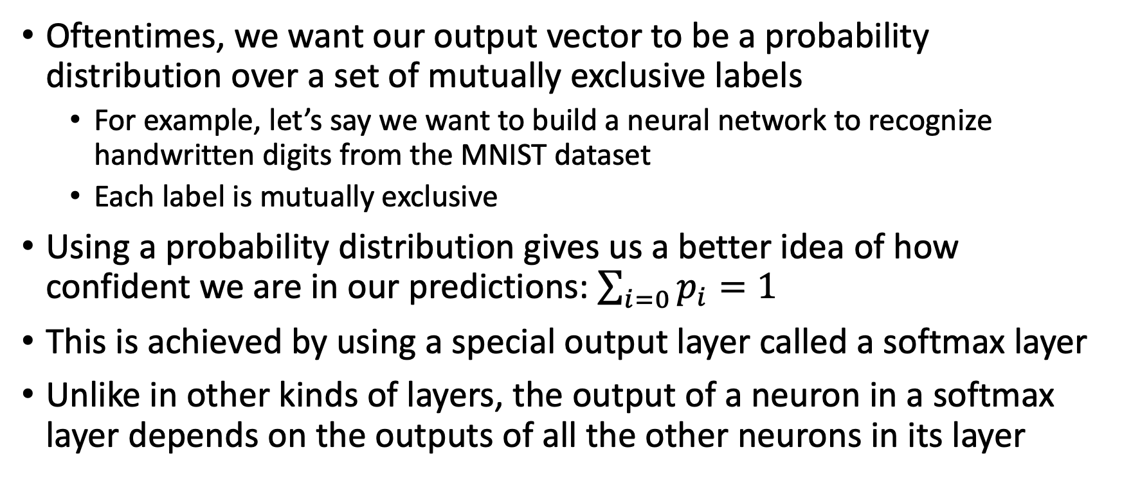
Softmax Output Layers
Oftentimes, we want our output vector to be a probability distribution over a set of mutually exclusive labels
For example, let’s say we want to build a neural network to recognize handwritten digits from the MNIST dataset
Each label is mutually exclusive
Using a probability distribution gives us a better idea of how confident we are in our predictions: $\sum_{i=0}{p_{i}=1}$
This is achieved by using a special output layer called a softmax layer
Unlike in other kinds of layers, the output of a neuron in a softmax layer depends on the outputs of all the other neurons in its layer

Slide 50
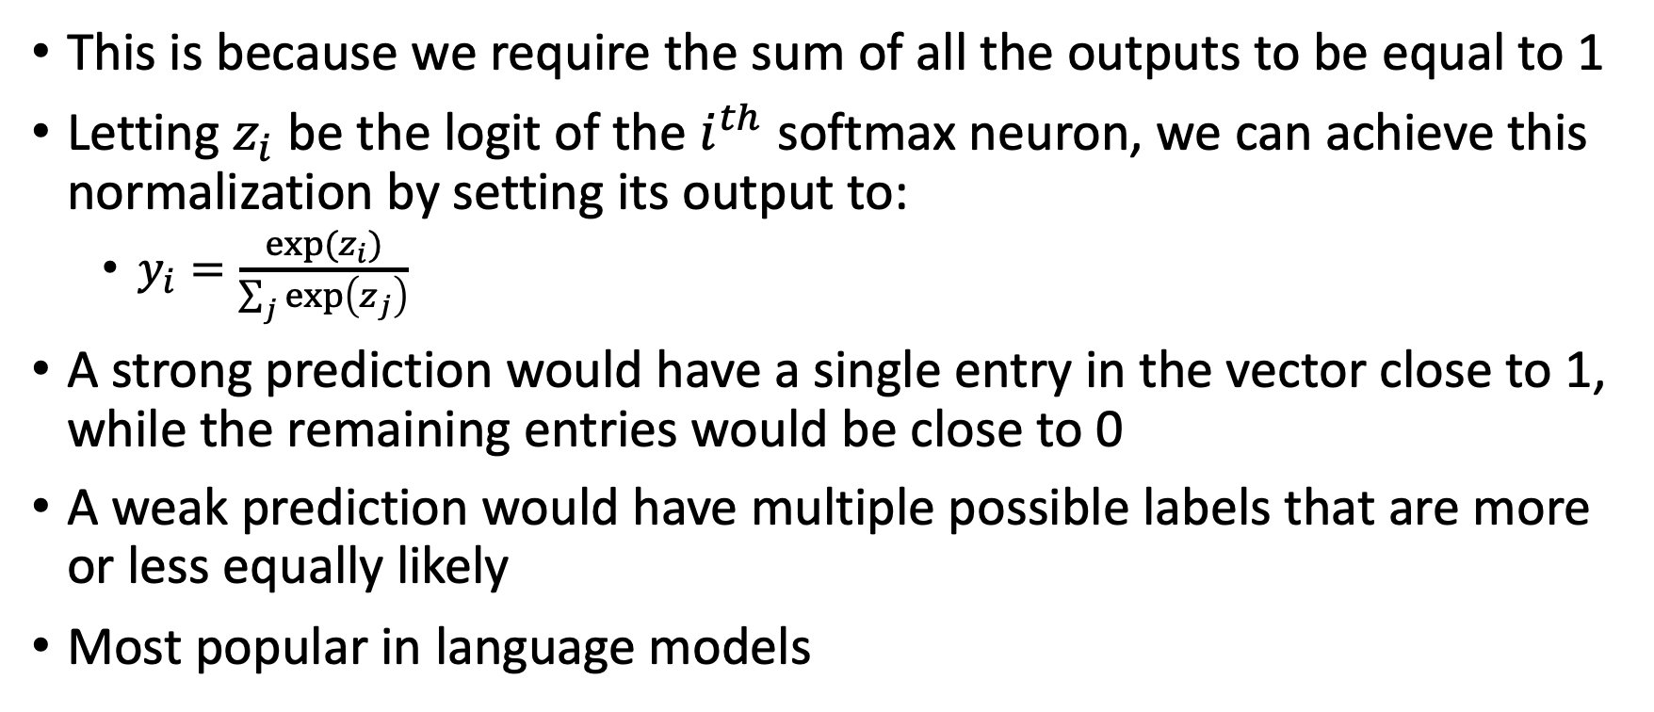
Softmax Output Layers
This is because we require the sum of all the outputs to be equal to 1
Letting $z_{i}$ be the logit of the $i^{th}$ softmax neuron, we can achieve this normalization by setting its output to:
$y_{i}=\frac{\exp{(z_{i})}}{\sum_{j}{\exp\left(z_{j}\right)}}$
A strong prediction would have a single entry in the vector close to 1, while the remaining entries would be close to 0
A weak prediction would have multiple possible labels that are more or less equally likely
Most popular in language models

Slide 51
Keras
Keras example

