Slide 1


BUS 243
Lecture 6: Distributional Semantics

Slide 2
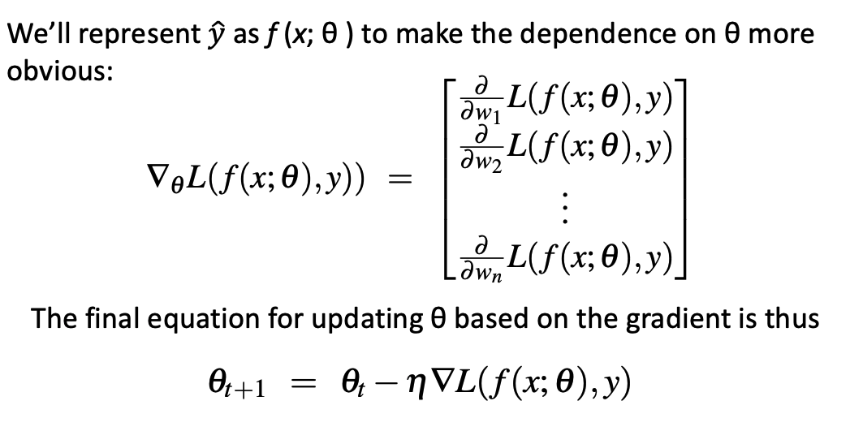

Slide 3
Word vectors
Arguably the most exciting discovery in NLP is word vectors
Previously, we understood the semantics in a statistical way
Consider the meaning of frequency
Now, introduce the effect of the neighbors of a word
have on its meaning
how those relationships affect the overall meaning of a statement

Slide 4
Previous approach
Suppose want to search a hotel in Boston on the web
Hostel, motel
How about Airbnb?
Previous approach to represent a word: one-hot vector
Hotel in Boston: [0 0 1 0 0 0 0 … 0 0 0]
Motel in Boston: [0 0 0 0 0 0 … 0 1 0]
Two vectors are orthogonal
Hard to measure a similarity among similar words

Slide 5
Representing words by their context
J. R. Firth 1957: You shall know a word by the company it keeps
Distributional semantics
One of the most successful ideas of modern statistical NLP
When a word w appears in a text, its context is the set of words that appear nearby

Slide 6
Context, context, context
Consider the meanings of the word “star” in various contexts
The night sky was clear, and the stars twinkled above.
Kim made a wish upon a star, hoping for a positive change in her life.
She would be the next star of the classical music world.
The movie features a cast of stars from various parts of the world.

Slide 7
Context, context, context
What does the term “jejune” indicate?
The poem seems to be rather jejune.
Two choices: uninteresting vs. exciting
How did you know?

Slide 8
Word vectors
Want to build a vector for each word
Dense vector with a limited length (300 - 500)
Previous one-hot vectors or BOW are spare vector
Capture similarity in similar contexts
Word vectors are also called (word or neural) embeddings
Called distributed representation
Previous representation is called denotational representation

Slide 9
Word vectors
Why dense vectors for similarity?
More important question is: How
Let’s consider three words
dog, cat, pizza: represent them in vectors

Slide 10
Discreteness of language
Consider one dim vector: scalar
Let’s assign indices:
Index(“cat”) = 1
Index(“dog”) = 2
Index(“pizza”) = 3
But this method isn’t any better than dealing with raw words

Slide 11
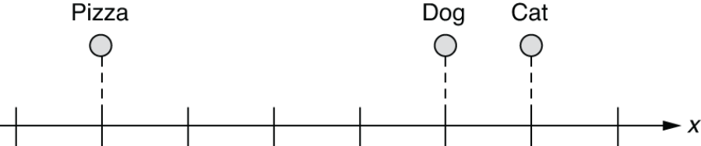
Word embeddings in a 1-D space
What if we can represent them on a numerical scale?
This is a step forward.
What if you wanted to place it somewhere that is equally far from “cat” and “dog?”

Slide 12
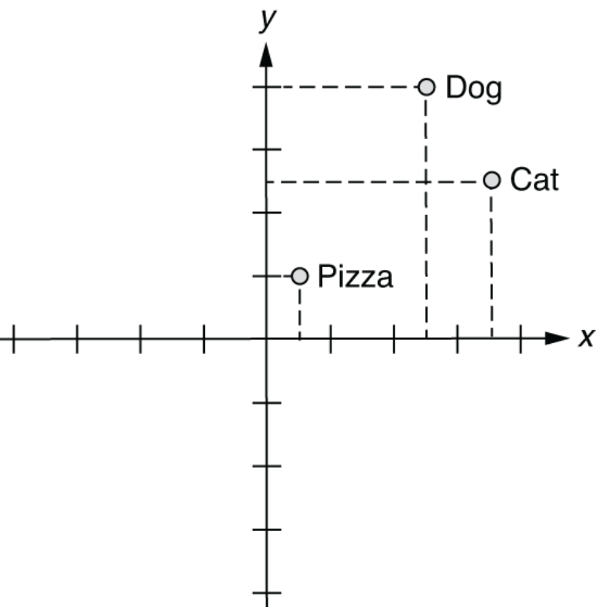
Word embeddings in a 2-D space

Slide 13
How about 3-D?
index(“cat”) = [0.7, 0.5, 0.1]
index(“dog”) = [0.8, 0.3, 0.1]
index(“pizza”) = [0.1, 0.2, 0.8]
Possibly attach meanings here?
Look at the number on X and Z axes
This is essentially what word embeddings are
Each axis may preserve some special meanings

Slide 14

Work well on Analogy question
Word vectors are vectors, so we can do vector reasoning
Portland Timbers: Men’s soccer club in Portland
What is the name of men’s soccer club in Seattle?

Slide 15
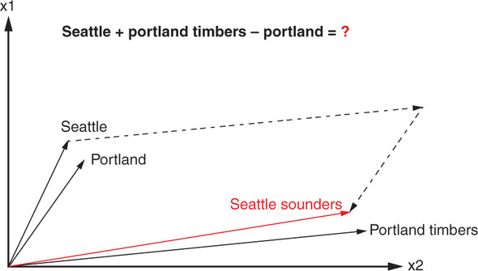
Work well on Analogy question

Slide 16
Again, previously
Much simpler method to “embed” words into a vector space
index(“cat”) = [1, 0, 0]
index(“dog”) = [0, 1, 0]
index(“pizza”) = [0, 0, 1]
Not very useful in representing semantic relationship between them
All at equal distance from each other

Slide 17
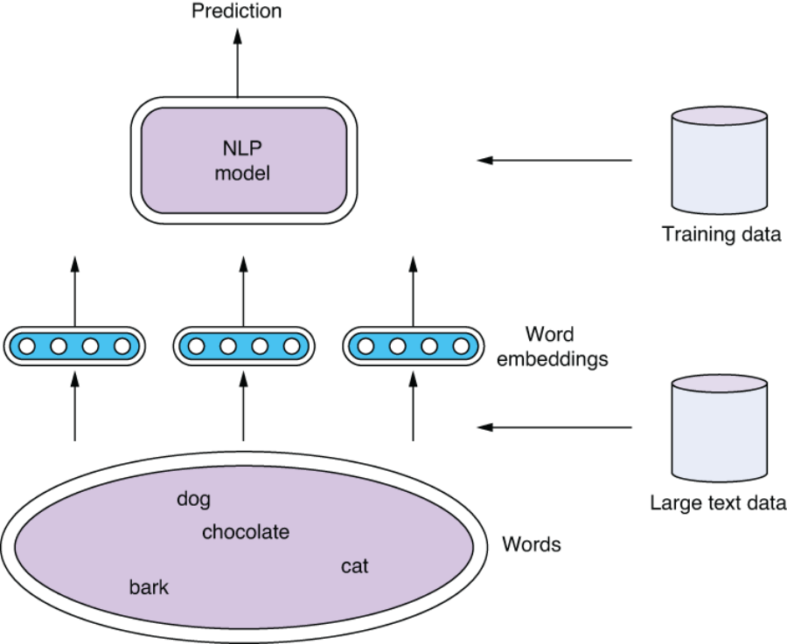

Slide 18
Word2vec
In 2012, Thomas Mikolov, an intern at Microsoft, found a way to encode the meaning of words
“Word2Vec” was indeed one of the most cited papers in NLP
Static embeddings, but remarkably well on vector reasoning

Slide 19
Why Word2vec?
Fast to train
Easy access to the legacy code
Archive: https://code.google.com/archive/p/word2vec/
Easy way: Gensim
Hard way: https://www.tensorflow.org/tutorials/text/word2vec

Slide 20
Let’s see what we want, first

Slide 21
Skip-gram algorithm
Conceptually, use logistic regression
However, no interest on classification task
The learned weights are of interest, and they are the embeddings
Inputs are the word pairs, and the target is whether they are neighbors (loosely)

Slide 22
Consider the word ‘apricot’
…lemon, a tablespoon of apricot jam, a pinch…
Classify whether a word around ‘apricot’ is its context
Using a window around apricot, we can define the context
…lemon, a [tablespoon of apricot jam, a] pinch…
Train a classifier for a candidate (word, context) pair
given a specific word w and c, want to predict 𝑃(𝐶=𝑐|𝑊=𝑤)
Two questions
How to construct negative (-) word pair?
How to estimate 𝑃(𝐶=𝑐|𝑊=𝑤)?

Slide 23
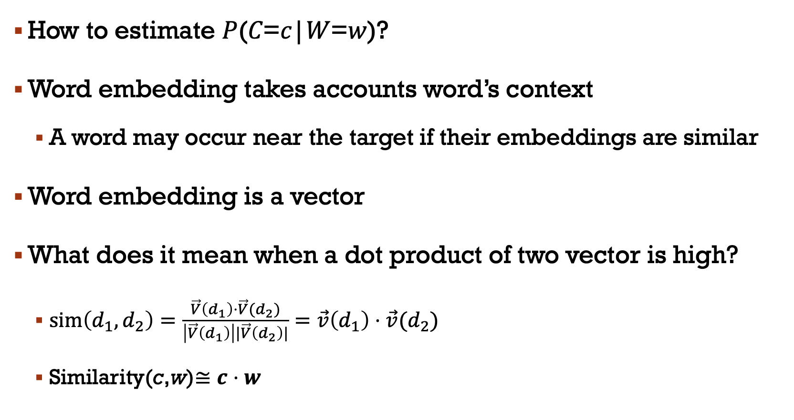
How to estimate 𝑃(𝐶=𝑐|𝑊=𝑤)?
Word embedding takes accounts word’s context
A word may occur near the target if their embeddings are similar
Word embedding is a vector
What does it mean when a dot product of two vector is high?
$sim\left(d_{1},d_{2}\right)=\frac{\vec{V}\left(d_{1}\right)⋅\vec{V}(d_{2})}{\left|\vec{V}\left(d_{1}\right)\right||\vec{V}\left(d_{2}\right)|}=\vec{v}\left(d_{1}\right)⋅\vec{v}(d_{2})$
Similarity(c,w)$≅c⋅w$

Slide 24
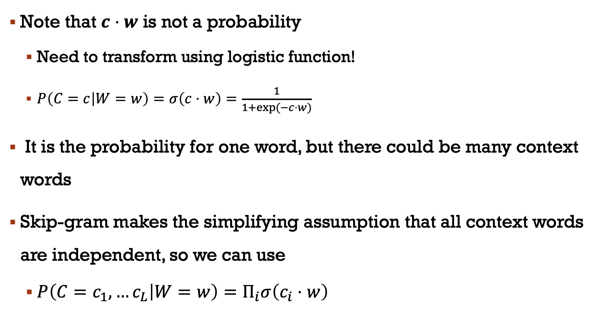
Note that $c⋅w$ is not a probability
Need to transform using logistic function!
$P\left(C=c | W=w\right)=σ\left(c⋅w\right)=\frac{1}{1+\exp{(−c⋅w)}}$
It is the probability for one word, but there could be many context words
Skip-gram makes the simplifying assumption that all context words are independent, so we can use
$P\left(C=c_{1},…c_{L} | W=w\right)=Π_{i}σ\left(c_{i}⋅w\right)$

Slide 25
Now consider how to construct the negative word pairs
…lemon, a [tablespoon of apricot jam, a] pinch…
Not feasible to use entire word outside the window
Word2vec uses the Negative Sampling
Treat the target word w and a context word c as positive examples
Randomly sample other words in the lexicon to get negative examples
Sample words more than context words
Those words should be rare

Slide 26
Skip-Gram Training data
…lemon, a [tablespoon of apricot jam, a] pinch…
Notes:
Here's the setting where k = 2, so we’ll have 2 negative examples in the negative training set − for each positive example w,cpos. The noise words are chosen according to their weighted unigram frequency.

Slide 27
Same intuition from logistic regression
Training data: the set of positive and negative instances
Weights: embeddings
The goal of the learning algorithm is to adjust those embeddings to
Maximize the similarity of the word pairs (target word and context word)
Dot product of the word with the actual context words
Minimize the similarity of the word pairs (target word and non context word)
Dot product of the word with non context words

Slide 28
Remember?

Slide 29
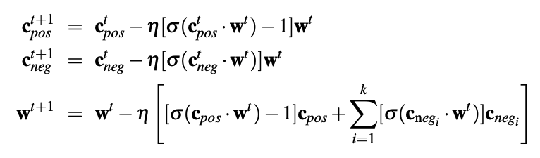
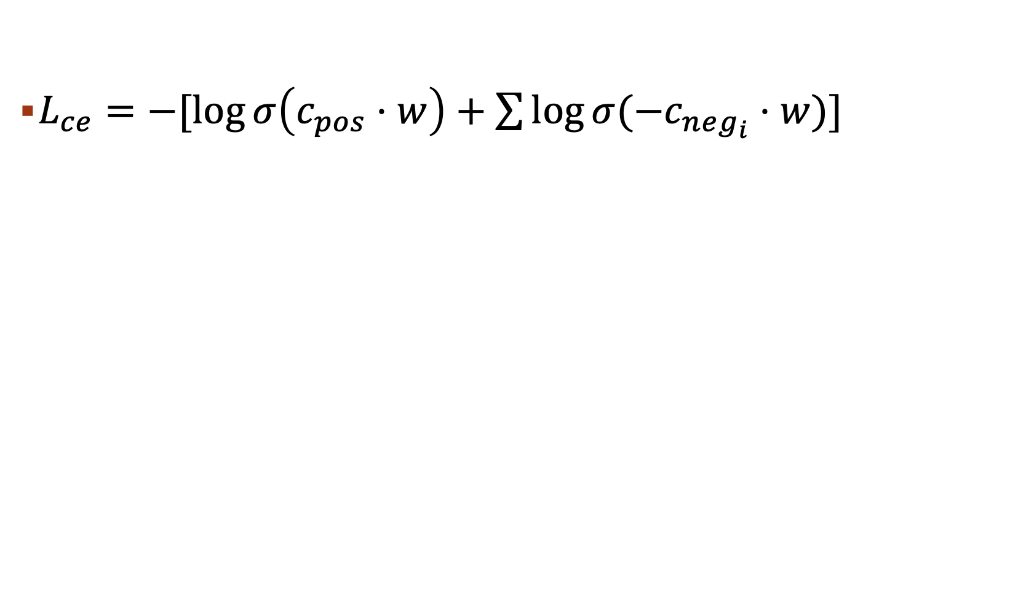
$L_{ce}=−[\log{σ\left(c_{pos}⋅w\right)+\sum{\log{σ(−c_{neg_{i}}⋅w)}}}]$

Slide 30
Application: Gensim
We will train Word2vec later
Use Keras
Gensim is handy way to play with distributional semantics
Gensim isn’t really a deep learning package.
But its efficient and scalable, and quite widely used

Slide 31
Discussions
What’s the size of window in the previous example?
Small windows (C= +/- 2)
nearest words are syntactically similar words in same taxonomy
Hogwarts nearest neighbors are other fictional schools: Sunnydale, Evernight,
Large windows (C= +/- 5)
nearest words are related words in same semantic field
Hogwarts nearest neighbors are Harry Potter world: Dumbledore, half-blood, Malfoy

Slide 32
Word analogy, again?
Portland Timbers + Seattle - Portland = ?

Slide 33
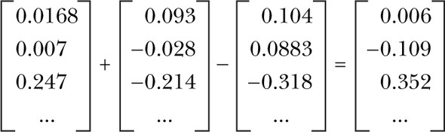
Vector-oriented reasoning
The Word2vec model contains information about the relationships between words
After adding and subtracting word vectors, your resultant vector will almost never exactly equal one of the vectors in your word vector vocabulary

Slide 34
Prosperities of Embeddings
Word2Vec requires a substantial amount of text data to learn meaningful word representations
Any concerns?

Slide 35
Let’s find out some errors
One day, a father is driving with his son, but suddenly a massive crash happened.
The Dad died, but fortunately the son survived.
His condition was critical, so he was rushed to the hospital and awaited a major surgery.
However, when the son reached the hospital, the doctor refused to perform the surgery.
Saying: “I cannot do this, since he is my son.”

