Slide 1
For creating this websites I use several computer language include:-
1, HTML for structure the website
2, CSS for change layout make responsive for deferent devices
3, JavaScript for make website interactive and more user friendly
4, PHP for backed process
5, Sqlite for database store user information , books so on. Why I use sqlite?
Because its file based database and can work fully offline because I access WiFi connection most of time their for I choose only work on offline tools.
This website fully created in mobile device.
Admin username: yeabsira
Admin password: pass$0989

Slide 2
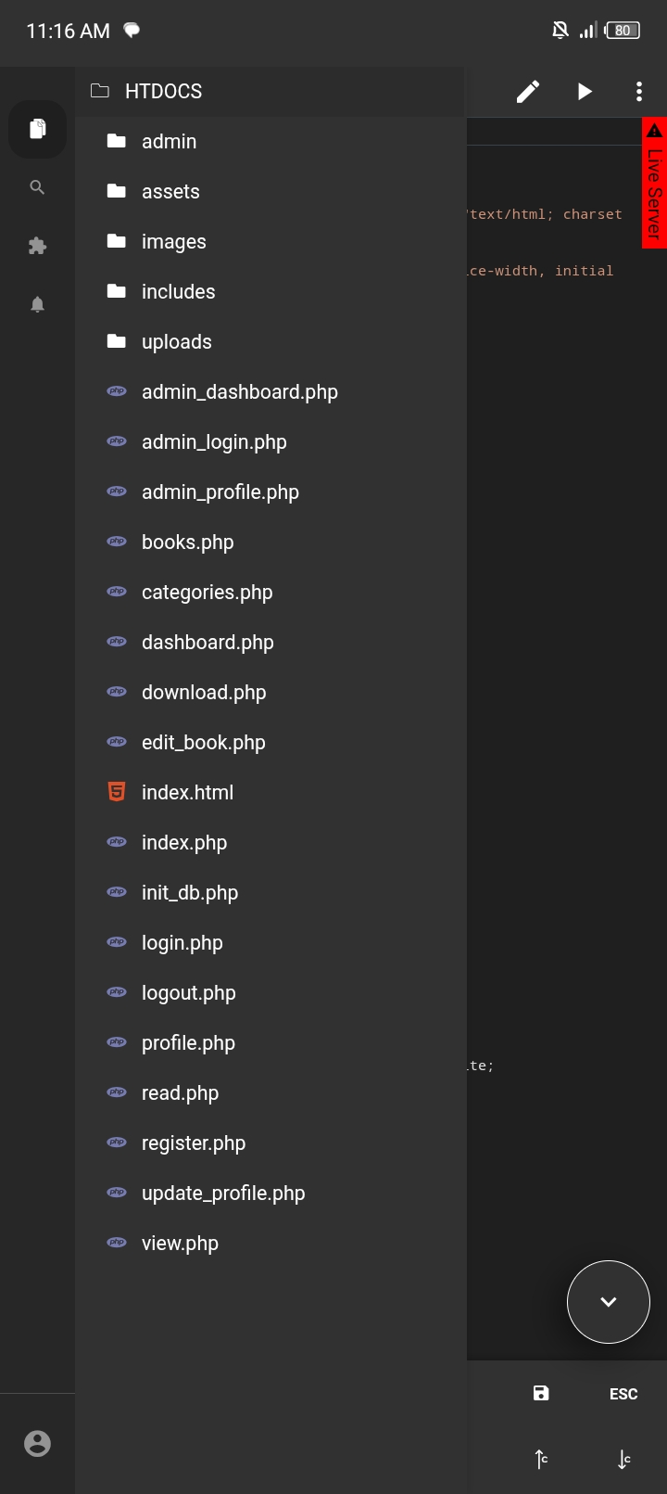
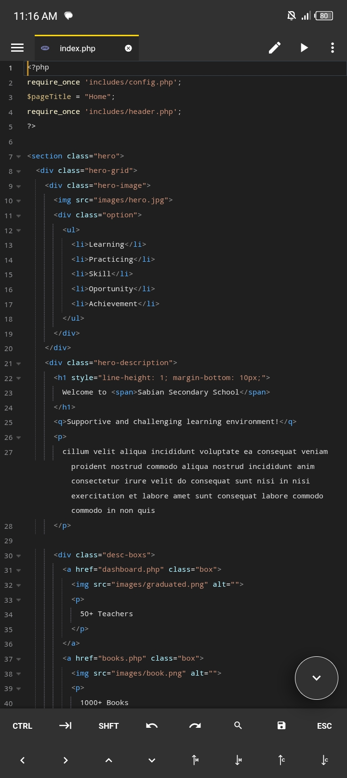
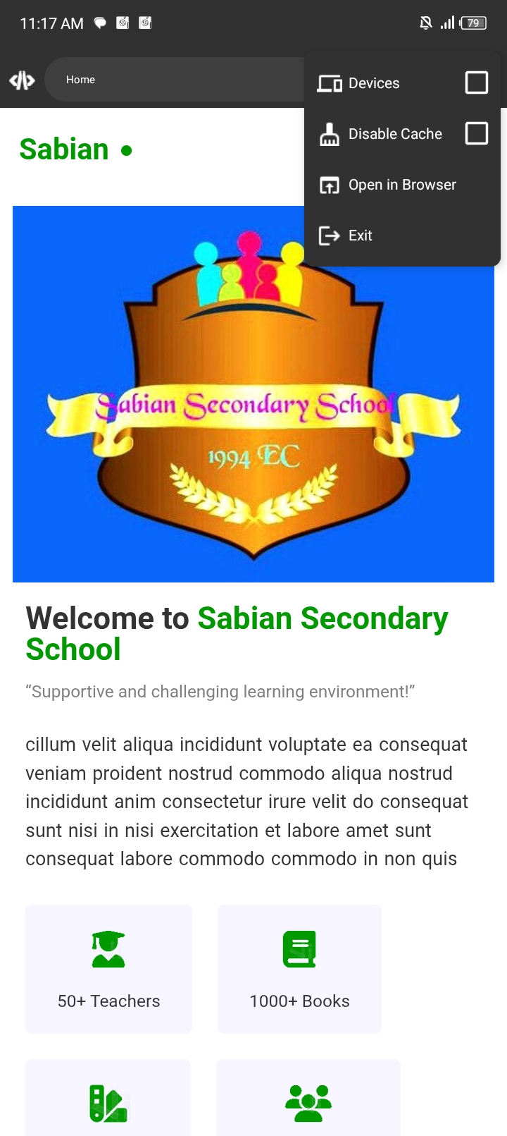
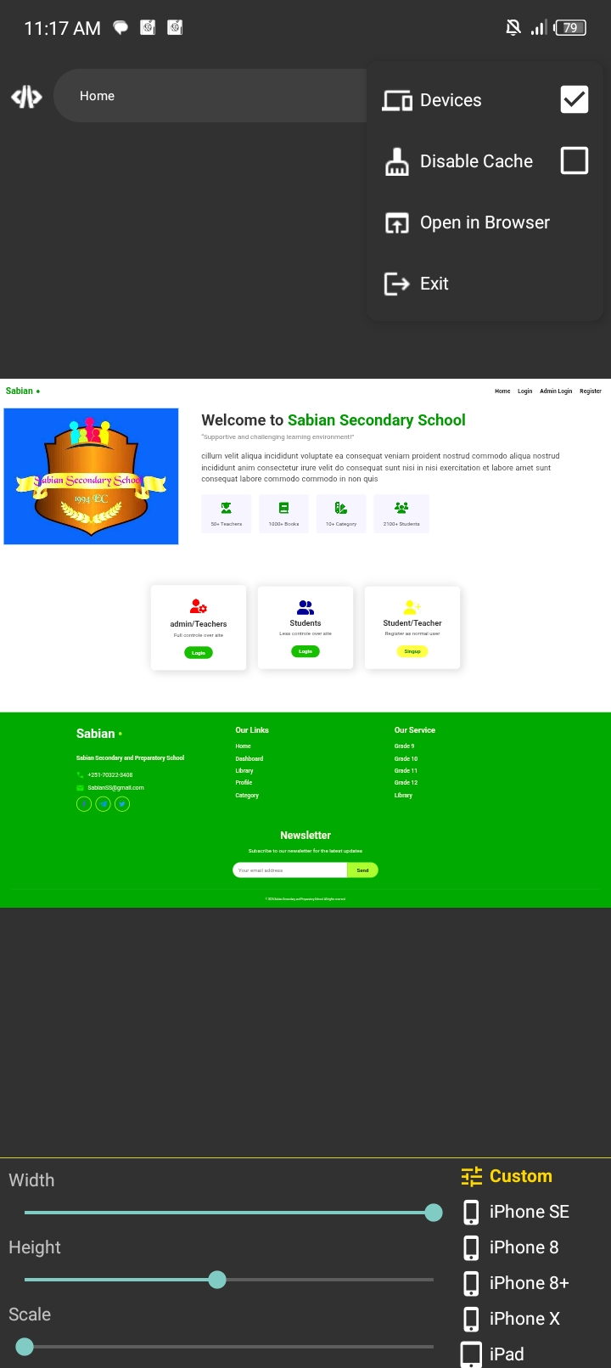
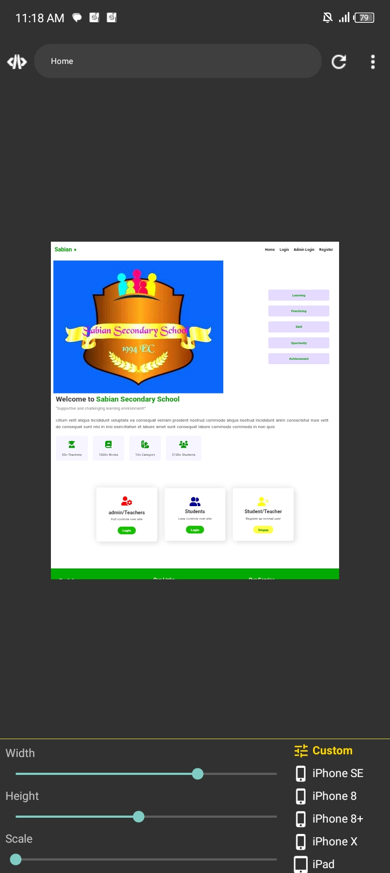
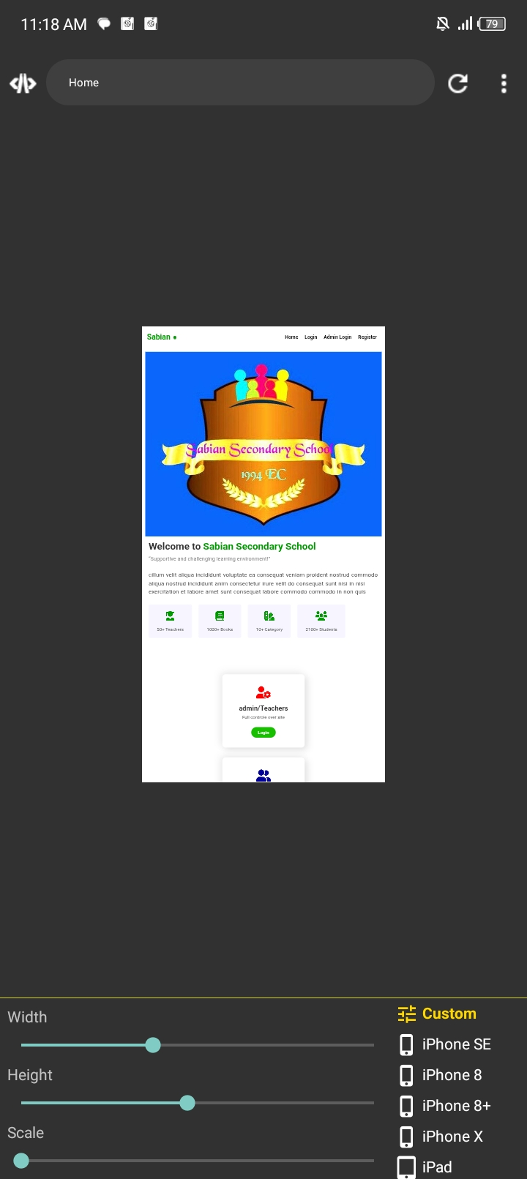
Welcome to sabian library
This website has created for sabian library system.and this PowerPoint presentation has created for usage guidelines for users. For creating this site I use several tools.
1, Acode editor:- For writing code and test site responsiveness

Slide 3

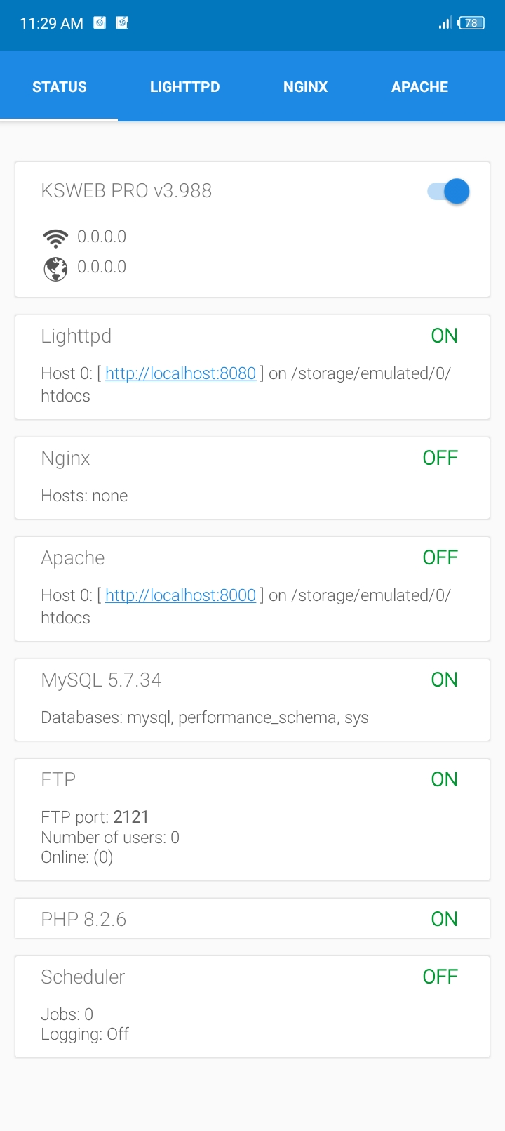
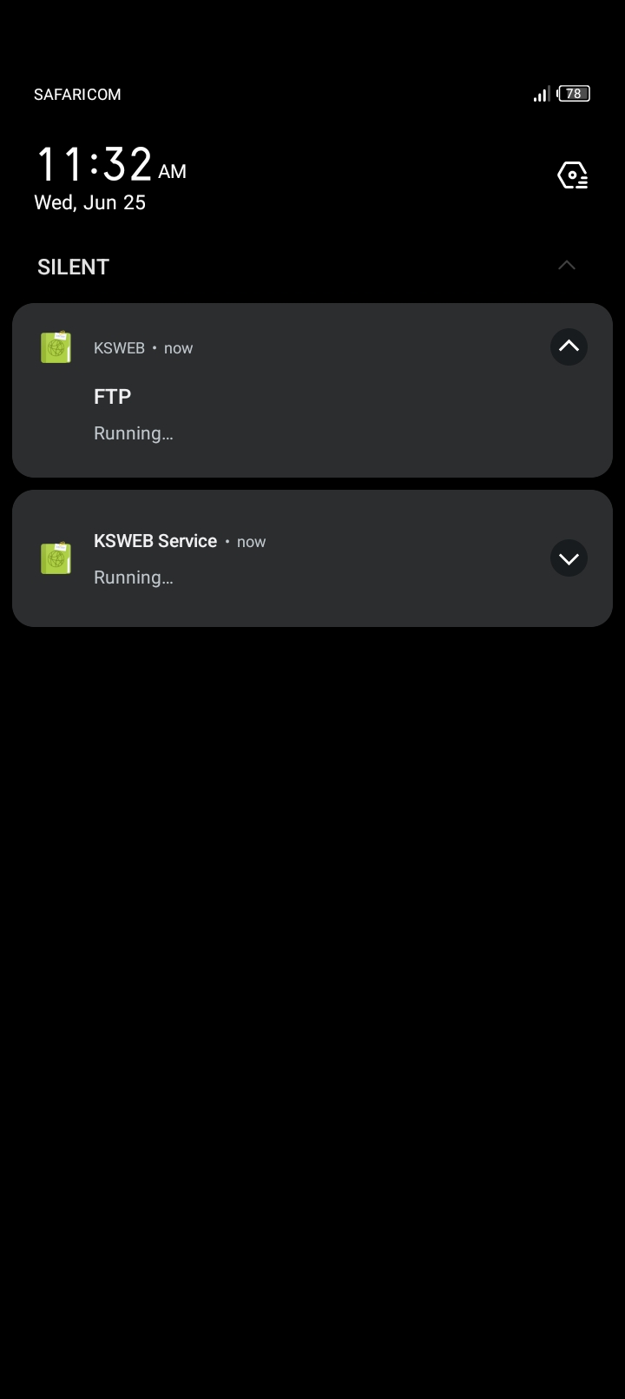
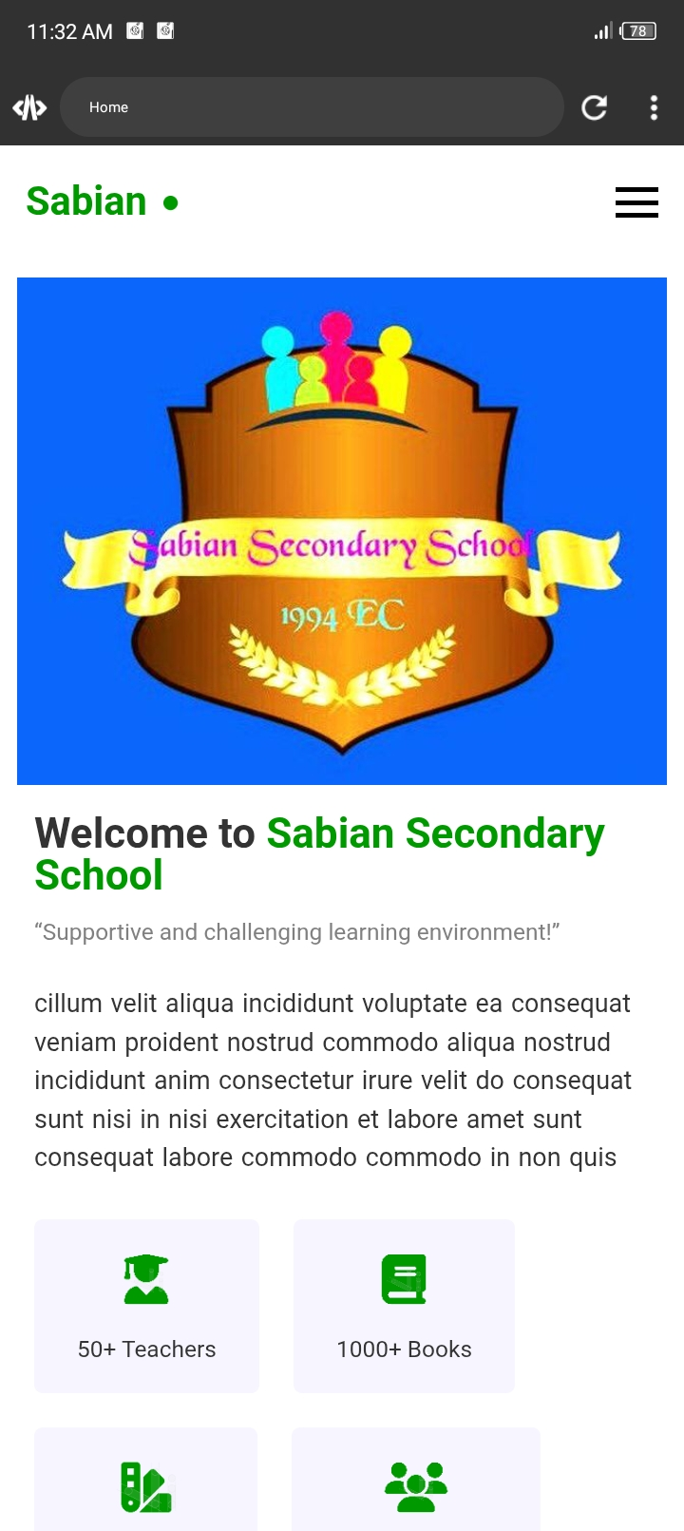
2, Ksweb mobile app:- I use this app for web server because php has don’t work like JavaScript in browser. Php require special tool like online server in mobile device that is so hard their for I find this tool after long time searching without this tool I can’t view my websites output this app is give me local web server.

Slide 4
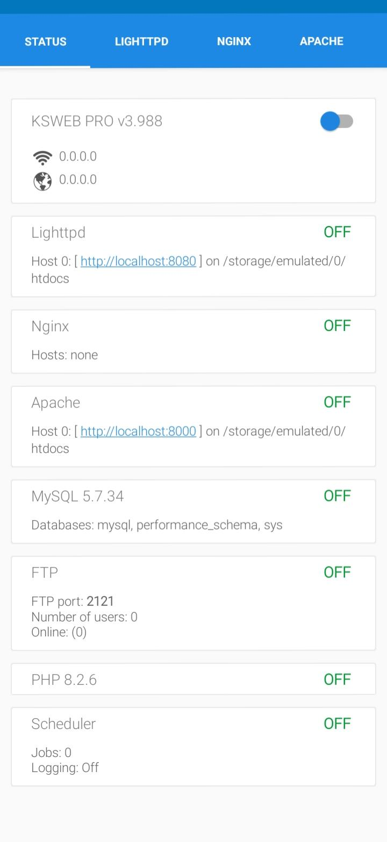

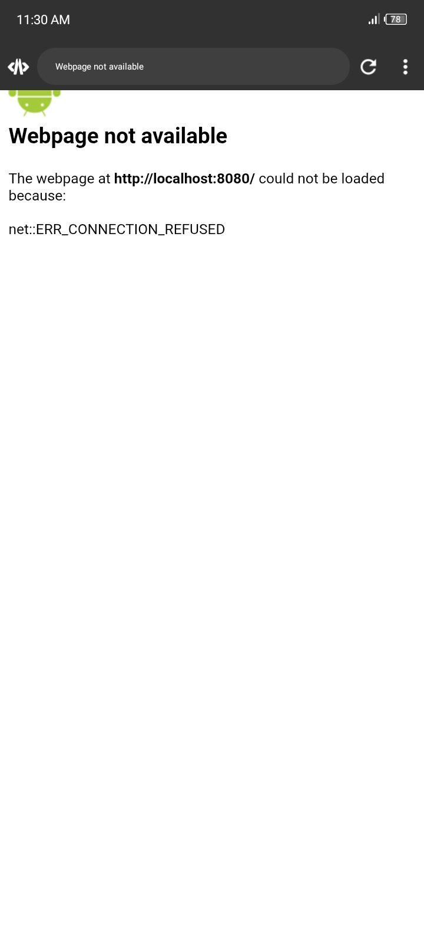
Only my website has placed on htdocs folder otherwise doesn’t read ksweb server app therefore my website has placed inside htdocs folder. When installed ksweb firstly app automatically create that folder and place sample php file. After that delete default php file and insert your website must have index.php file york properly otherwise not work.

Slide 5
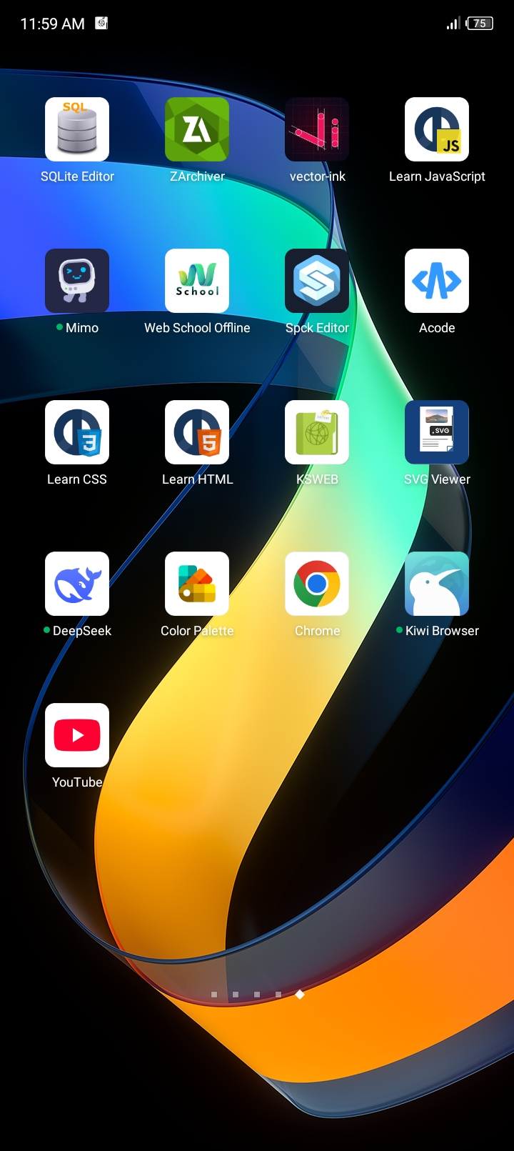
3, Color palette for picking colors
4, w3 school app
5, YouTube for some tool finding
6, deepseek ai for error finding
7, svg viewer app
8, zarchiver for folder management
9, vector-ink app for svg icon edition
10, sqlite editor app for database edition etc.

Slide 6
Users right and role in Library management system website.
Boss Admin | Teachers | Students
1, Add book | 1, Add book | 1, Read book
2, Edit book | 2, Edit book only their upload | 2, Preview book
3, Delete book | 3, Delete book only their upload | 3, Download book
4, Add category | 4, Add category | 4, View category details
5, Edit category | 5, Edit category | 5, Edit profile
6, Delete category | 6, Delete category | 6, Explore library
7, Change users role | -
8, Remove users | -
9, Edit profile | 9, Edit profile
10, View statistics -Total Students -Total Teachers -Total Books -Total Categories | 10, View statistics -Total Books -Total Categories
11, Read book | 11, Read book
12, Preview book | 12, Preview book
13, Download book | 13, Download book

Slide 7
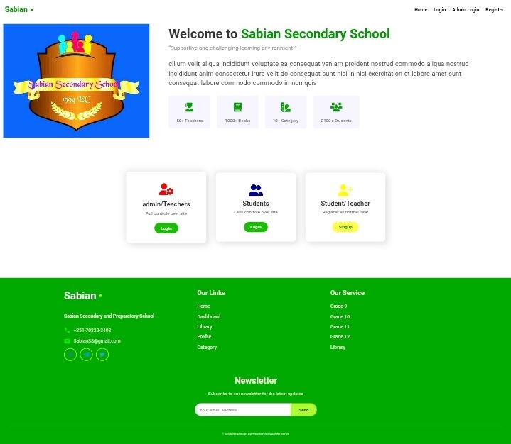
Home Page of library management system website.
This is Home page of library management system website.
This page includes:-
1, Admin or teachers login page link
2, Students login page link
3, Students registration page link
Disclaimer: Users can’t login in the admin login page and admin can’t login in student login page. Because admins and students have different role, right and features.
Firstly all users register as student right only admin can change role form student to teacher and can teacher back to student.
1
2
3

Slide 8
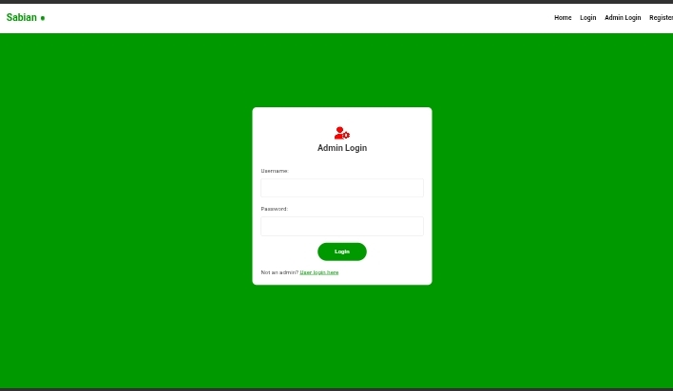
Admin login page
This is admin and teacher login page. In this page can login only admin and teacher role users. After login admin role redirect to admin dashboard, Teacher role redirect to teacher dashboard.
1, Fill your admin or teacher username in first input box.
2, Fill your password in second input box.
3, Click on login button for login to you account.
If your account details are correct your dashboard open automatically. If your account details are wrong site will be display warning message says “Invalid admin credential” after getting this error message check your account details and try again.

Slide 9
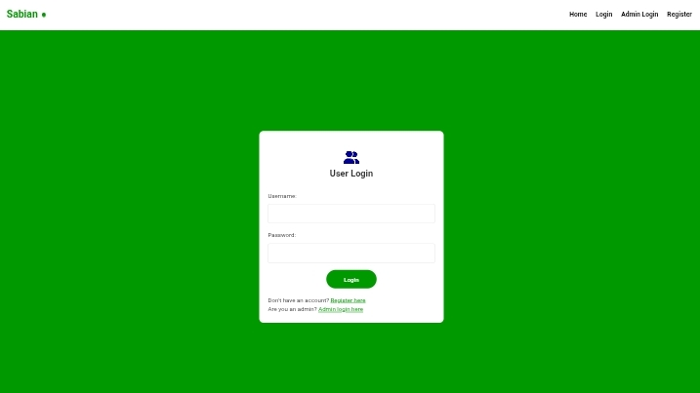
Students login page
This is Student login page. In this page can login only student role users. After login Page automatically redirect to student dashboard.
1, Fill your student username in first input box.
2, Fill your password in second input box.
3, Click on login button for login to you account.
If your account details are correct your dashboard open automatically. If your account details are wrong site will be display warning message says “Invalid username or password” after getting this error message check your account details and try again.

Slide 10
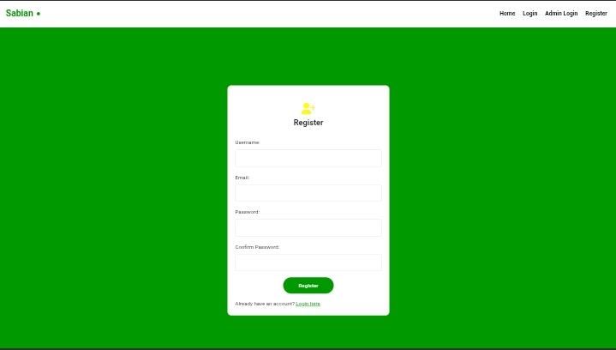
Users signup page
This is user signup page help to register to this website to student role. After signup to student role teachers can ask the admin for change their role from student to teacher after asking admin change their role to teacher. Until admin change their role to teacher they can login in student login page only.
1, Fill first input box your username
2, Fill second input box your Email address
3, Fill third input box your password
4, conform your password
5, click on Register button.
Disclaimer : After changed your role to teacher only you can login in admin/teacher login page.

Slide 11
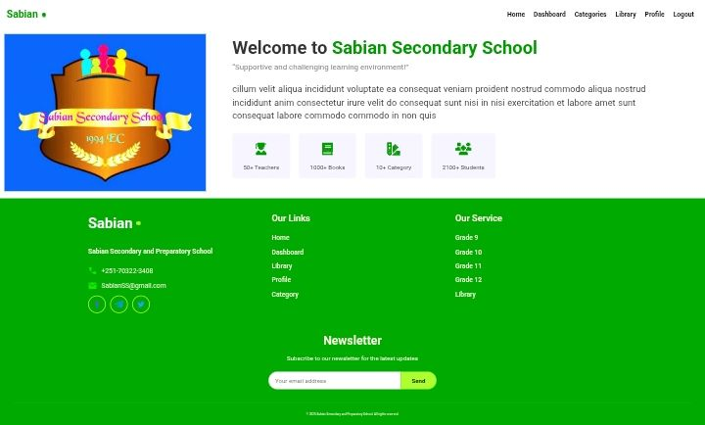
Home page
After login home page of all users changed to this page.

Slide 12
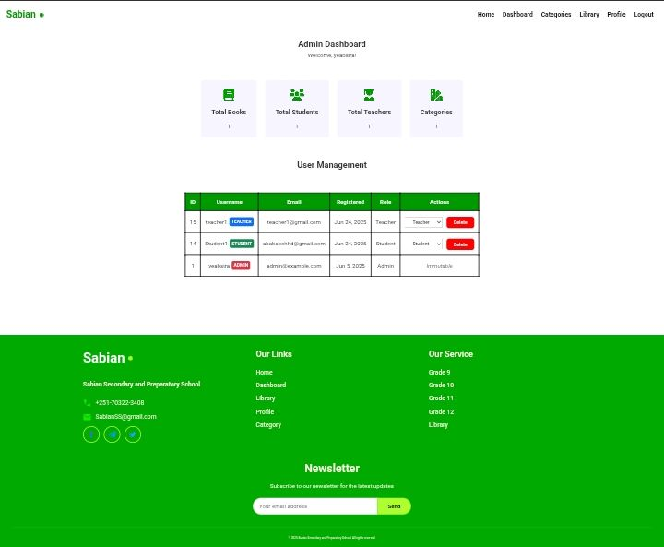
Admin dashboard
This is admin dashboard in this page admin can manage users view site statistics and other.
This page include:-
1, Site statistics
2, user management
3, other admin pages link

Slide 13
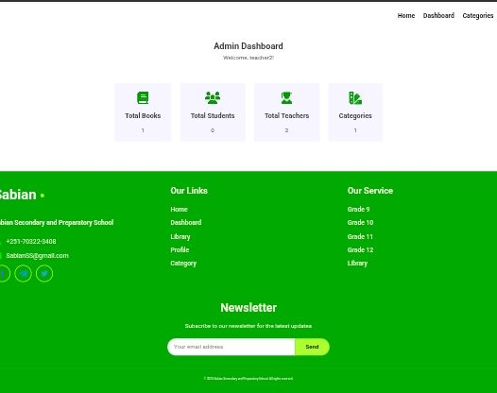
Teachers dashboard
This is teacehteacher dashboard don’t have user management table because only can manage user by boss admin

Slide 14
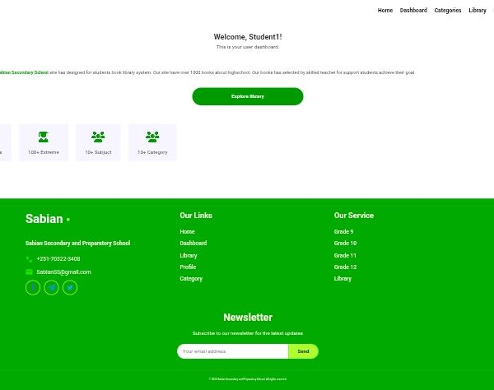
Student dashboard page
Student dashboard don’t have any site statistics user management table because students can only explore library.

Slide 15
Admin Navigation links
Home:- redirect to home page
Dashboard: redirect to dashboard
Categories: redirect to category page
Library: redirect to library page
Profile: redirect to profile management page
Logout: logout from the site

Slide 16
Admin dashboard links
⓵ Display Total uploaded books in this site and on click redirect to book management page.
⓶ Display Total registered students in this site and onclick scroll down to user management table.
⓷ Display Total teacher role users in this site and onclick scroll down to user management table.
⓸ Display Total Categories in this site and onclick redirect to category management page.
1
2
3
4

Slide 17
User management table
Id: show the users id in this site all users have unique id number.
Email: show users registered email address in system
Registered: show users registered date in system.
Role: show users role in this site.
Action: admin can manage the users by:
this dropdown button can admin change the role of users. When click on this button display dropdowns menu then admin can choose one of them. By default text display in this button has users current role in this site after changing change the text to current changed role.
By this button admin can delete users from the system.when click page display popup message that conform the action to proceed.after conform users delete from the system permanently.
Disclaimer: that displaying in action columns text “immutable” is this user has boss admin can’t changeable role and can’t delete from the system.
Teacher
Student
Delete

Slide 18
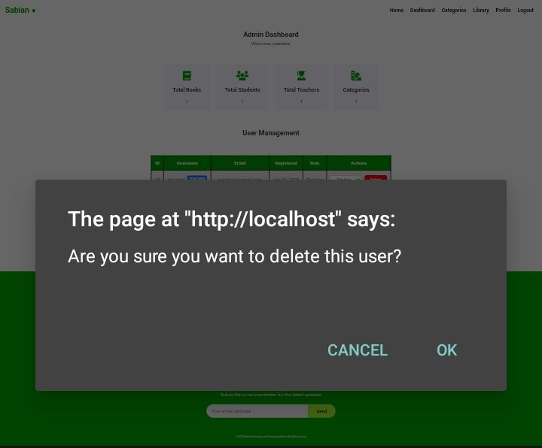
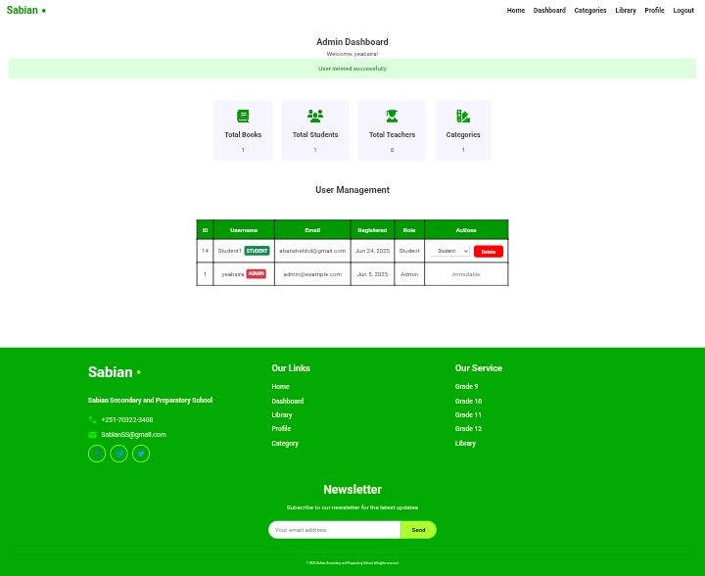
Deleting User account
Admin can delete the users account permanently from the system by following this step.
Step1: Click on delete button you want to delete user account row from user management table under action column. Lookalike below button.
Step 2: Conform your action in popup message by clicking “yes” text.
After that page display conformation message says “user delete successfully” in green container. Lookalike third image.
Delete

Slide 19
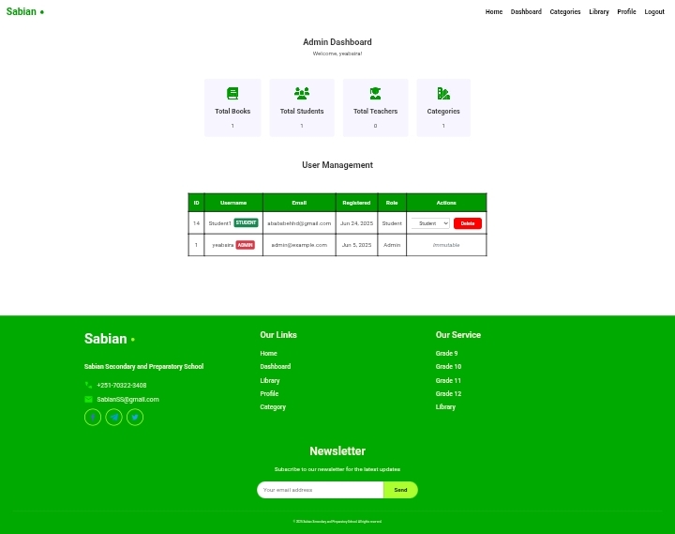
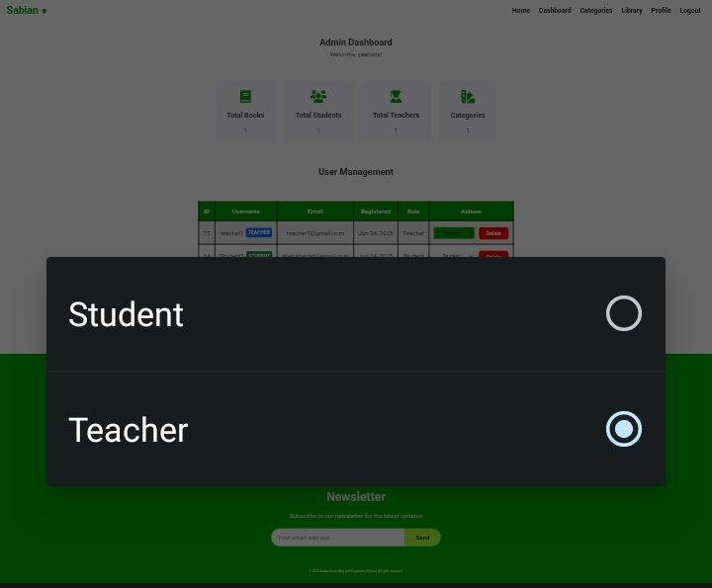
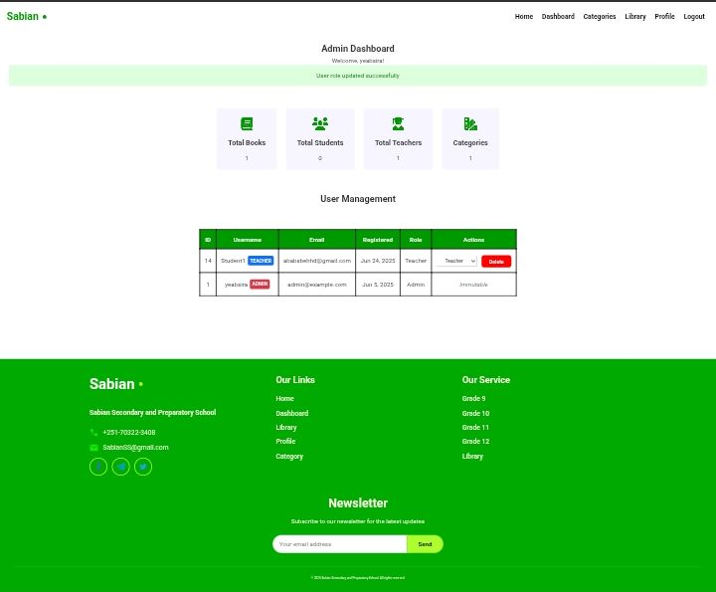
Changing user role
Admin can change user role by following this step.
Step 1: Click on role change button say “teacher” or “student” you want to change role buttons lookalike below.
or
Step 2: choose you want to switch role in popup box.
After that page display conformation message says “role update successfully” in green box lookalike third image. After changed user role change user role column to current user role.
Teacher
Student

Slide 20
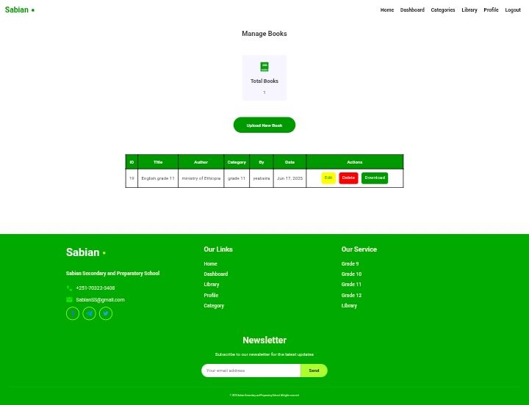
Book management page
Admin or teacher can manage books in this page.
This page include:-
1, Book statistics
2, book deletion
3, book edition
4, book download

Slide 21
Book statistics box
Admin or teacher ca view book statistics.
This box show total books in this site uploaded and currently available.
When click on this box automatically redirect to library page in that page you can read book preview book so on.

Slide 22
Upload new book
By clicking button says”upload new book” you can upload new book to the system. After clicking that button automatically open upload book page in that page you can upload new book.

Slide 23
Managing books
By following this step you can manage books.
1, you can edit book by clicking “Edit” button then edit book page open automatically.
2, you can delete book from the system by clicking “delete” button.
3, you can download book from the site by clicking “download” button.
Book table data
Id: all books have unique id this is book id
Title: display book title you can search by this title.
Author: display author of this book
Category: display category of this book
By: display who upload this book
Date: display uploaded date
action/action: display management buttons

Slide 24
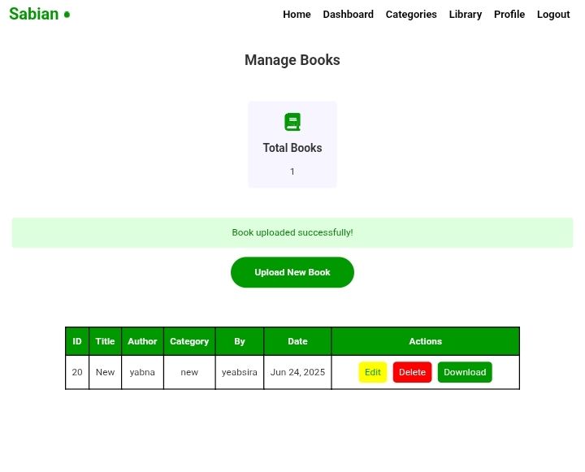
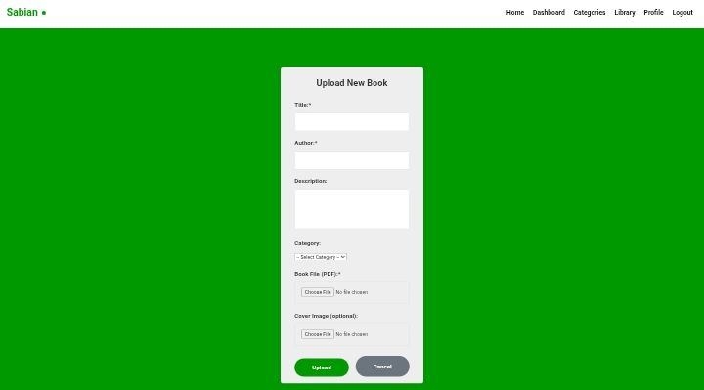
Book upload page
By following this stem you can upload new book.
Step 1: Enter Book title in title input field.
Step 2: Enter book author in author input field.
Step 3: write some description about book.
Step 4: choose category of book.
Step 5: choose pdf file format of book.
Step 6: choose book cover that display in library page.
Step 7:click on “upload” button
Finally page display conformation message in green box says “book upload successfully”.

Slide 25
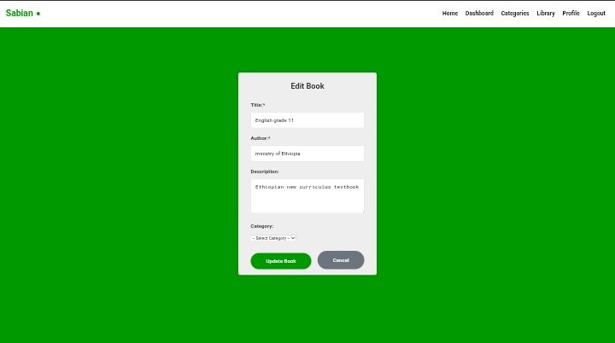
Edit book page
By following this step you can edit book.
Step 1: Enter your title you want to change.
Step 2: Enter you need to change author name.
Step 3: Enter your new book description
Step 4: click on “update book” button.
After that page display conformation message.

Slide 26
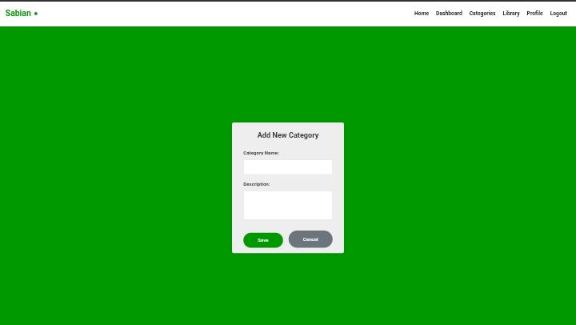
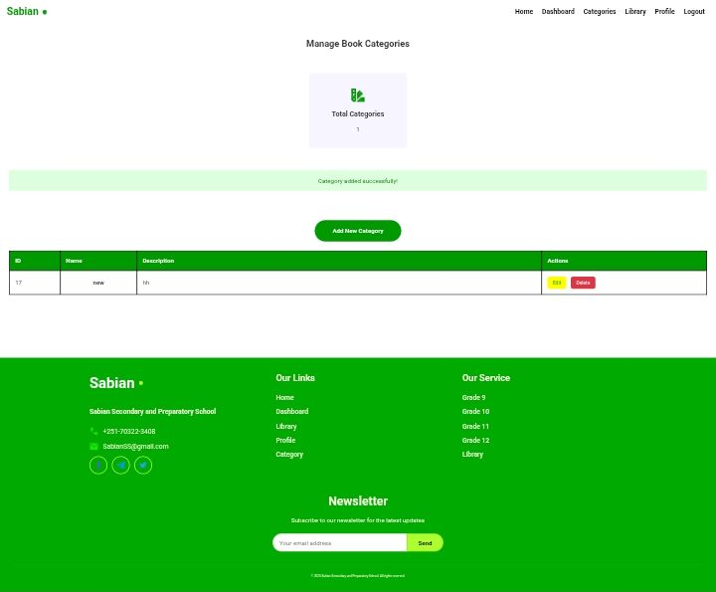
Add new category
By following this step you can add new category to the system.
Step 1: Enter category name in first input field.
Step 2: Enter description about that category.
Step 3: click on “save” button.
Aafter that page redirect to category page and display conformation message in green box.

Slide 27
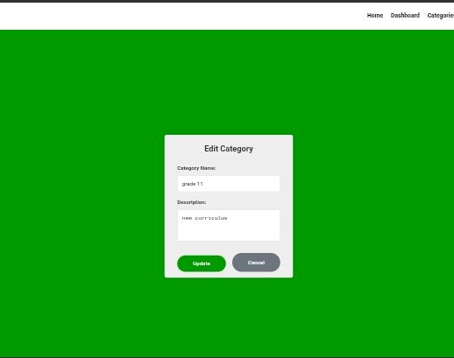
Edit category page
By following this step you can edit categories.
Step 1: Enter category name you want to edit.
Step 2: Enter description about category you want to edit.
step 3: click on “save” button.
Page automatically redirect to category page and display conformation message in green box.

Slide 28
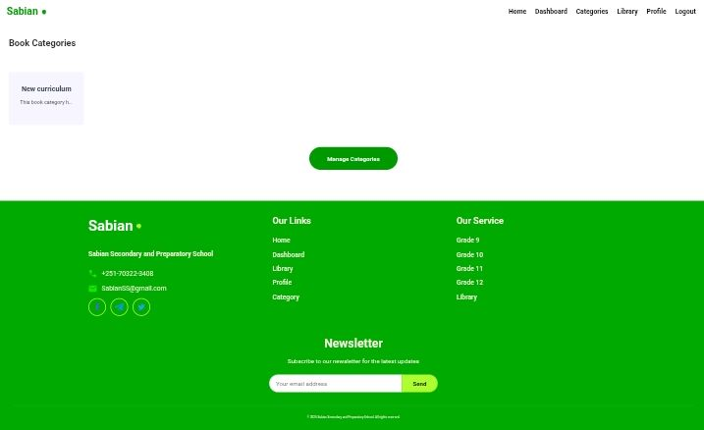
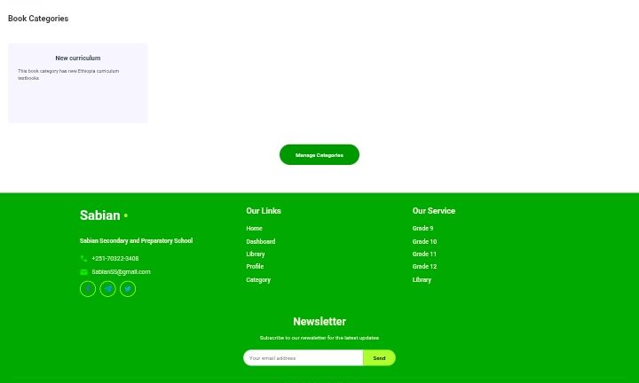
Admin category view page
Admin can view categories in this page.
Can view category name and can read category description by hovering cursor in category box. After hovering display full description of category.
Admin category view page havcantegory management page link.

Slide 29
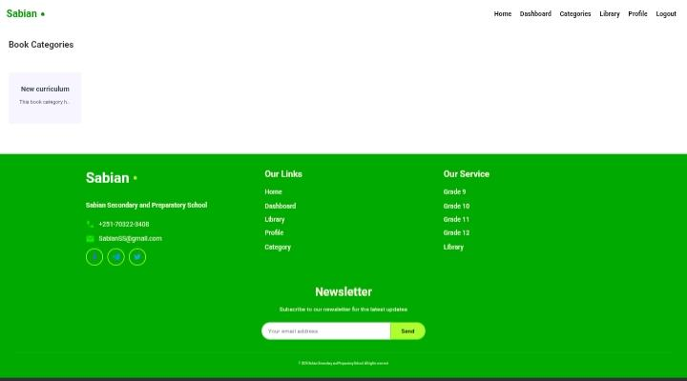
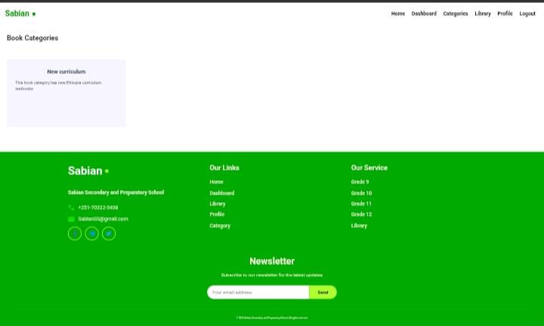
Student category view page
Students can view categories in this page.
Can view category name and can read category description by hovering cursor in category box. After hovering display full description of category.

Slide 30
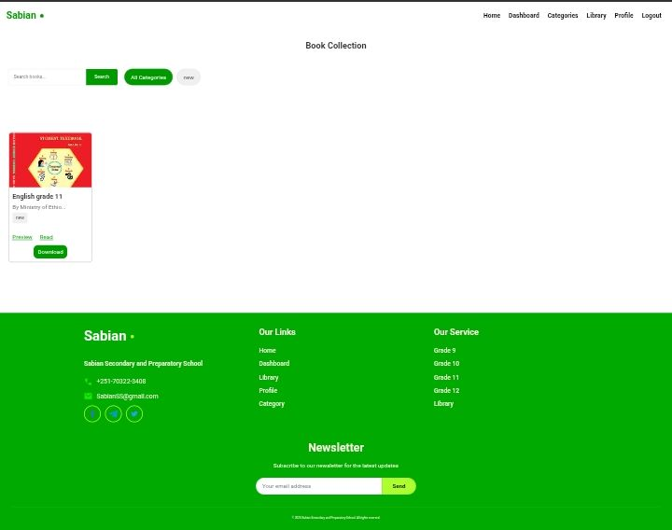
Library page
In this page users can explore books this page have.
1, search box users can search book by title or author name.
2, category selection users car choose category that display books only uploaded in that category.
3, book box this box have book cover image book title book description and preview,read and download page links.

Slide 31
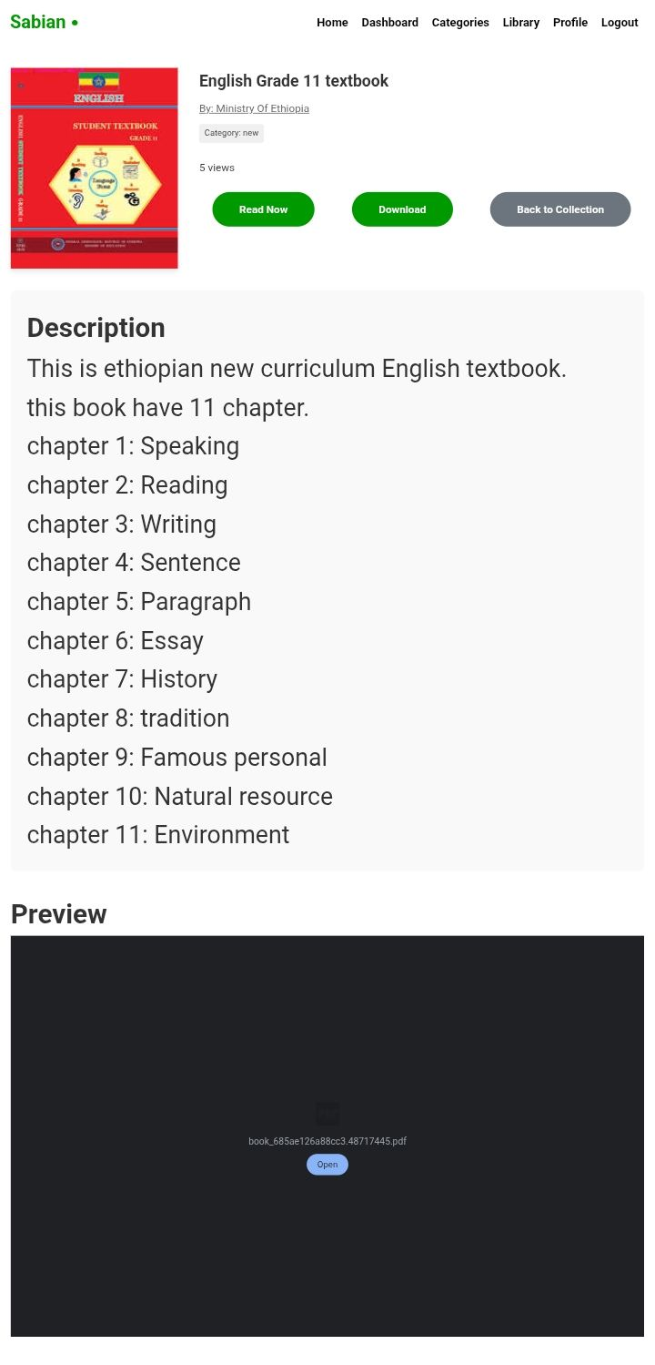
Preview book page.
I this page users can read full description about book can see author name can see book preview can see total book views. And so on.

Slide 32
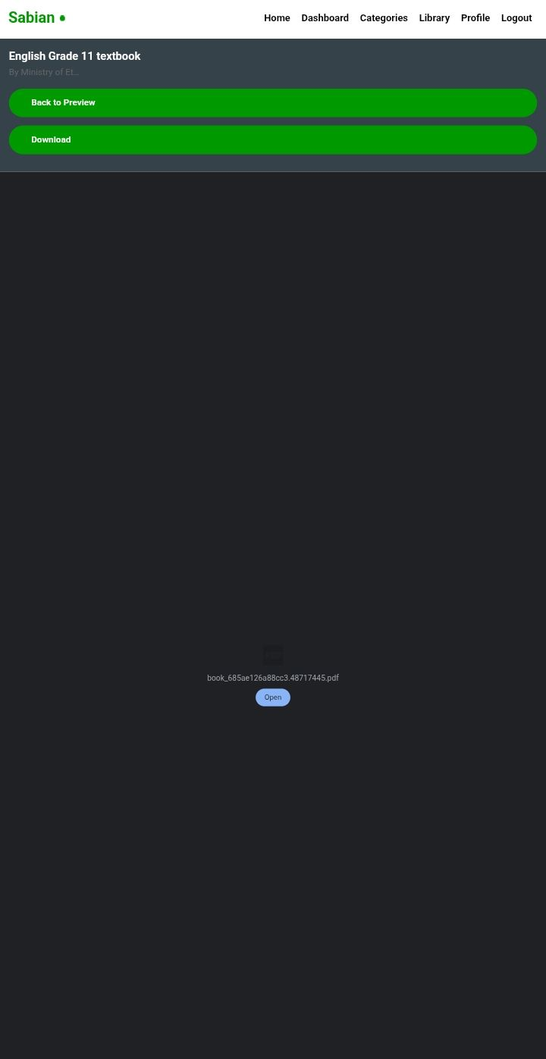
Book read page
Users can read book in this section, can download book pdf format and can back to preview book page

Slide 33
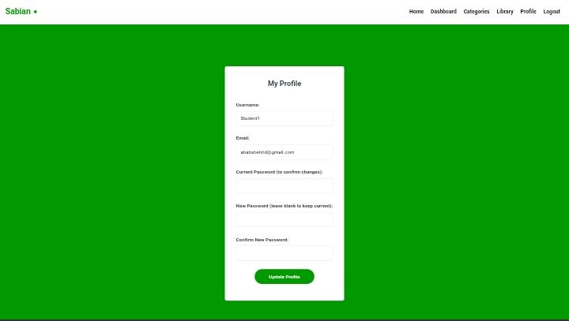
Profile edit page
All users can edit their profile such as username, email, password.
For edition must requires current password otherwise you can’t edit your profile.
After edition page will be display conformation message.

