Slide 1


Forecasting Renewable Energy Generation at the Plant Level Using XGBoost
Yeabsra Habtu, PGR/38331/17
by Yeabsra Habtu

Slide 2
Abstract
Research Challenge
Methodology
General forecasting of renewable energy generation at the power-plant level remains limited by data gaps, variability across regions, and the non-linear nature of influencing factors.
This study addresses these challenges by developing an XGBoost regression model to predict annual electricity generation (GWh) for global renewable power plants. Using a cleaned and imputed dataset—including capacity, fuel type, location, and commissioning year—we engineer features such as plant age and log-transformed capacity. Missing values are handled via predictive mean matching.
Results
Significance
The model is trained on 80% of the data and tested on the remaining 20%, achieving an R² of 0.88, RMSE of 698.15 GWh, and MAE of 293.80 GWh. Installed capacity, plant age, and technology type emerged as key predictors. Five-fold crossvalidation confirms the model's robustness.
These results highlight the value of gradientboosted trees for capturing complex relationships in heterogeneous datasets, offering a scalable approach to support energy planning, investment, and policy development.

Slide 3




1. Introduction & Background
Importance of Renewable Energy
The increasing global focus on sustainability has elevated the importance of renewable energy sources, such as solar, wind, and hydroelectric power.
Forecasting Challenges
Efficiently forecasting renewable energy generation is crucial for optimizing grid stability, energy trading, and planning operations at both regional and plant levels. However, the variable and weather-dependent nature of renewables introduces significant uncertainty, posing challenges to accurate forecasting.
Plant-Level Forecasting
Forecasting at the individual plant level offers a more granular understanding of energy patterns, enabling more precise operational decisions. Unlike aggregate forecasting, plant-level prediction demands handling site-specific characteristics and localized external factors, which increase the complexity of modeling.
XGBoost Application
Machine learning techniques, particularly tree-based ensemble models, have proven effective in capturing nonlinear patterns in energy data. Among them, Extreme Gradient Boosting (XGBoost) stands out due to its scalability, regularization capabilities, and superior performance in structured data prediction tasks.

Slide 4


2. Related Baseline Works
Machine Learning in Energy Forecasting
Machine learning techniques have become valuable tools for handling the complexities and non-linear relationships inherent in these forecasting tasks. Extreme Gradient Boosting (XGBoost) is frequently identified for its strong predictive performance, scalability, and ability to manage intricate variable interactions and time series data(Qi et al., 2025).
Hydropower Generation Prediction
Studies demonstrate the successful application of XGBoost across various energy forecasting domains. For instance, in hydropower generation prediction, XGBoost has been applied both as a standalone predictive model and as part of hybrid models incorporating optimization techniques like the Slime Mould Algorithm (SMA), Aquila Optimizer (AO), and Grey Wolf Optimization (GWO) (Qi et al., 2025). One study found that XGBoost alone achieved an R2 value of 0.8632 and an RMSE of 40.90, outperforming Support Vector Regression (SVR) in single model predictions (Qi et al., 2025).

Slide 5


Continue…
Day-Ahead Load Forecasting
For day-ahead load forecasting, especially in systems experiencing distortion from increasing behind-the-meter (BTM) solar PV generation, an XGBoost-based algorithm has been proposed (Bae et al., 2022). This method estimates historical BTM solar PV generation to derive a "reconstituted load," thereby removing the distortion for more accurate forecasting using XGBoost (Bae et al., 2022).
Net Load Forecasting for Buildings
In day-ahead net load forecasting for buildings with integrated renewable energy, XGBoost has been employed in a decoupled model approach (Kerkau et al., 2025). This involves forecasting gross load demand and PV production separately. When tested on a sunny weekend, the model resulted in an MAPE score of 0.09. For a cloudy weekday scenario, the MAPE was 0.08.

Slide 6
3. Methods and Materials
A. Proposed Machine Learning Method
XGBoost (Extreme Gradient Boosting) is selected as the primary machine learning model due to its high performance on tabular data and its capacity to handle both numerical and categorical features through encoding. XGBoost is an ensemble learning technique based on gradient boosting decision trees, known for its robustness to multicollinearity and ability to automatically handle feature importance.
The training process involves an initial model with base parameters followed by a hyperparameter optimization step using GridSearchCV with 3-fold crossvalidation. The model is configured to minimize root mean squared error (RMSE), using reg:squarederror as the objective function. Early stopping is employed to prevent overfitting, using a validation set during training.
After identifying the optimal parameters including max depth, learning rate, number of estimators, and subsampling rate, a final model is trained. The model's performance is then evaluated on a hold-out test set, ensuring it reflects unseen data behavior.

Slide 7
B. Statistical Description
Dataset Source
The dataset used for this study was obtained from the Global Power Plant (GPP) records, focusing on predicting the annual power generation (generation_gwh_2019) for individual plants.
Feature Composition
The dataset includes a mix of categorical and numerical features such as plant location, capacity in megawatts, commissioning year, and primary fuel type. The target variable is numerical and continuous, making the problem suitable for regression modeling.
Distribution Analysis
The distribution of annual electricity generation values was examined using summary statistics of the variable generation_gwh_2019, which records each plant's total output in gigawatt-hours for 2019.

Slide 8
Continue…
Statistic
Before Preprocessing
After Preprocessing
Min.
-780.3390
-780.3390
1st Qu.
2.7515
8.9370
Median
11.5300
122.2080
Mean
423.9224
766.3272
3rd Qu.
122.7815
497.1860
Max.
31920.3680
31920.3680
Figure 1. Statistical Summary of generation_gwh_2019 Target Variable

Slide 9
C. Evaluation and Optimization Methods
Model evaluation is conducted using three primary metrics: Root Mean Squared Error (RMSE), Mean Absolute Error (MAE), and R-squared (R²). RMSE measures the average magnitude of error, penalizing larger errors more than MAE. MAE provides an intuitive measure of the average absolute difference between predicted and actual values. R-squared indicates how much variance in the target variable is explained by the model.
The initial XGBoost model, trained with default settings and early stopping, served as a performance baseline. After tuning, the optimized model achieved an RMSE of 698.15, an R² score of 0.88, and an MAE of 293.80 on the test set. These results demonstrate a strong predictive capability, especially considering the high variability in the dataset.
The optimization process involved tuning the learning rate, tree depth, number of estimators, and subsample ratio using exhaustive grid search. Each configuration was evaluated through cross-validation to ensure that performance improvements were not a result of overfitting.

Slide 10
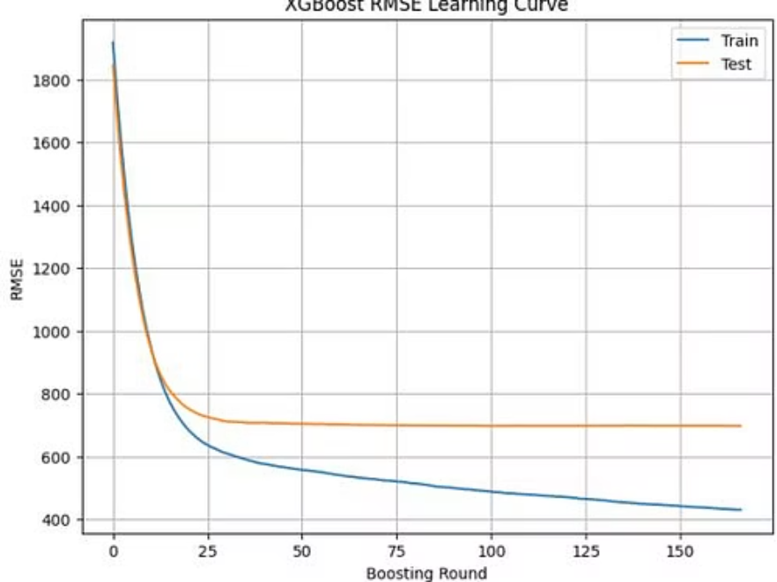
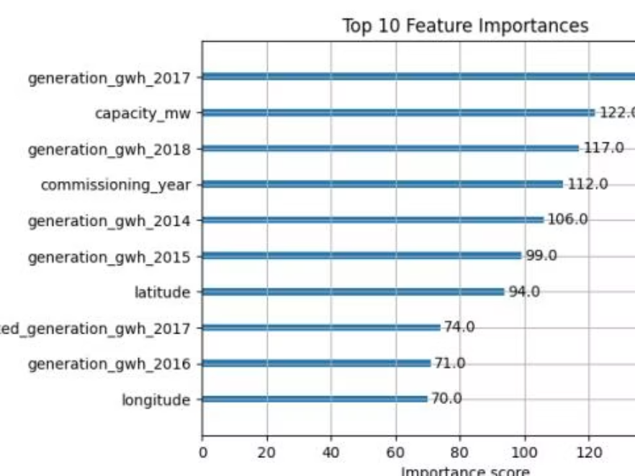
Continue…
Figure 2. XGBoost RMSE Learning Curve
Figure 3. Top 10 Feature Importance

Slide 11




4. Dataset Visualization and Preprocessing Discussion
Missing Value Handling
Outlier Treatment
To handle missing values in the Global Power Plant dataset, the Multiple Imputation by Chained Equations (MICE) method was used, employing predictive mean matching (PMM) as the imputation technique.
Following imputation, outliers in the Global Power Plant dataset were identified and treated using the Interquartile Range (IQR) method. For each numerical feature, the first and third quartiles were computed, and any values lying beyond 1.5 times the IQR from these bounds were flagged as outliers.
Data Splitting
Correlation Analysis
The dataset was split into training (80%) and test (20%) subsets. The split was performed randomly with stratification (when appropriate) to maintain representative distributions across target classes.
3
A heatmap of pairwise Pearson correlations between numerical variables was generated to assess the relationships among features. This revealed moderate positive correlations between features such as installed capacity and generation values.
Figure 4. Correlation for the raw global dataset
Figure 5. Correlation for the cleaned global dataset

Slide 12
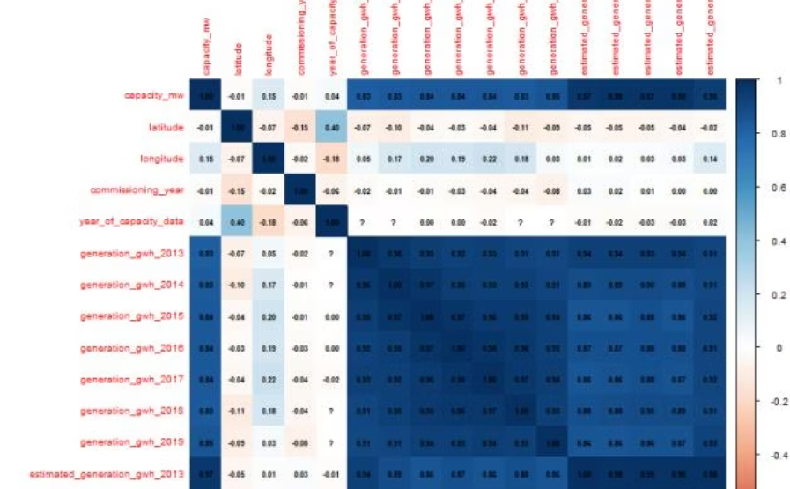
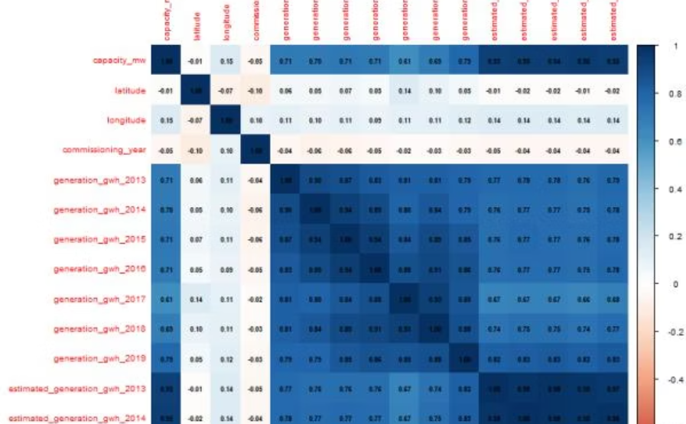
Continue…
Figure 4. Correlation for global plant dataset before pre-processing
Figure 5. Correlation for global plant dataset after pre-processing

Slide 13
5. Future Works
Explore hybrid approaches combining XGBoost with other models like neural networks, or ensemble stacking to improve the robustness and accuracy.
Integrate geospatial data or use geospatial Machine Learning techniques (e.g. Spatial autocorrelation, spatial clustering) to model location-based generation patterns more accurately.
Use the model to simulate different policy or investment scenarios – such as change in fule mix or new installations – to assess potential impact on national or regional generation.

Slide 14




6. Conclusion
Predictive Performance
XGBoost demonstrated consistent performance across evaluation metrics
Key Predictive Features
2
Installed capacity and primary fuel type were dominant factors
Robust Data Preprocessing
3
Imputation, Winsorization, and normalization improved dataset quality
In this study, machine learning techniques were employed to predict annual electricity generation for global power plants based on multiple technical and contextual features. The data underwent thorough preprocessing, including imputation of missing values using predictive mean matching, treatment of outliers through Winsorization based on the interquartile range, and normalization to ensure scale consistency. These steps helped improve the robustness and suitability of the dataset for modeling.
Among the models tested, XGBoost was selected due to its consistent performance across evaluation metrics and its ability to handle heterogeneous features. The model demonstrated a strong predictive capacity, especially for mid-range generation values, and produced high accuracy with minimal generalization error. Feature importance analysis highlighted the dominance of installed capacity and primary fuel in influencing generation outcomes, reinforcing the reliability of the model's learning.

Slide 15
Thank You!

