Slide 1
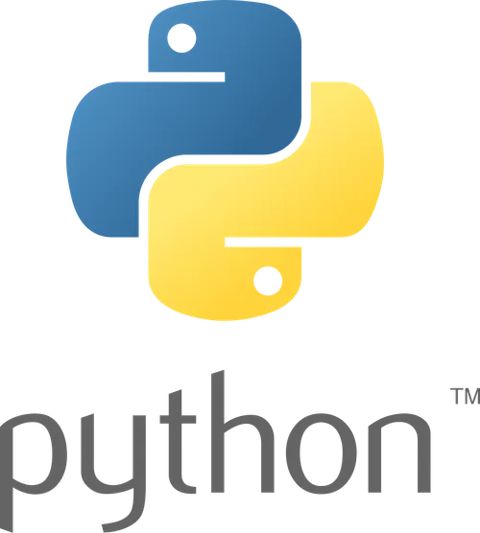
Python
Chapter: 3

Slide 2
➢Overview
Block of code
Conditional Blocks
if-else statement
The nested-if statement
The if-elif-else ladder
Loop Blocks
While Loop in Python
For Loop in Python
Nested Loops
Loop control statements
Break Statement:
Continue Statement:
Pass Statement:

Slide 3
Block of code
In Python, a block of code is a set of statements that are grouped together and executed as a single unit. Blocks are defined by their indentation level, which is typically four spaces. The indentation is crucial for Python, as it indicates the scope of the code and how statements are grouped together.

Slide 4
Block of code
The most common types of blocks in Python include:
Function Blocks: def my_function(): # Code inside the function block print("Hello, World!") Conditional Blocks: x = 10 if x > 5: # Code inside the if block print("x is greater than 5") else: # Code inside the else block print("x is not greater than 5") | Loop Blocks: for i in range(5): # Code inside the loop block print(i) Exception Handling Blocks: try: # Code inside the try block result = 10 / 0 except ZeroDivisionError: # Code inside the except block print("Cannot divide by zero")

Slide 5
Conditional Blocks
There are situations in real life when we need to make some decisions and based on these decisions, we decide what we should do next. Similar situations arise in programming also where we need to make some decisions and based on these decisions we will execute the next block of code. Conditional statements in Python languages decide the direction(Control Flow) of the flow of program execution.
Types of Control Flow in Python
The if statement
The if-else statement
The nested-if statement
The if-elif-else ladder

Slide 6
Python If statement
The if statement is the most simple decision-making statement. It is used to decide whether a certain statement or block of statements will be executed or not.
Syntax:
if condition:
# Statements to execute if
# condition is true

Slide 7
Python If statement
Here, the condition after evaluation will be either true or false. if the statement accepts boolean values – if the value is true then it will execute the block of statements below it otherwise not.
As we know, python uses indentation to identify a block. So the block under an if statement will be identified as shown in the below example:
if condition:
statement1
statement2
# Here if the condition is true, if block
# will consider only statement1 to be inside
# its block.

Slide 8
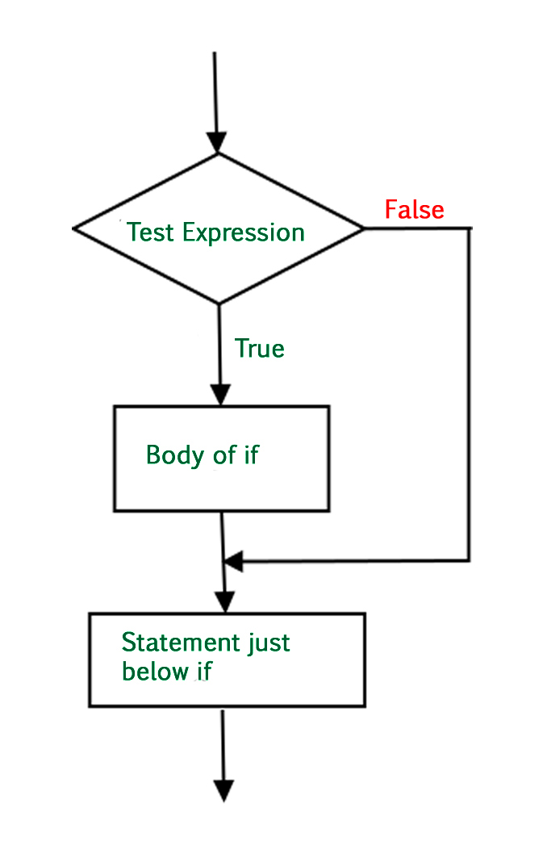
Python If statement

Slide 9
Python If statement
Example of Python if Statement
As the condition present in the if statement is false. So, the block below the if statement is executed.
i = 10
if (i > 15):
print("10 is less than 15")
print("I am Not in if")
Output:
I am Not in if

Slide 10
Python If Else
The if statement alone tells us that if a condition is true it will execute a block of statements and if the condition is false it won’t. But if we want to do something else if the condition is false, we can use the else statement with if statement to execute a block of code when the if condition is false.
Syntax of Python If-Else:
if (condition):
# Executes this block if
# condition is true
else:
# Executes this block if
# condition is false

Slide 11
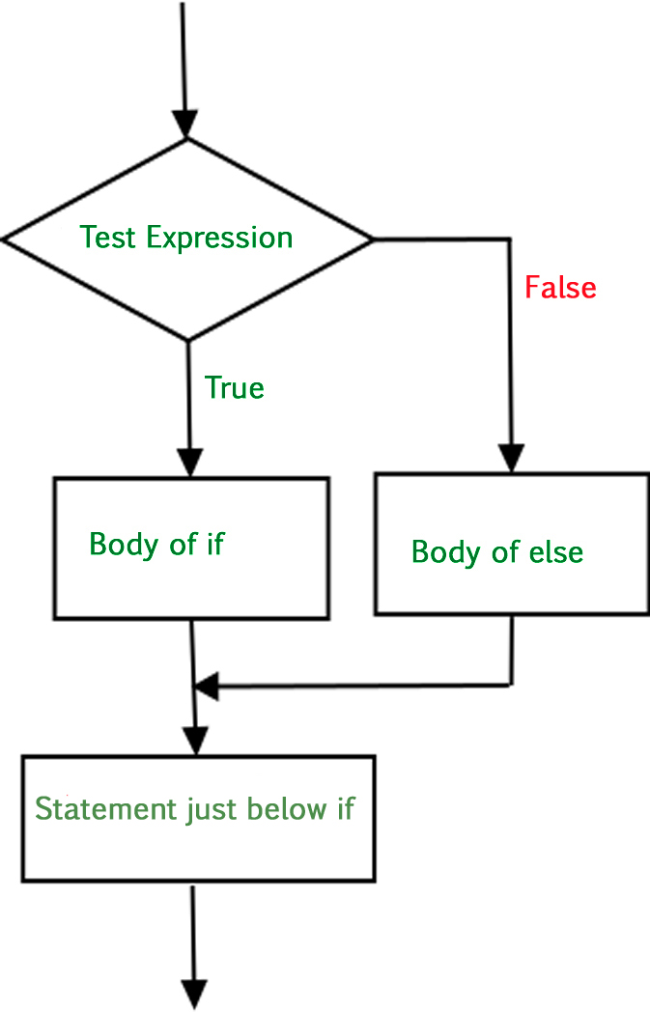
Python If Else

Slide 12
Python If Else
Using Python if-else statement
The block of code following the else statement is executed as the condition present in the if statement is false after calling the statement which is not in the block(without spaces).
i = 20 if (i < 15): print("i is smaller than 15") print("i'm in if Block") else: print("i is greater than 15") print("i'm in else Block") print("i'm not in if and not in else Block") | Output: i is greater than 15 i'm in else Block i'm not in if and not in else Block

Slide 13
Nested-If Statement
A nested if is an if statement that is the target of another if statement. Nested if statements mean an if statement inside another if statement. Yes, Python allows us to nest if statements within if statements. i.e., we can place an if statement inside another if statement.
Syntax:
if (condition1):
# Executes when condition1 is true
if (condition2):
# Executes when condition2 is true
# if Block is end here
# if Block is end here

Slide 14
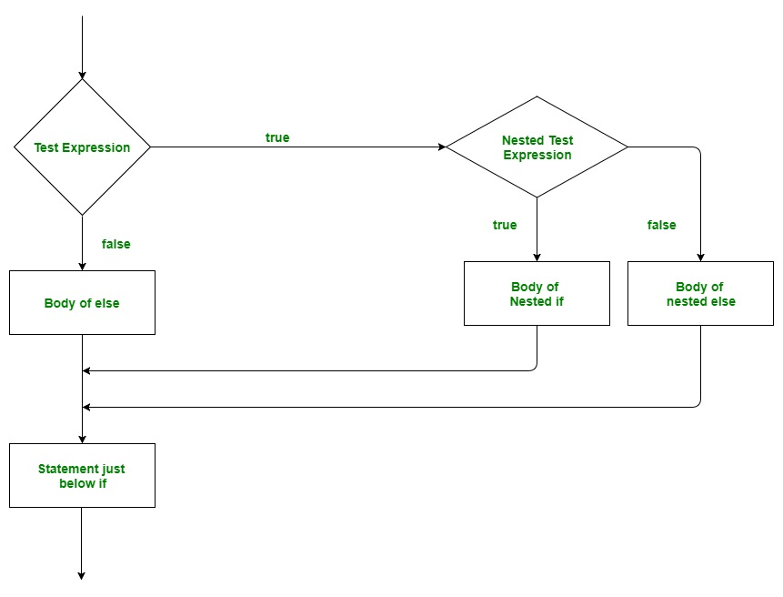
Python If statement

Slide 15
Nested-If Statement
Example of Python Nested if statement
In this example, we are showing nested if conditions in the code, All the If conditions will be executed one by one.
i = 10 if (i == 10): # First if statement if (i < 15): print("i is smaller than 15") # Nested - if statement # Will only be executed if statement above # it is true if (i < 12): print("i is smaller than 12 too") else: print("i is greater than 15") | Output: i is smaller than 15 i is smaller than 12 too

Slide 16
Python if-elif-else Ladder
Here, a user can decide among multiple options. The if statements are executed from the top down. As soon as one of the conditions controlling the if is true, the statement associated with that if is executed, and the rest of the ladder is bypassed. If none of the conditions is true, then the final else statement will be executed.
Syntax:
if (condition):
statement
elif (condition):
statement
else:
statement

Slide 17
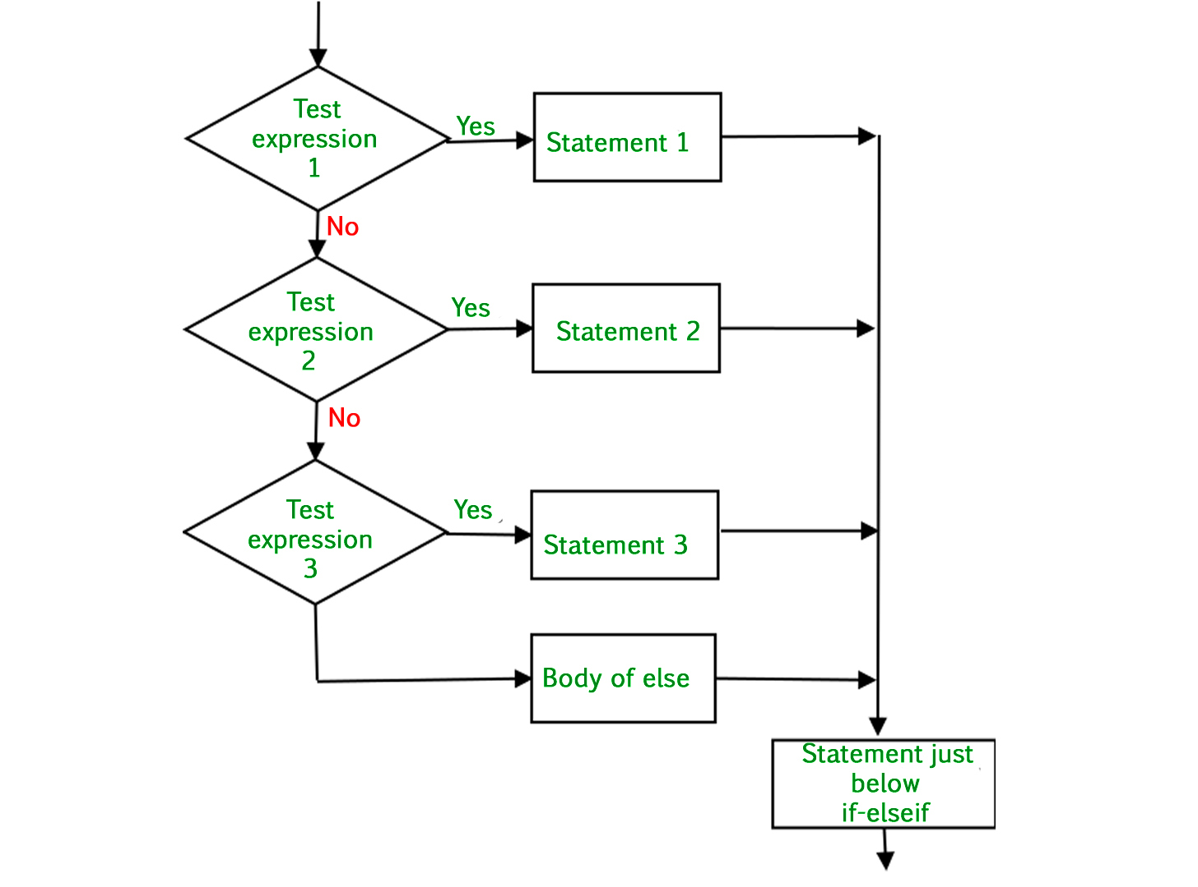
Python If statement

Slide 18
Python if-elif-else Ladder
Example of Python if-elif-else ladder
In the example, we are showing single if condition and multiple elif conditions, and single else condition.
i = 20 if (i == 10): print("i is 10") elif (i == 15): print("i is 15") elif (i == 20): print("i is 20") else: print("i is not present") | Output: i is 20

Slide 19
Python Logical Operators
Logical operators are used to combine conditional statements:
Operator | Description | Example
and | Returns True if both statements are true | x < 5 and x < 10
or | Returns True if one of the statements is true | x < 5 or x < 4
not | Reverse the result, returns False if the result is true | not(x < 5 and x < 10)

Slide 20
Loop Blocks
In programming, a loop is a control structure that allows a set of instructions to be repeated multiple times, based on a certain condition or a predefined number of iterations.
Types of Python Loops
While Loop in Python
For Loop in Python
Nested Loops

Slide 21
While Loop
A while loop is used to execute a block of statements repeatedly until a given condition is satisfied. And when the condition becomes false, the line immediately after the loop in the program is executed.
Syntax:
while expression:
# Statements to execute if
# condition is true
All the statements indented by the same number of character spaces after a programming construct are considered to be part of a single block of code.

Slide 22
While Loop
Example of While Loop
The given Python code uses a ‘while' loop to print “Hello Geek” three times by incrementing a variable called ‘count' from 1 to 3.
count = 0 while (count < 3): count = count + 1 print("Hello Geek") | Output: Hello Geek Hello Geek Hello Geek

Slide 23
While Loop
Using else statement with While Loop in Python
The else clause is only executed when your while condition becomes false. If you break out of the loop, or if an exception is raised, it won’t be executed.
Syntax of While Loop with else statement:
while condition:
# execute these statements
else:
# execute these statements

Slide 24
While Loop
Examples of While Loop with else statement
The code prints “Hello Geek” three times using a ‘while' loop and then, after the loop, it prints “In Else Block” because there is an “else” block associated with the ‘while' loop.
count = 0 while (count < 3): count = count + 1 print("Hello Geek") else: print("In Else Block") | Output: Hello Geek Hello Geek Hello Geek In Else Block

Slide 25
While Loop
Infinite While Loop in Python
If we want a block of code to execute infinite number of time, we can use the while loop in Python to do so.
The code uses a ‘while' loop with the condition (count == 0). This loop will only run as long as count is equal to 0. Since count is initially set to 0, the loop will execute indefinitely because the condition is always true.
count = 0
while (count == 0):
print("Hello Geek")

Slide 26
For Loop
For loops are used for sequential traversal. For example: traversing a list or string or array etc. In Python, there is “for in” loop which is similar to for each loop in other languages. Let us learn how to use for in loop for sequential traversals.
Syntax:
for iterator_var in sequence:
statements(s)

Slide 27
For Loop
Example of forLoop
The code uses a Python for loop that iterates over the values from 0 to 3 (not including 4), as specified by the range(0, n) construct. It will print the values of ‘i' in each iteration of the loop.
n = 4 for i in range(0, n): print(i) | Output: 0 1 2 3

Slide 28
For Loop
Example with List, Tuple, string, and dictionary iteration using For Loops in Python
We can use for loop to iterate lists, tuples, strings and dictionaries in Python.
Example with List:
print("List Iteration") lis = ["geeks", "for", "geeks"] for i in lis: print(i) | Output: List Iteration geeks for geeks

Slide 29
For Loop
Example with String:
print("\nString Iteration") s = "Geeks" for i in s: print(i) | Output: String Iteration G e e k s

Slide 30
For Loop
Reading Exercsie
Read different ways to iterate through various data structures in Python.
how to iteration over lists, tuples, strings, dictionaries, and sets, printing their elements or key-value pairs.
Resoures
https://www.geeksforgeeks.org/loops-in-python/#loop-control-statements

Slide 31
For Loop
Iterating by the index of sequences
We can also use the index of elements in the sequence to iterate. The key idea is to first calculate the length of the list and in iterate over the sequence within the range of this length. See the below

Slide 32
For Loop
Example Iterating by the index of sequences:
Example: This code uses a ‘for' loop to iterate over a list and print each element. It iterates through the list based on the index of each element, obtained using ‘range(len(list))'. The result is that it prints each item in the list on separate lines.
list = ["geeks", "for", "geeks"] for index in range(len(list)): print(list[index]) | Output: geeks for geeks

Slide 33
For Loop
Using else statement with for loop in Python
We can also combine else statement with for loop like in while loop. But as there is no condition in for loop based on which the execution will terminate so the else block will be executed immediately after for block finishes execution.
Syntax:
for iterator_var in sequence:
# execute these statements
else:
# execute these statements

Slide 34
For Loop
Examples of for Loop with else statement
In this code, the ‘for' loop iterates over a list and prints each element, just like in the previous example. However, after the loop is finished, the “else” block is executed. So, in this case, it will print “Inside Else Block” once the loop completes.
list = ["geeks", "for", "geeks"] for index in range(len(list)): print(list[index]) else: print("Inside Else Block") | Output: geeks for geeks Inside Else Block

Slide 35
Nested Loops
Nested loops refer to the situation where one loop is placed inside another loop. This means that the body of one loop contains another loop. Each iteration of the outer loop triggers a complete set of iterations of the inner loop.
Syntax:
for iterator_var in sequence: for iterator_var in sequence: statements(s) statements(s) | while expression: while expression: statement(s) statement(s)

Slide 36
Nested Loops
Example of Nested Loops:
This Python code uses nested ‘for' loops to create a triangular pattern of numbers. It iterates from 1 to 4 and, in each iteration, prints the current number multiple times based on the iteration number. The result is a pyramid-like pattern of numbers.
for i in range(1, 5): for j in range(i): print(i, end=' ') print(“\n”) | Output: 1 2 2 3 3 3 4 4 4 4

Slide 37
Loop Control Statements
Loop control statements are used in programming languages to alter the normal flow of execution within loops. These statements provide programmers with the ability to fine-tune the behavior of loops, control iteration conditions, and manage the execution sequence. The most common loop control statements are:
Break Statement:
Continue Statement:
Pass Statement:

Slide 38
Loop Control Statements
Break Statement
The break statement is a control flow statement in programming languages that is used to terminate the execution of a loop prematurely. When a break statement is encountered inside a loop, the loop is immediately exited, and the program continues with the next statement after the loop.

Slide 39
Loop Control Statements
Examples of break statement:
it iterates through the characters of the string ‘geeksforgeeks’. When it encounters the characters ‘e’ or ‘s’, it uses the break statement to exit the loop. After the loop is terminated, it prints “Current Letter :” followed by the last character encountered in the loop (either ‘e’ or ‘s’). So, the output will display “Current Letter :” followed by the first occurrence of ‘e’ or ‘s’ in the string.
for letter in 'geeksforgeeks': if letter == 'e' or letter == 's': break print('Current Letter :', letter) | Output: Current Letter : e

Slide 40
Loop Control Statements
Continue Statement
The continue statement is a control flow statement in programming languages that is used to skip the rest of the code inside a loop for the current iteration and proceed to the next iteration. When a continue statement is encountered, it interrupts the normal flow of the loop, skipping the remaining code in the loop body and moving on to the next iteration.

Slide 41
Loop Control Statements
Examples of Continue Statement:
This Python code iterates through the characters of the string ‘geeksforgeeks’. When it encounters the characters ‘e’ or ‘s’, it uses the continue statement to skip the current iteration and continue with the next character. For all other characters, it prints “Current Letter :” followed by the character. So, the output will display all characters except ‘e’ and ‘s’, each on a separate line
for letter in 'geeksforgeeks': if letter == 'e' or letter == 's': continue print('Current Letter :', letter) | Output: Current Letter : g Current Letter : k Current Letter : f Current Letter : o Current Letter : r Current Letter : g Current Letter : k

Slide 42
Loop Control Statements
Pass Statement
The pass statement in programming is a no-operation (no-op) statement. It serves as a placeholder where syntactically some statement is required but no action is desired or necessary. The pass statement does nothing and is essentially a way of saying "do nothing" or "continue as if nothing happened." It is often used when the interpreter expects a statement, but the program logic does not require any action.

Slide 43
Loop Control Statements
Examples of Pass Statement:
This Python code iterates through the characters of the string ‘geeksforgeeks’ using a ‘for' loop. However, it doesn’t perform any specific action within the loop, and the ‘pass' statement is used. After the loop, it prints “Last Letter :” followed by the last character in the string, which is ‘s’.
for letter in 'geeksforgeeks': pass print('Last Letter :', letter) | Output: Last Letter : s

