Slide 1
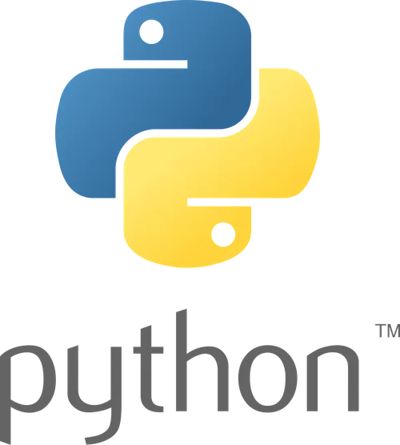
Python

Slide 2
➢Overview of the course
1: Introduction to Python and Setup
2: Data Types And Operators
3: Control Flow
4: Data Structures - Lists and Dictionaries
5: Functions
6: Practical Exercises
7: Modules and Libraries
8: File Handling

Slide 3
What is Python?
Python is a high-level, interpreted programming language known for its simplicity, readability, and versatility.
A programming language is a formal system designed to communicate instructions to a computer. It is a set of rules and symbols that allows humans to write programs, which are sequences of instructions that a computer can execute. These instructions can perform various tasks, such as calculations, data manipulation, and control of hardware devices.

Slide 4
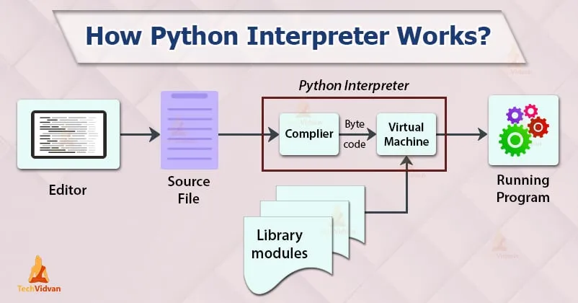

Slide 5
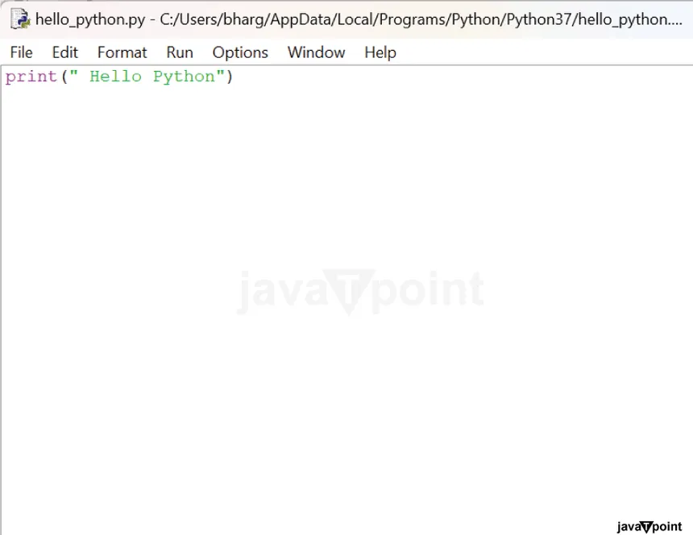
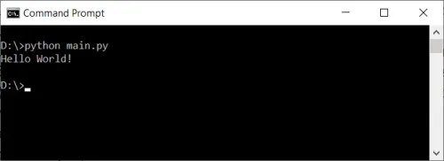
First Python Program

Slide 6
print("Hello, World!")
In Python, print() is a built-in function used to display information on the console or terminal. It allows you to output text, variables, or the results of expressions to the standard output, which is usually the console or terminal where the Python script is run.

Slide 7
Python Variables
Variables are containers for storing data values.
Creating Variables
Python has no command for declaring a variable.
A variable is created the moment you first assign a value to it.
x = 5
y = "John"
print(x)
print(y)

Slide 8
Rules
Valid Characters:
Variable names can contain letters (both uppercase and lowercase), numbers, and underscores.
The first character of a variable name cannot be a number.
Case Sensitivity:
Python is case-sensitive, so myVariable and myvariable would be considered different variables.
Reserved Words:
Avoid using Python keywords and reserved words as variable names. Examples of reserved words include if, else, for, while, class, def, and so on.
Length:
Variable names can be of any length, but it's good practice to keep them meaningful and reasonably short for readability.

Slide 9
Python Data Types
Built-in Data Types
In programming, data type is an important concept.
Variables can store data of different types, and different types can do different things.
Python has the following data types built-in by default, in these categories:

Slide 10
example
Text Type: str
example: "Hello, World!"
Numeric Types: int, float, complex
example: 12, 12.4, 12i
Boolean Type: bool
example: true/false
Sequence Types: list, tuple, range
Mapping Type: dict
Set Types: set, frozenset
Binary Types: bytes, bytearray, memoryview

Slide 11
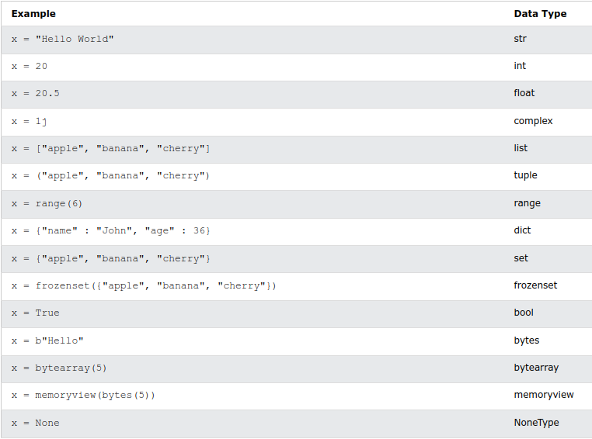

Slide 12
Get the Type
You can get the data type of a variable with the type() function.
Example
x = 5
y = "John"
print(type(x))
print(type(y))

Slide 13
Practical Exercises
write a program that store ur name, age, grade, sex, id and if u are alive or dead, and display it.

Slide 14
Python Numbers
There are three numeric types in Python:
int
float
complex
Variables of numeric types are created when you assign a value to them:
x = 1 # int
y = 2.8 # float
z = 1j # complex

Slide 15
Int
Int, or integer, is a whole number, positive or negative, without decimals, of unlimited length.
Example
Integers:
x = 1 y = 35656222554887711 z = -3255522 | print(type(x)) print(type(y)) print(type(z))

Slide 16
Float
Float, or "floating point number" is a number, positive or negative, containing one or more decimals.Example
Example
Floats:
x = 1.10 y = 1.0 z = -35.59 | print(type(x)) print(type(y)) print(type(z))

Slide 17
Float can also be scientific numbers with an "e" to indicate the power of 10.
Example
Floats:
x = 35e3 y = 12E4 z = -87.7e100 | print(type(x)) print(type(y)) print(type(z))

Slide 18
Complex
Complex numbers are written with a "j" as the imaginary part:
Example
Complex:
x = 3+5j y = 5j z = -5j | print(type(x)) print(type(y)) print(type(z))

Slide 19
Python Casting
Casting refers to the process of explicitly converting a variable or value from one data type to another. This is sometimes necessary when you want to perform operations that involve different data types, or when you need to ensure that a value is of a specific type.
Casting in python is therefore done using constructor functions:

Slide 20
int() - constructs an integer number from an integer literal, a float literal (by removing all decimals), or a string literal (providing the string represents a whole number)
float() - constructs a float number from an integer literal, a float literal or a string literal (providing the string represents a float or an integer)
complex() - constructs a complex number from a numeric literal, a numeric variable, or a string literal (provided the string represents a valid complex number).
str() - constructs a string from a wide variety of data types, including strings, integer literals and float literals

Slide 21
Floats:
x = float(1) # x will be 1.0
y = float(2.8) # y will be 2.8
z = float("3") # z will be 3.0
w = float("4.2") # w will be 4.2
Integers:
x = int(1) # x will be 1
y = int(2.8) # y will be 2
z = int("3") # z will be 3

Slide 22
Complex:
c = complex(1, 2) # Creates a complex number 1 + 2j
Strings:
x = str("s1") # x will be 's1'
y = str(2) # y will be '2'
z = str(3.0) # z will be '3.0'

Slide 23
x = 1 # int y = 2.8 # float z = 1j # complex #convert from int to float: a = float(x) #convert from float to int: b = int(y) #convert from int to complex: c = complex(x) | print(a) print(b) print(c) print(type(a)) print(type(b)) print(type(c))

Slide 24
Python Operators
Operators are used to perform operations on variables and values.
Python divides the operators in the following groups:
Arithmetic operators
Assignment operators
Comparison operators
Logical operators
Identity operators
Membership operators
Bitwise operators
Example: print(10 + 5)

Slide 25
Python Assignment Operators
Operator | Name | Example
+ | Addition | x + y
- | Subtraction | x - y
* | Multiplication | x * y
/ | Division | x / y
% | Modulus | x % y
** | Exponentiation | x ** y
// | Floor division | x // y

Slide 26
Boolean Values
In programming you often need to know if an expression is True or False.
You can evaluate any expression in Python, and get one of two answers, True or False.
When you compare two values, the expression is evaluated and Python returns the Boolean answer:
ExampleGet your own Python Server
print(10 > 9)
print(10 == 9)
x=(10 < 9)
print(x)

Slide 27
Python Comparison Operators
Comparison operators are used to compare two values:
Operator | Name | Example
== | Equal | x == y
!= | Not equal | x != y
> | Greater than | x > y
< | Less than | x < y
>= | Greater than or equal to | x >= y
<= | Less than or equal to | x <= y

Slide 28
input("Enter ur name: ")
The input() function is a built-in function in Python used to interactively collect user input from the console or terminal. It allows a script to pause and wait for the user to enter some data, which is then returned as a string.

Slide 29
name=input("Enter ur name: ")
age=int(input("Enter ur age: "))
print(name, age)
write a program that store ur name, age, grade, sex, id and if u are alive or dead, and display it.
write a program that calculates ur age from ur birthday.

