Slide 1


Slide 2
Presented By :
Mohammed Nafees Imtiaz ( 2212426642 )
Eershan Reza Khan ( 213180464 )
Most Yeanur Akter ( 2121800642 )
Most Aysha Siddika Sumona ( 2212717042 )
Date : 13 – 07 -2025

Slide 3

Introduction & Motivation
Credit card fraud is a serious issue causing billions in financial losses annually.
Traditional rule-based systems struggle to adapt to new fraud patterns.
Machine Learning (ML) offers dynamic and
adaptive fraud detection.
Our motivation: to build a smarter, real-time fraud detection model.
Notes: Highlight the importance of fraud prevention for financial security.

Slide 4
Problem Statement
Fraudulent credit card transactions are difficult to detect due to:
Large volume of data
Imbalanced class distributions (fraud cases are rare)
Constantly evolving fraud strategies
Need for fast, accurate, and automated detection methods.

Slide 5
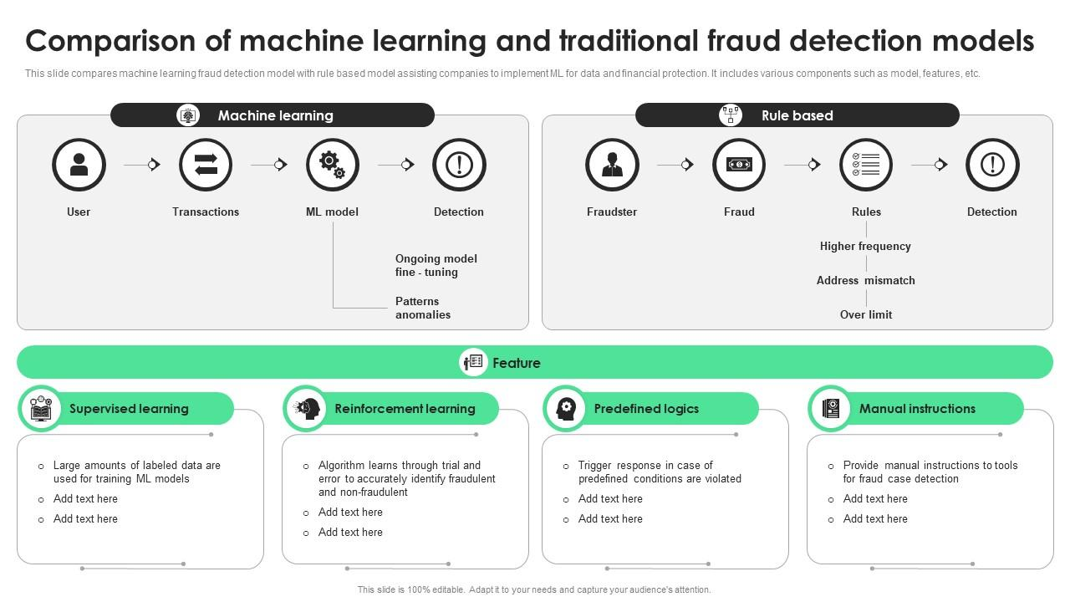
Existing Solutions
Rule-based systems – rigid, high false positives.
Manual review – time-consuming and inefficient.
Basic ML models – often not optimized for imbalance or latency.
Limitations: Lack of adaptability, high cost, and lower precision.

Slide 6
Our Proposed Solution
Build a machine learning pipeline to detect fraud in real-time.
Use supervised learning models trained on historical data.
Incorporate data preprocessing, feature engineering, and model evaluation.
Leverage imbalanced learning techniques to improve accuracy.

Slide 7
Solution Details
Dataset: Kaggle Credit Card Fraud Dataset (European cardholders).
Features: 30 anonymized features, including transaction time and amount.
Target: Binary class — Fraud (1) or Not Fraud (0).
Preprocessing: Scaling, missing value handling, class balancing
(SMOTE/undersampling).

Slide 8
Technologies Used
Python: Programming language
Pandas, NumPy: Data processing
Scikit-learn: Model building (Logistic Regression, SVM, Random Forest)
Matplotlib, Seaborn: Visualization
Jupyter Notebook/Kaggle: Development environment

Slide 9
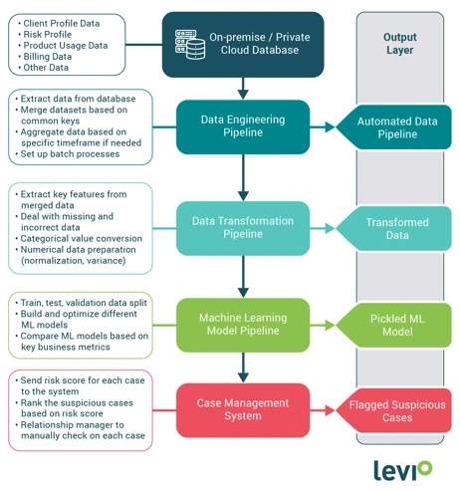
Model Workflow
Data Cleaning & Preprocessing
Exploratory Data Analysis
Feature Selection & Engineering
Model Training (SVM, Random Forest, Logistic Regression)
Evaluation (Precision, Recall, F1-Score, ROC-AUC)

Slide 10
Project Timeline & Roles
Week | Task | Responsible Member
1 | Research & Dataset Collection | Team Member A
2 | Preprocessing & Analysis | Team Member B
3 | Model Development | Team Member C
4 | Testing & Evaluation | Team Member A
5 | Report & Presentation | All Members

Slide 11
Results & Expected Outcomes
Accuracy Achieved: ~99.7% on test set
Recall (Fraud detection): ~89% (High priority metric)
Improved F1-score due to class balancing techniques
Expect real-time prediction capability with further tuning

Slide 12
Conclusion
Machine learning can effectively detect fraudulent transactions.
Our model adapts to new patterns and handles imbalanced data well.
Can reduce financial losses significantly and improve trust.

Slide 13
Future Directions
Deploy model via API for real-time fraud detection.
Improve performance using deep learning (e.g., Autoencoders, LSTM).
Integrate with bank systems and alert mechanisms.
Regular re-training with new data to maintain accuracy.

