Slide 1
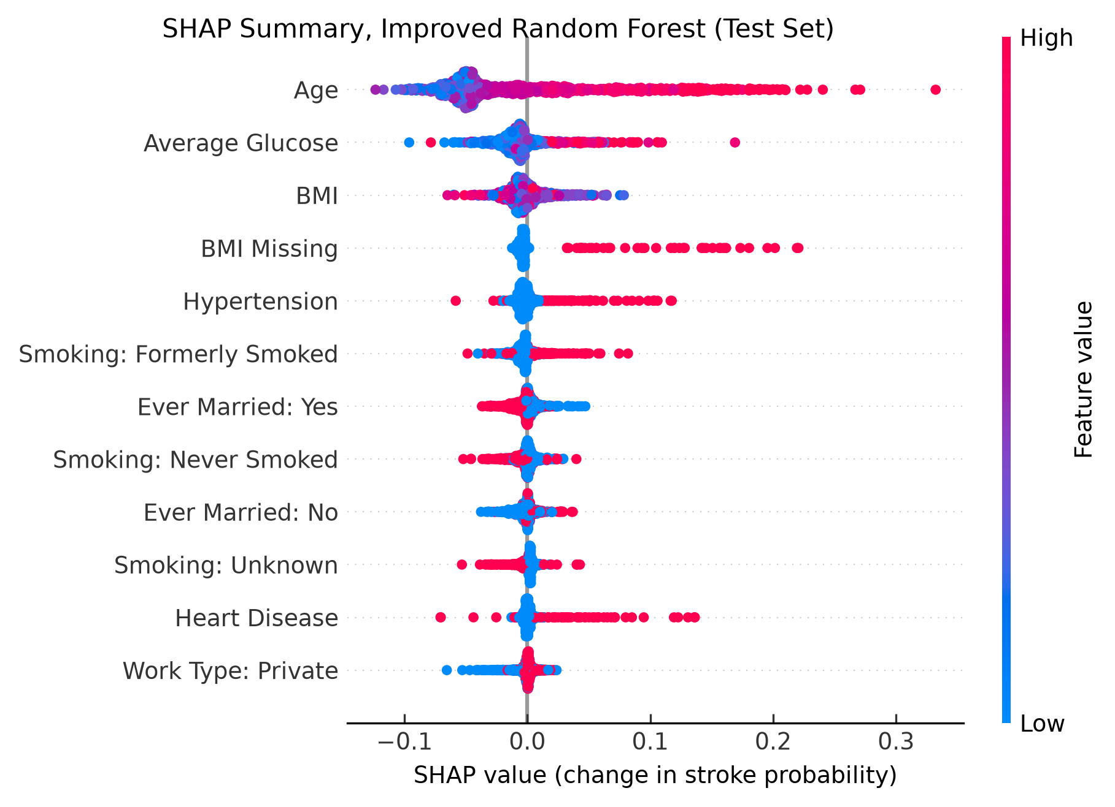
FOR DATA SCIENTISTS
Age drives the improved random forest, which catches 29 of 50 strokes
0.58
0.11
0.75
recall
(baseline 0.08)
precision
(1 in 9 flags)
ROC AUC
(baseline 0.73)
How it was explained
TreeExplainer (interventional), 100 training patients as reference
Output P(stroke); base value 0.08; threshold 0.09 (5-fold CV)
Exactly additive for 1,015 of 1,022 test patients
Limits
Scores are not calibrated: rank only, not risk
Missing BMI is a data-collection signal (4.7× stroke share)
Marriage and work type share the age signal
Recall 0.32 under 60 vs 0.79 at 60+; no external validation
Kaggle Stroke Prediction data (fedesoriano, 2021); test set of 1,022 patients, 50 with a recorded stroke. Cross-check: an MLP with Deep SHAP gives the same top 3 for Patient ID 43717 (AUC 0.79).
Notes:
Improved random forest (median BMI + missing flag, threshold 0.09). Beeswarm: each dot is a test patient; right = pushes towards stroke. Age dominates. Baseline at 0.5 caught 4 of 50 strokes despite 94% accuracy.

