Slide 1
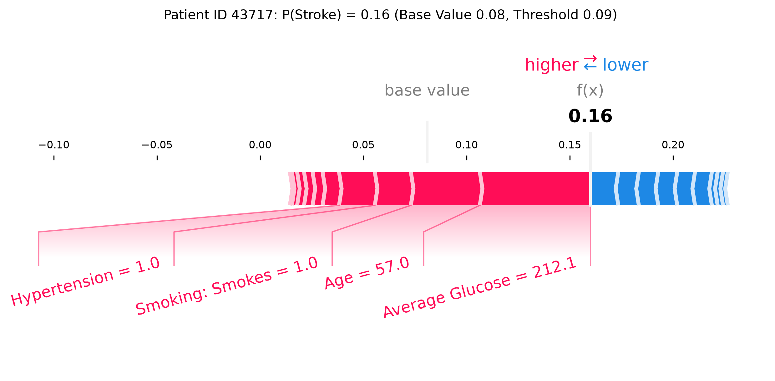
FOR CLINICIANS
Patient ID 43717 was flagged mainly for high glucose, age and smoking
How to read it
Score 0.16 is above the flag threshold of 0.09
It starts from 0.08, the average over reference patients
A ranking score, not a 16% chance of stroke
A neural network flags this patient for the same three reasons
Before acting on it
Misses 21 of 50 strokes (15 under age 60)
Only 1 in 9 flagged patients had a stroke
Shows what the model used, not what caused the stroke
Public retrospective data, not validated: use with history, exam and tests
What raised the score (red in the plot)
+0.054
+0.033
+0.017
+0.017
Glucose 212 mg/dL
Age 57
Current smoker
Hypertension
Kaggle Stroke Prediction data (fedesoriano, 2021); test set of 1,022 patients, 50 with a recorded stroke. Improved random forest, SHAP TreeExplainer. Educational analysis, not for clinical use.
Notes:
Same patient as report Section 4. Red arrows push the score up from the base value 0.08 to 0.16; blue push down. The remaining features together lower it by 0.025.

