Slide 1
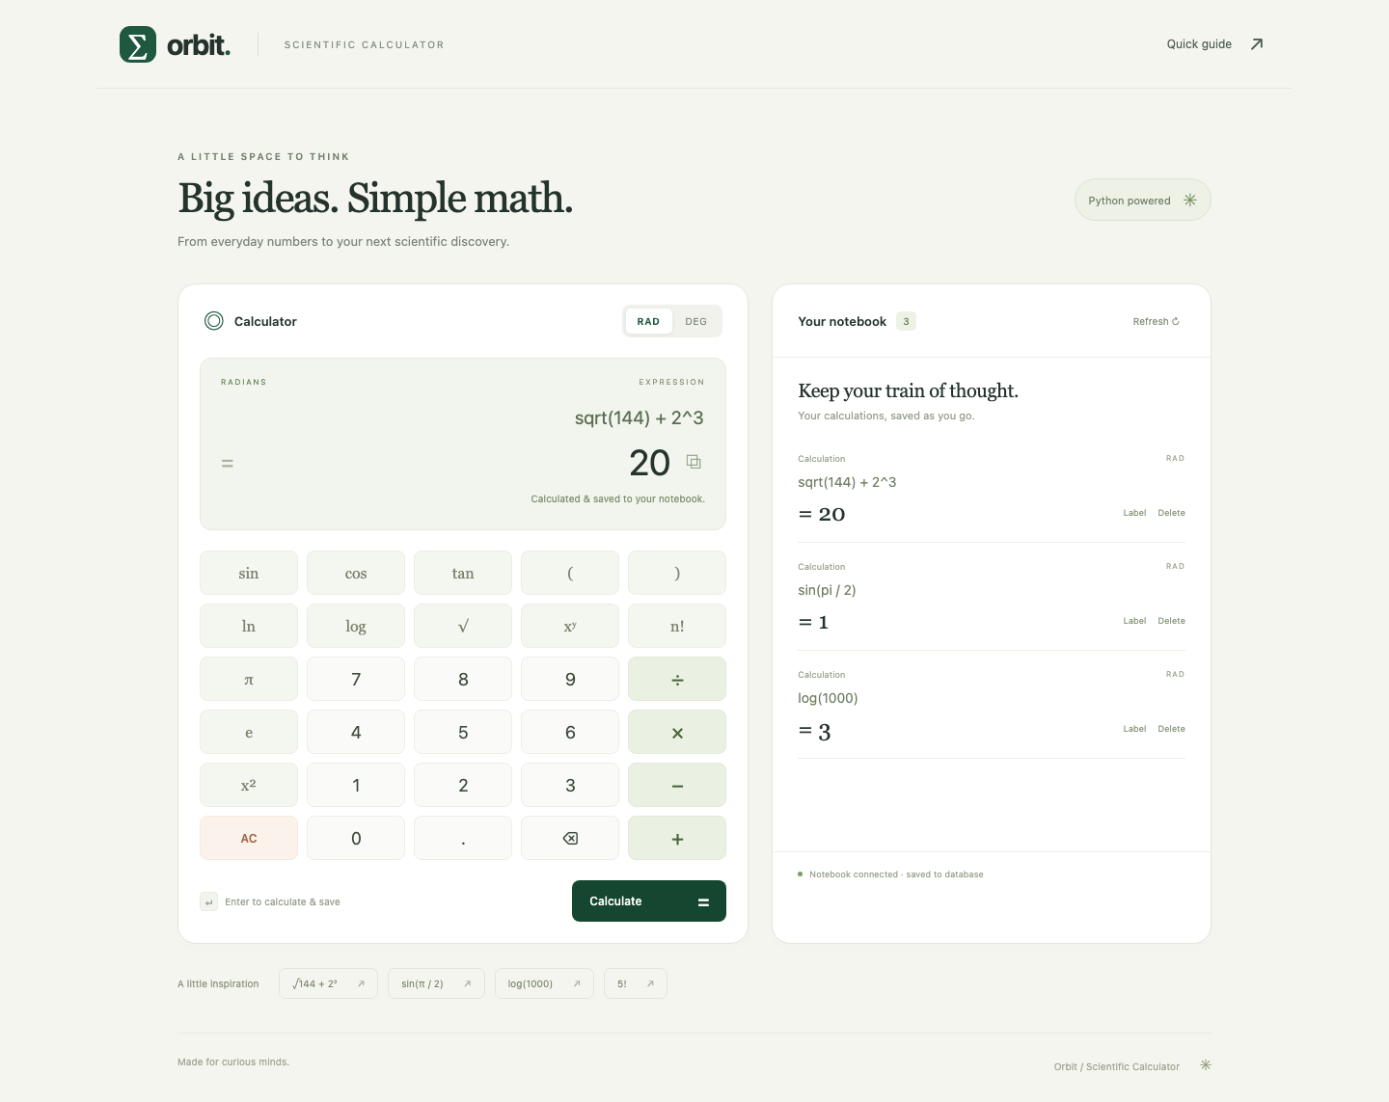
Orbit
Scientific calculator
DevOps final capstone
Python / FastAPI / PostgreSQL
Notes:
Hello, this is Orbit, my scientific calculator capstone. The application evaluates scientific expressions and saves calculations in a PostgreSQL notebook. I will show the application, the quality gates, the AWS deployment, and the evidence collected before cleanup.
Sources
https://github.com/Yeashu/DevOps-Capstone/blob/main/README.md
https://github.com/Yeashu/DevOps-Capstone/blob/main/docs/screenshots/01-application-desktop.png

Slide 2
Application architecture
Layer | Responsibility
HTML, CSS, JavaScript | Responsive calculator and notebook
Python FastAPI | Evaluate expressions and validate API requests
PostgreSQL + Alembic | Persist calculations and manage schema changes
REST API
GET, POST: /api/calculations
PUT, DELETE: /api/calculations/{id}
Health: /health Readiness: /ready Metrics: /metrics
02
Notes:
The frontend calls a FastAPI backend. The calculator uses a bounded expression parser rather than unrestricted Python evaluation. PostgreSQL stores the notebook, and Alembic owns schema changes. The API supports creating, listing, updating and deleting calculations. Health, readiness and Prometheus metrics have separate endpoints.
Sources
https://github.com/Yeashu/DevOps-Capstone/blob/main/backend/app/routes.py
https://github.com/Yeashu/DevOps-Capstone/blob/main/backend/app/calculator.py
https://github.com/Yeashu/DevOps-Capstone/blob/main/backend/app/main.py
https://github.com/Yeashu/DevOps-Capstone/blob/main/README.md#architecture

Slide 3
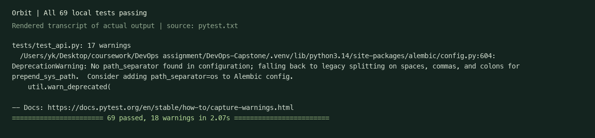
Tests and code quality
69 tests passed
Isolated SQLite locally and disposable PostgreSQL in CI
Four frontend tests, a production build and Ruff checks also pass
03
Notes:
The backend suite has sixty nine passing tests covering calculations and API behavior. Tests use an isolated database, with SQLite locally and disposable PostgreSQL in GitHub Actions. The production notebook is never the test database. Ruff checks Python code, and the frontend has four tests plus a production build.
Sources
https://github.com/Yeashu/DevOps-Capstone/blob/main/docs/evidence/pytest.txt
https://github.com/Yeashu/DevOps-Capstone/blob/main/docs/evidence/hosted-pytest.txt
https://github.com/Yeashu/DevOps-Capstone/blob/main/docs/screenshots/pytest-03.png
https://github.com/Yeashu/DevOps-Capstone/blob/main/frontend/package.json

Slide 4
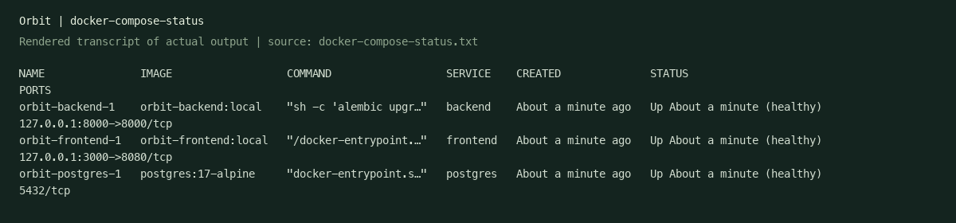
Docker and local development
Three healthy services
Non-root application images
Frontend, backend and PostgreSQL
Backend UID 10001, frontend UID 101
Node build and Nginx runtime stages
04
Notes:
Docker Compose starts the complete stack with one command. Health checks confirm that the frontend, backend and database are ready. The backend and frontend run as non-root users. The frontend Dockerfile uses a Node build stage and an Nginx runtime stage. The local demo is stopped now after evidence collection.
Sources
https://github.com/Yeashu/DevOps-Capstone/blob/main/docker-compose.yml
https://github.com/Yeashu/DevOps-Capstone/blob/main/backend/Dockerfile
https://github.com/Yeashu/DevOps-Capstone/blob/main/frontend/Dockerfile
https://github.com/Yeashu/DevOps-Capstone/blob/main/docs/screenshots/docker-compose-status.png
https://github.com/Yeashu/DevOps-Capstone/blob/main/docs/evidence/non-root-users.txt

Slide 5
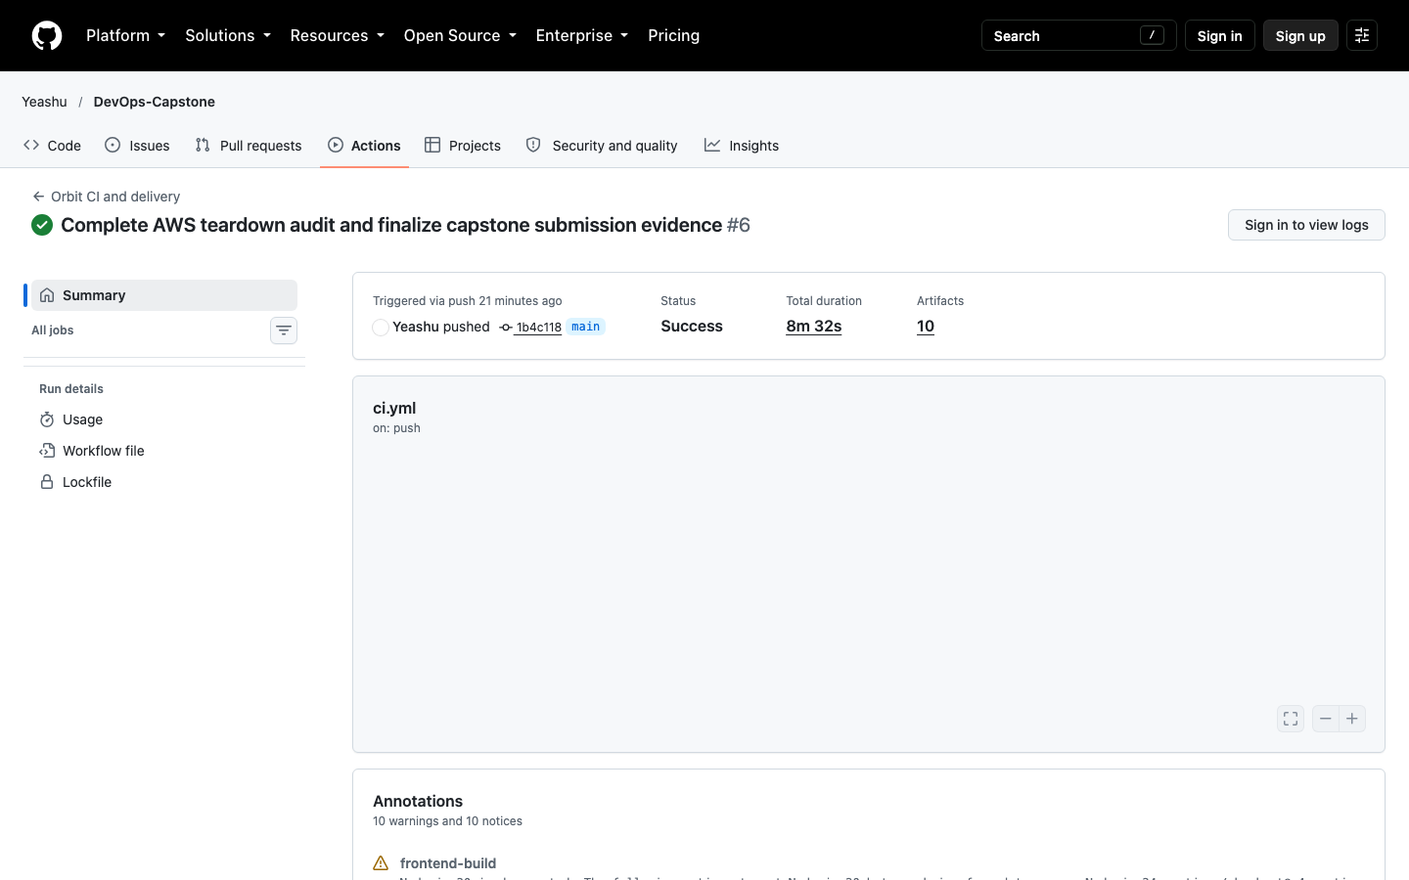
GitHub Actions and GHCR
Version control
Public repository and meaningful commit history
Quality gates
Tests and both Trivy image scans precede publishing
Image publication
Exact scanned images use full commit SHA tags
CI result: green. Automatic EKS job: skipped.
05
Notes:
Every push to main starts the pipeline. Tests and the frontend build must pass before the images reach publication. The pipeline scans both images and publishes those exact images to GitHub Container Registry using full commit SHA tags. It also deploys to a temporary Kind cluster. The overall run is green. The separate automatic EKS job is disabled, so the recorded EKS upgrade uses the local authenticated Helm CLI.
Sources
https://github.com/Yeashu/DevOps-Capstone/blob/main/.github/workflows/ci.yml
https://github.com/Yeashu/DevOps-Capstone/blob/main/docs/screenshots/github-actions-success.png
https://github.com/Yeashu/DevOps-Capstone/actions/runs/38959438459

Slide 6
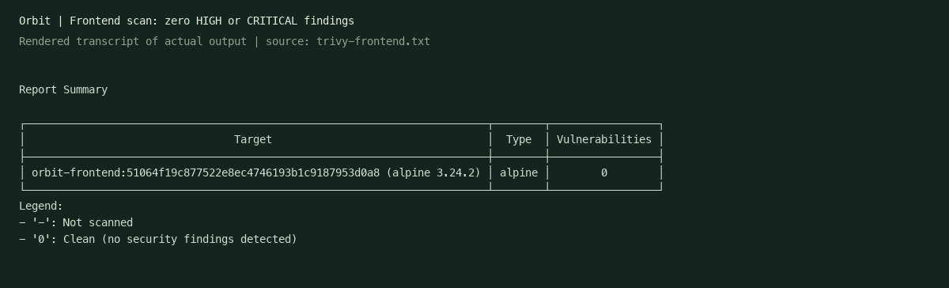
Trivy security gate
0 HIGH or CRITICAL findings
Both remediated images pass the same strict gate
HIGH and CRITICAL findings fail CI, including unfixed vulnerabilities
06
Notes:
Trivy scans the operating system and packaged dependencies inside both container images. The initial backend image triggered the gate. Updating the runtime and removing unused vendored installer libraries resolved the findings. Both final images report zero high or critical findings. The workflow still fails on those severities, including unfixed vulnerabilities.
Sources
https://github.com/Yeashu/DevOps-Capstone/blob/main/security/README.md
https://github.com/Yeashu/DevOps-Capstone/blob/main/docs/evidence/trivy-backend.txt
https://github.com/Yeashu/DevOps-Capstone/blob/main/docs/evidence/trivy-frontend.txt
https://github.com/Yeashu/DevOps-Capstone/blob/main/docs/screenshots/trivy-frontend.png

Slide 7
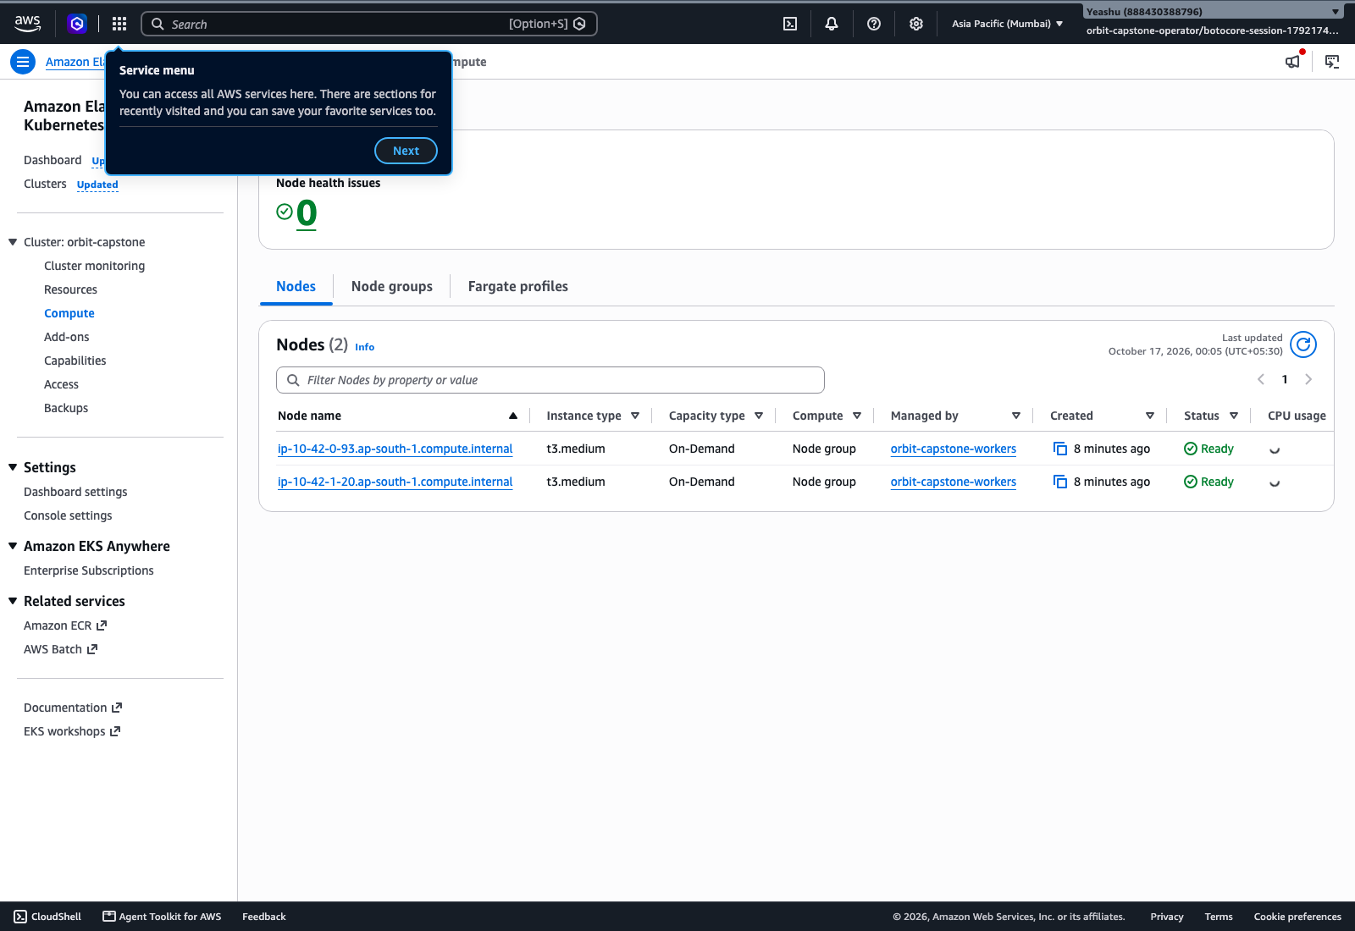
Terraform and AWS EKS
20
resources provisioned
Mumbai: ap-south-1
VPC and two public subnets
EKS with two Ready workers
Actual AWS capture before Terraform destroy
07
Notes:
Terraform planned and provisioned twenty real resources in the Mumbai region. The infrastructure includes a VPC, two public subnets in different availability zones, an EKS control plane and a managed worker group. The actual AWS Console capture shows two Ready workers. These are historical captures because the infrastructure has since been destroyed.
Sources
https://github.com/Yeashu/DevOps-Capstone/blob/main/terraform/vpc.tf
https://github.com/Yeashu/DevOps-Capstone/blob/main/terraform/eks.tf
https://github.com/Yeashu/DevOps-Capstone/blob/main/docs/evidence/terraform-plan.txt
https://github.com/Yeashu/DevOps-Capstone/blob/main/docs/evidence/terraform-apply.txt
https://github.com/Yeashu/DevOps-Capstone/blob/main/docs/screenshots/aws-eks-workers-console.png

Slide 8
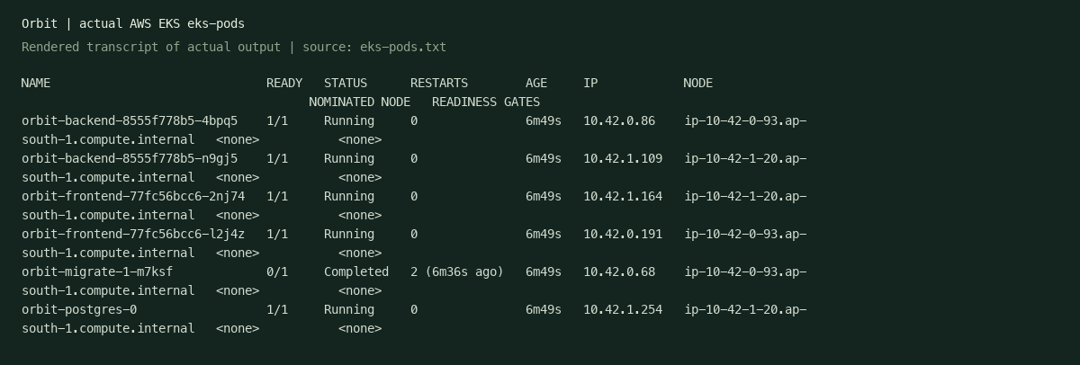
Kubernetes and Helm on EKS
2 backend replicas
2 frontend replicas
PostgreSQL storage
ClusterIP Services and Ingress routes for / and /api
08
Notes:
Helm manages the application on EKS. Both the backend and frontend have two running replicas. PostgreSQL uses persistent storage. ClusterIP Services provide internal access, and Ingress routes the root path to the frontend and API traffic to FastAPI. A migration job completes during release upgrades, while readiness checks keep traffic away from unready application pods.
Sources
https://github.com/Yeashu/DevOps-Capstone/blob/main/helm/orbit/values.yaml
https://github.com/Yeashu/DevOps-Capstone/blob/main/docs/evidence/eks-pods.txt
https://github.com/Yeashu/DevOps-Capstone/blob/main/docs/evidence/eks-services.txt
https://github.com/Yeashu/DevOps-Capstone/blob/main/docs/evidence/eks-ingress.txt
https://github.com/Yeashu/DevOps-Capstone/blob/main/docs/screenshots/eks-pods.png

Slide 9
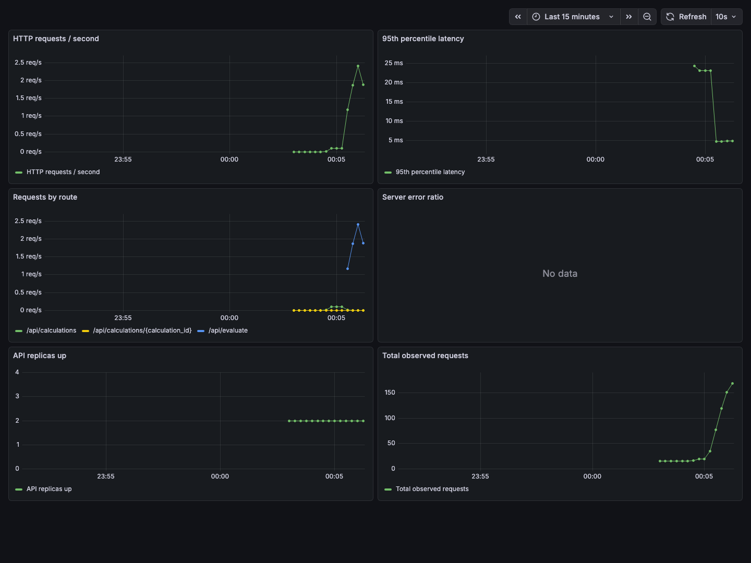
Prometheus and Grafana
Application metrics
FastAPI exposes request and latency measurements
Prometheus
Both backend targets report UP
Grafana
Request and latency panels show data
09
Notes:
The backend exposes Prometheus-formatted metrics. Prometheus scrapes both backend replicas, and both targets report UP. Grafana shows populated request and latency panels. The error panel has no series in this capture. The screenshot shows actual metrics from the EKS deployment. This demonstrates that the monitoring stack observes the application, rather than just running alongside it.
Sources
https://github.com/Yeashu/DevOps-Capstone/blob/main/monitoring/
https://github.com/Yeashu/DevOps-Capstone/blob/main/docs/evidence/eks-prometheus-targets.json
https://github.com/Yeashu/DevOps-Capstone/blob/main/docs/evidence/eks-metrics.txt
https://github.com/Yeashu/DevOps-Capstone/blob/main/docs/screenshots/eks-grafana-dashboard.png

Slide 10
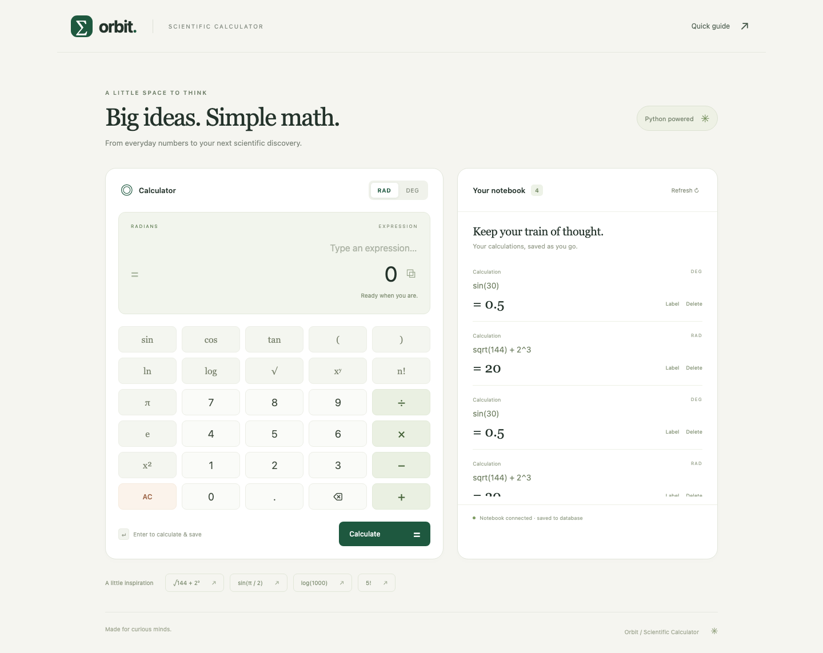
Recorded deployment update
Successful pipeline
Run 38947611595 publishes the scanned SHA
Local Helm upgrade
EKS health reports commit 7f36caf
Persistent notebook
Calculations survive pod replacement
Local Helm delivery after green CI
10
Notes:
The original recording shows the calculator on EKS, a successful pipeline, and an upgrade to that pipeline’s exact published commit. I ran the Helm upgrade through the authenticated local CLI. The backend health endpoint then reported the new SHA, and the notebook still contained the saved calculations after pod replacement. The automatic EKS Actions job remained skipped. This is evidence of a real deployment update, with the delivery mechanism stated clearly.
Sources
https://github.com/Yeashu/DevOps-Capstone/blob/main/docs/evidence/rollout-demo.json
https://github.com/Yeashu/DevOps-Capstone/blob/main/docs/evidence/eks-rollout.txt
https://github.com/Yeashu/DevOps-Capstone/blob/main/docs/screenshots/eks-updated-version.png
https://github.com/Yeashu/DevOps-Capstone/blob/main/docs/screenshots/eks-after-rollout.png
https://github.com/Yeashu/DevOps-Capstone/actions/runs/38947611595

Slide 11
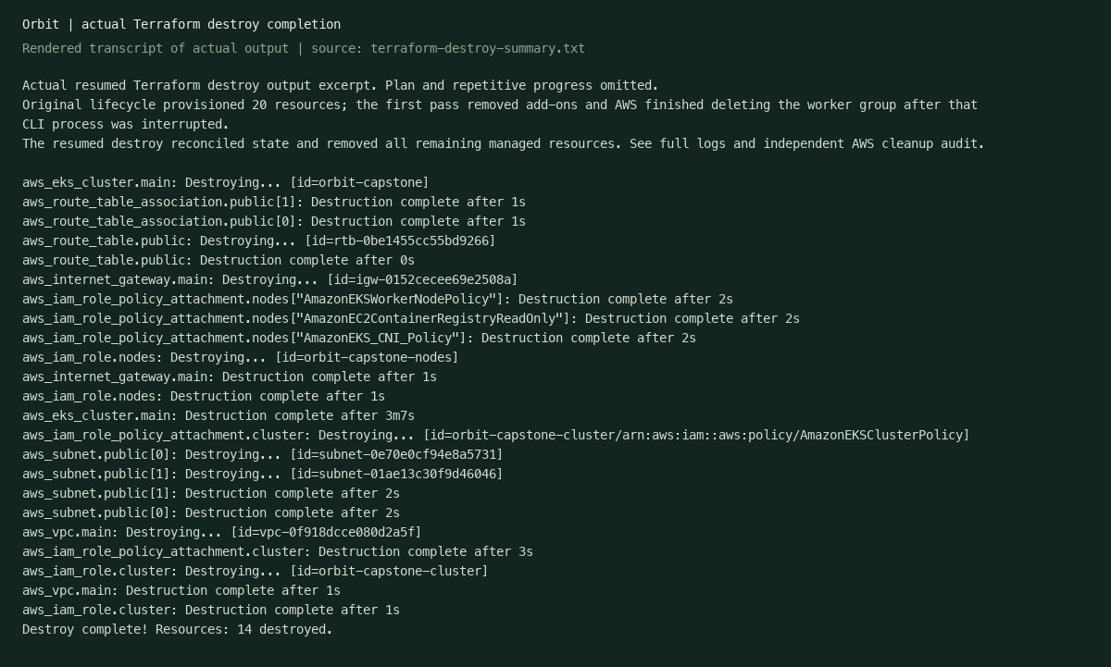
Cleanup and submission
Cloud teardown complete
Independent audit confirms no project EKS, VPC, active workers or volumes remain.
Source, 75 screenshots, the video and this deck remain in the repository.
github.com/Yeashu/DevOps-Capstone
11
Notes:
Terraform destroy completed, and the independent audit confirmed removal of the project cluster, VPC, active workers, recorded volumes and related network resources. Temporary IAM access was also removed. The source, evidence screenshots, silent video and slide deck remain in the public repository. The demo folder contains the mandatory MP4 and the PowerPoint and PDF copies. Thank you.
Sources
https://github.com/Yeashu/DevOps-Capstone/blob/main/docs/screenshots/terraform-destroy.png
https://github.com/Yeashu/DevOps-Capstone/blob/main/docs/evidence/aws-cleanup-audit.json
https://github.com/Yeashu/DevOps-Capstone/blob/main/docs/evidence/aws-bootstrap-cleanup.json
https://github.com/Yeashu/DevOps-Capstone/blob/main/docs/evidence/final-workspace-cleanup.json

