Slide 1
Graphs

Slide 2
Graphs
A graph G = (V ,E) consists of
V , a nonempty set of vertices (or nodes) and E, a set of edges.

Slide 3
Undirected Graph
0
2
No Direction
Representation: 02
20

Slide 4
Undirected Graph
0
Vertices = {0, 1, 2, 3, 4, 5}
2
5
4
3
1

Slide 5
Undirected Graph
0
Edges = {02, 05, 04, 15, 14, 24, 23, 45 }
No convention
Which vertex to write first.
2
5
4
3
1

Slide 6
Directed Graph
0
0
2
2
Direction: From Node 0 - Node 2
Node 0: Initial Vertex
Node 2: Terminal Vertex
Direction: Initial Vertex - Terminal Vertex
Representation: 02
20
5
4
3
1

Slide 7
Directed Graph
0
2
Edges = {05, 04, 02,
24, 45, 15, 14, 23}
5
4
3
1

Slide 8
Loops in Graphs
0
2
5
4
3
1

Slide 9
Multiple edges in Graphs
0
2
5
4
3
1

Slide 10
Undirected Graph: Adjacency Matrix Representation
0
 | 0 | 1 | 2 | 3 | 4 | 5
0
1
2
3
4
5
2
5
4
3
1

Slide 11
Undirected Graph: Adjacency Matrix Representation
0
 | 0 | 1 | 2 | 3 | 4 | 5
0 | 0 | 0 | 1 | 0 | 1 | 1
1
2
3
4
5
2
5
4
3
1

Slide 12
Undirected Graph: Adjacency Matrix Representation
0
 | 0 | 1 | 2 | 3 | 4 | 5
0 | 0 | 0 | 1 | 0 | 1 | 1
1 | 0 | 0 | 0 | 0 | 1 | 1
2
3
4
5
2
5
4
3
1

Slide 13
Undirected Graph: Adjacency Matrix Representation
 | 0 | 1 | 2 | 3 | 4 | 5
0 | 0 | 0 | 1 | 0 | 1 | 1
1 | 0 | 0 | 0 | 0 | 1 | 1
2 | 1 | 0 | 0 | 1 | 1 | 0
3 | 0 | 0 | 1 | 0 | 0 | 0
4 | 1 | 1 | 1 | 0 | 0 | 1
5 | 1 | 1 | 0 | 0 | 1 | 0
A 2D array:
a[Number of vertices]
[Number of vertices]
a[i][j] = a[j][i]

Slide 14
Undirected Graph: Adjacency List Representation
0
2
vertices | Adjacent vertices
0 | 2, 4, 5
1 | 4, 5
2 | 0, 3, 4
3
4
5
5
4
3
1

Slide 15
Directed Graph: Adjacency Matrix Representation
Terminal Vertex
0
 | 0 | 1 | 2 | 3 | 4 | 5
0
1
2
3
4
5
2
5
4
Initial Vertex
3
1

Slide 16
Directed Graph: Adjacency Matrix Representation
Terminal Vertex
0
2
 | 0 | 1 | 2 | 3 | 4 | 5
0 | 0 | 0 | 1 | 0 | 1 | 1
1
2
3
4
5
5
4
Initial Vertex
3
1

Slide 17
Directed Graph: Adjacency Matrix Representation
Terminal Vertex
0
 | 0 | 1 | 2 | 3 | 4 | 5
0 | 0 | 0 | 1 | 0 | 1 | 1
1 | 0 | 0 | 0 | 0 | 1 | 1
2
3
4
5
2
5
4
Initial Vertex
3
1

Slide 18
Directed Graph: Adjacency Matrix Representation
Terminal Vertex
0
 | 0 | 1 | 2 | 3 | 4 | 5
0 | 0 | 0 | 1 | 0 | 1 | 1
1 | 0 | 0 | 0 | 0 | 1 | 1
2 | 0 | 0 | 0 | 1 | 1 | 0
3
4
5
2
5
Initial Vertex
4
3
1

Slide 19
Directed Graph: Adjacency Matrix Representation
Terminal Vertex
A 2D array:
a[Number of vertices]
[Number of vertices]
a[i][j] = a[j][i]/
a[i][j] = a[j][i]
No Restriction
 | 0 | 1 | 2 | 3 | 4 | 5
0 | 0 | 0 | 1 | 0 | 1 | 1
1 | 0 | 0 | 0 | 0 | 1 | 1
2 | 0 | 0 | 0 | 1 | 1 | 0
3 | 0 | 0 | 0 | 0 | 0 | 0
4 | 0 | 0 | 0 | 0 | 0 | 1
5 | 0 | 0 | 0 | 0 | 0 | 0
Initial Vertex

Slide 20
Directed Graph: Adjacency List Representation
0
Initial vertex | Terminal vertex
0 | 2, 4, 5
1 | 4, 5
2 | 3, 4
3
4
5
2
5
4
3
1

Slide 21
Undirected Graph: Degree of a vertex
Number of edges incident with it
In case of Loop add +2
0
2
5
4
3
1

Slide 22
Undirected Graph: Degree of a vertex
Number of edges incident with it
In case of Loop add +2
0
2
Vertex | Degree
0 | 3
1
2
3
4
5
5
4
3
1

Slide 23
Undirected Graph: Degree of a vertex
Number of edges incident with it
In case of Loop add +2
0
2
Vertex | Degree
0 | 3
1 | 2
2
3
4
5
5
4
3
1

Slide 24
Undirected Graph: Degree of a vertex
Number of edges incident with it
In case of Loop add +2
0
2
Vertex | Degree
0 | 3
1 | 2
2 | 3
3 | 1
4 | 4
5 | 3
5
4
3
1

Slide 25
Undirected Graph: Degree of a vertex
Number of edges incident with it
In case of Loop add +2
0
Vertex | Degree
0 | 5 (3 + 2)
1 | 2
2 | 3
3 | 1
4 | 4
5 | 3
2
5
4
3
1

Slide 26
Undirected Graph: Degree of a vertex
Vertex | Degree
0 | 3
1 | 2
2 | 3
3 | 1
4 | 4
5 | 3
 | 0 | 1 | 2 | 3 | 4 | 5
0 | 0 | 0 | 1 | 0 | 1 | 1
1 | 0 | 0 | 0 | 0 | 1 | 1
2 | 1 | 0 | 0 | 1 | 1 | 0
3 | 0 | 0 | 1 | 0 | 0 | 0
4 | 1 | 1 | 1 | 0 | 0 | 1
5 | 1 | 1 | 0 | 0 | 1 | 0
⅀ (1’s)
⅀ (1’s)

Slide 27
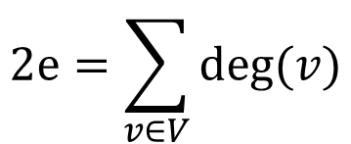
Handshaking theorem
Let G= (V, E) be an undirected graph with e edges. Then
$$2e=\sum_{v∈V}{deg⁡(v)}$$

Slide 28
Directed Graph: Degree of a vertex
In Degree : No of INCOMING edges
Out Degree : No of OUTGOING edges

Slide 29
Directed Graph: Degree of a vertex
Vertex | In Degree | Out Degree
0 | 0
1
2
3
4
5
0
2
5
4
3
1

Slide 30
Directed Graph: Degree of a vertex
Vertex | In Degree | Out Degree
0 | 0 | 3
1
2
3
4
5
0
2
5
4
3
1

Slide 31
Directed Graph: Degree of a vertex
Vertex | In Degree | Out Degree
0 | 0 | 3
1
2
3
4 | 3
5
0
2
5
4
3
1

Slide 32
Directed Graph: Degree of a vertex
Vertex | In Degree | Out Degree
0 | 0 | 3
1
2
3
4 | 3 | 1
5
0
2
5
4
3
1

Slide 33
Directed Graph: Degree of a vertex
Vertex | In Degree | Out Degree
0 | 0 | 3
In degree = number of incoming edges
In degree of vertex 0 = number of incoming edges to 0
So, for counting in degrees of vertex 0
0 must be a TERMINAL VERTEX
0

Slide 34
Directed Graph: Degree of a vertex
Vertex | In Degree | Out Degree
0 | 0 | 3
 | 0 | 1 | 2 | 3 | 4 | 5
0 | 0 | 0 | 1 | 0 | 1 | 1
1 | 0 | 0 | 0 | 0 | 1 | 1
2 | 0 | 0 | 0 | 1 | 1 | 0
3 | 0 | 0 | 0 | 0 | 0 | 0
4 | 0 | 0 | 0 | 0 | 0 | 1
5 | 0 | 0 | 0 | 0 | 0 | 0
⅀ (1’s)

Slide 35
Directed Graph: Degree of a vertex
Vertex | In Degree | Out Degree
0 | 0 | 3
 | 0 | 1 | 2 | 3 | 4 | 5
0 | 0 | 0 | 1 | 0 | 1 | 1
1 | 0 | 0 | 0 | 0 | 1 | 1
2 | 0 | 0 | 0 | 1 | 1 | 0
3 | 0 | 0 | 0 | 0 | 0 | 0
4 | 0 | 0 | 0 | 0 | 0 | 1
5 | 0 | 0 | 0 | 0 | 0 | 0
⅀ (1’s)

Slide 36
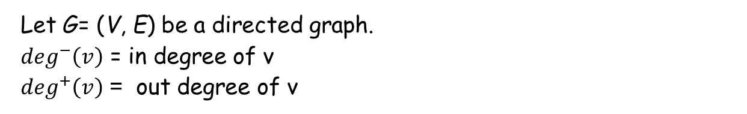
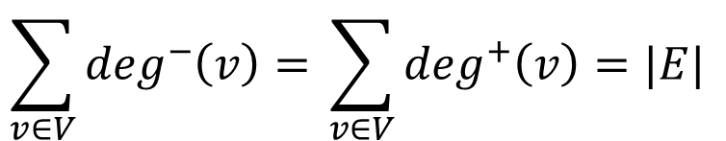
Let G= (V, E) be a directed graph.
$\deg^{−}\left(v\right)$ = in degree of v
$\deg^{+}\left(v\right)$ = out degree of v
$$\sum_{v∈V}{\deg^{−}\left(v\right)= }\sum_{v∈V}{\deg^{+}\left(v\right)=|E| }$$

Slide 37
Bipartite Graph
if its vertex set V can be partitioned into two disjoint sets V1 and V2 such that no edge in G connects either two vertices in V1 or two vertices in V2

Slide 38
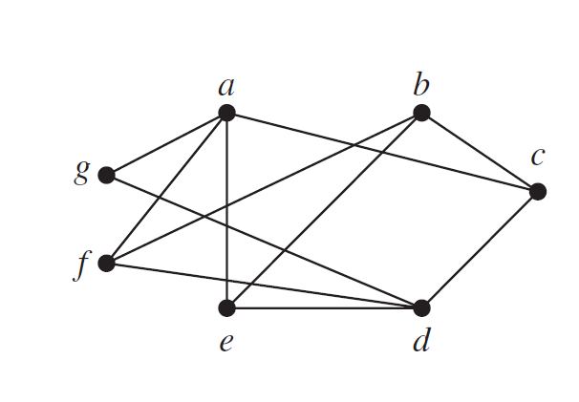
Bipartite Graph
c
a
e
b
f
d
g
V1 = {a, b, d} V2 = {c, e, f, g}
V = {a, b, c, d, e, f, g}

Slide 39
How to decide if a graph is bipartite or not
a
b
g
c
f
e
d

Slide 40
How to decide if a graph is bipartite or not
1. Color any of the vertices blue
a
b
g
c
f
e
d

Slide 41
How to decide if a graph is bipartite or not
2. Identify all uncolored vertices that are adjacent to the blue vertex.
a
b
g
c
f
e
d

Slide 42
How to decide if a graph is bipartite or not
2. Identify all uncolored vertices that are adjacent to the blue vertex.
Color them red
a
b
g
c
f
e
d

Slide 43
How to decide if a graph is bipartite or not
3. Identify all uncolored vertices that are adjacent to a red vertex.
a
b
g
c
f
e
d

Slide 44
How to decide if a graph is bipartite or not
3. Identify all uncolored vertices that are adjacent to a red vertex.
Color them blue.
a
b
g
c
f
e
d

Slide 45
How to decide if a graph is bipartite or not
Repeat steps 2 and 3 until all the vertices are colored red or blue.
a
b
g
c
f
e
d

Slide 46
How to decide if a graph is bipartite or not
Repeat steps 2 and 3 until all the vertices are colored red or blue.
a
b
g
c
f
e
d

Slide 47
How to decide if a graph is bipartite or not
Repeat steps 2 and 3 until all the vertices are colored red or blue.
a
b
g
c
f
e
d

Slide 48

How to decide if a graph is bipartite or not
If there are any two vertices adjacent of the same color, then your graph is not bipartite, otherwise it is bipartite
a
b
g
c
f
e
d
$∴$Bipartite graph

Slide 49
How to decide if a graph is bipartite or not
Disjoint sets
V1 = {a, b, d}
V2 = {c, e, f, g}
a
b
g
c
f
e
d

