Slide 1
Graphs

Slide 2
Undirected Graph: Vertices and edges
0
2
No Direction
Representation: 02
20

Slide 3
Undirected Graph: Vertices and edges
0
Vertices = {0, 1, 2, 3, 4, 5}
2
5
4
3
1

Slide 4
Undirected Graph: Vertices and edges
0
Edges = {02, 05, 04, 15, 14, 24, 23, 45 }
No convention
Which vertex to write first.
2
5
4
3
1

Slide 5
Directed Graph: Vertices and edges
0
0
2
2
Direction: From Node 0 - Node 2
Node 0: Initial Vertex
Node 2: Terminal Vertex
Direction: Initial Vertex - Terminal Vertex
Representation: 02
20
5
4
3
1

Slide 6
Directed Graph: Vertices and edges
0
2
Edges = {05, 04, 02,
24, 45, 15, 14, 23}
5
4
3
1

Slide 7
Loops in Graphs
0
2
5
4
3
1

Slide 8
Multiple edges in Graphs
0
2
5
4
3
1

Slide 9
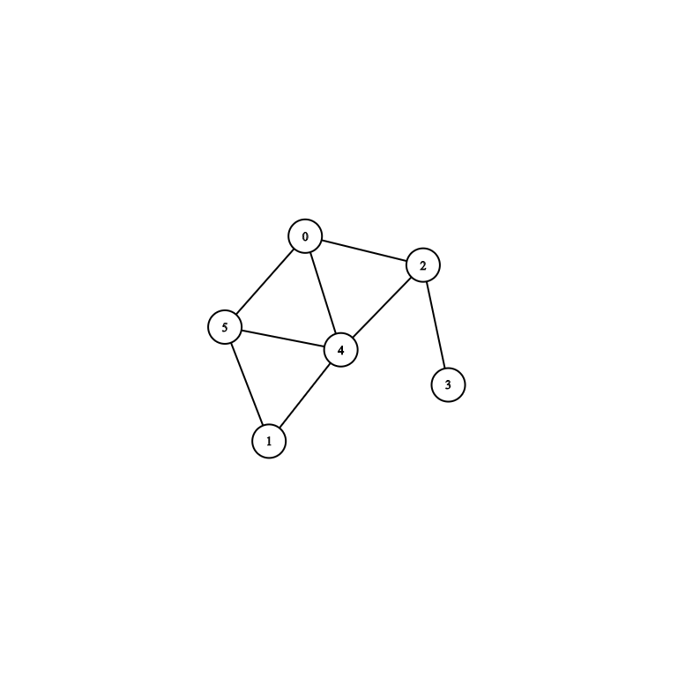
Adjacency Matrix Representation: Undirected Graph
 | 0 | 1 | 2 | 3 | 4 | 5 | 6
0
1
2
3
4
5
6

Slide 10
Adjacency Matrix Representation: Undirected Graph
 | 0 | 1 | 2 | 3 | 4 | 5
0 | 0 | 0 | 1 | 0 | 1 | 1
1
2
3
4
5

Slide 11
Adjacency Matrix Representation: Undirected Graph
 | 0 | 1 | 2 | 3 | 4 | 5
0 | 0 | 0 | 1 | 0 | 1 | 1
1 | 0 | 0 | 0 | 0 | 1 | 1
2
3
4
5

Slide 12
Adjacency Matrix Representation: Undirected Graph
 | 0 | 1 | 2 | 3 | 4 | 5
0 | 0 | 0 | 1 | 0 | 1 | 1
1 | 0 | 0 | 0 | 0 | 1 | 1
2 | 1 | 0 | 0 | 1 | 1 | 0
3 | 0 | 0 | 1 | 0 | 0 | 0
4 | 1 | 1 | 1 | 0 | 0 | 1
5 | 1 | 1 | 0 | 0 | 1 | 0
A 2D array:
a[Number of vertices]
[Number of vertices]
a[i][j] = a[j][i]

Slide 13

Adjacency Matrix Representation: Directed Graph
Terminal Vertex
 | 0 | 1 | 2 | 3 | 4 | 5
0
1
2
3
4
5
Initial Vertex

Slide 14
Adjacency Matrix Representation: Directed Graph
Terminal Vertex
 | 0 | 1 | 2 | 3 | 4 | 5
0 | 0 | 0 | 1 | 0 | 1 | 1
1
2
3
4
5
Initial Vertex

Slide 15
Adjacency Matrix Representation: Directed Graph
Terminal Vertex
 | 0 | 1 | 2 | 3 | 4 | 5
0 | 0 | 0 | 1 | 0 | 1 | 1
1 | 0 | 0 | 0 | 0 | 1 | 1
2
3
4
5
Initial Vertex

Slide 16
Adjacency Matrix Representation: Directed Graph
Terminal Vertex
 | 0 | 1 | 2 | 3 | 4 | 5
0 | 0 | 0 | 1 | 0 | 1 | 1
1 | 0 | 0 | 0 | 0 | 1 | 1
2 | 0 | 0 | 0 | 1 | 1 | 0
3
4
5
Initial Vertex

Slide 17
Adjacency Matrix Representation: Directed Graph
Terminal Vertex
A 2D array:
a[Number of vertices]
[Number of vertices]
a[i][j] = a[j][i]/
a[i][j] ≠ a[j][i]
No Restriction
 | 0 | 1 | 2 | 3 | 4 | 5
0 | 0 | 0 | 1 | 0 | 1 | 1
1 | 0 | 0 | 0 | 0 | 1 | 1
2 | 0 | 0 | 0 | 1 | 1 | 0
3 | 0 | 0 | 0 | 0 | 0 | 0
4 | 0 | 0 | 0 | 0 | 0 | 1
5 | 0 | 0 | 0 | 0 | 0 | 0
Initial Vertex

Slide 18
Degree of a vertex: Undirected Graph
Number of edges incident with it
In case of Loop add +2
0
2
Vertex | Degree
0 | 3
1
2
3
4
5
5
4
3
1

Slide 19
Degree of a vertex: Undirected Graph
Number of edges incident with it
In case of Loop add +2
0
2
Vertex | Degree
0 | 3
1 | 2
2
3
4
5
5
4
3
1

Slide 20
Degree of a vertex: Undirected Graph
Number of edges incident with it
In case of Loop add +2
0
2
Vertex | Degree
0 | 3
1 | 2
2 | 3
3 | 1
4 | 4
5 | 3
5
4
3
1

Slide 21
Degree of a vertex: Undirected Graph
Number of edges incident with it
In case of Loop add +2
Vertex | Degree
0 | 5 (3 + 2)
1 | 2
2 | 3
3 | 1
4 | 4
5 | 3

Slide 22
Degree of a vertex: Undirected Graph
Vertex | Degree
0 | 3
1 | 2
2 | 3
3 | 1
4 | 4
5 | 3
 | 0 | 1 | 2 | 3 | 4 | 5
0 | 0 | 0 | 1 | 0 | 1 | 1
1 | 0 | 0 | 0 | 0 | 1 | 1
2 | 1 | 0 | 0 | 1 | 1 | 0
3 | 0 | 0 | 1 | 0 | 0 | 0
4 | 1 | 1 | 1 | 0 | 0 | 1
5 | 1 | 1 | 0 | 0 | 1 | 0
⅀ (1’s)
⅀ (1’s)

Slide 23
Degree of a vertex: Directed Graph
In Degree : No of INCOMING edges
Out Degree : No of OUTGOING edges

Slide 24
Degree of a vertex: Directed Graph
Vertex | In Degree | Out Degree
0 | 0
1
2
3
4
5
0
2
5
4
3
1

Slide 25
Degree of a vertex: Directed Graph
Vertex | In Degree | Out Degree
0 | 0 | 3
1
2
3
4
5
0
2
5
4
3
1

Slide 26
Degree of a vertex: Directed Graph
Vertex | In Degree | Out Degree
0 | 0 | 3
1
2
3
4 | 3
5
0
2
5
4
3
1

Slide 27
Degree of a vertex: Directed Graph
Vertex | In Degree | Out Degree
0 | 0 | 3
1
2
3
4 | 3 | 1
5
0
2
5
4
3
1

Slide 28
Degree of a vertex: Directed Graph
Vertex | In Degree | Out Degree
0 | 0 | 3
 | 0 | 1 | 2 | 3 | 4 | 5
0 | 0 | 0 | 1 | 0 | 1 | 1
1 | 0 | 0 | 0 | 0 | 1 | 1
2 | 0 | 0 | 0 | 1 | 1 | 0
3 | 0 | 0 | 0 | 0 | 0 | 0
4 | 0 | 0 | 0 | 0 | 0 | 1
5 | 0 | 0 | 0 | 0 | 0 | 0
In degree = number of incoming edges
In degree of vertex 0 = number of incoming edges to 0
So, for counting in degrees of vertex 0
0 must be a
TERMINAL VERTEX
0

Slide 29
Degree of a vertex: Directed Graph
Vertex | In Degree | Out Degree
0 | 0 | 3
 | 0 | 1 | 2 | 3 | 4 | 5
0 | 0 | 0 | 1 | 0 | 1 | 1
1 | 0 | 0 | 0 | 0 | 1 | 1
2 | 0 | 0 | 0 | 1 | 1 | 0
3 | 0 | 0 | 0 | 0 | 0 | 0
4 | 0 | 0 | 0 | 0 | 0 | 1
5 | 0 | 0 | 0 | 0 | 0 | 0
⅀ (1’s)

Slide 30
Degree of a vertex: Directed Graph
Vertex | In Degree | Out Degree
0 | 0 | 3
 | 0 | 1 | 2 | 3 | 4 | 5
0 | 0 | 0 | 1 | 0 | 1 | 1
1 | 0 | 0 | 0 | 0 | 1 | 1
2 | 0 | 0 | 0 | 1 | 1 | 0
3 | 0 | 0 | 0 | 0 | 0 | 0
4 | 0 | 0 | 0 | 0 | 0 | 1
5 | 0 | 0 | 0 | 0 | 0 | 0
⅀ (1’s)

Slide 31
Bipartite Graph
if its vertex set V can be partitioned into two disjoint sets V1 and V2 such that
no edge in G connects either two vertices in V1 or two vertices in V2

Slide 32
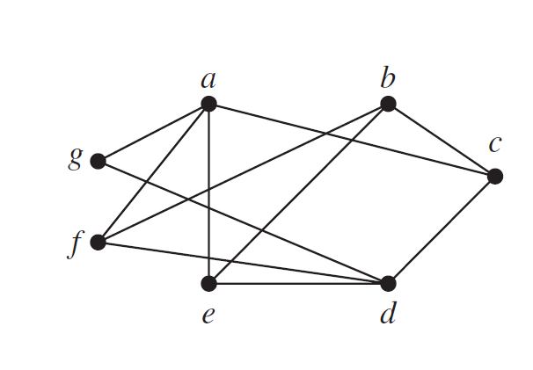
Bipartite Graph
V1 = {a, b, d}
V2 = {c, e, f, g}

Slide 33
How to decide if a graph is bipartite or not
a
b
g
c
f
e
d

Slide 34
How to decide if a graph is bipartite or not
a
b
g
c
f
e
d

Slide 35
How to decide if a graph is bipartite or not
a
b
g
c
f
e
d

Slide 36
How to decide if a graph is bipartite or not
a
b
g
c
f
e
d

Slide 37
How to decide if a graph is bipartite or not
a
b
g
c
f
e
d

Slide 38
How to decide if a graph is bipartite or not
Check if two adjacent vertices are assigned same color?
a
b
g
Answer: NO
Bipartite graph
c
f
e
d

