Slide 1
Sets: Sets Definition

Slide 2
What is a Set?
Informally: A set is a collection of mathematical objects, with the collection treated as a single mathematical object.
(This is circular of course: what’s a collection?)

Slide 3
A set of 4 things
{7, “Albert R.”, π/2, T}
A set with 4 elements: two numbers, a string, and a Boolean.
Same as {T, “Albert R.”, π/2, 7}
-- order doesn’t matter

Slide 4
In or not in
An element is either in a set or not in a set
{7, 2} is same as {7, 2, 7}
--No notion of being in the set more than once

Slide 5
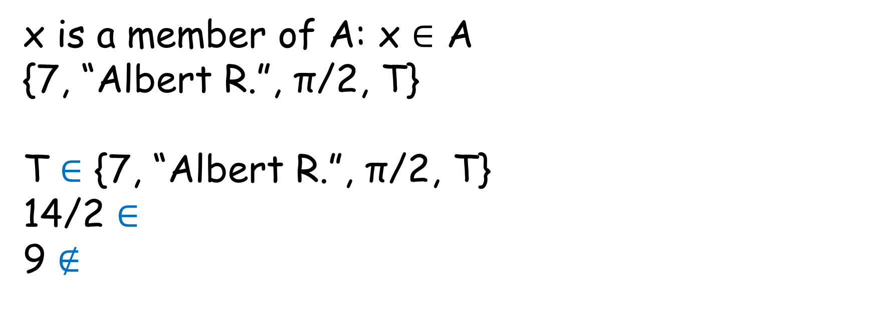
Membership
x is a member of A: x $∈$ A
{7, “Albert R.”, π/2, T}
T $∈$ {7, “Albert R.”, π/2, T}
14/2 $∈$
9 $∉$

Slide 6
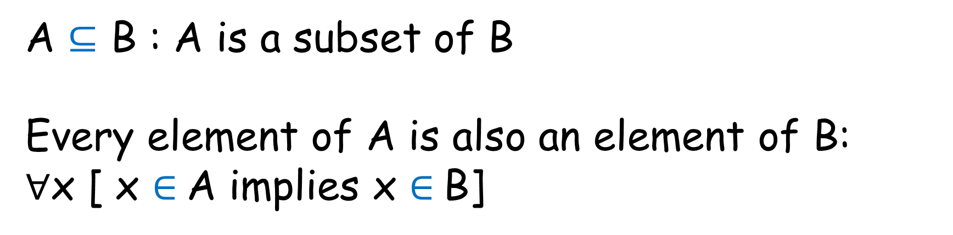

Subset($⊆$)
A $⊆$ B : A is a subset of B
Every element of A is also an element of B:
∀x [ x $∈$A implies x $∈$B]
$ℤ$ ⊆ $ℝ$, {3} ⊆ {5,7,3} A ⊆ A, ∅ ⊆ every set

Slide 7
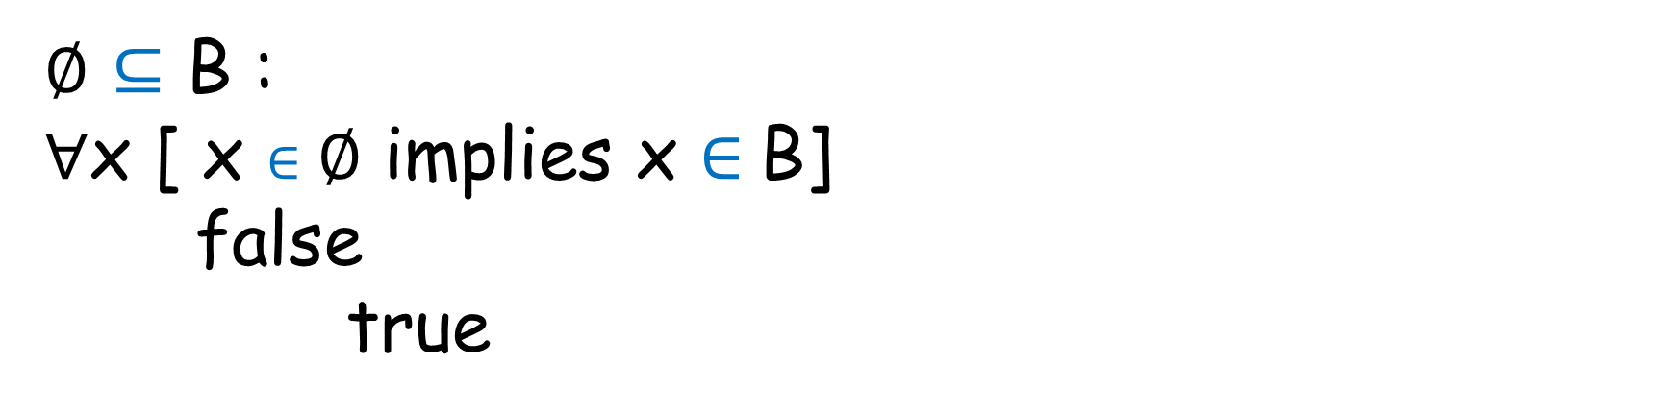
Why ∅ ⊆ every set?
∅ $⊆$ B :
∀x [ x $∈\text{∅}$ implies x $∈$B]
false
true

Slide 8
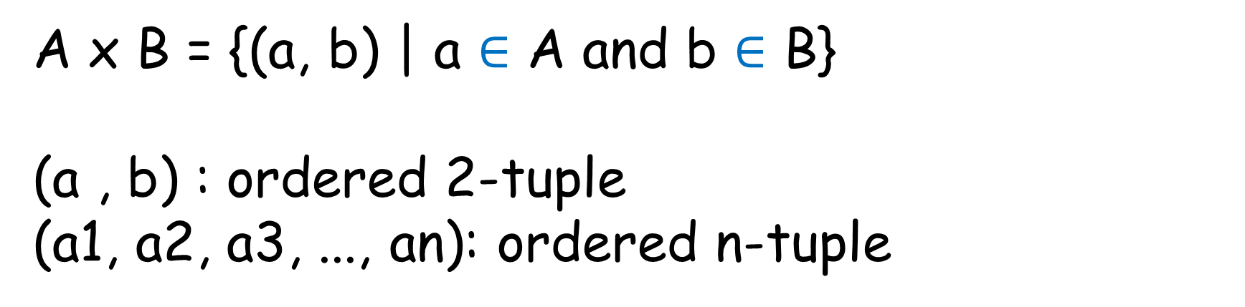
Cartesian Product
A x B = {(a, b) | a $∈$ A and b $∈$ B}
(a , b) : ordered 2-tuple
(a1, a2, a3, ..., an): ordered n-tuple

Slide 9
Cartesian Product
A = {1, 2, 3}
B = {a, b}
A x B = {1, 2, 3} x {a, b} = { (1, a), (1, b), (2, a), (2, b), (3, a), (3, b)}

Slide 10
Cartesian Product
A = {1, 2, 3}
B = {a, b}
C = {p, q}
A x B x C= {1, 2, 3} x {a, b} x {p, q}

Slide 11
Cartesian Product
A = {1, 2, 3}
B = {a, b}
C = {p, q}
A x (B x C) = {1, 2, 3} x ({a, b} x {p, q})

Slide 12
Sets: Set Operations

Slide 13
New sets from old
A
B
Venn diagram for 2 sets

Slide 14
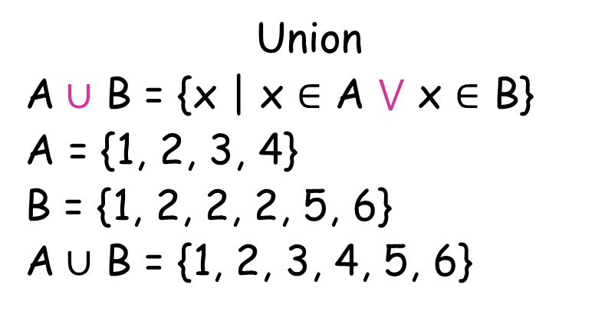
Set Operations: union
Union
A $∪$ B = {x | x $∈$ A $⋁$ x $∈$ B}
A = {1, 2, 3, 4}
B = {1, 2, 2, 2, 5, 6}
A $∪$ B = {1, 2, 3, 4, 5, 6}
A
B

Slide 15
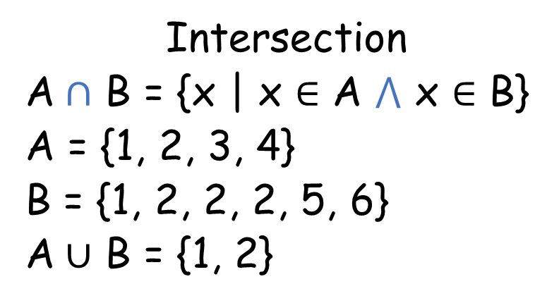
Set Operations: intersection
Intersection
A $∩$ B = {x | x $∈$ A $⋀$ x $∈$ B}
A = {1, 2, 3, 4}
B = {1, 2, 2, 2, 5, 6}
A $∪$ B = {1, 2}
A
B

Slide 16
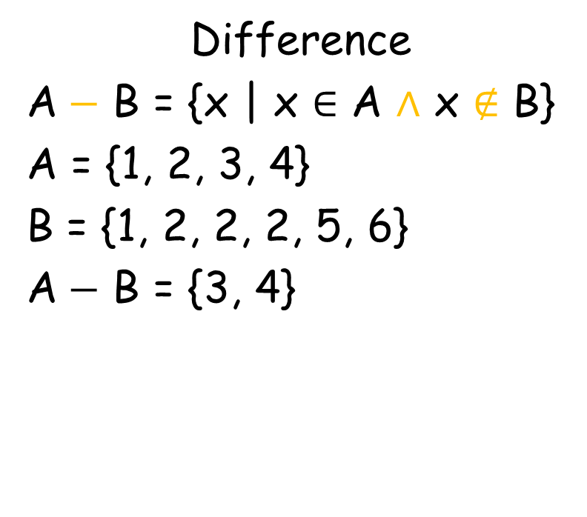
Set Operations: difference
Difference
A $−$ B = {x | x $∈$ A $∧$ x $∉$ B}
A = {1, 2, 3, 4}
B = {1, 2, 2, 2, 5, 6}
A $−$ B = {3, 4}
A
B

Slide 17
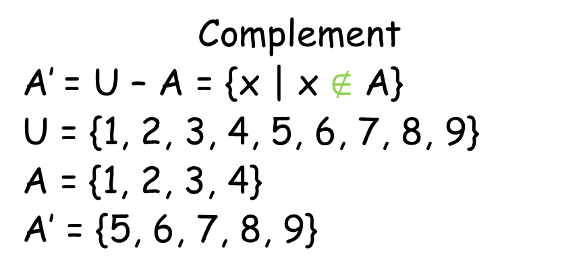
Set Operations: complement
Complement
A’ = U – A = {x | x $∉$ A}
U = {1, 2, 3, 4, 5, 6, 7, 8, 9}
A = {1, 2, 3, 4}
A’ = {5, 6, 7, 8, 9}
A

Slide 18
Computer representation of sets
U = {1, 5, 6, 7, 8, 9, 10, 11, 12, 13, 14, 15, 16, 17}
U =
1 | 5 | 6 | 7 | 8 | 9 | 10 | 11 | 12 | 13 | 14 | 15 | 16 | 17
U =
(Bit set Representation)
1 | 1 | 1 | 1 | 1 | 1 | 1 | 1 | 1 | 1 | 1 | 1 | 1 | 1

Slide 19
Computer representation of sets
A = {1, 6, 8, 11, 12, 13, 16}
1 | 5 | 6 | 7 | 8 | 9 | 10 | 11 | 12 | 13 | 14 | 15 | 16 | 17
U =
1 | 1 | 1 | 1 | 1 | 1 | 1 | 1 | 1 | 1 | 1 | 1 | 1 | 1
A =

Slide 20
Computer representation of sets
A = {1, 6, 8, 11, 12, 13, 16}
1 | 5 | 6 | 7 | 8 | 9 | 10 | 11 | 12 | 13 | 14 | 15 | 16 | 17
U =
1 | 1 | 1 | 1 | 1 | 1 | 1 | 1 | 1 | 1 | 1 | 1 | 1 | 1
A =
1

Slide 21
Computer representation of sets
A = {1, 6, 8, 11, 12, 13, 16}
1 | 5 | 6 | 7 | 8 | 9 | 10 | 11 | 12 | 13 | 14 | 15 | 16 | 17
U =
1 | 1 | 1 | 1 | 1 | 1 | 1 | 1 | 1 | 1 | 1 | 1 | 1 | 1
A =
1 |  | 1

Slide 22
Computer representation of sets
A = {1, 6, 8, 11, 12, 13, 16}
1 | 5 | 6 | 7 | 8 | 9 | 10 | 11 | 12 | 13 | 14 | 15 | 16 | 17
U =
1 | 1 | 1 | 1 | 1 | 1 | 1 | 1 | 1 | 1 | 1 | 1 | 1 | 1
A =
1 |  | 1 |  | 1

Slide 23
Computer representation of sets
A = {1, 6, 8, 11, 12, 13, 16}
1 | 5 | 6 | 7 | 8 | 9 | 10 | 11 | 12 | 13 | 14 | 15 | 16 | 17
U =
1 | 1 | 1 | 1 | 1 | 1 | 1 | 1 | 1 | 1 | 1 | 1 | 1 | 1
A =
1 |  | 1 |  | 1 |  |  | 1

Slide 24
Computer representation of sets
A = {1, 6, 8, 11, 12, 13, 16}
1 | 5 | 6 | 7 | 8 | 9 | 10 | 11 | 12 | 13 | 14 | 15 | 16 | 17
U =
1 | 1 | 1 | 1 | 1 | 1 | 1 | 1 | 1 | 1 | 1 | 1 | 1 | 1
A =
1 |  | 1 |  | 1 |  |  | 1 | 1 | 1 |  |  | 1

Slide 25
Computer representation of sets
A = {1, 6, 8, 11, 12, 13, 16}
1 | 5 | 6 | 7 | 8 | 9 | 10 | 11 | 12 | 13 | 14 | 15 | 16 | 17
U =
1 | 1 | 1 | 1 | 1 | 1 | 1 | 1 | 1 | 1 | 1 | 1 | 1 | 1
A =
1 | 0 | 1 | 0 | 1 | 0 | 0 | 1 | 1 | 1 | 0 | 0 | 1 | 0

Slide 26
Computer representation of sets
B = {5, 7, 8}
1 | 5 | 6 | 7 | 8 | 9 | 10 | 11 | 12 | 13 | 14 | 15 | 16 | 17
U =
1 | 1 | 1 | 1 | 1 | 1 | 1 | 1 | 1 | 1 | 1 | 1 | 1 | 1
B =
0 | 1 | 0 | 1 | 1 | 0 | 0 | 0 | 0 | 0 | 0 | 0 | 0 | 0

Slide 27
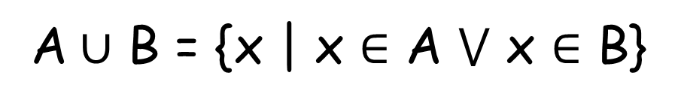

Set operations: Union
U =
1 | 1 | 1 | 1 | 1 | 1 | 1 | 1 | 1 | 1 | 1 | 1 | 1 | 1
A =
1 | 0 | 1 | 0 | 1 | 0 | 0 | 1 | 1 | 1 | 0 | 0 | 1 | 0
B =
0 | 1 | 0 | 1 | 1 | 0 | 0 | 0 | 0 | 0 | 0 | 0 | 0 | 0
A $∪$ B =
1 | 1 | 1 | 1 | 1 | 0 | 0 | 1 | 1 | 1 | 0 | 0 | 1 | 0
Perform OR operation
A $∪$ B = {x | x $∈$ A $⋁$ x $∈$ B}

Slide 28
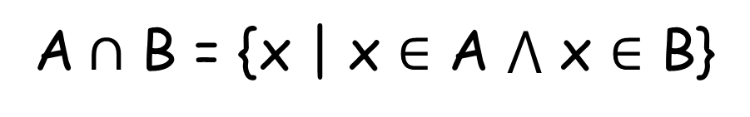
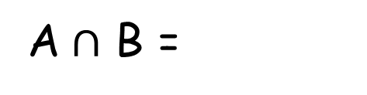
Set operations: Intersection
U =
1 | 1 | 1 | 1 | 1 | 1 | 1 | 1 | 1 | 1 | 1 | 1 | 1 | 1
A =
1 | 0 | 1 | 0 | 1 | 0 | 0 | 1 | 1 | 1 | 0 | 0 | 1 | 0
B =
0 | 1 | 0 | 1 | 1 | 0 | 0 | 0 | 0 | 0 | 0 | 0 | 0 | 0
A $∩$ B =
0 | 0 | 0 | 0 | 1 | 0 | 0 | 0 | 0 | 0 | 0 | 0 | 0 | 0
Perform AND operation
A $∩$ B = {x | x $∈$ A $⋀$ x $∈$ B}

Slide 29
Set operations: Complement
U =
1 | 1 | 1 | 1 | 1 | 1 | 1 | 1 | 1 | 1 | 1 | 1 | 1 | 1
A =
1 | 0 | 1 | 0 | 1 | 0 | 0 | 1 | 1 | 1 | 0 | 0 | 1 | 0
B =
0 | 1 | 0 | 1 | 1 | 0 | 0 | 0 | 0 | 0 | 0 | 0 | 0 | 0
A ‘=
0 | 1 | 0 | 1 | 0 | 1 | 1 | 0 | 0 | 0 | 1 | 1 | 0 | 1
Toggle the bits

Slide 30
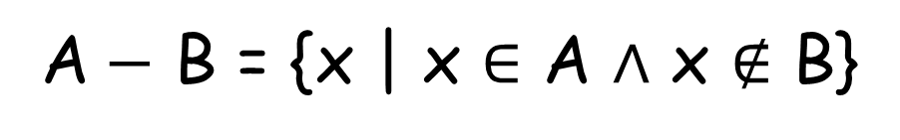
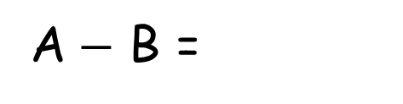
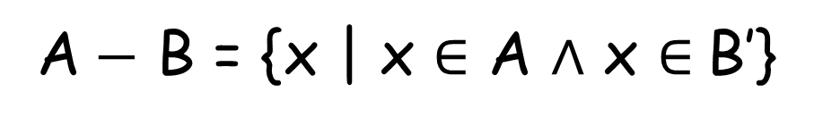
Set operations: Difference
U =
1 | 1 | 1 | 1 | 1 | 1 | 1 | 1 | 1 | 1 | 1 | 1 | 1 | 1
A =
1 | 0 | 1 | 0 | 1 | 0 | 0 | 1 | 1 | 1 | 0 | 0 | 1 | 0
B =
0 | 1 | 0 | 1 | 1 | 0 | 0 | 0 | 0 | 0 | 0 | 0 | 0 | 0
A $−$ B =
A $−$ B = {x | x $∈$ A $∧$ x $∉$ B}
A $−$ B = {x | x $∈$ A $∧$ x $∈$B’}

Slide 31
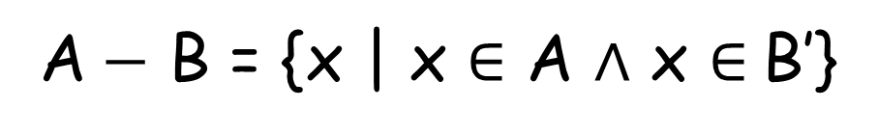
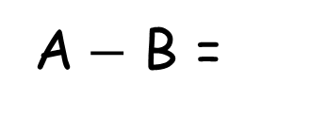
Set operations: Difference
U =
1 | 1 | 1 | 1 | 1 | 1 | 1 | 1 | 1 | 1 | 1 | 1 | 1 | 1
A =
1 | 0 | 1 | 0 | 1 | 0 | 0 | 1 | 1 | 1 | 0 | 0 | 1 | 0
B =
0 | 1 | 0 | 1 | 1 | 0 | 0 | 0 | 0 | 0 | 0 | 0 | 0 | 0
B’ =
1 | 0 | 1 | 0 | 0 | 1 | 1 | 1 | 1 | 1 | 1 | 1 | 1 | 1
A $−$ B =
1 | 0 | 1 | 0 | 0 | 0 | 0 | 1 | 1 | 1 | 0 | 0 | 1 | 0
A $−$ B = {x | x $∈$ A $∧$ x $∈$B’}

Slide 32
Functions

Slide 33
What are functions?
Mappings between two sets
1
5
7
9
10
Prime
Not prime
A(numbers)
prime/not

Slide 34
What are functions?
A function from A to B is an assignment of exactly one member of B to each element of A
denoted by f: A $→$ B

