Slide 1
Java
Introduction

Slide 2
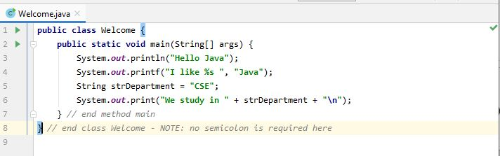
Editing a Java Program

Slide 3
Examining Welcome.java
public static void main(String[] args)
main is the starting point of every Java application
public is used to make the method accessible by all
static is used to make main a static method of class Welcome. Static methods can be called without using any object; just using the class name. JVM call main using the ClassName.methodName notation
void means main does not return anything
String args[ ] represents an array of String objects that holds the command line arguments passed to the application. Where is the length of args array?

Slide 4
Examining Welcome.java
System.out.println()
Used to print a line of text followed by a new line
System is a class inside the Java API
out is a public static member of class System
out is an object of another class of the Java API
out represents the standard output (similar to stdout or cout)
println is a public method of the class of which out is an object

Slide 5
Examining Welcome.java
System.out.print() is similar to System.out.println(), but does not print a new line automatically
System.out.printf() is used to print formatted output like printf() in C
In Java, characters enclosed by double quotes (“ ”) represents a String object, where String is a class of the Java API
We can use the plus operator (+) to concatenate multiple String objects and create a new String object

Slide 6
Examining Welcome.java
A Java source file can contain multiple classes, but only one class can be a public class
A public class is accessible across packages
The source file name must match the name of the public class defined in the file with the .java extension

Slide 7
Examining Welcome.java
In Java, there is no provision to declare a class, and then define the member functions outside the class
Body of every member function of a class (called method in Java) must be written when the method is declared
Java methods can be written in any order in the source file
A method defined earlier in the source file can call a method defined later

Slide 8
Examining Welcome.java
Think of JVM as a outside Java entity who tries to access the main method of class Welcome
main must be declared as a public member of class Welcome
JVM wants to access main without creating an object of class Welcome
main must be declared as static
JVM wants to pass an array of String objects containing the command line arguments
main must take an array of String as parameter

Slide 9
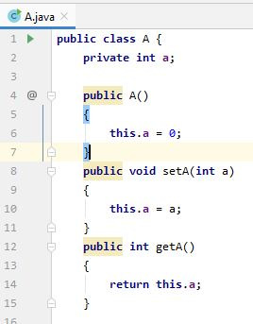
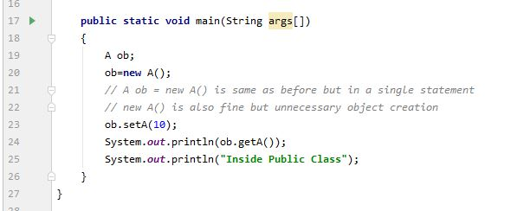
Another Java Program

Slide 10
A class and its objects, References
A class is like the blueprint for a house. Using this blueprint, you can build as many houses as you like
Each house you build (or instantiate, in OO lingo) is an object, also known as an instance
Each house also has an address, of course. If you want to tell someone where the house is, you give them a card with the address written on it. That card is the object's reference

Slide 11
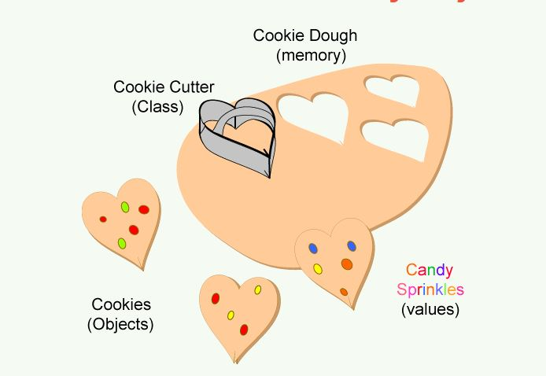
A class and its objects, References

Slide 12

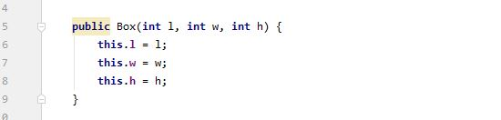
Class constructors

Slide 13
Class constructors and this keyword
- Constructors have no return type, not even
void
- Constructors can be parameterized (Box.java)
- this keyword is used to refer to the current object.

Slide 14
Examining A.java
The variable of a class type is called a reference
ob is a reference to A object
Declaring a class reference is not enough, we have to use new to create an object
Every Java object has to be instantiated using keyword new
We access a public member of a class using the dot operator (.)

Slide 15
Examining A.java
The variable of a class type is called a reference
ob is a reference to A object
Declaring a class reference is not enough, we have to use new to create an object
Every Java object has to be instantiated using keyword new
We access a public member of a class using the dot operator (.)

Slide 16
Primitive (built‐in) Data types
Integers
byte 8‐bit integer (new)
short 16‐bit integer
int 32‐bit signed integer
long 64‐bit signed integer
Real Numbers
float 32‐bit floating‐point number
double 64‐bit floating‐point number
Other types
char 16‐bit, Unicode 2.1 character
boolean true or false, false is not 0 in Java

Slide 17
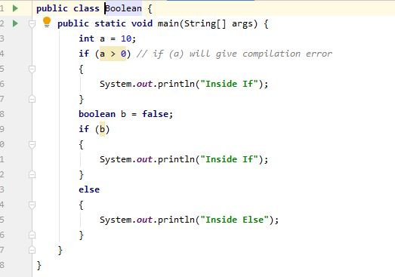
Boolean Type

Slide 18
Non‐primitive Data types
The non‐primitive data types in java are
Objects
Array
Non‐primitive types are also called reference types

