Slide 1
Course Site
https://yeasirrayhanprince.github.io/teaching/cse106-spring-2020

Slide 2
Propositional Logic

Slide 3
What is Proposition?
A statement that is either true or false
2 + 3 = 5

Slide 4
What is Proposition?
A statement that is either true or false
2 + 3 = 5 : true

Slide 5
What is Proposition?
A statement that is either true or false
1 + 1 = 3

Slide 6
What is Proposition?
A statement that is either true or false
1 + 1 = 3 : false

Slide 7
What is Proposition?
A statement that is either true or false
Dhaka is the capital of Bangladesh

Slide 8
What is Proposition?
A statement that is either true or false
Dhaka is the capital of Bangladesh : true

Slide 9
What is Proposition?
A statement that is either true or false
Chittagong is the capital of Bangladesh : false

Slide 10
What is Proposition?
A statement that is either true or false
Give me an A

Slide 11
What is Proposition?
A statement that is either true or false
Give me an A
Neither true or false
Not a proposition

Slide 12
What is Proposition?
A statement that is either true or false
Would there be a third world war?
Neither true or false
Not a proposition

Slide 13
Compound Proposition
All humans are mortal and 2 + 3 =5

Slide 14
Compound Proposition
All humans are mortal and 2 + 3 =5 :
Hard to depict whether true / false

Slide 15
Compound Proposition
All humans are mortal and 2 + 3 =5

Slide 16
Compound Proposition
All humans are mortal : true and 2 + 3 =5 : true

Slide 17
Compound Proposition
All humans are mortal : true and 2 + 3 =5 : true
Logical connector

Slide 18
Propositional Variable
All humans are mortal

Slide 19
Propositional Variable
All humans are mortal: p
p can either be true / false

Slide 20
Propositional Variable
All humans are mortal and 2 + 3 =5
p and q

Slide 21
Logical Connector
Not
And
Or
Implies
Xor
Iff

Slide 22
Logical Connector: NOT
Notation: ¬
Truth table:
p | ¬ p
0 | 1
1 | 0

Slide 23
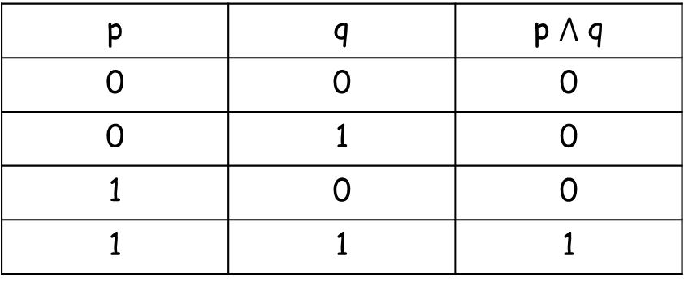

Logical Connector: AND
Notation: $⋀$
Truth table:
p | q | p $⋀$ q
0 | 0 | 0
0 | 1 | 0
1 | 0 | 0
1 | 1 | 1

Slide 24
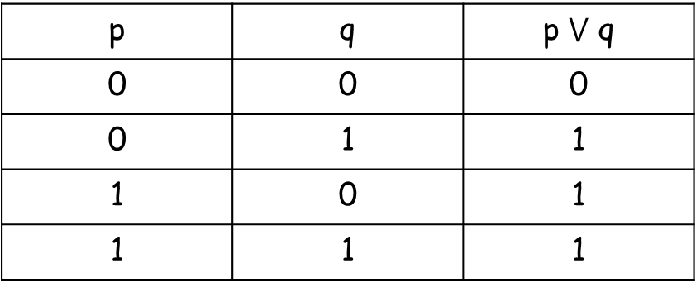

Logical Connector: OR
Notation: $⋁$
Truth table:
p | q | p $⋁$ q
0 | 0 | 0
0 | 1 | 1
1 | 0 | 1
1 | 1 | 1

Slide 25
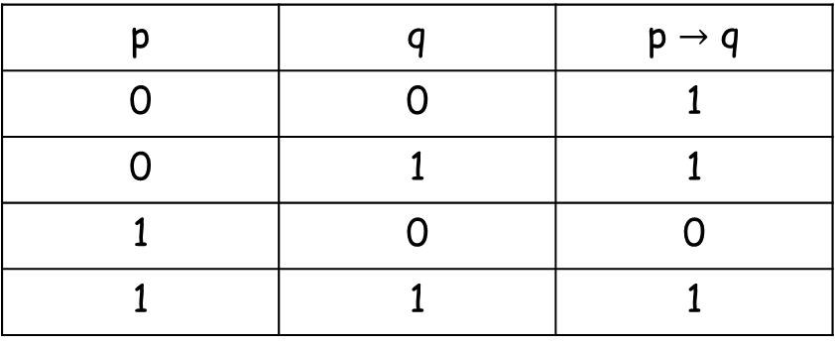

Logical Connector: IMPLIES
Notation: $→$
Truth table:
p | q | p $→$ q
0 | 0 | 1
0 | 1 | 1
1 | 0 | 0
1 | 1 | 1

Slide 26

Logical Connector: XOR
Notation: $⊕$
Truth table:
p | q | p xor q
0 | 0 | 0
0 | 1 | 1
1 | 0 | 1
1 | 1 | 0

Slide 27

Logical Connector: IFF
Notation: $↔$
Truth table:
p | q | p IFF q
0 | 0 | 1
0 | 1 | 0
1 | 0 | 0
1 | 1 | 1

Slide 28

FINDING TRUTH TABLE OF COMPOUND PROPOSTIONS: Example1
P $⋀$ q $⊕$ s
No of propositional variables = 3
No of rows in truth table = 2³ = 8

Slide 29

FINDING TRUTH TABLE OF COMPOUND PROPOSTIONS
P $⋀$ q $⊕$ s
p | q | s
0 | 0 | 0
0 | 0 | 1
0 | 1 | 0
0 | 1 | 1
1 | 0 | 0
1 | 0 | 1
1 | 1 | 0
1 | 1 | 1

Slide 30

FINDING TRUTH TABLE OF COMPOUND PROPOSTIONS
P $⋀$ q $⊕$ s
Which operation to perform first?
p $⋀$ q / q $⊕$ s

Slide 31
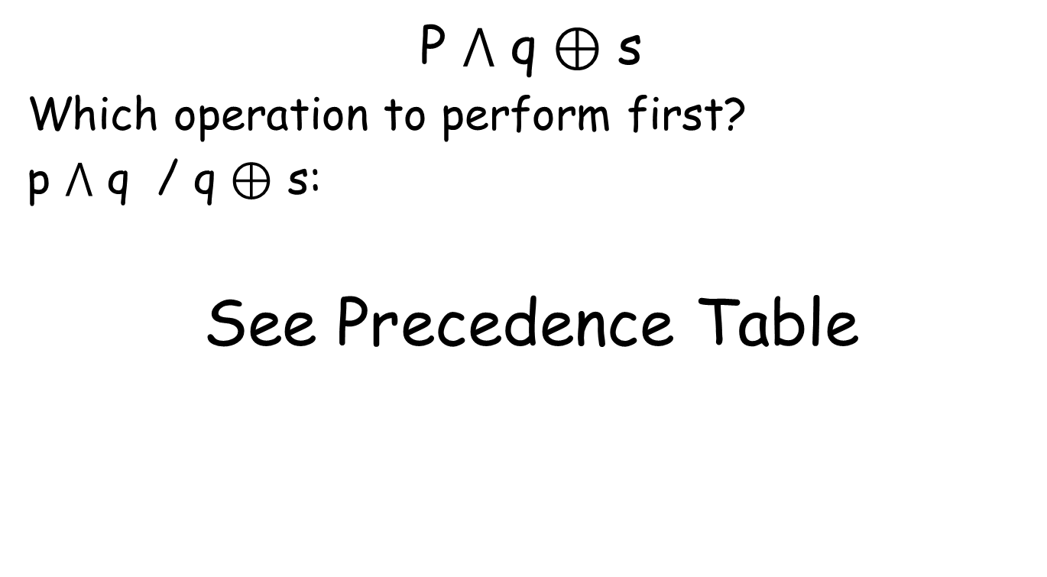
FINDING TRUTH TABLE OF COMPOUND PROPOSTIONS
P $⋀$ q $⊕$ s
Which operation to perform first?
p $⋀$ q / q $⊕$ s:
See Precedence Table

Slide 32
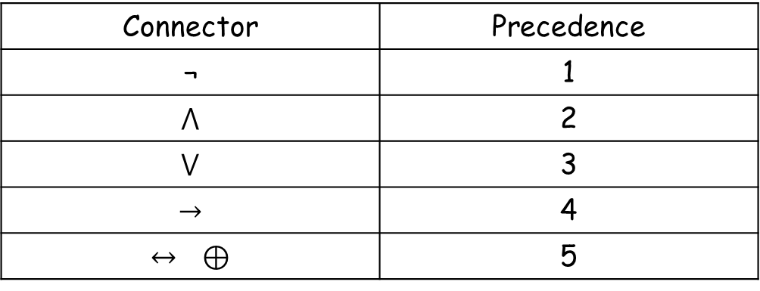
Precedence Table
Connector | Precedence
¬ | 1
$$⋀$$ | 2
$$⋁$$ | 3
$$→$$ | 4
$$↔ ⊕$$ | 5

Slide 33
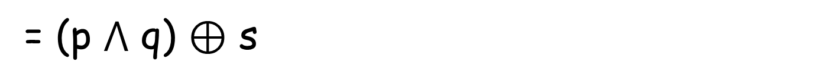

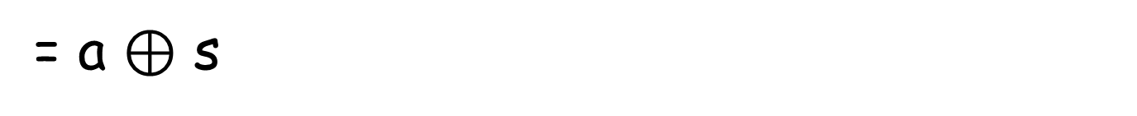
FINDING TRUTH TABLE OF COMPOUND PROPOSTIONS
P $⋀$ q $⊕$ s
= (p $⋀$ q) $⊕$ s
= a $⊕$ s
= b

Slide 34
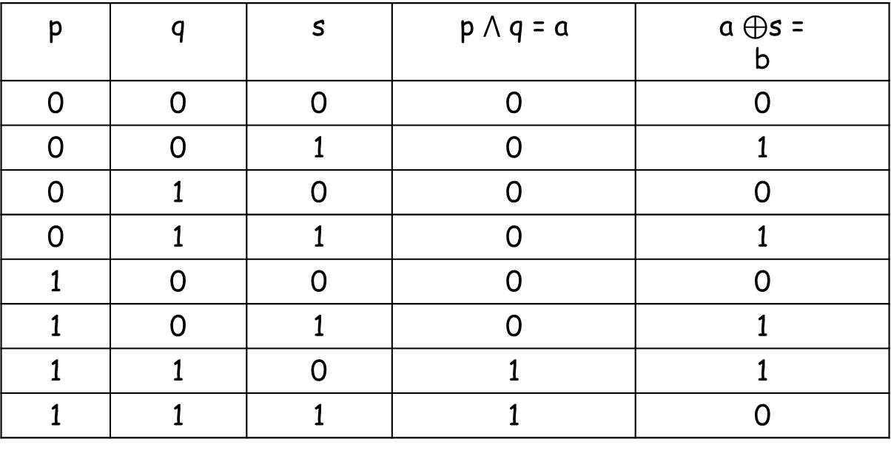

FINDING TRUTH TABLE OF COMPOUND PROPOSTIONS
P $⋀$ q $⊕$ s = (p $⋀$ q) $⊕$ s = a $⊕$ s = b
p | q | s | p $⋀$ q = a | a $⊕$s = b
0 | 0 | 0 | 0 | 0
0 | 0 | 1 | 0 | 1
0 | 1 | 0 | 0 | 0
0 | 1 | 1 | 0 | 1
1 | 0 | 0 | 0 | 0
1 | 0 | 1 | 0 | 1
1 | 1 | 0 | 1 | 1
1 | 1 | 1 | 1 | 0

Slide 35
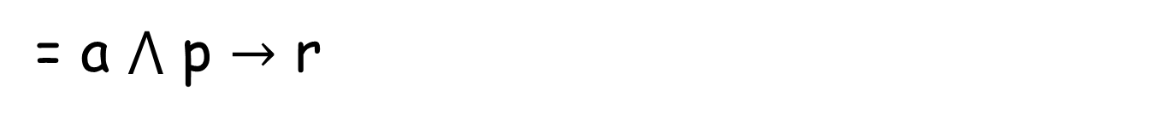

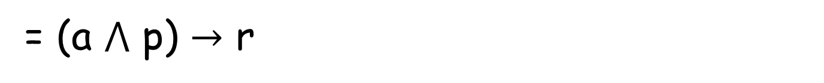
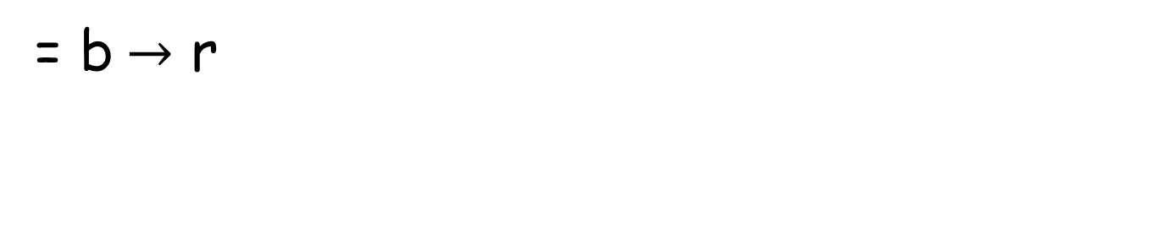
FINDING TRUTH TABLE OF COMPOUND PROPOSTIONS: Example 2
(￢p ↔￢q) $⋀$ p $→$ r
= a $⋀$ p $→$ r
= (a $⋀$ p) $→$ r
= b$→$ r

Slide 36
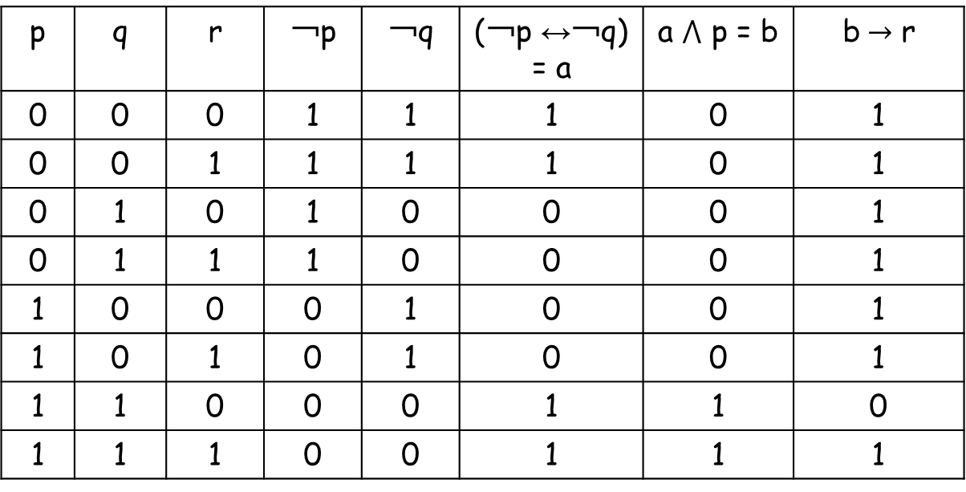
FINDING TRUTH TABLE OF COMPOUND PROPOSTIONS: Example 2
p | q | r | ￢p | ￢q | (￢p ↔￢q) = a | a $⋀$ p = b | b$→$ r
0 | 0 | 0 | 1 | 1 | 1 | 0 | 1
0 | 0 | 1 | 1 | 1 | 1 | 0 | 1
0 | 1 | 0 | 1 | 0 | 0 | 0 | 1
0 | 1 | 1 | 1 | 0 | 0 | 0 | 1
1 | 0 | 0 | 0 | 1 | 0 | 0 | 1
1 | 0 | 1 | 0 | 1 | 0 | 0 | 1
1 | 1 | 0 | 0 | 0 | 1 | 1 | 0
1 | 1 | 1 | 0 | 0 | 1 | 1 | 1

Slide 37
Propositional Equivalences

Slide 38
Tautology
[￢p ∧ (p ∨ q)] → q
p | q |  |  |  | [￢p ∧ (p ∨ q)] → q
0 | 0 |  |  |  | 1
0 | 1 |  |  |  | 1
1 | 0 |  |  |  | 1
1 | 1 |  |  |  | 1

Slide 39
Contradiction
￢([￢p ∧ (p ∨ q)] → q)
p | q |  |  |  | ￢([￢p ∧ (p ∨ q)] → q)
0 | 0 |  |  |  | 0
0 | 1 |  |  |  | 0
1 | 0 |  |  |  | 0
1 | 1 |  |  |  | 0

Slide 40
Contingency
p → q
p | q | p → q
0 | 0 | 1
0 | 1 | 1
1 | 0 | 0
1 | 1 | 1

Slide 41
Logical Equivalences
The compound propositions p and q are called logically equivalent if p ↔ q is a tautology.
Notation: ≡

Slide 42
Logical Equivalences
Compound propositions that have the same truth values in all possible cases are called logically equivalent

Slide 43
Proving Logical Equivalences: Example 1
Prove that: p ∨ (q ∧ r) ≡ (p ∨ q) ∧ (p ∨ r)

Slide 44
Proving Logical Equivalences: Example 1
Truth table of p ∨ (q ∧ r)
p | q | r | (q ∧ r) | p ∨ (q ∧ r)
0 | 0 | 0 | 0 | 0
0 | 0 | 1 | 0 | 0
0 | 1 | 0 | 0 | 0
0 | 1 | 1 | 1 | 1
1 | 0 | 0 | 0 | 1
1 | 0 | 1 | 0 | 1
1 | 1 | 0 | 0 | 1
1 | 1 | 1 | 1 | 1

Slide 45
Proving Logical Equivalences: Example 1
Truth table of (p ∨ q) ∧ (p ∨ r)
p | q | r | (p ∨ q) | (p ∨ r) | (p ∨ q) ∧ (p ∨ r)
0 | 0 | 0 | 0 | 0 | 0
0 | 0 | 1 | 0 | 1 | 0
0 | 1 | 0 | 1 | 0 | 0
0 | 1 | 1 | 1 | 1 | 1
1 | 0 | 0 | 1 | 1 | 1
1 | 0 | 1 | 1 | 1 | 1
1 | 1 | 0 | 1 | 1 | 1
1 | 1 | 1 | 1 | 1 | 1

Slide 46
Proving Logical Equivalences: Example 1
Prove that: p ∨ (q ∧ r) ≡ (p ∨ q) ∧ (p ∨ r)
p ∨ (q ∧ r) | (p ∨ q) ∧ (p ∨ r)
0 | 0
0 | 0
0 | 0
1 | 1
1 | 1
1 | 1
1 | 1
1 | 1

Slide 47
Proving Logical Equivalences: Example 2
Prove that: (p → q) ∧ (p → r) ≡ p → (q ∧ r)

Slide 48

Logical Equivalences
p → q ≡ ￢p ∨ q
p ↔ q ≡ (p → q) ∧ (q → p)
$p⊕q$ ≡ (p ∨ q) ∧ (￢p ∨ ￢ q)

