Slide 1
Functions

Slide 2
What are functions?
Informally, mapping between two sets
1
5
7
9
10
Prime
Not prime
A(numbers)
B(prime/not)

Slide 3
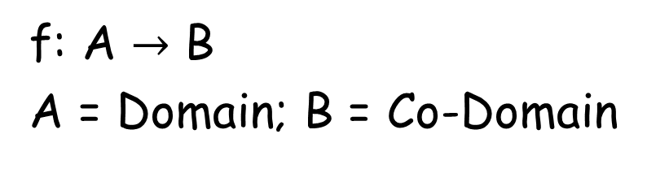
What are functions?
Informally, mapping between two sets
f: A $→$ B
A = Domain; B = Co-Domain
1
5
7
9
10
Prime
Not prime
If f(a) = b
b = image of a
a = pre-image of b
Range, R = Images of A
A(numbers)
B(prime/not)

Slide 4
Examples of functions
Suppose that each student in a discrete mathematics class is assigned a letter grade from the set {A, B, C, D, F}. And suppose that the grades are A for Adams, C for Chou, B for Goodfriend, A for Rodriguez, and F for Stevens.

Slide 5
What are functions?
A function from A to B is an assignment of exactly one member of B to each element of A

Slide 6
What are functions?
1
5
7
9
10
1
5
7
9
10
Prime
Not prime
Prime
Not prime

Slide 7
What are functions?
1
5
7
9
10
Prime
Not prime
composite

Slide 8
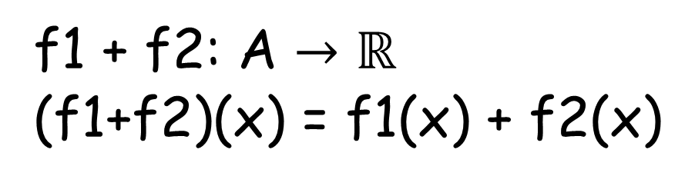
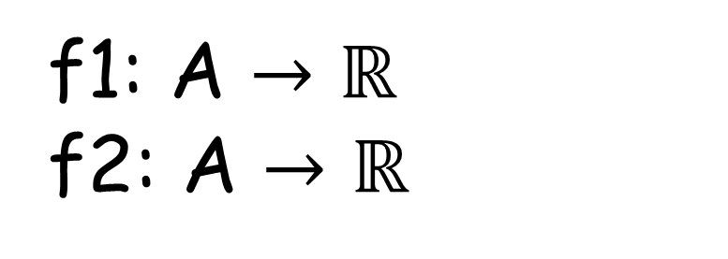
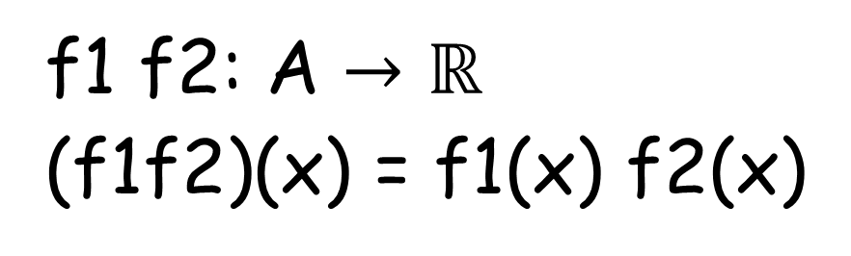
Multiplication and addition of functions
f1: A $→$ $ℝ$
f2: A $→$ $ℝ$
f1 f2: A $→$ $ℝ$
(f1f2)(x) = f1(x) f2(x)
f1 + f2: A $→$ $ℝ$
(f1+f2)(x) = f1(x) + f2(x)

Slide 9
One to One(Injective) functions
A function f is said to be one-to-one, or an injunction, if and only if f (a) = f (b) implies that a = b for all a and b in the domain of f
∀a∀b(f (a) = f (b)) → a = b

Slide 10
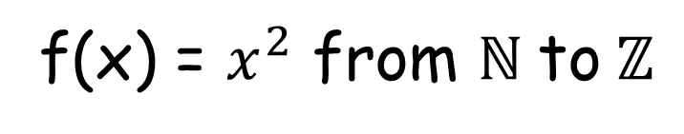
One to One(Injective) functions
To show that f is injective Show that if f (x) = f (y) for arbitrary x, y ∈ A with x = y, then x = y.
f(x) = $x^{2}$ from $ℕ \text{to} ℤ$

Slide 11
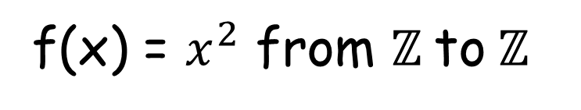
One to One(Injective) functions
To show that f is injective Show that if f (x) = f (y) for arbitrary x, y ∈ A with x = y, then x = y.
f(x) = $x^{2}$ from $ℤ \text{to} ℤ$

Slide 12
Onto(Surjective) Functions
A function f from A to B is called onto if and only if for every element b ∈ B there is an element a ∈ A with f (a) = b.
∀y∃xf (x) = y

Slide 13
Onto(Surjective) functions
To show that f is surjective Consider an arbitrary element y ∈ B and find an element x ∈ A such that f (x) = y.
f(x) = $x^{2}$ from $ℕ \text{to} ℤ$

Slide 14
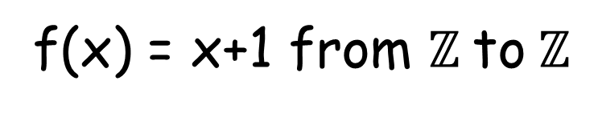
Onto(Surjective) functions
To show that f is surjective Consider an arbitrary element y ∈ B and find an element x ∈ A such that f (x) = y.
f(x) = x+1 from $ℤ \text{to} ℤ$

Slide 15
Bijective Functions
A function f is a one-to-one correspondence, or a bijection, if it is both one-to-one and onto.

Slide 16
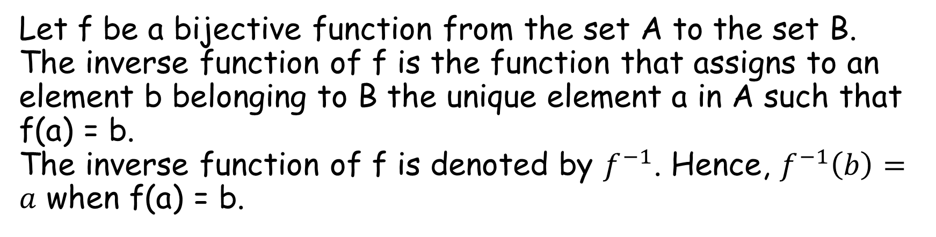
Inverse Functions
Let f be a bijective function from the set A to the set B. The inverse function of f is the function that assigns to an element b belonging to B the unique element a in A such that f(a) = b. The inverse function of f is denoted by $f^{−1}$. Hence, $f^{−1}\left(b\right)=a$ when f(a) = b.

Slide 17
Inverse Functions
f(a)
b
a
f⁻¹(b)
f
f⁻¹

Slide 18

Inverse functions
f:$ℤ \text{to} ℤ$ such that f(x) = x + 1. Find if f is invertible and if invertible what’s the inverse

Slide 19
Composition of functions
Let g be a function from the set A to the set B and let f be a function from the set B to the set C. The composition of the functions f and g, denoted for all a ∈ A by f ◦ g, is defined by
(f ◦ g)(a) = f (g(a))

