Slide 1
Interpolation

Slide 2
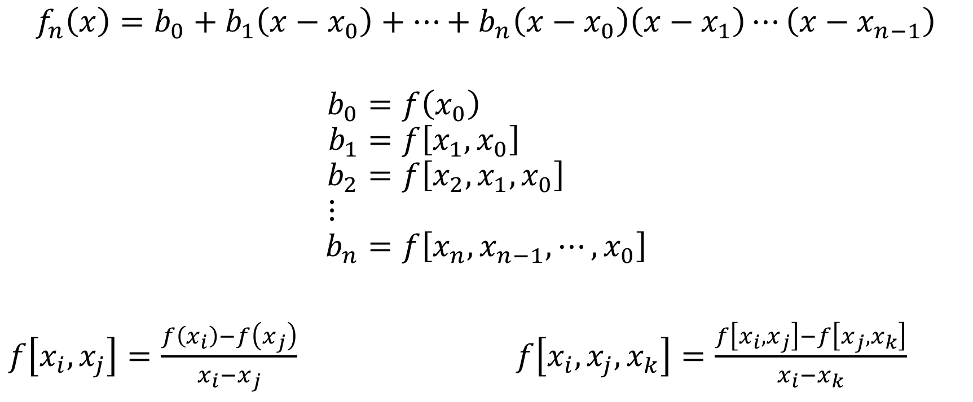
Newton’s Divided-Difference Interpolating Polynomials
$$f_{n}\left(x\right)=b_{0}+b_{1}\left(x−x_{0}\right)+⋯+b_{n}\left(x−x_{0}\right)\left(x−x_{1}\right)⋯\left(x−x_{n−1}\right)$$
$$b_{0}=f\left(x_{0}\right) \\ b_{1}=f\left[x_{1},x_{0}\right] \\ b_{2}=f\left[x_{2},x_{1},x_{0}\right] \\ ⋮ \\ b_{n}=f\left[x_{n},x_{n−1},⋯,x_{0}\right]$$
$f\left[x_{i},x_{j}\right]=\frac{f\left(x_{i}\right)−f\left(x_{j}\right)}{x_{i}−x_{j}}$ $f\left[x_{i},x_{j},x_{k}\right]=\frac{f\left[x_{i},x_{j}\right]−f\left[x_{j},x_{k}\right]}{x_{i}−x_{k}}$

Slide 3
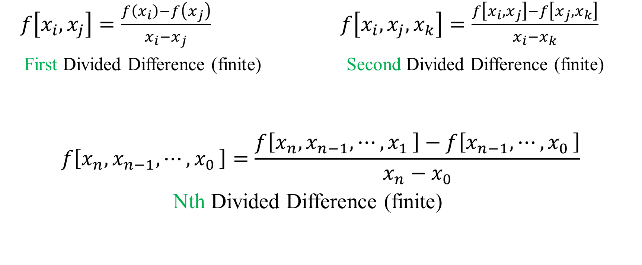
Newton’s Divided-Difference Interpolating Polynomials
$f\left[x_{i},x_{j}\right]=\frac{f\left(x_{i}\right)−f\left(x_{j}\right)}{x_{i}−x_{j}}$ $f\left[x_{i},x_{j},x_{k}\right]=\frac{f\left[x_{i},x_{j}\right]−f\left[x_{j},x_{k}\right]}{x_{i}−x_{k}}$
First Divided Difference (finite) Second Divided Difference (finite)
$$f\left[x_{n},x_{n−1},{⋯,x}_{0}\right]=\frac{f\left[x_{n},x_{n−1},{⋯,x}_{1}\right]−f\left[x_{n−1},{⋯,x}_{0}\right]}{x_{n}−x_{0}}$$
Nth Divided Difference (finite)

Slide 4


Find $f\left[x_{3},x_{2},x_{1},x_{0}\right]$
Step 1:
$$f\left(x_{3}\right)= ? \\ f\left(x_{2}\right)= ? \\ f\left(x_{1}\right)= ? \\ f\left(x_{0}\right)= ?$$
Step 2:
$$f\left[x_{3},x_{2} \right]= ? \\ f\left[x_{2},x_{1} \right]= ?$$
$$f\left[x_{1},x_{0} \right]=?$$

Slide 5

Find $f\left[x_{3},x_{2},x_{1},x_{0}\right]$
Step 3:
$$f\left[x_{3},x_{2},x_{1} \right]= ? \\ f\left[x_{2},x_{1},x_{0} \right]= ?$$
Step 4:
$$f\left[x_{3},x_{2},x_{1},x_{0}\right]= ?$$

Slide 6

Lagrange Interpolating Polynomial
$$f_{n}\left(x\right)=\sum_{i=0}^{n}{L_{i}\left(x\right)f(x_{i}) }$$
$$L_{i}\left(x\right)=\prod_{j=0, j≠i}^{n}{\frac{x−x_{j}}{x_{i}−x_{j}}}$$

Slide 7


Find$L_{2}\left(x\right)$
$$L_{i}\left(x\right)=\prod_{j=0, j≠i}^{n}{\frac{x−x_{j}}{x_{i}−x_{j}}}$$
$$L_{2}\left(x\right)=\frac{(x−x_{0})(x−x_{1})}{(x_{2}−x_{0})(x_{2}−x_{1})}$$
$$L_{3}\left(x\right)=\frac{(x−x_{0})(x−x_{1})(x−x_{2})}{(x_{3}−x_{0})(x_{3}−x_{1})(x_{3}−x_{2})}$$

