Slide 1
Functions

Slide 2
What are functions?
Informally, mapping between two sets
1
5
7
9
10
Prime
Not prime
A(numbers)
B(prime/not)

Slide 3
What are functions?
A function from A to B is an assignment of exactly one member of B to each element of A
denoted by f: A $→$ B (f maps A to B)

Slide 4
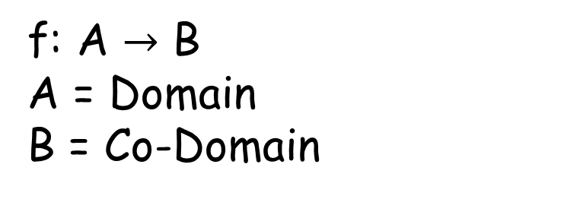
What are functions?
f: A $→$ B
A = Domain
B = Co-Domain
1
5
7
9
10
Prime
Not prime
If f(a) = b
b = image of a
a = pre-image of b
A(numbers)
B(prime/not)

Slide 5

What are functions?
Real valued function: codomain = $ℝ$
Integer valued function: codomain = $ℤ$

Slide 6
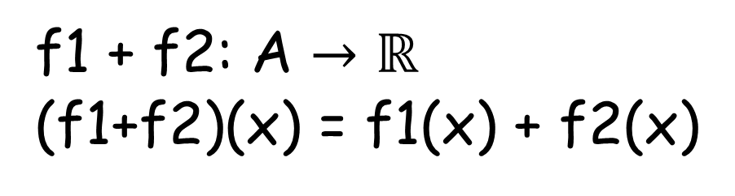
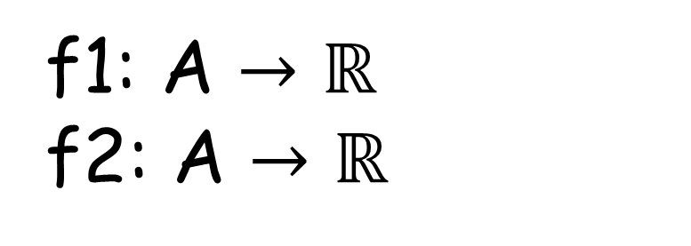
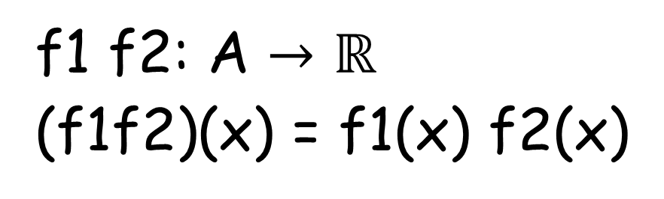
Multiplication and addition of functions
f1: A $→$ $ℝ$
f2: A $→$ $ℝ$
f1 f2: A $→$ $ℝ$
(f1f2)(x) = f1(x) f2(x)
f1 + f2: A $→$ $ℝ$
(f1+f2)(x) = f1(x) + f2(x)

Slide 7
One to One(Injective) functions
A function f is said to be one-to-one, or an injunction, if and only if f (a) = f (b) implies that a = b for all a and b in the domain of f
∀a∀b(f (a) = f (b)) → a = b

Slide 8
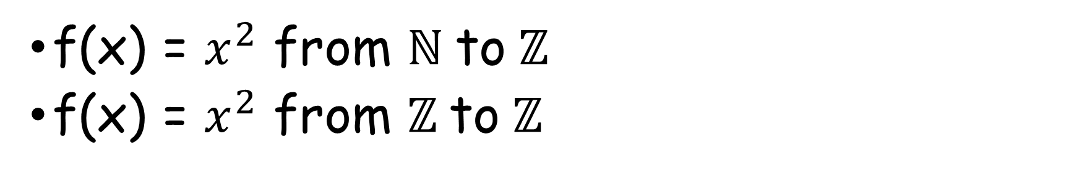
One to One(Injective) functions
f(x) = $x^{2}$ from $ℕ \text{to} ℤ$
f(x) = $x^{2}$ from $ℤ \text{to} ℤ$
To show that f is injective Show that if f (x) = f (y) for arbitrary x, y ∈ A with x = y,
then x = y.

Slide 9
Onto(Surjective) Functions
A function f from A to B is called onto if and only if for every element b ∈ B there is an element a ∈ A with f (a) = b.
∀y∃xf (x) = y

Slide 10
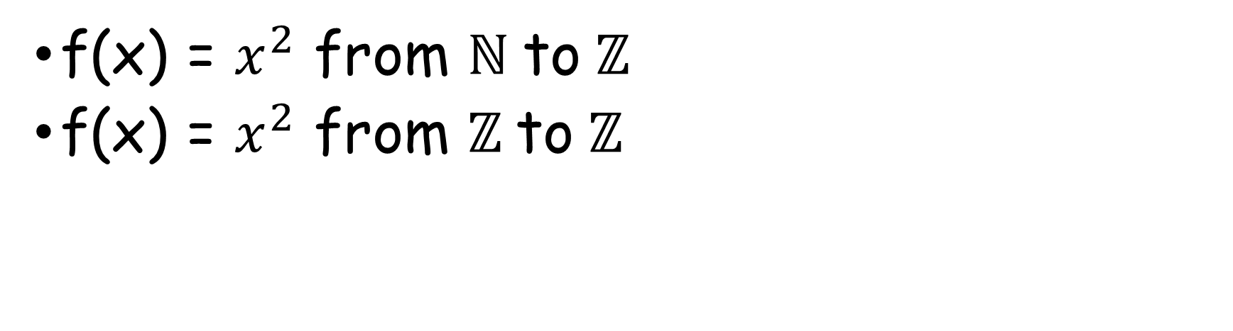
Onto(Surjective) functions
f(x) = $x^{2}$ from $ℕ \text{to} ℤ$
f(x) = $x^{2}$ from $ℤ \text{to} ℤ$
To show that f is surjective Consider an arbitrary element y ∈ B and find an element x ∈ A
such that f (x) = y.

Slide 11
Bijective Functions
A function f is a one-to-one correspondence, or a bijection, if it is both one-to-one and onto.

Slide 12
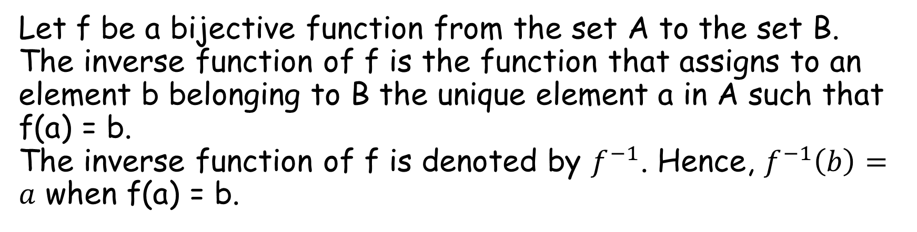
Inverse Functions
Let f be a bijective function from the set A to the set B. The inverse function of f is the function that assigns to an element b belonging to B the unique element a in A such that f(a) = b. The inverse function of f is denoted by $f^{−1}$. Hence, $f^{−1}\left(b\right)=a$ when f(a) = b.

Slide 13
Inverse Functions
f(a)
b
a
f⁻¹(b)
f
f⁻¹

Slide 14

Inverse functions
f:$ℤ \text{to} ℤ$ such that f(x) = x + 1. Find if f is invertible and if invertible what’s the inverse

Slide 15
Composition of functions
Let g be a function from the set A to the set B and let f be a function from the set B to the set C. The composition of the functions f and g, denoted for all a ∈ A by f ◦ g, is defined by
(f ◦ g)(a) = f (g(a))

