Slide 1

Summer Undergraduate Research Award 2024
Shear Thickening Fluids
Prediction of viscosity of Non-Newtonian fluids at different shear rates and temperatures using Machine Learning
Applicant: Lakshya Kumar (2022TT12183)
Abhiraj Kumar Koslia (2022TT12187)
Department: Dept. of Textile & Fibre Engg.
Facilitator: Prof. Abhijit Majumdar
Department: Dept. of Textile & Fibre Engg.

Slide 2
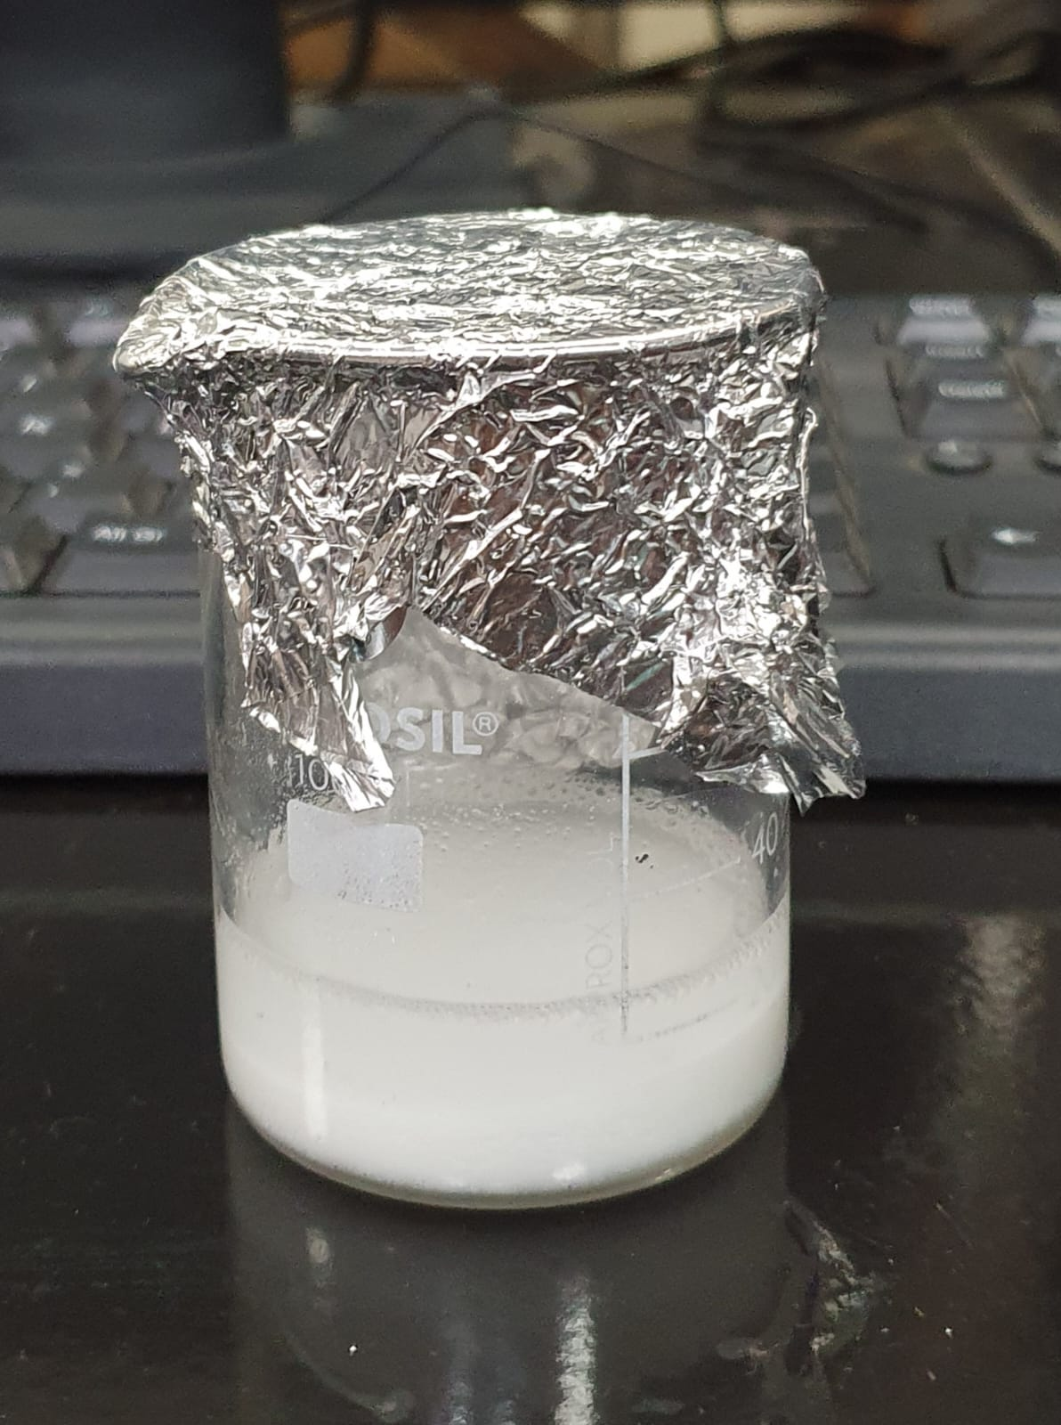
Table of Contents
1
Objectives
2
Methodology
3
Results & Discussion
4
Conclusion
5
References

Slide 3
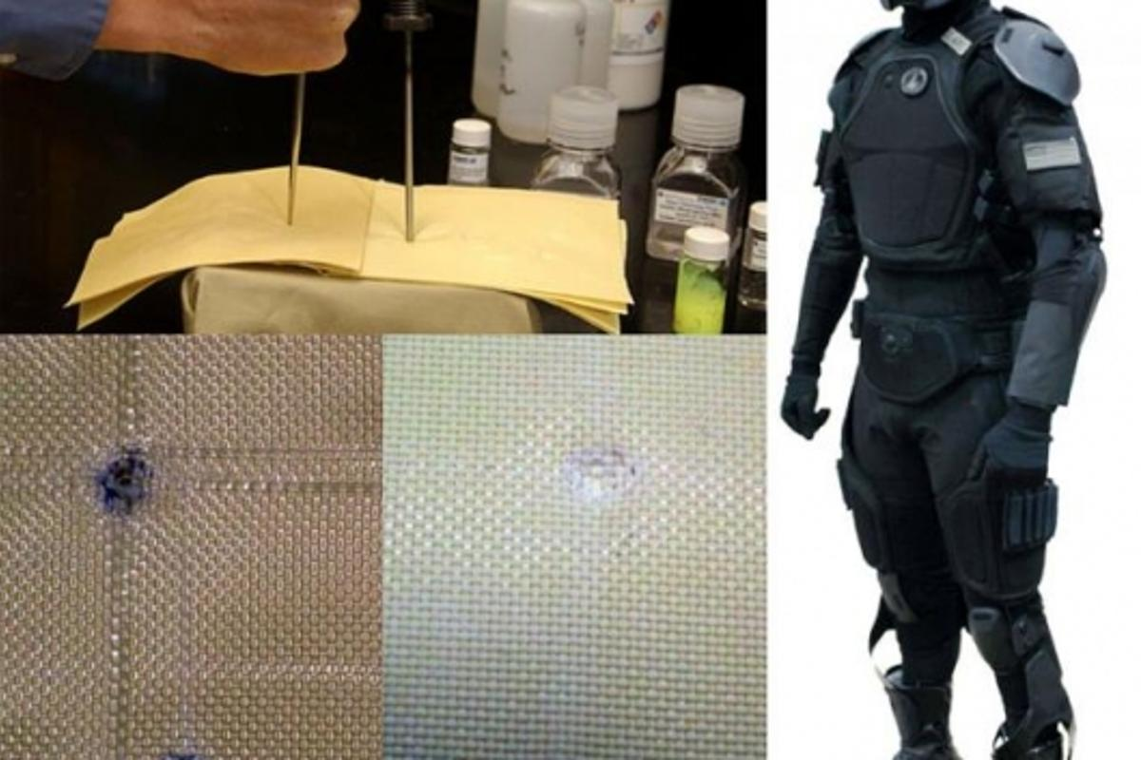
01.
The main objective of our project is to analyze the changes in viscosity of a non-Newtonian fluid due to changing parameters such as particle size and temperature.
1. Synthesis of Shear Thickening Fluids (STFs)
2. Perform rheological studies on the prepared STFs
3. Data Driven Insights can be taken by analyzing the data collected and building a predictive model using curve-fitting techniques and artificial neural networks.
4. Identify and implement suitable changes to current models to address their shortcomings on the given dataset by evaluating several configurations.
Objectives
(self generated)

Slide 4
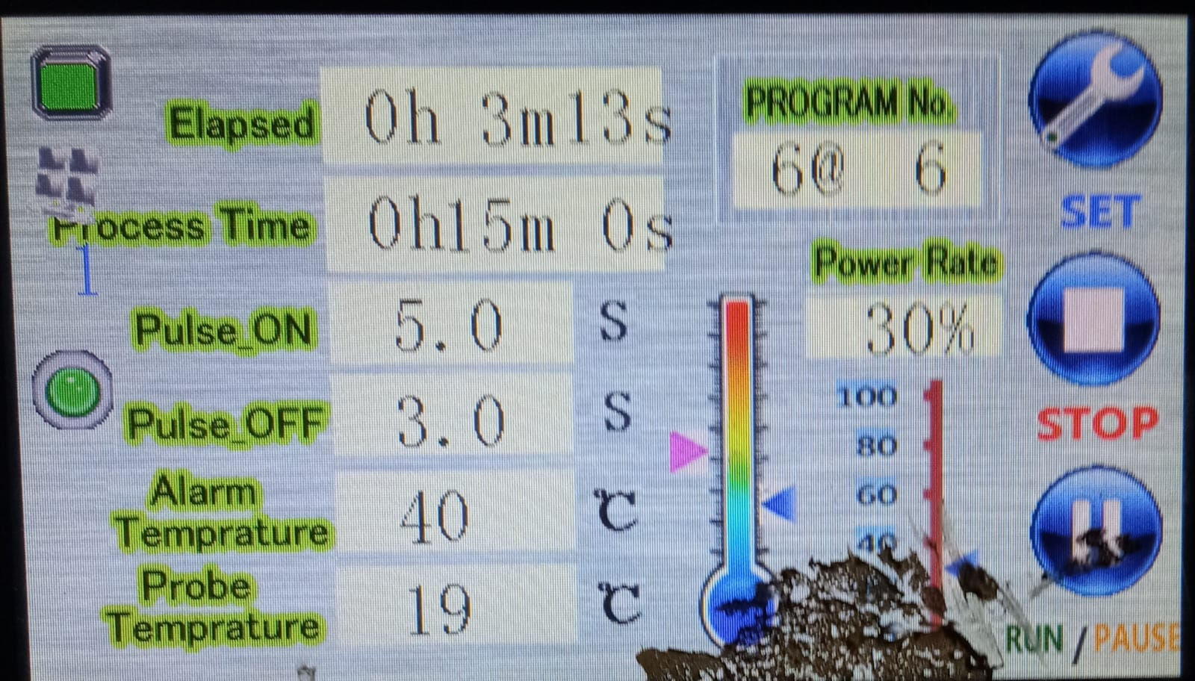
02.
Methodology

Slide 5

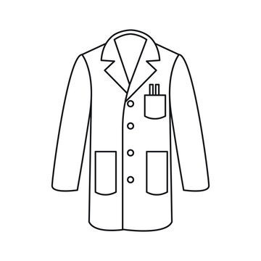
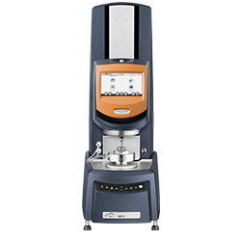


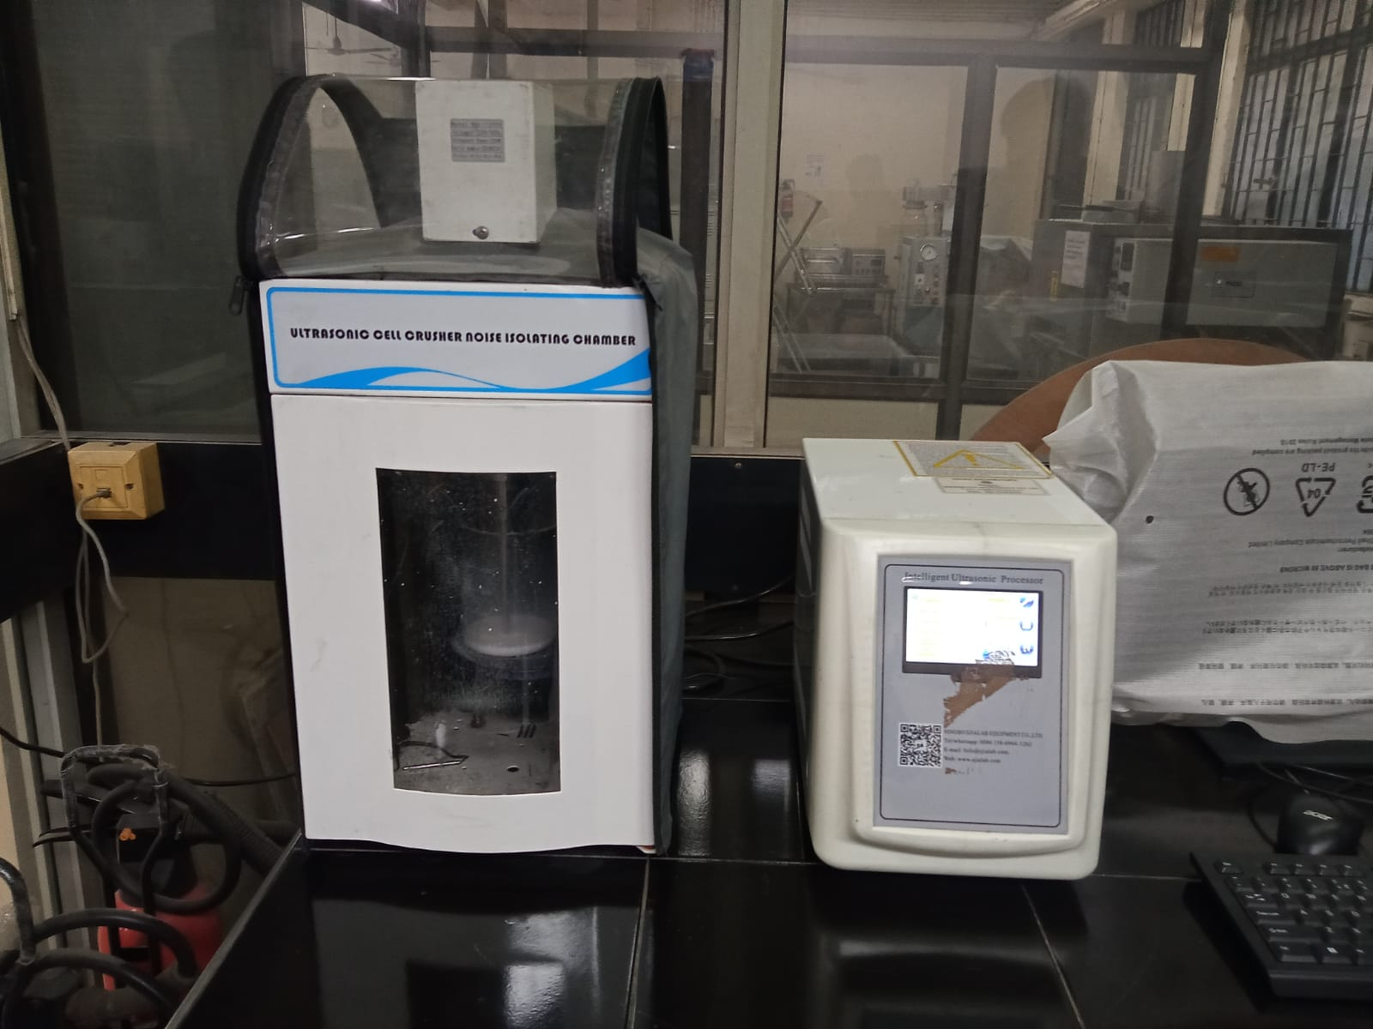
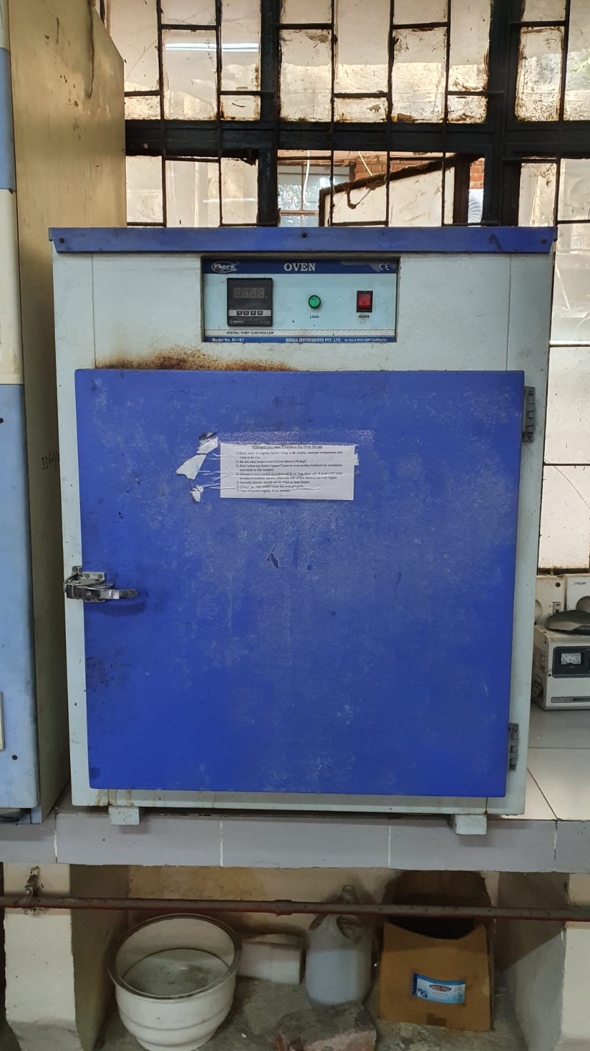


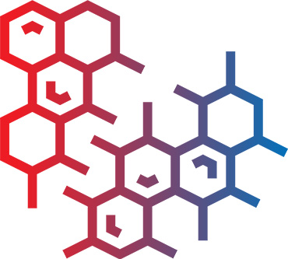
Experimental aspect:
2.1 Experimental Design
Particle sizes
Temperatures
Equipments used
100 nm
500 nm
20˚C
40 ˚C
300 nm
30 ˚C
2.2 Sample Preparation
Weigh and Measure
Disperse in the PEG
Ultrasonicator to ensure proper mixing
Mixture allowed to rest in Oven

Slide 6
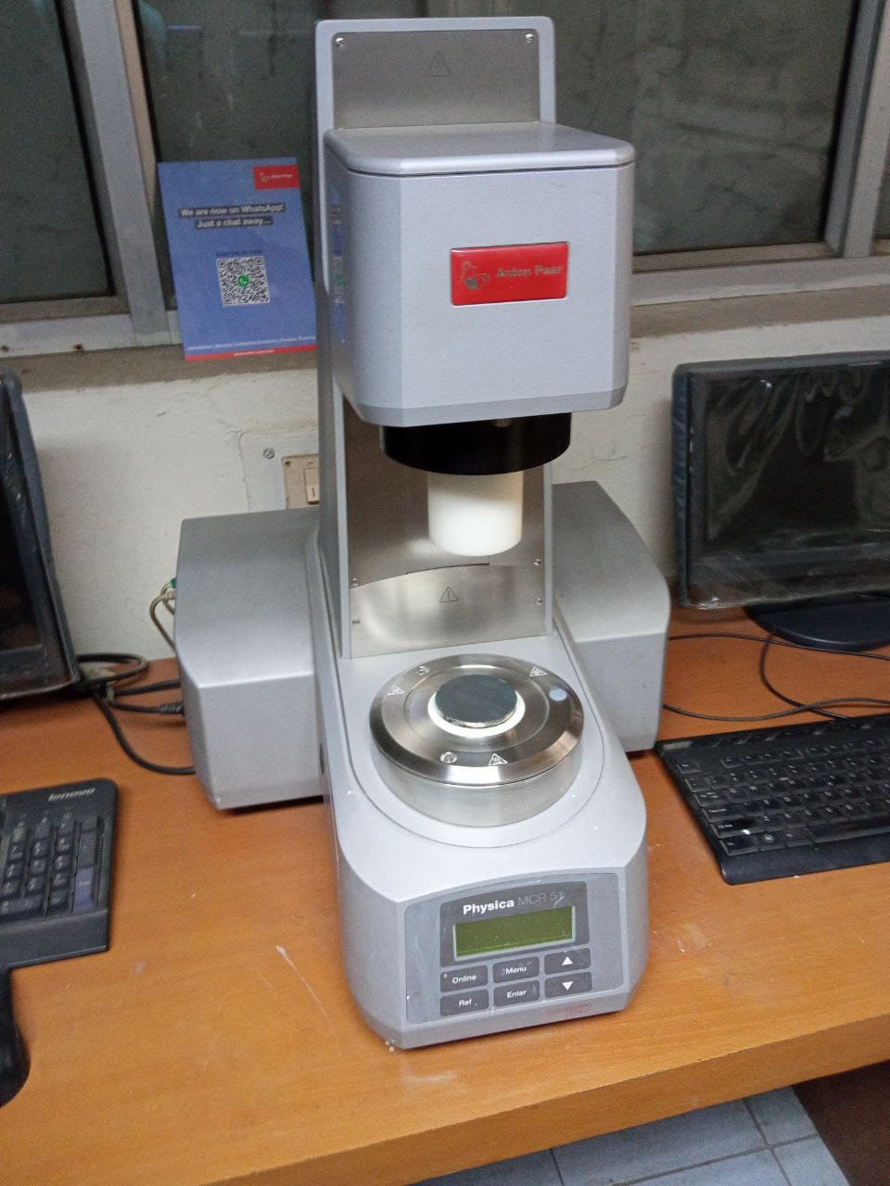
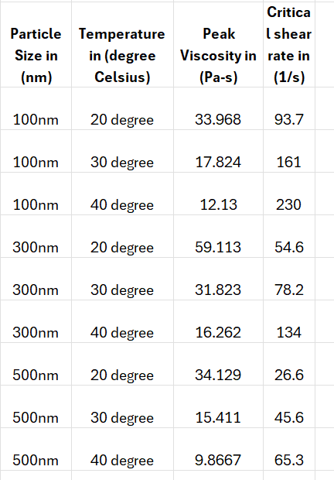
2.3 Rheology Testing
Using the prepared samples, we conducted rheology testing on the rheometer.
Viscosity measurements were taken at various shear rates (controlled by the rheometer settings) at the specified temperatures.
Data collected included shear rate, temperature, and the corresponding viscosity values for each sample.
2.4 Data Collection
The viscosity data obtained from the rheology tests served as the training dataset for the machine learning models.
Each data point will consist of:
Input: Shear rate, temperature, nanoparticle size
Output: Viscosity

Slide 7
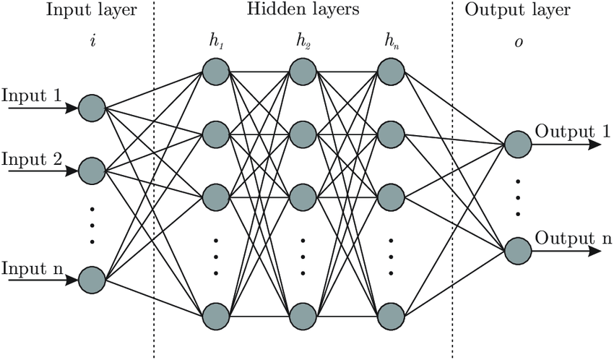

Computational aspect:
(Proposed Earlier)
2.5 Artificial Neural Network (ANN) Model Development
Design an ANN model using software like TensorFlow or PyTorch.
The input layer will have nodes for shear rate, temperature, and nanoparticle size.
The output layer will predict the viscosity.

Slide 8
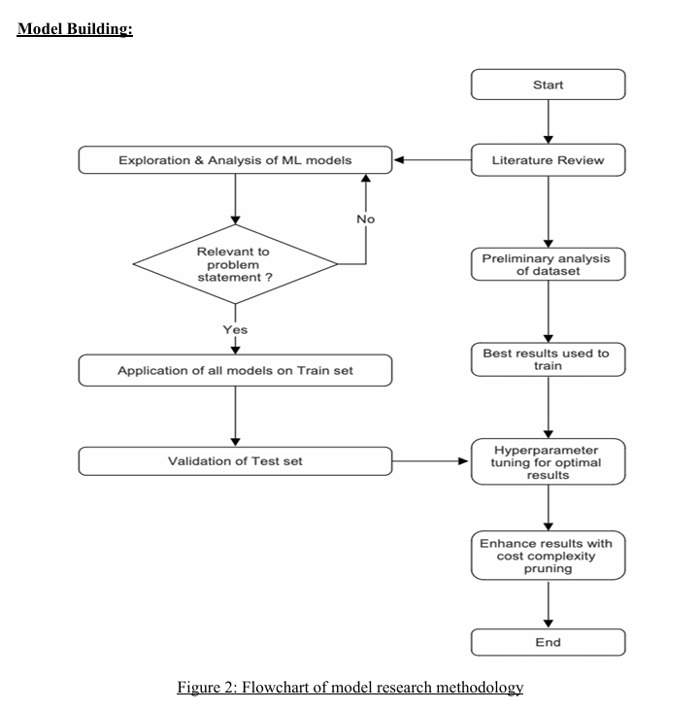
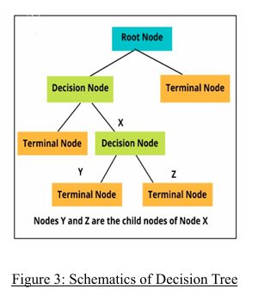
Refining Our Approach
Hyperparameter tuning was performed, specifically varying the maximum depth of the Decision Tree from 2 to 15, with intervals of 4. It was observed that with each 4-level increase in depth, the model's performance improved significantly. The best results were obtained with a maximum depth of 15.

Slide 9
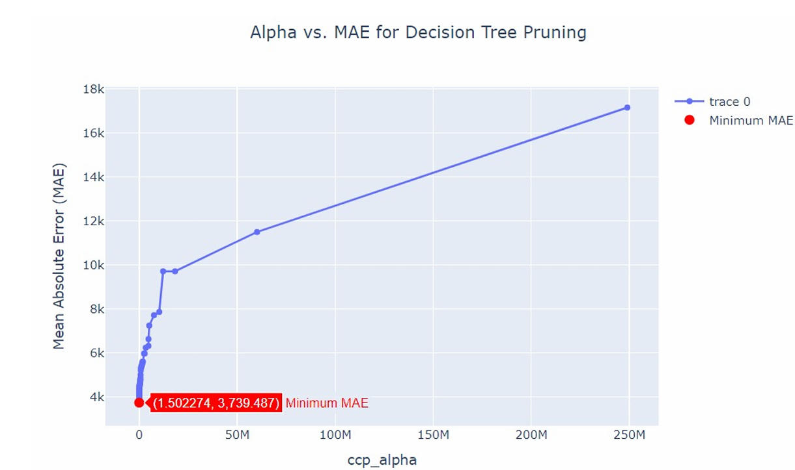
2.6 Fine tuning and model optimization
To optimize the Decision Tree model and avoid overfitting, cost complexity pruning was implemented by considering different values for the ‘ccp_alpha’ parameter. For each pruned tree, the corresponding Mean Absolute Error (MAE) was calculated. The tree associated with the minimum MAE was selected as the final model. The plot here illustrates the MAE values produced by the predictions of various pruned trees at different ‘ccp_alpha’ values, demonstrating how the model's performance changes with increasing pruning levels.

Slide 10
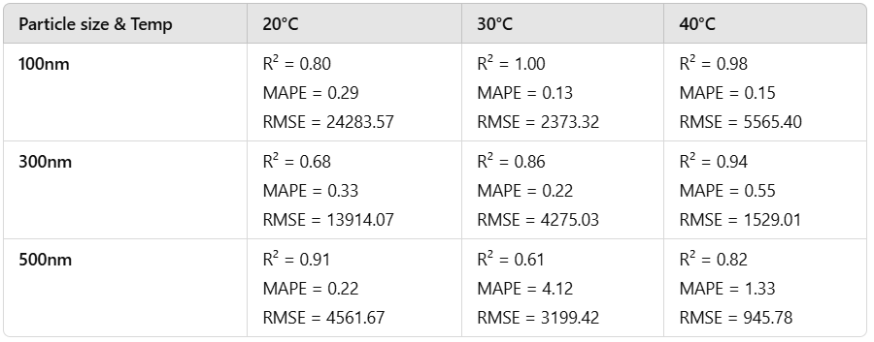
03.
Below is the table presenting the results obtained from the Gradient Boosting Regressor model along with plots of ‘Actual v/s Predicted Viscosity’:
Results & Discussion

Slide 11
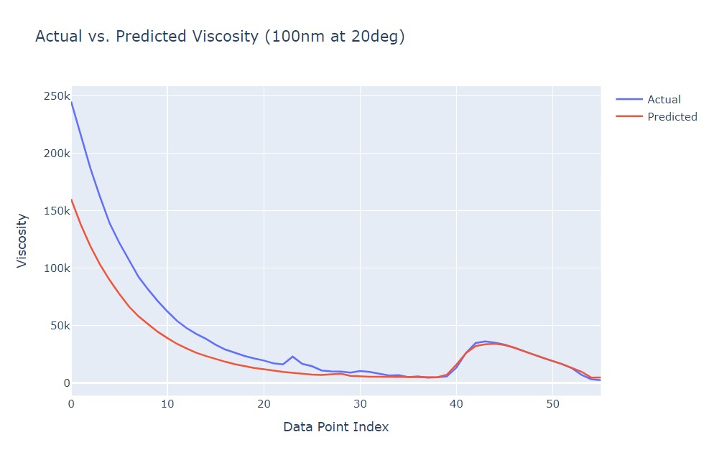
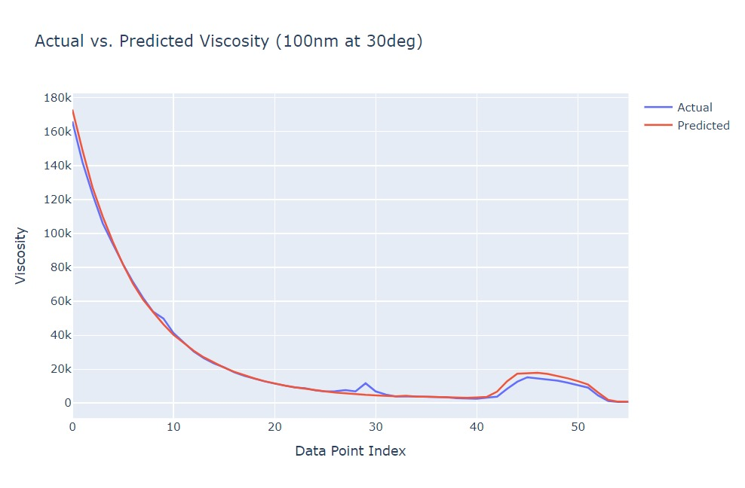
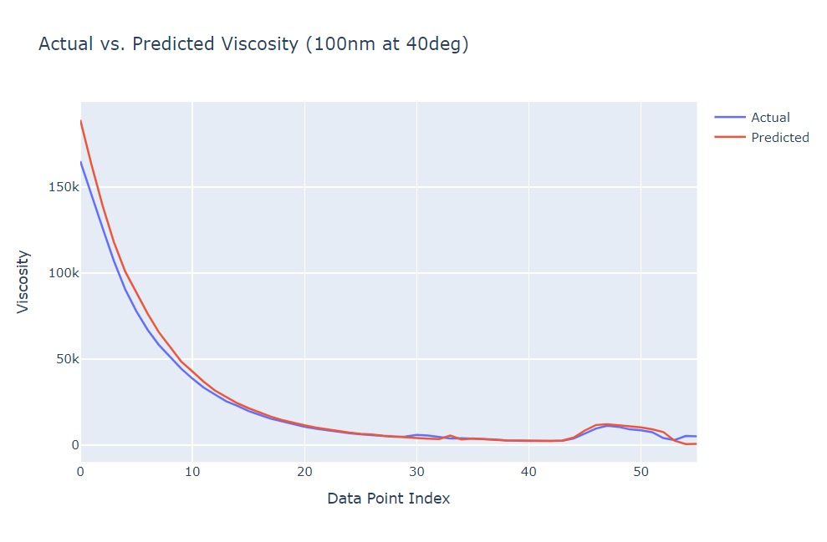
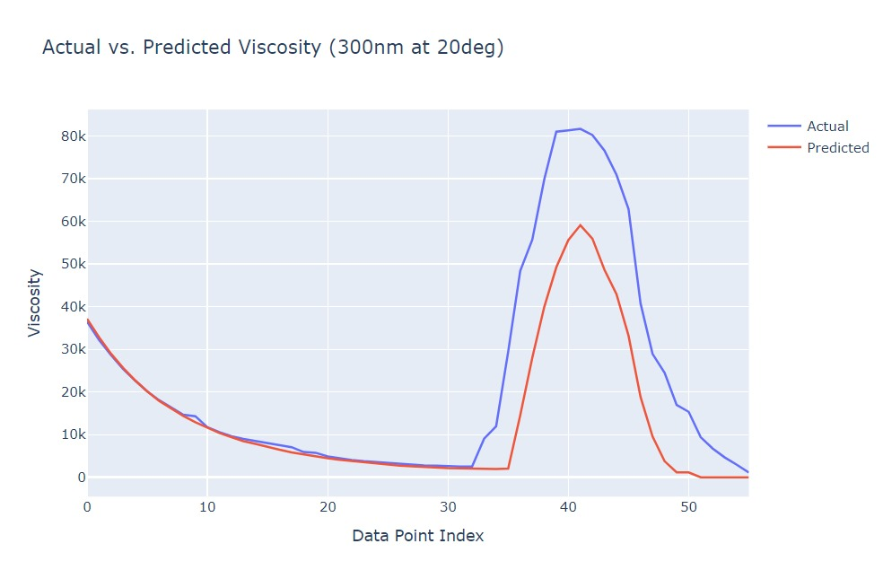
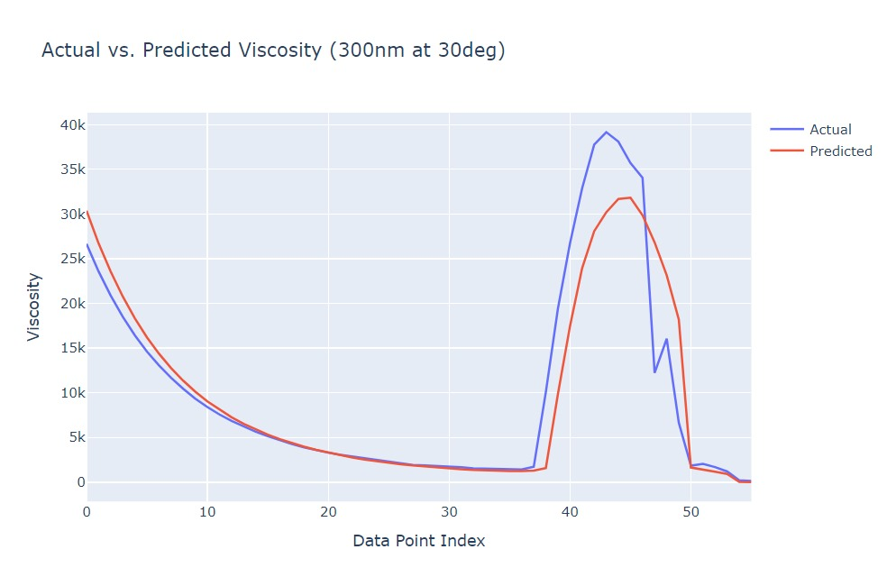
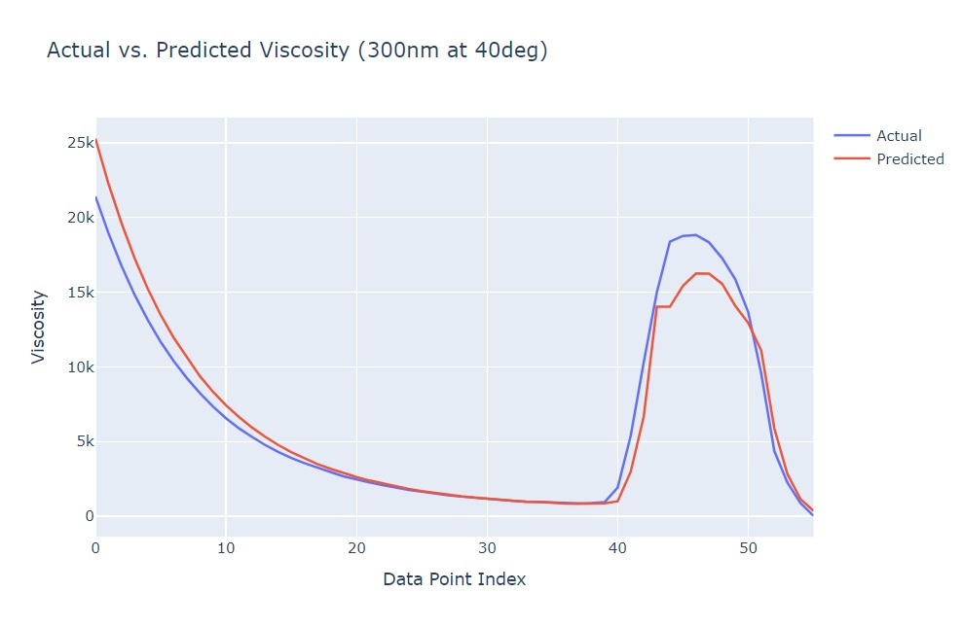
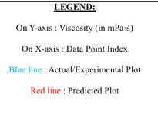
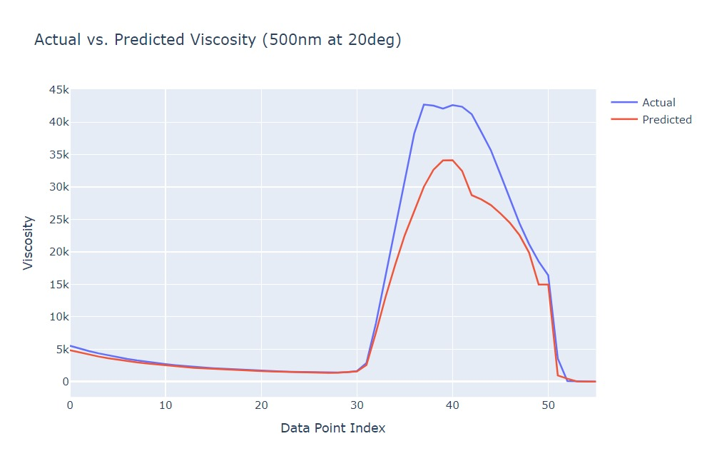
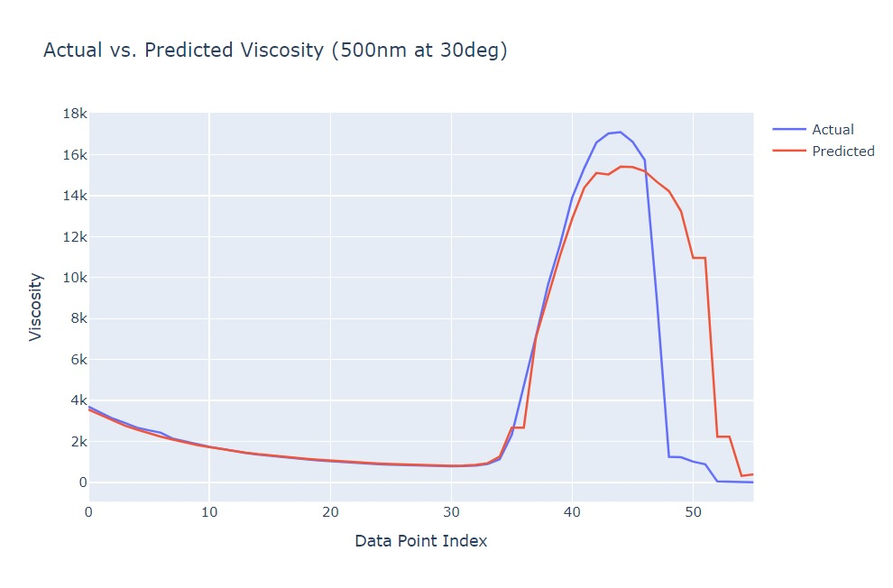
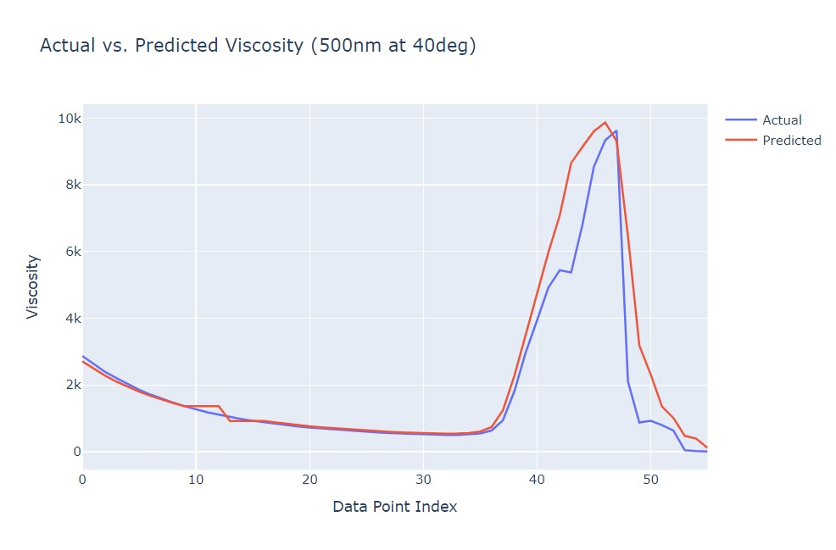

Slide 12
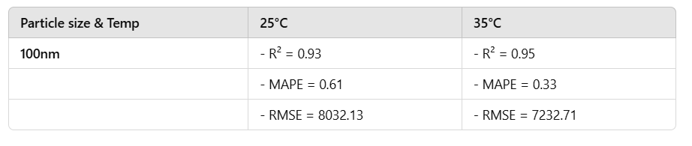
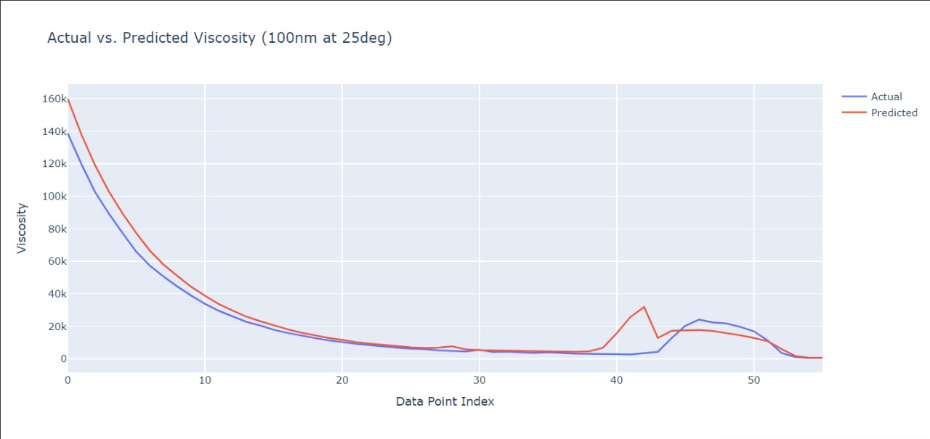
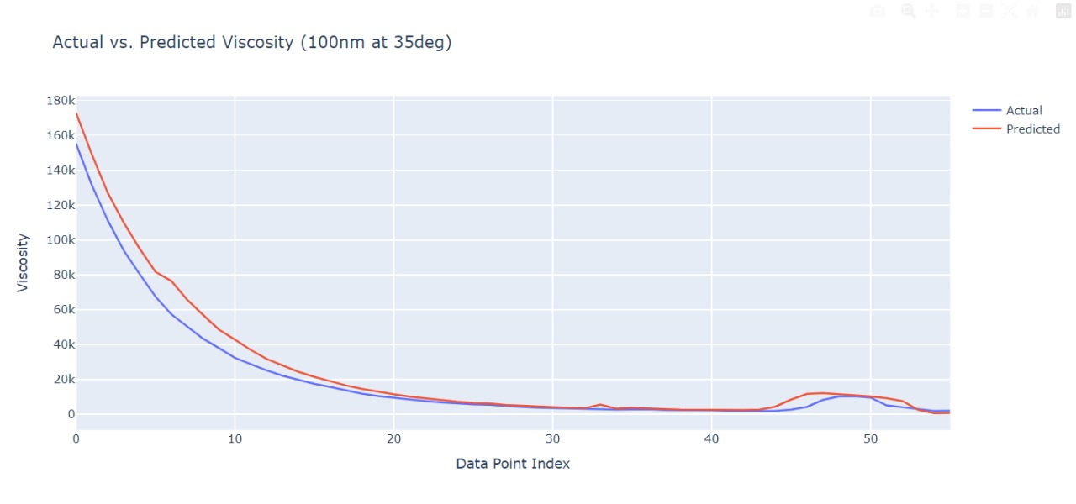
3.1 Assessing Model Validity Across Conditions
We evaluated the predictive accuracy of our model by forecasting the viscosity values for 100 nm silica nanoparticles under rheological testing conditions at 25°C and 35°C. The predicted values were then compared with the experimentally derived viscosity values, for validation of the model.
Here are the results that we obtained along with the plots:

Slide 13
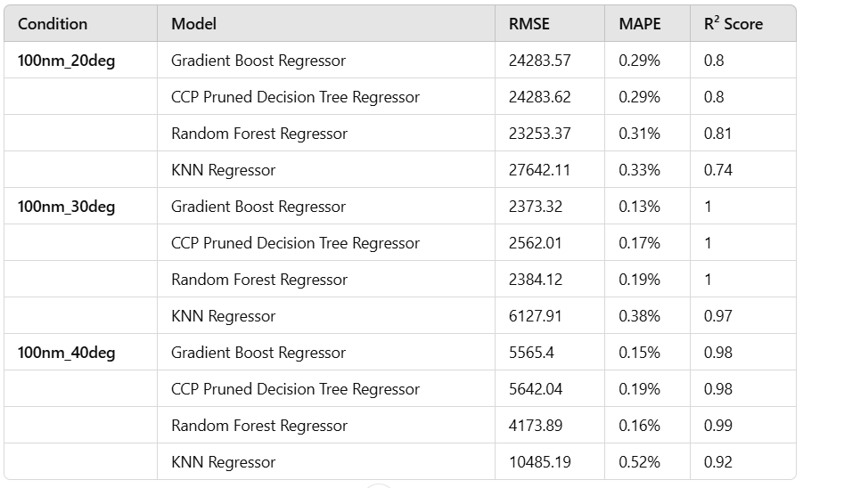
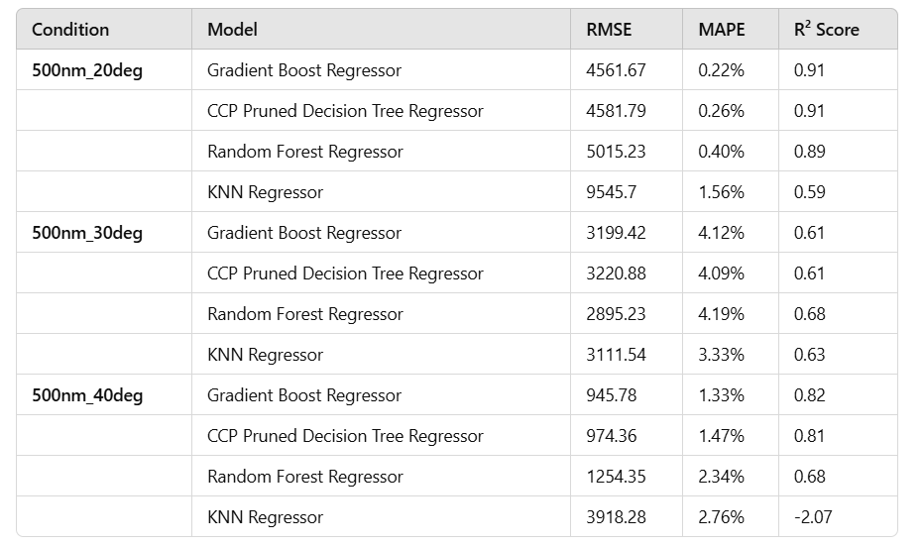
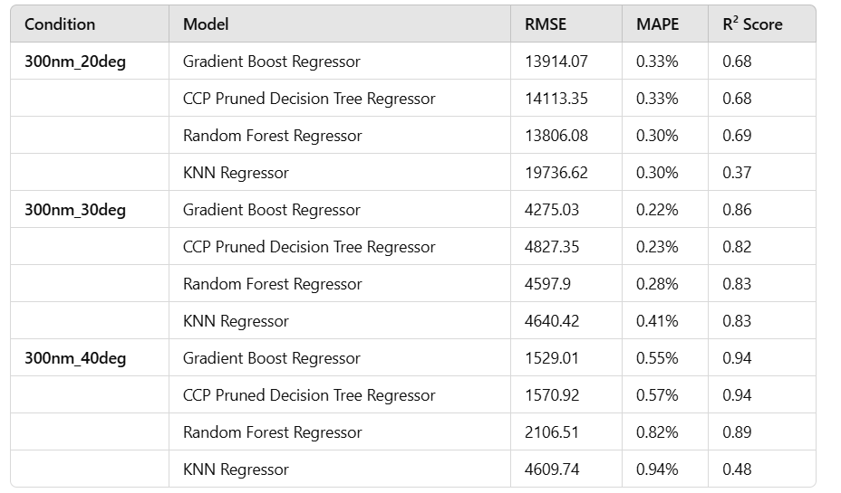
3.2 Comparison between different models
Gradient Boosting Regressor:
Demonstrates superior predictive accuracy across conditions with the best R^2 scores and lowest MAPE.
Ideal for scenarios requiring high accuracy and low error metrics.
CCP Pruned Decision Tree Regressor:
Performs competitively in specific conditions, such as smaller particle sizes and moderate temperatures (e.g., 100nm_20deg, 100nm_40deg).
Achieves comparable R^2 scores and lower RMSE than other models in these cases.
Random Forest Regressor:
Maintains good overall performance but with slightly higher RMSE compared to Gradient Boosting.
Delivers reliable R^2 scores, ensuring reasonable model fit for most datasets.
KNN Regressor:
Lags behind other models, with significantly higher RMSE and MAPE.
May not be suitable for this dataset or problem type, highlighting its limitations.

Slide 14
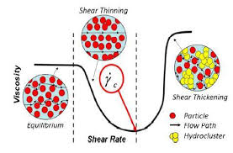
04.
Successfully synthesized multiple Shear Thickening Fluids (STFs) using silica particles of different sizes, specifically 100 nm, 300 nm, and 500 nm.
Conducted rheological studies on the prepared STFs using a rheometer and collected data showing the variation of viscosity with temperature and particle sizes.
Analyzed the collected data and built a predictive model using curve fitting techniques and machine learning models, providing data-driven insights.
Identified and implemented improvements to existing models by evaluating various machine learning techniques to address shortcomings observed.
Schematics of Shear Thinning and Shear Thickening Effect
Conclusion

Slide 15
References
F.J. Galindo-Rosales,F.J. Rubio-Hernández, and A. Sevilla, (2011) ‘An apparent viscosity function for shear thickening fluids’, Journal of Non-Newtonian Fluid Mechanics, 166(5–6), pp. 321–325. doi:10.1016/j.jnnfm.2011.01.001.
Mohammad Hemmat Esfe,Seyfolah Saedodin,Nima Sina,Masoud Afrand,Sara Rostami, (2015) ‘Designing an artificial neural network to predict thermal conductivity and dynamic viscosity of ferromagnetic nanofluid’, International Communications in Heat and Mass Transfer, 68, pp. 50–57. doi:10.1016/j.icheatmasstransfer.2015.06.013.
Marziyeh Ramzi , Mahdi Kashaninejad , Fakhreddin Salehi , Ali Reza Sadeghi Mahoonak, Seyed Mohammad Ali Razavi (2015) ‘Modeling of rheological behavior of honey using genetic algorithm–artificial neural network and adaptive neuro-fuzzy inference system’, Food Bioscience, 9, pp. 60–67. doi:10.1016/j.fbio.2014.12.001.
Zarei, M. and Aalaie, J. (2020) ‘Application of shear thickening fluids in material development’, Journal of Materials Research and Technology, 9(5), pp. 10411–10433. doi:10.1016/j.jmrt.2020.07.049.
Sanchi Arora, Animesh Laha, Abhijit Majumdar and Bhupendra Singh Butola (2017) ‘Prediction of rheology of shear thickening fluids using phenomenological and artificial neural network models’, Korea-Australia Rheology Journal, 29(3), pp. 185–193. doi:10.1007/s13367-017-0019-x.

Slide 16
THANK
YOU!

