Slide 1
Analysis of Maynard et al., 2020 brain spatial transcriptomic data
4/17

Slide 2
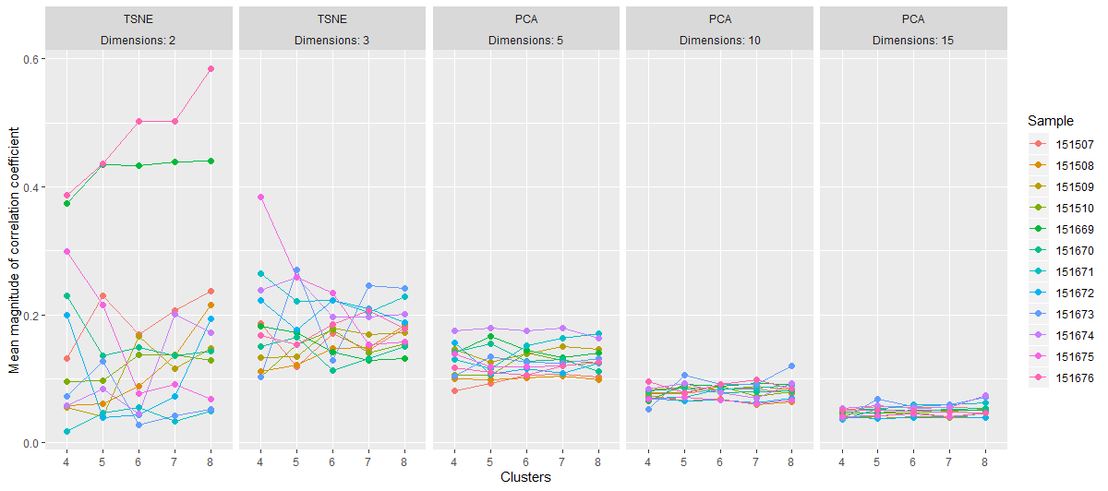
TSNE vs. PCA

Slide 3
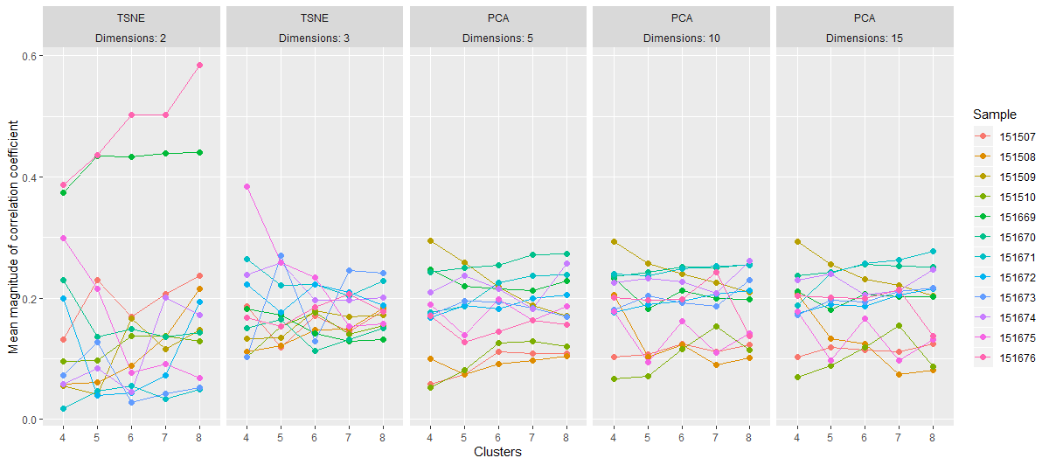
TSNE vs. top 3 PCs

Slide 4
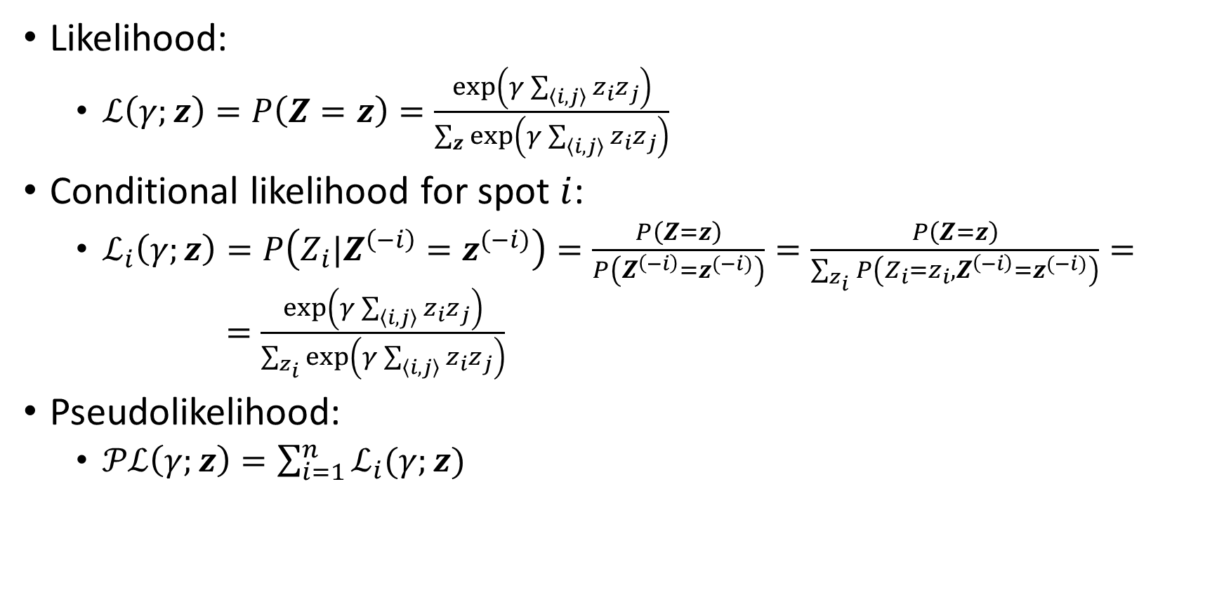
Ising Likelihood and pseudolikelihood
Likelihood:
$ℒ\left(γ;z\right)=P\left(Z=z\right)=\frac{\exp\left(γ\sum_{\left\langle i,j\right\rangle }{z_{i}z_{j}}\right)}{\sum_{z}{\exp\left(γ\sum_{\left\langle i,j\right\rangle }{z_{i}z_{j}}\right)}}$
Conditional likelihood for spot $i$:
$ℒ_{i}\left(γ;z\right)=P\left(Z_{i}|Z^{\left(−i\right)}=z^{(−i)}\right)=\frac{P\left(Z=z\right)}{P\left(Z^{\left(−i\right)}=z^{(−i)}\right)}=\frac{P\left(Z=z\right)}{\sum_{z_{i}}{P\left(Z_{i}=z_{i},Z^{\left(−i\right)}=z^{(−i)}\right)}}= =\frac{\exp\left(γ\sum_{\left\langle i,j\right\rangle }{z_{i}z_{j}}\right)}{\sum_{z_{i}}{\exp\left(γ\sum_{\left\langle i,j\right\rangle }{z_{i}z_{j}}\right)}}$
Pseudolikelihood:
$𝒫ℒ\left(γ;z\right)=\sum_{i=1}^{n}{ℒ_{i}(γ;z)}$

Slide 5
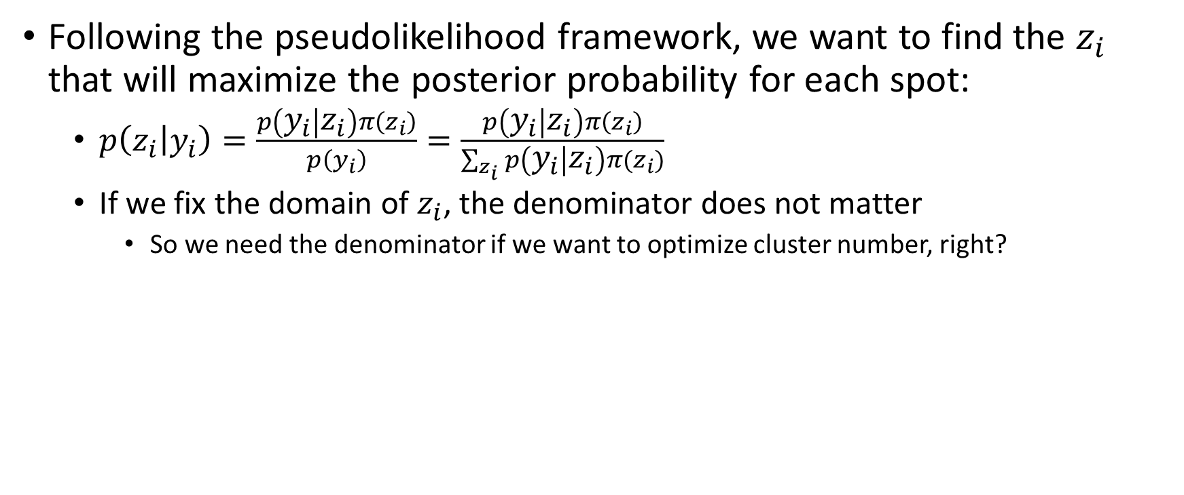
Maximum a posterior probability
Following the pseudolikelihood framework, we want to find the $z_{i}$ that will maximize the posterior probability for each spot:
$p\left(z_{i} | y_{i}\right)=\frac{p\left(y_{i} | z_{i}\right)π\left(z_{i}\right)}{p\left(y_{i}\right)}=\frac{p\left(y_{i} | z_{i}\right)π\left(z_{i}\right)}{\sum_{z_{i}}{p\left(y_{i} | z_{i}\right)π(z_{i})}}$
If we fix the domain of $z_{i}$, the denominator does not matter
So we need the denominator if we want to optimize cluster number, right?

Slide 6

Initialization issues
Start with weak field (Besag 1986)
Start with $γ=0$, gradually increasing to final desired $γ$ in successive iterations
Estimate $γ$ at each iteration (Besag 1986)
Maximize $\prod_{i}{p_{i}\left(x_{i}|x^{\left(−i\right)},γ\right)}$

Slide 7

Next steps
Speed up code
Tune $γ$ for deconvolution
Normality of t-SNE

