Slide 1
BayesSpace Update
6-10

Slide 2
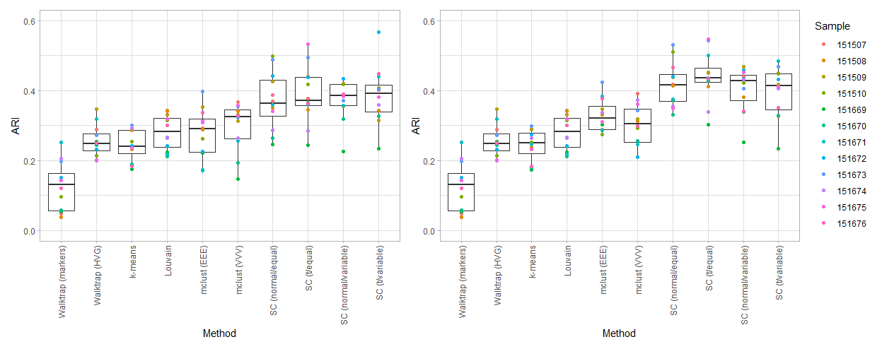
DLPFC spatial clustering on 10 (left) and 15 (right) PCs

Slide 3
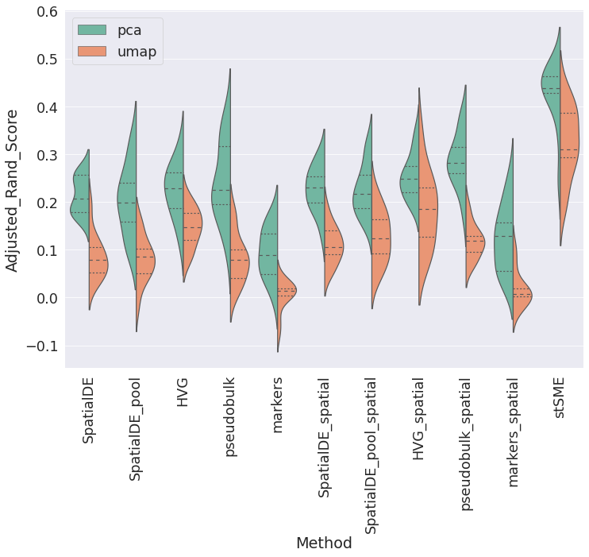
Comparison with stLearn

Slide 4
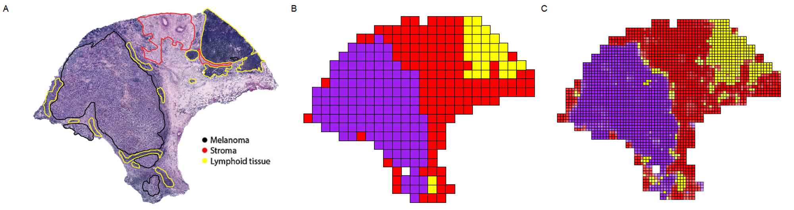
Melanoma: clustering

Slide 5
Melanoma: deconvolution

Slide 6
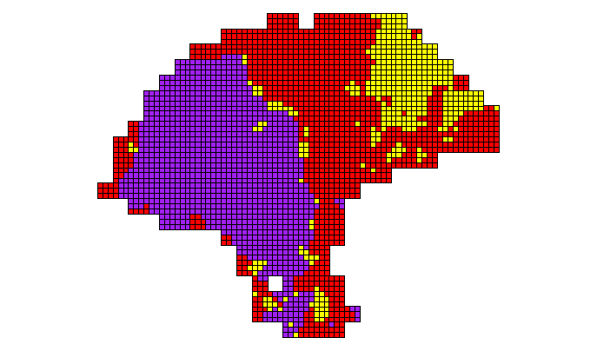
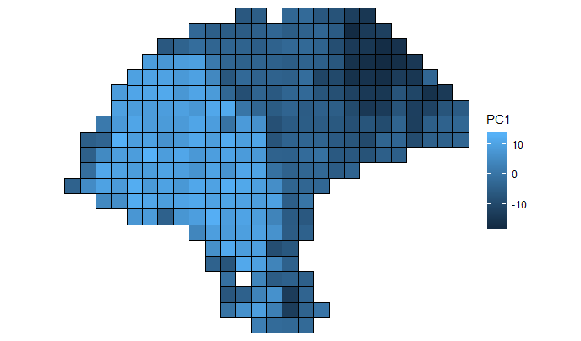
Melanoma simulation
Ground truth
Simulated PC1

Slide 7
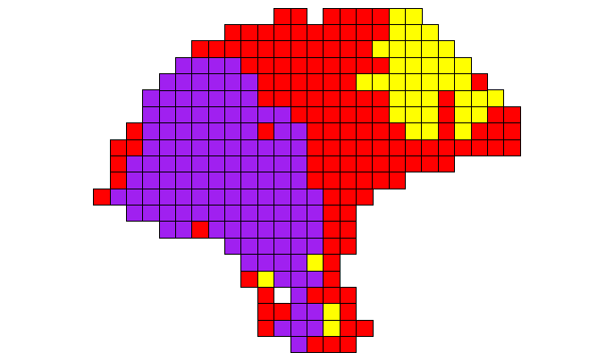
Melanoma simulation
Ground truth
K-means (ARI = 0.756)

Slide 8
Melanoma simulation
Ground truth
K-means (ARI = 0.756)

Slide 9
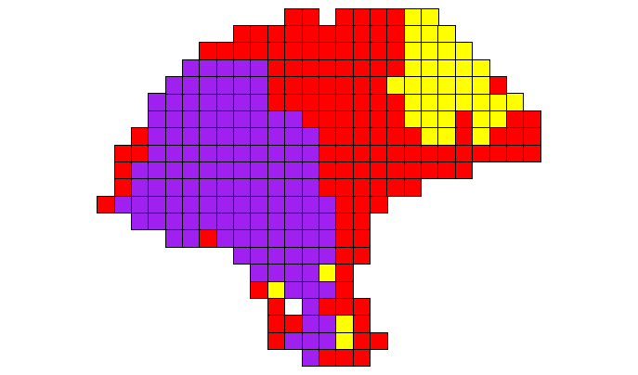
Melanoma simulation
Ground truth
Spatial clustering (ARI = 0.765)

Slide 10
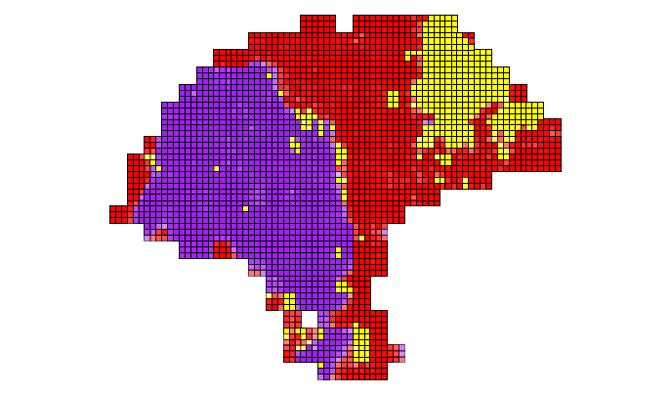
Melanoma simulation
Ground truth
Spatial deconvolution (ARI = 0.823)

Slide 11
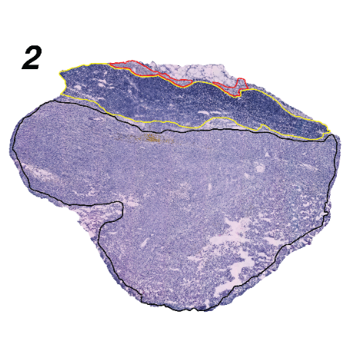
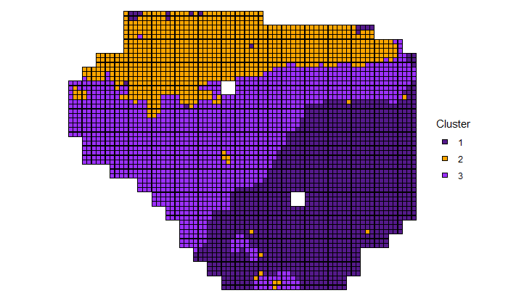
Melanoma sample 2

