Slide 1
Update
6/17

Slide 2
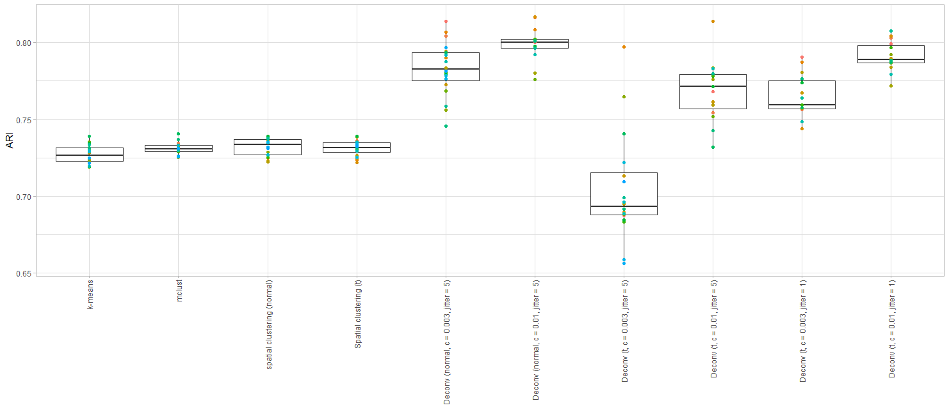
Deconvolution simulations
Normal deconv
t deconv
Big step
Small step

Slide 3


Normal deconvolution, weak prior
Ground truth
Normal deconvolution, c = 0.003

Slide 4
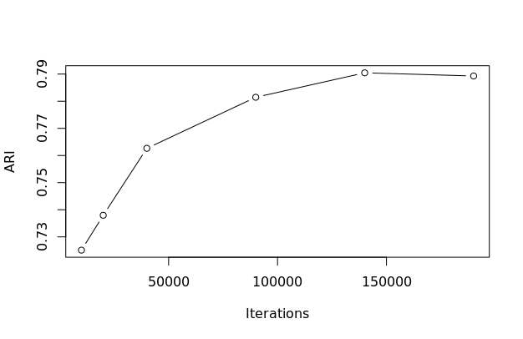
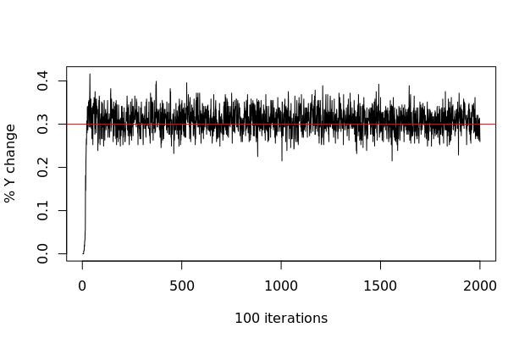
Normal deconvolution ARI vs. iterations

Slide 5

T deconvolution, weak prior, large step
Ground truth
T deconvolution, c = 0.003, jitter = 5

Slide 6
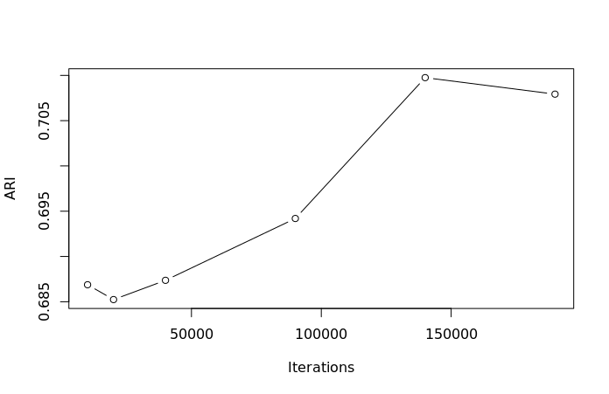
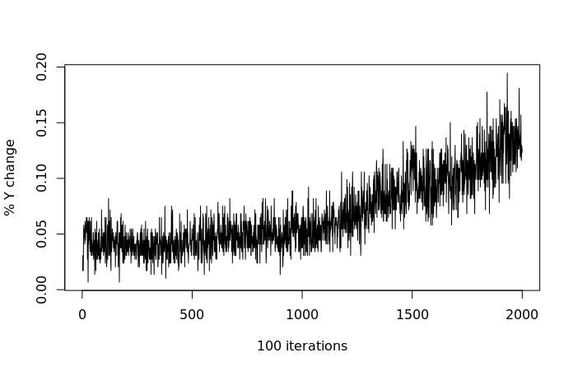
T deconvolution ARI vs. iterations

Slide 7

T deconvolution, weak prior, small step
Ground truth
T deconvolution, c = 0.003, jitter = 1

Slide 8
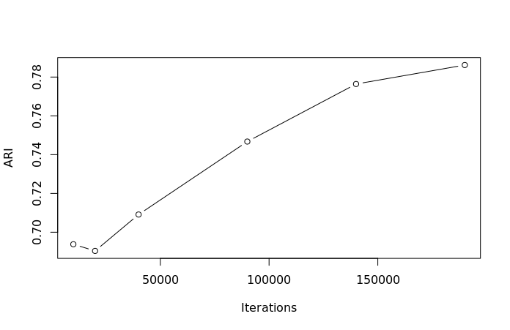
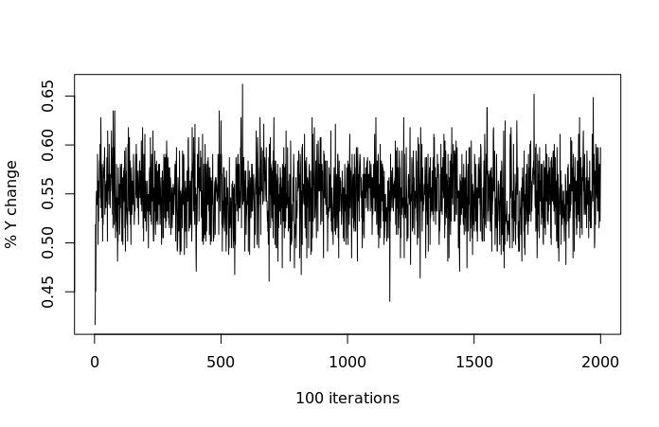
T deconvolution ARI vs. iterations

Slide 9

T deconvolution, strong prior, small step
Ground truth
T deconvolution, c = 0.01, jitter = 1

Slide 10
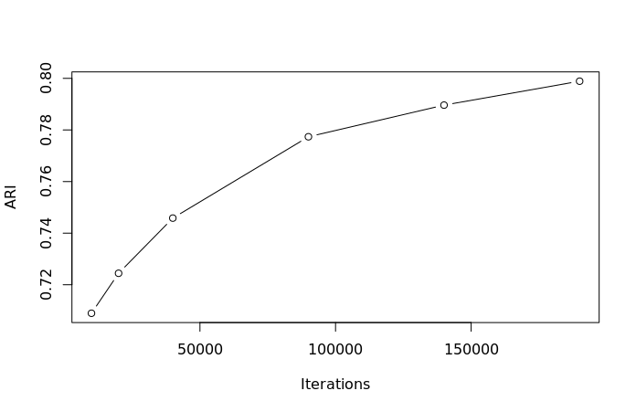
T deconvolution ARI vs. iterations

