Slide 1
Update
6-12

Slide 2
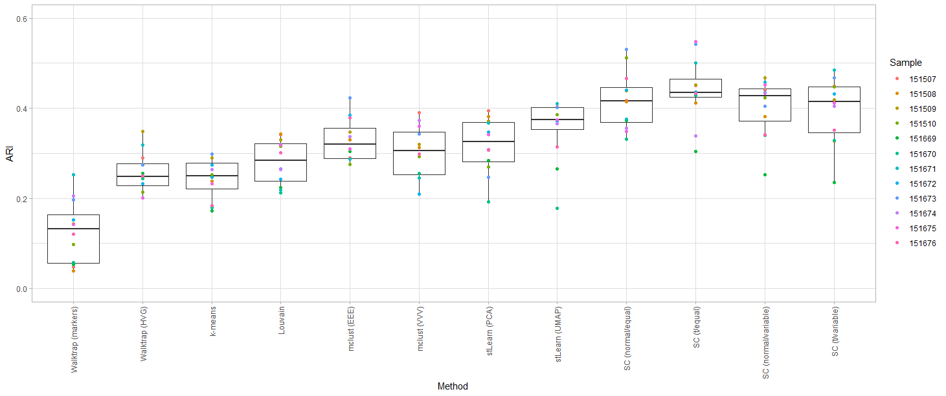
stLearn

Slide 3
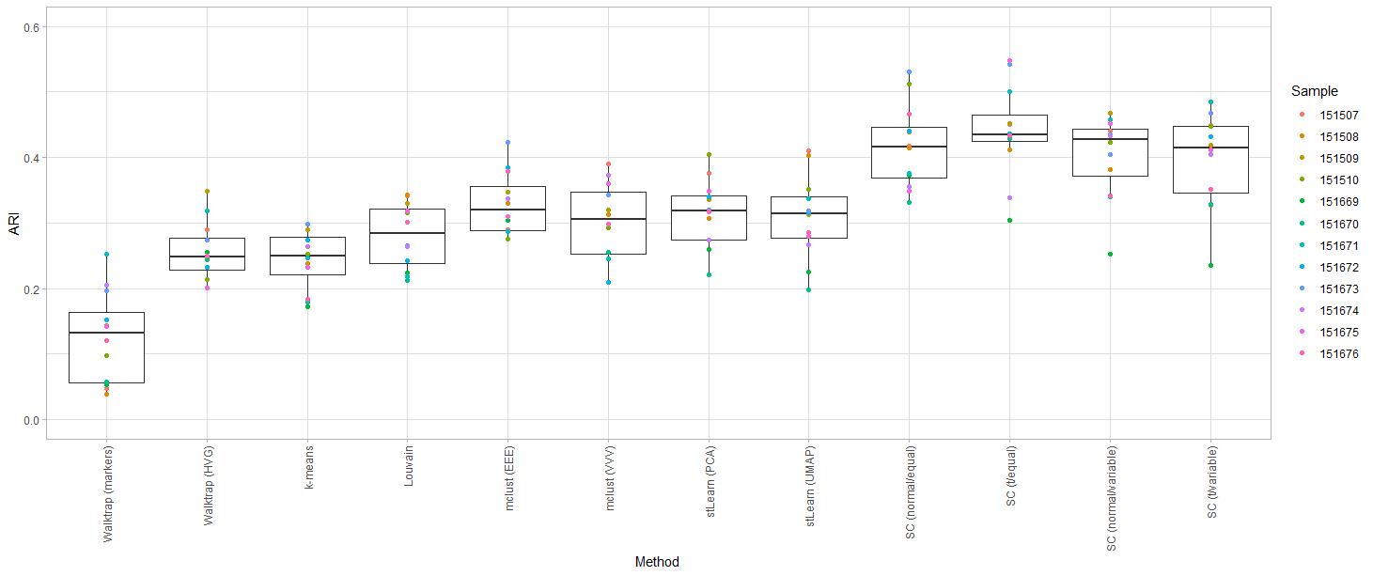
stLearn on HVGs

Slide 5
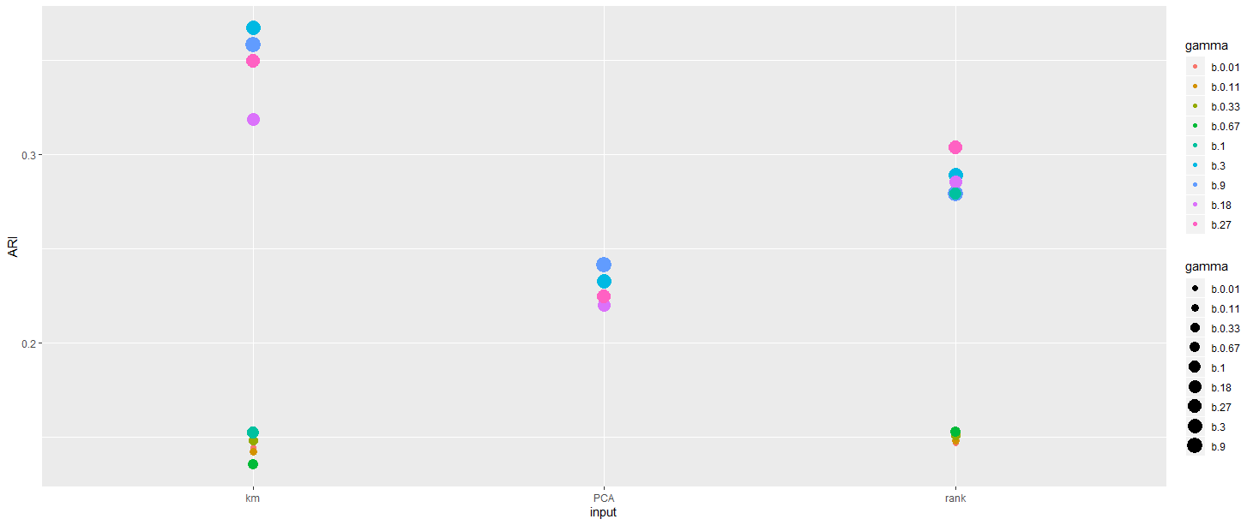
Giotto

Slide 6
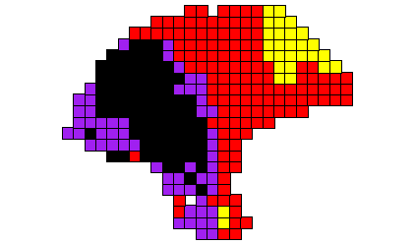
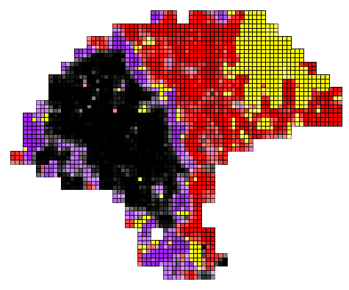
Melanoma sample with 4 clusters

Slide 7
