Slide 1
BayesSpace Update
6-5

Slide 2
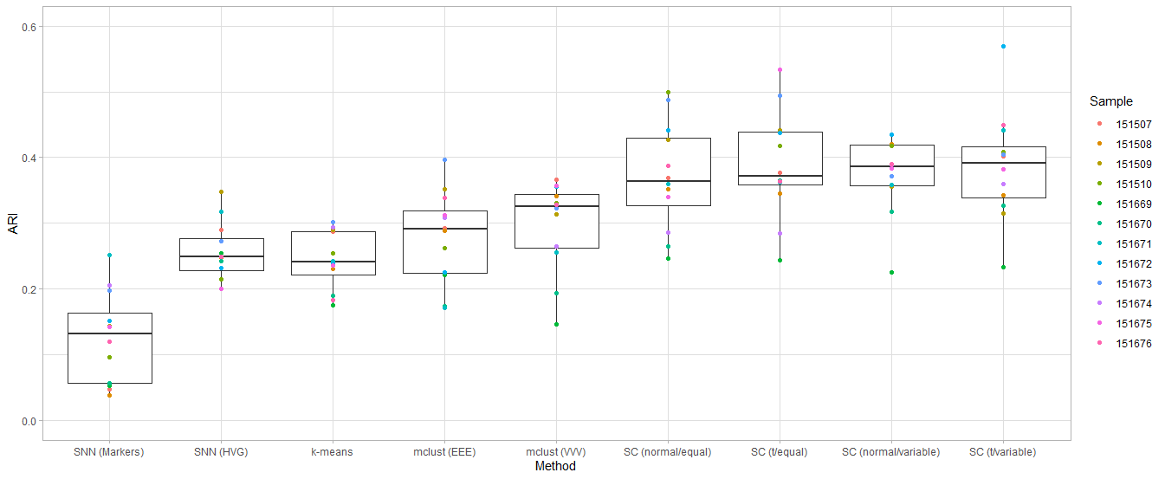
DLPFC Spatial clustering on 10 PCs

Slide 3
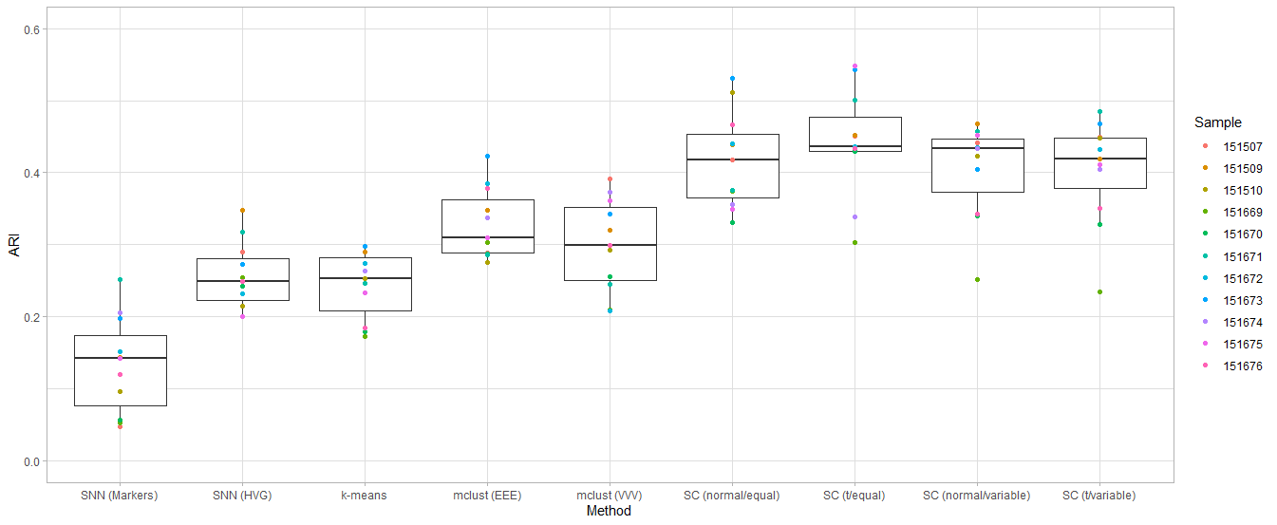
DLPFC Spatial clustering on 15 PCs

Slide 4
Sample 151508
Spatial clustering with t-distributed errors and variable cluster precision results in an error on iteration 224
warning: chol(): given matrix is not symmetric
Error in iterate_t_vvv(): Probabilities must be finite and non-negative!

Slide 5
Giotto workflow
createGiottoObject
raw_exprs = counts(sce)
spatial_locs = positions
normalizeGiotto
calculateHVG
runPCA
createSpatialNetwork
maximum_distance_delaunay = 9
binSpect (calculate spatially expressed genes)
doHMRF
k
dimensions_to_use = 1:10
betas
viewHMRF

