Slide 1
Spatial Update
5/26

Slide 2
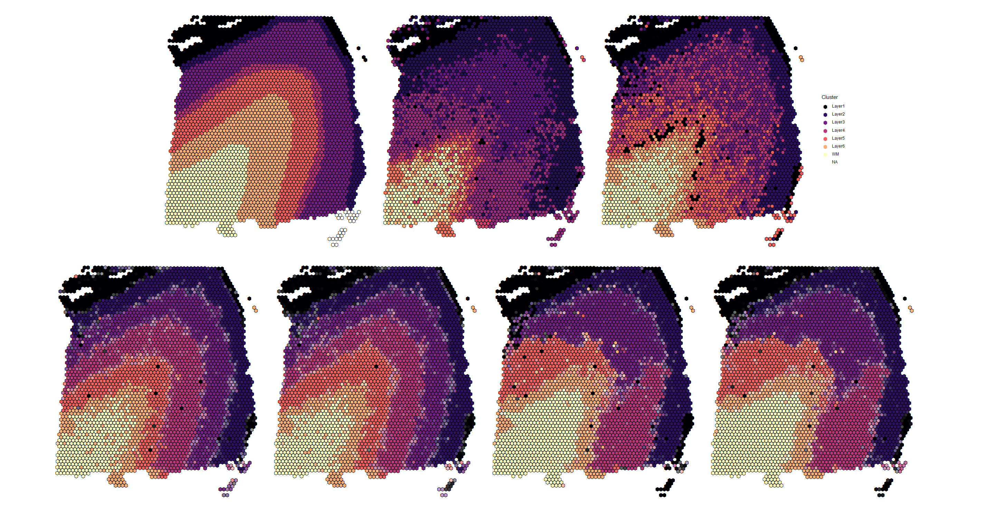
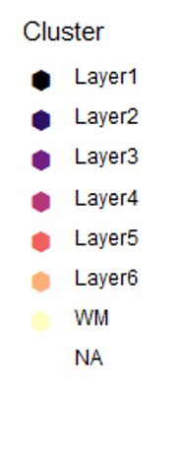
Manual Annotation
SNN (ARI = 0.273)
k-means (ARI = 0.281)
Prefrontal Cortex
Sample 151673
Spatial clustering, γ = 1.5
Gaussian, fixed (ARI = 0.468)
t, fixed (ARI = 0.484)
Gaussian, variable (ARI = 0.351)
t, variable (ARI = 0.360)

Slide 3

Simulation 1
Run deconvolution on PCs from sample 151673
Given estimated $μ,Λ,z$, simulate $Y_{i}$ (at the sub-spot level)
Aggregate sub-spots to generate spot-level $Y_{i}^{∗}$
Run deconvolution on aggregated simulated $Y_{i}^{∗}$

