Slide 1
BayesSpace Update
6-6

Slide 2
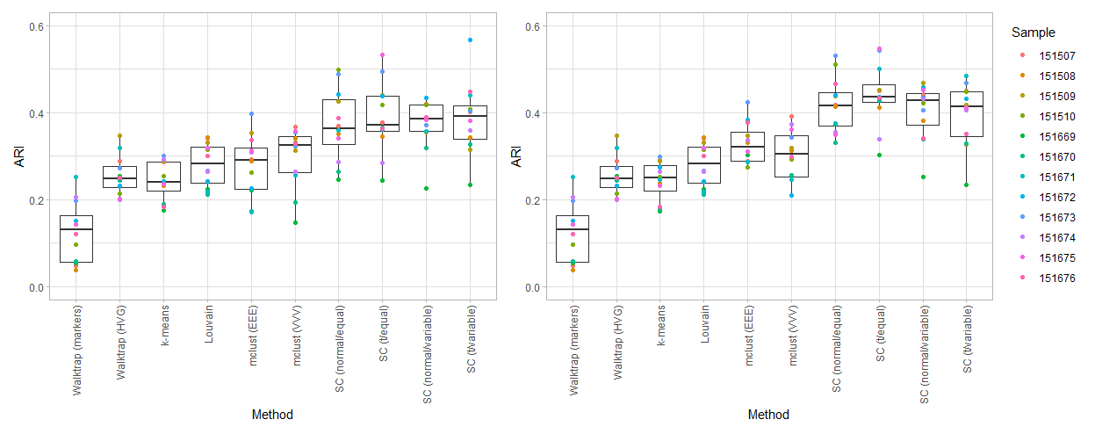
DLPFC spatial clustering on 10 (left) and 15 (right) PCs

Slide 3
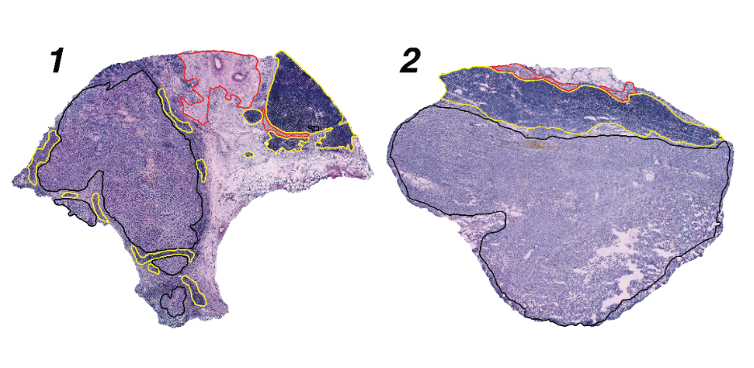
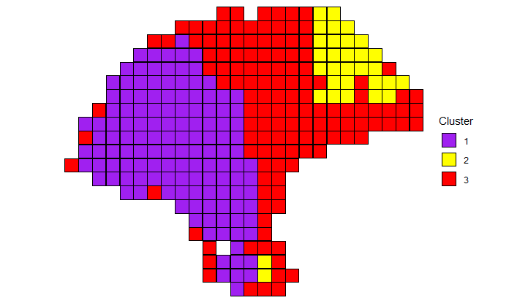
Deconvolution with melanoma

Slide 4
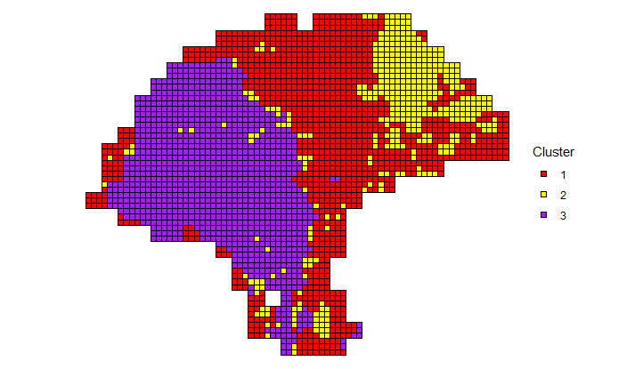
Deconvolution with melanoma

Slide 5
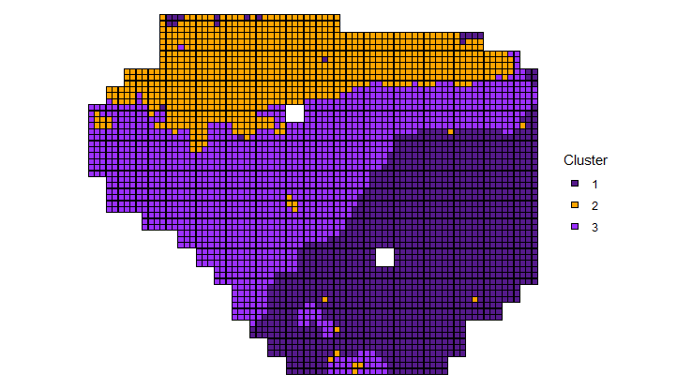
Sample 2

Slide 6
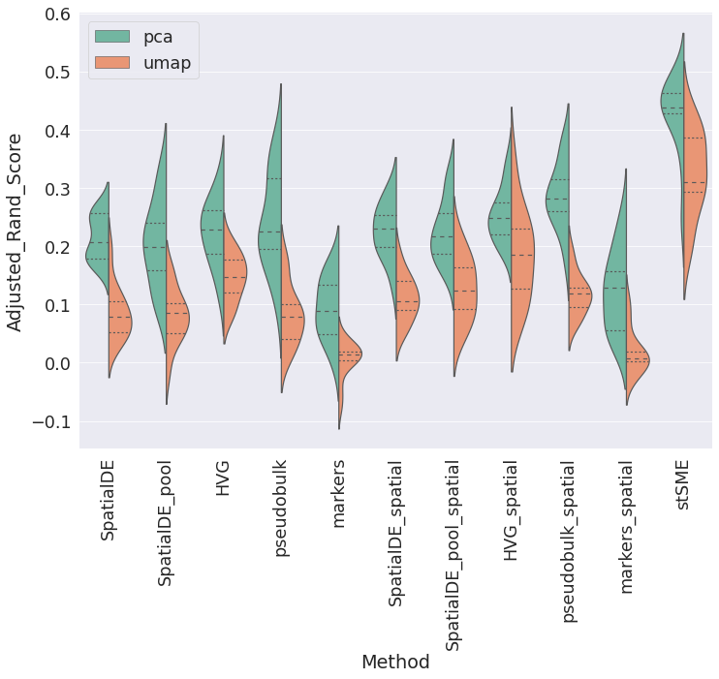
Comparison with stLearn

