Slide 1
3/11

Slide 2
Hexagonal lattice 1 overlaid on capture locations (left), idealized (right)

Slide 3
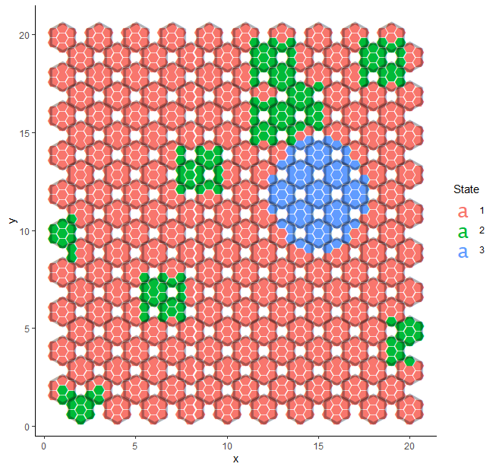
Ground truth with 3 states

Slide 4
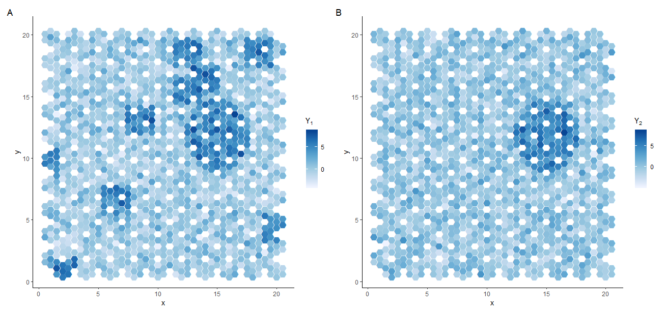
Single-cell resolution expression

Slide 5
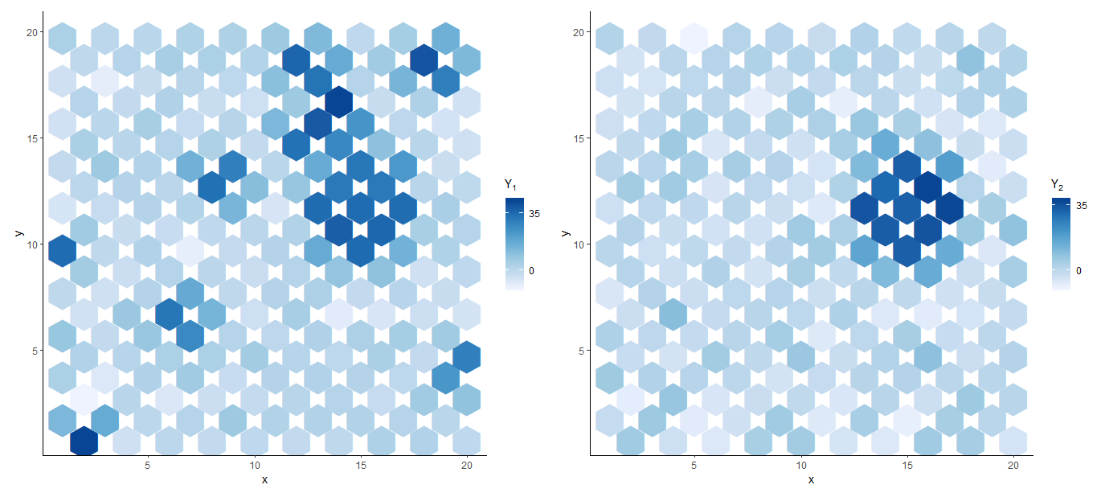
Pooled expression

Slide 6
Drawing to scale:
VISIUM capture locations (blue circles) shown on a square lattice
Diameter of capture location: 55μm
Distance between capture locations: 100μm
Grid unit length: 100μm/sqrt(2)

