Slide 1
Spatial Update
5/26

Slide 2

Simulation 1
Run deconvolution on PCs from sample 151673
Given estimated $μ,Λ,z$, simulate $Y_{i}$ (at the sub-spot level)
Aggregate sub-spots to generate spot-level $Y_{i}^{∗}$
Run deconvolution on aggregated simulated $Y_{i}^{∗}$

Slide 3
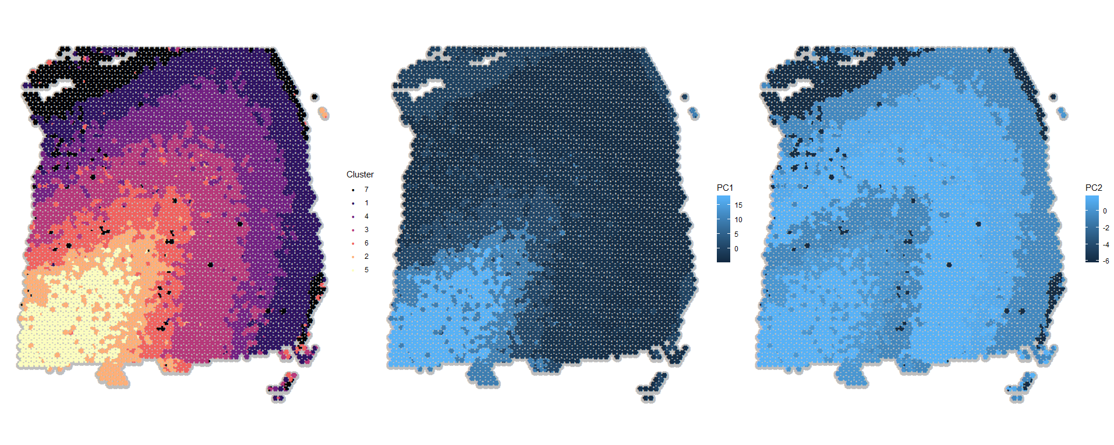
Deconvolution labels and means
Truth
PC1
Cluster mean
PC2
Cluster mean

Slide 4
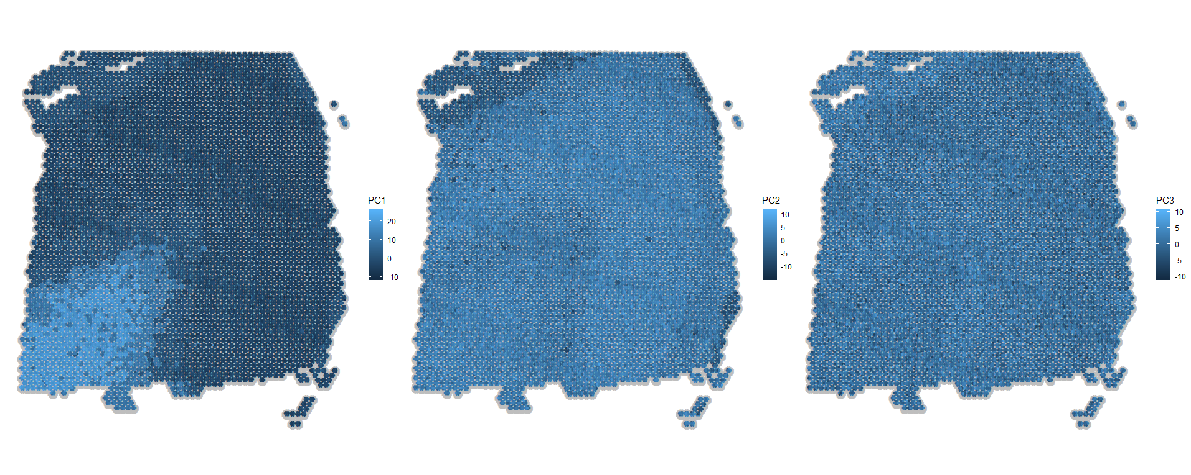
Simulated PCs at the sub-spot level
PC1
PC2
PC3

Slide 5
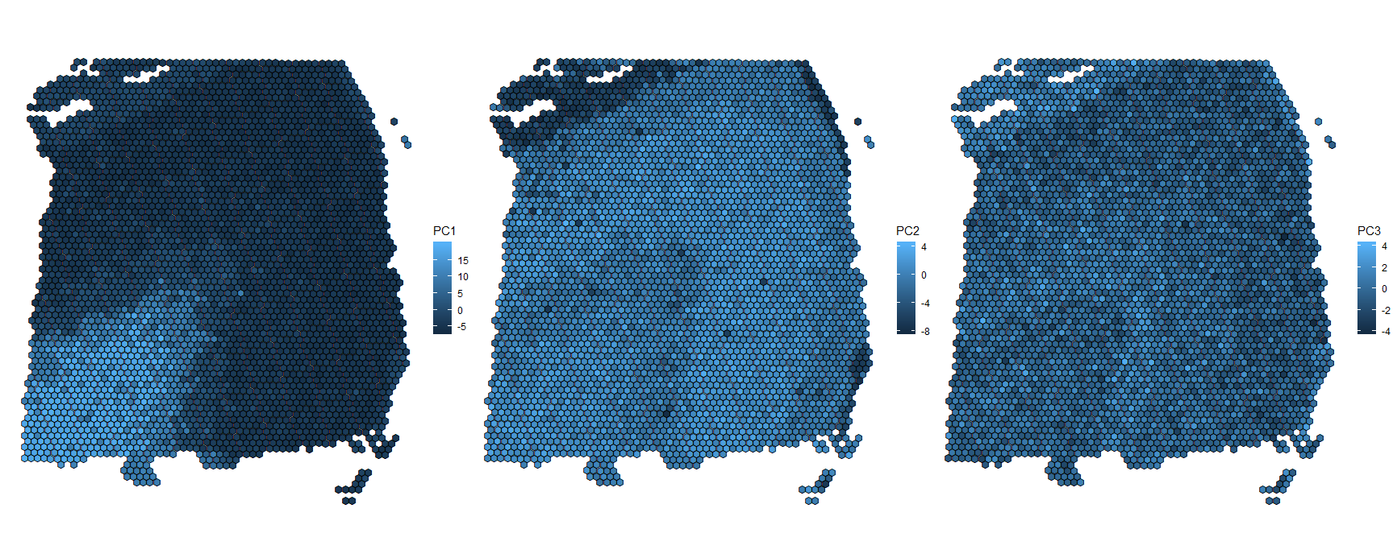
Aggregated simulated PCs: 7 sub-spots ⇨ 1 spot
PC1
PC2
PC3

Slide 6
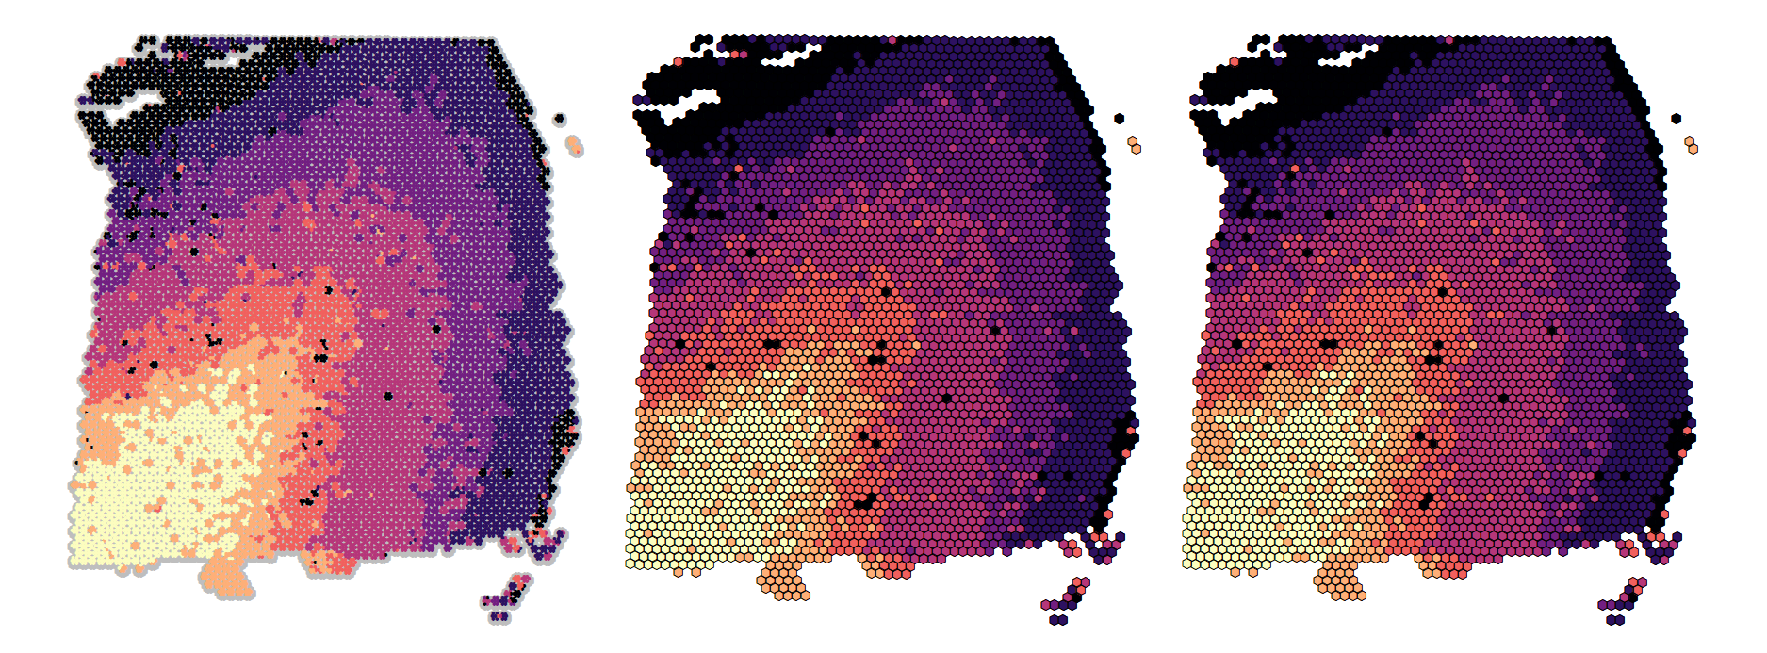
Clustering
Truth
mclust
ARI=0.874
Spatial clustering
ARI=0.881

Slide 7
Deconvolution
ARI
γ=2: 0.896
γ=3: 0.901
γ=4: 0.898
γ=5: 0.896

