Slide 1
BayesSpace Update
6-6

Slide 2
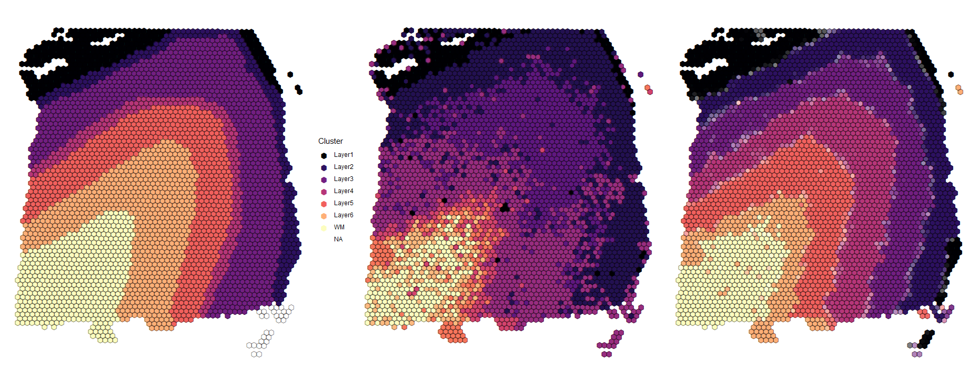
Dorsolateral prefrontal cortex (DLPFC) layers
Manual Annotation
Non-spatial Clustering
Spatial Clustering

Slide 3
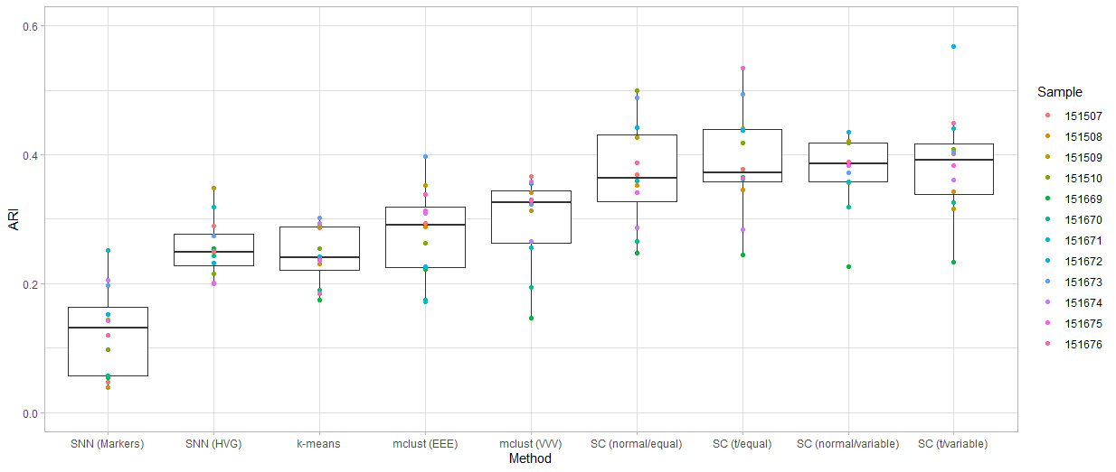
DLPFC spatial clustering on 10 PCs

Slide 4
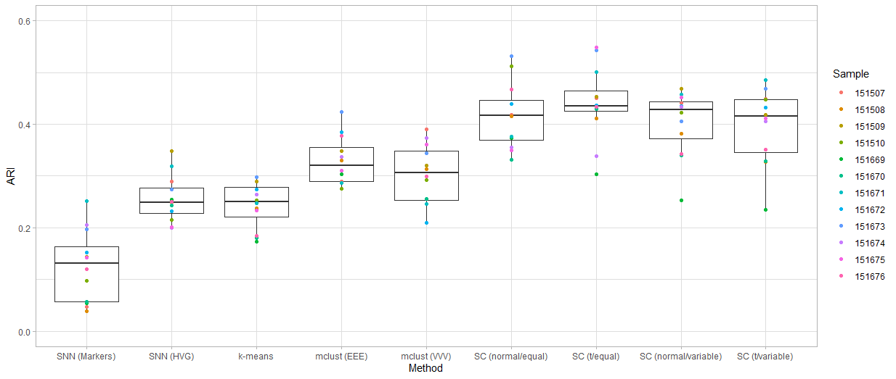
DLPFC spatial clustering on 15 PCs

