Slide 1
2/14/2020

Slide 2
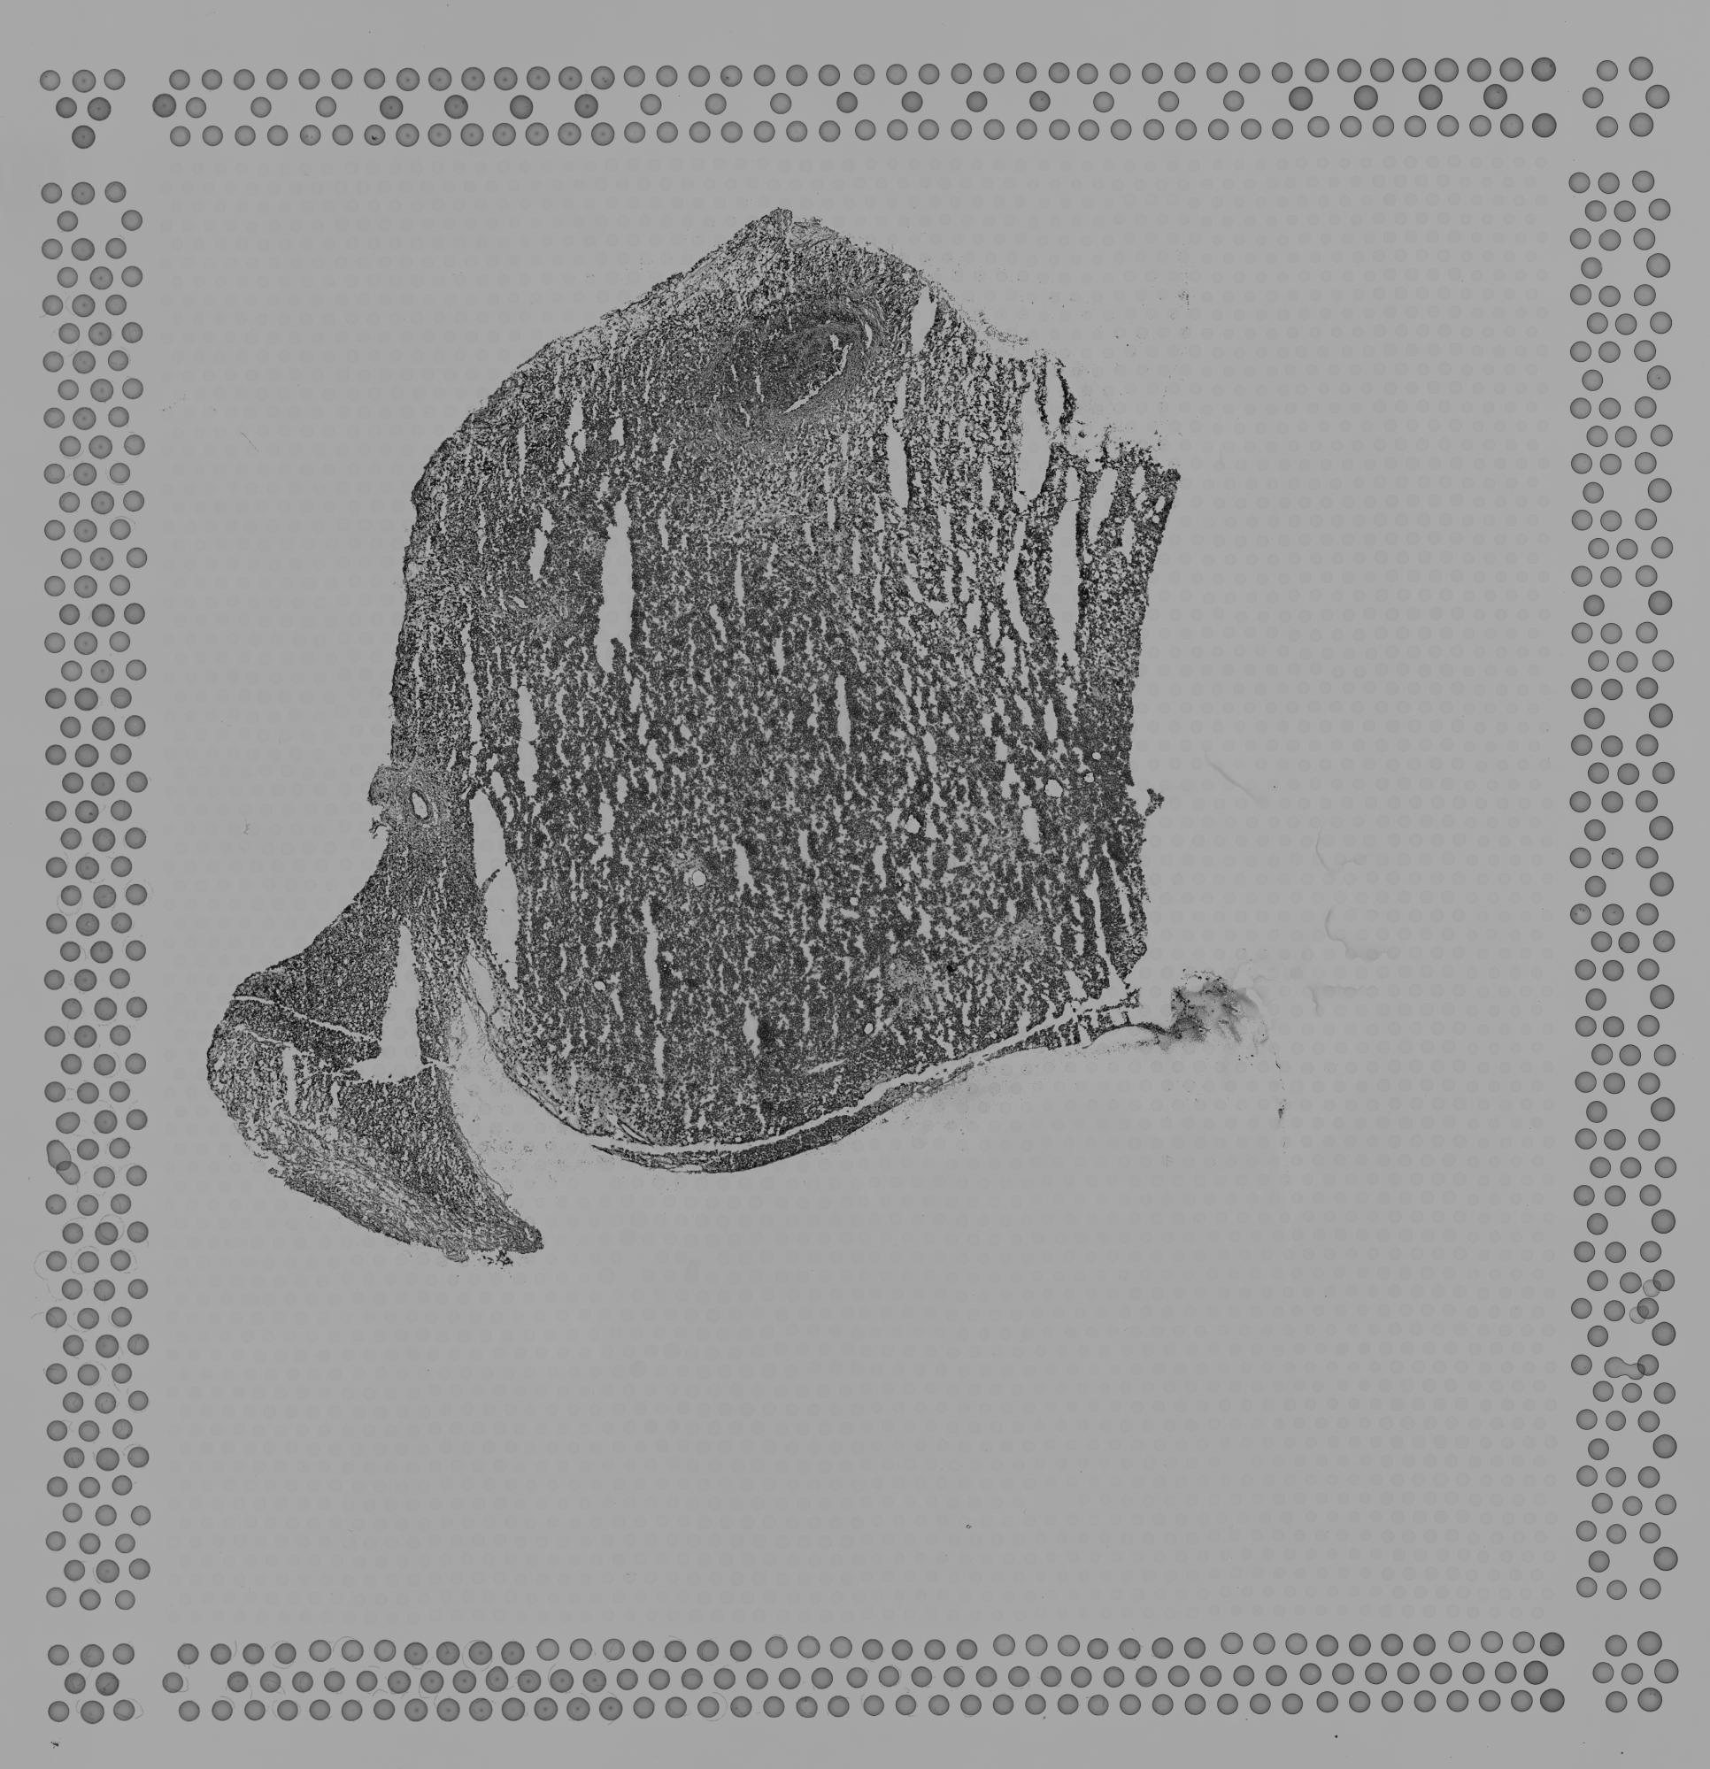
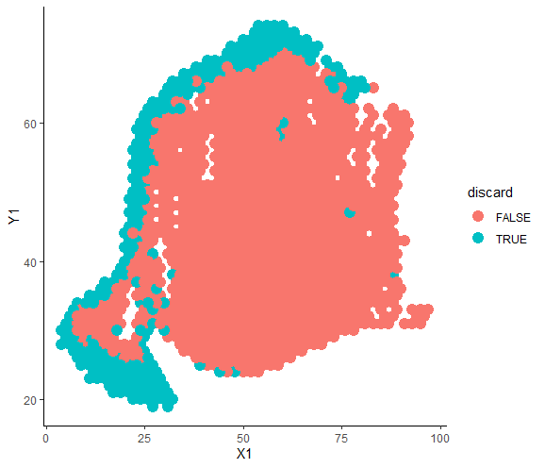
Marked in QC for low library size and/or high mitochondrial %

Slide 3
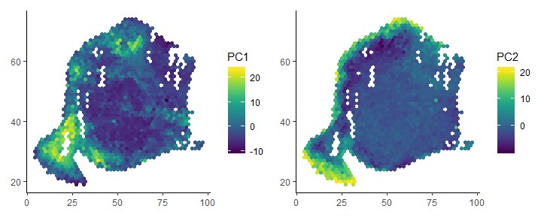
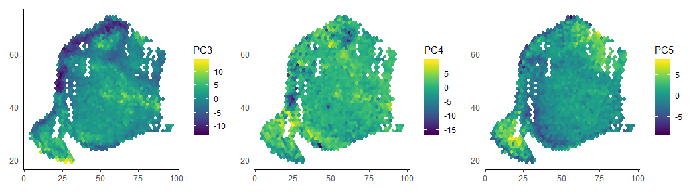
Distribution of PCs

Slide 4
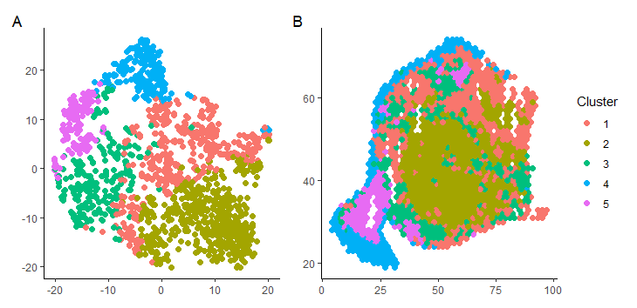
KNN clustering shown on tSNE and spatial

Slide 5
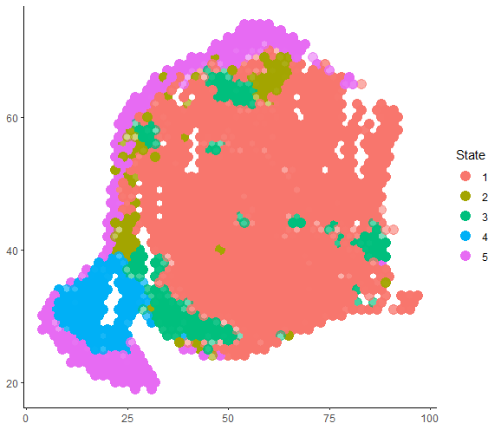
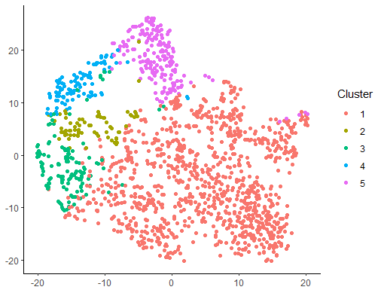
MCMC shown on tSNE and spatial

Slide 6
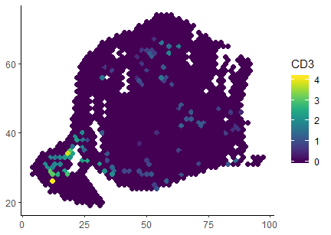
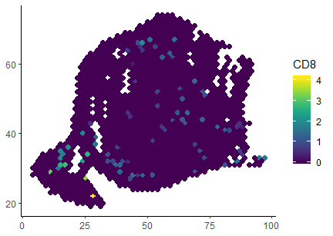

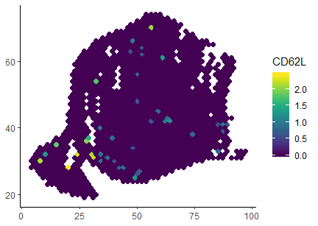

Slide 7
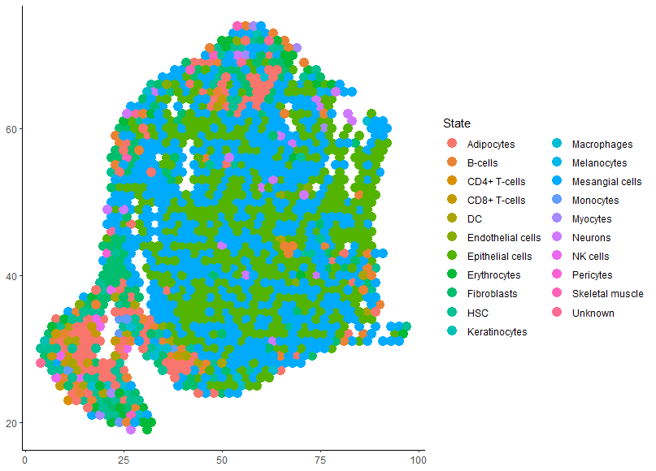
SingleR annotation
Most common cell types are:
blue “Mesangial cells”
green “Epithelial cells”
red “Adipocytes”
What are the cancer markers?

Slide 8
Deconvolution

