Slide 1
BayesSpace Update
6-11

Slide 2
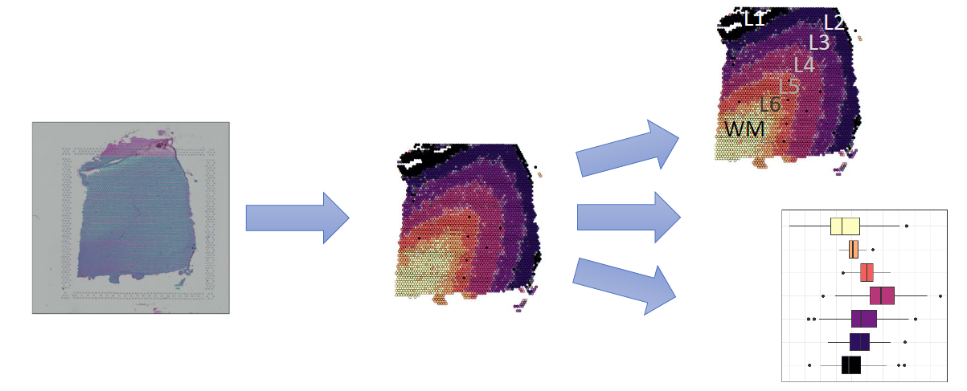
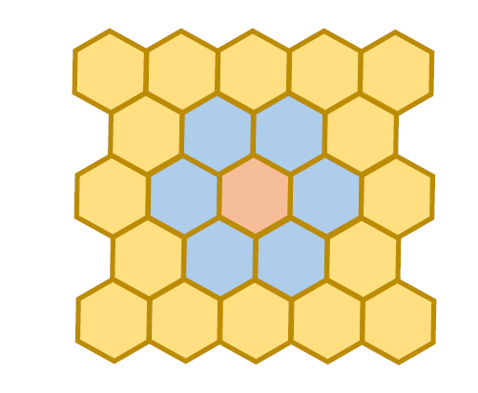
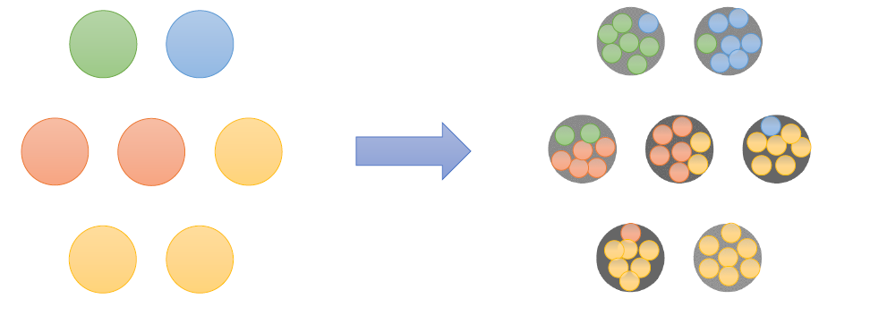
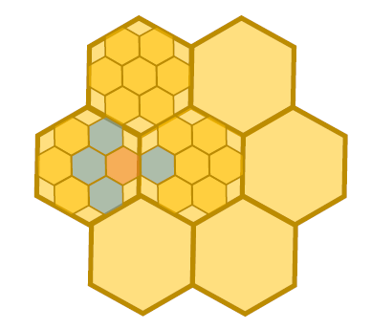
Fig 1:
Diagram of analysis workflow
Clustering cartoon
Deconvolution cartoon

Slide 3
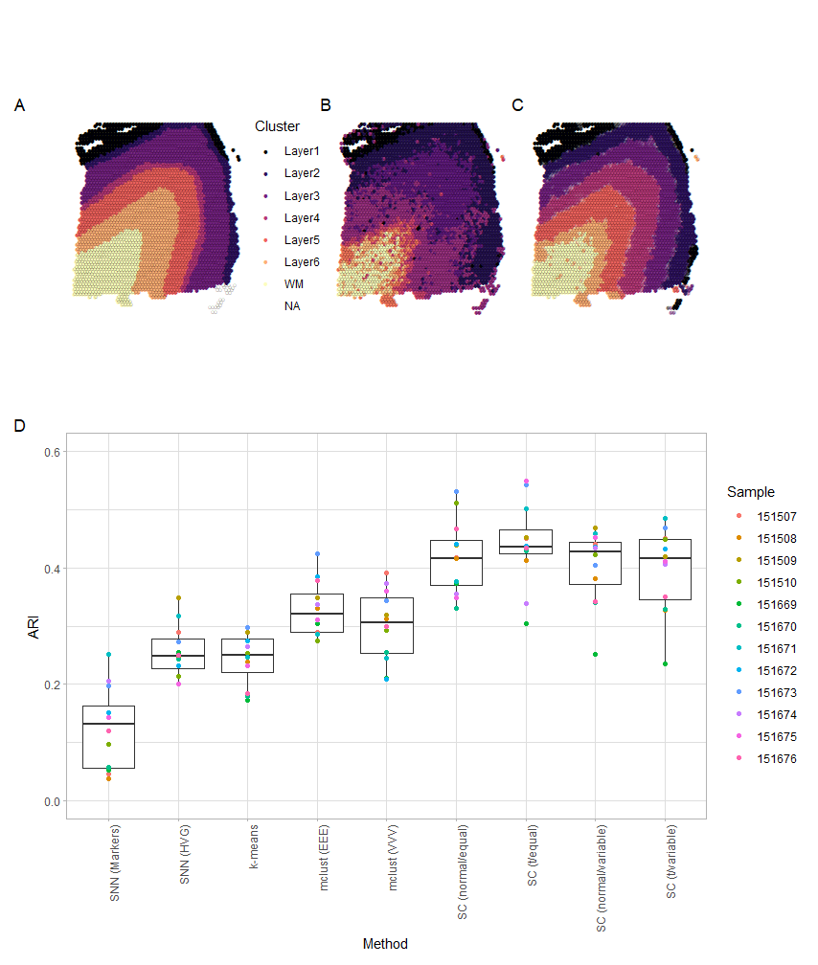
Fig 2:
DLPFC dataset
Sample 151673: Ground truth
Sample 151673: Walktrap clustering by Maynard et al.
Sample 151673: Spatial clustering
12 Samples: ARI(clustering vs. ground truth)
To do:
add Giotto/stLearn to D.

Slide 4
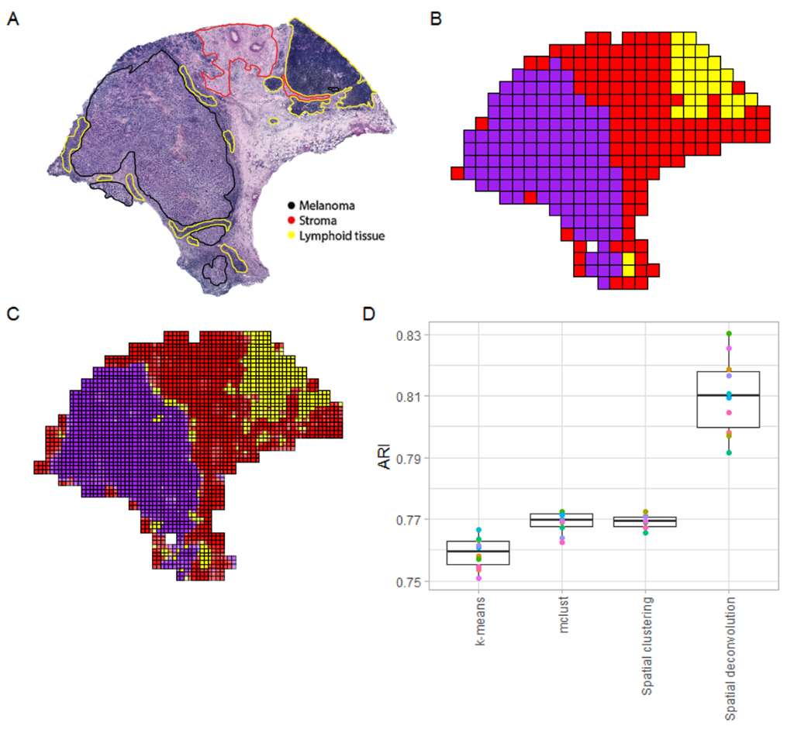
Fig 4:
Melanoma dataset
Annotated H&E
Spatial clustering
Spatial deconvolution
Simulation with labels in C as ground truth.
To do:
Repeat with breast cancer sample

Slide 5
Fig 3:
To do:
clustering simulation using
melanoma sample
breast cancer sample
Question:
How many clusters do we want to do for these simulations?

Slide 6
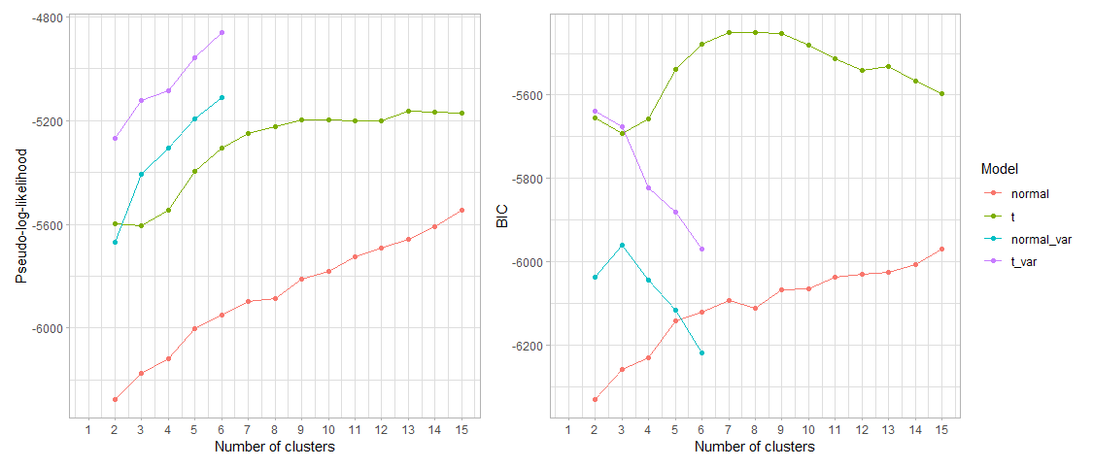
Melanoma cluster number

Slide 7
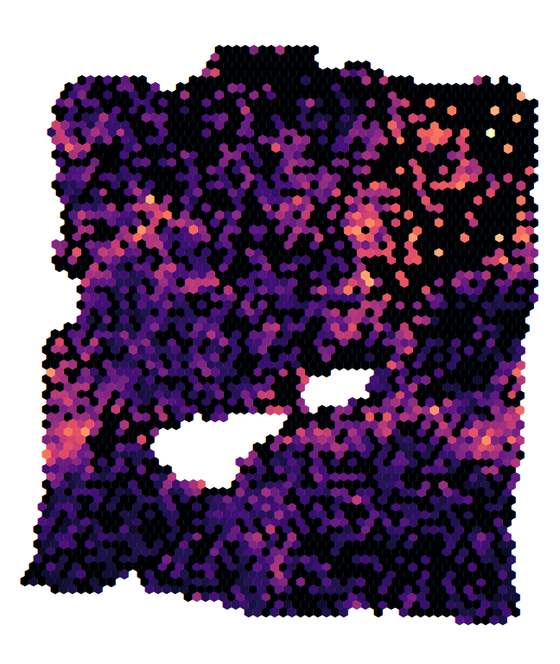
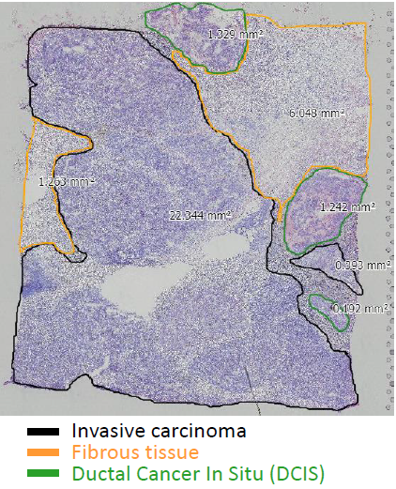
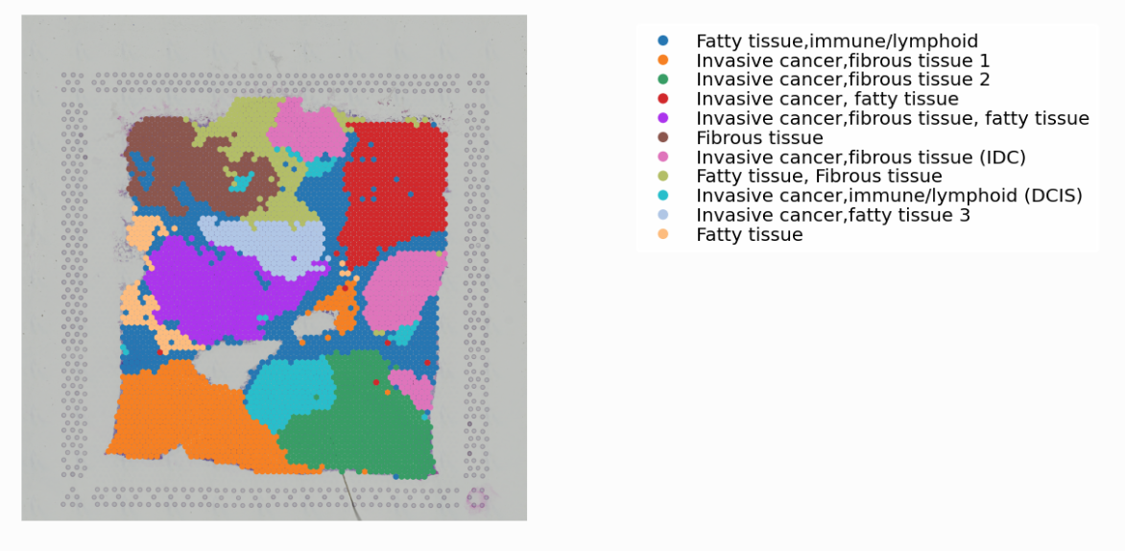
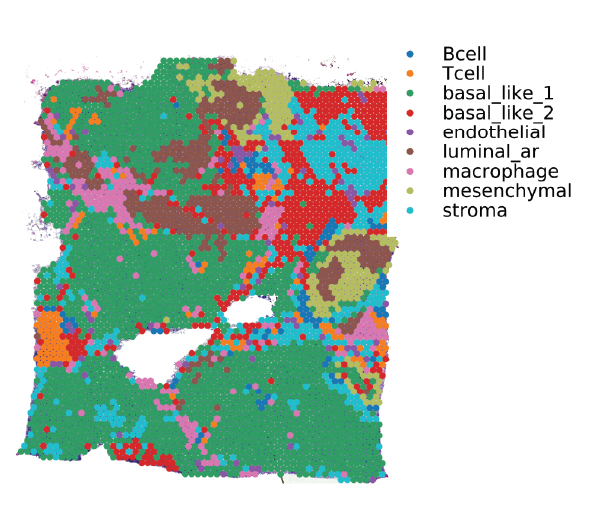
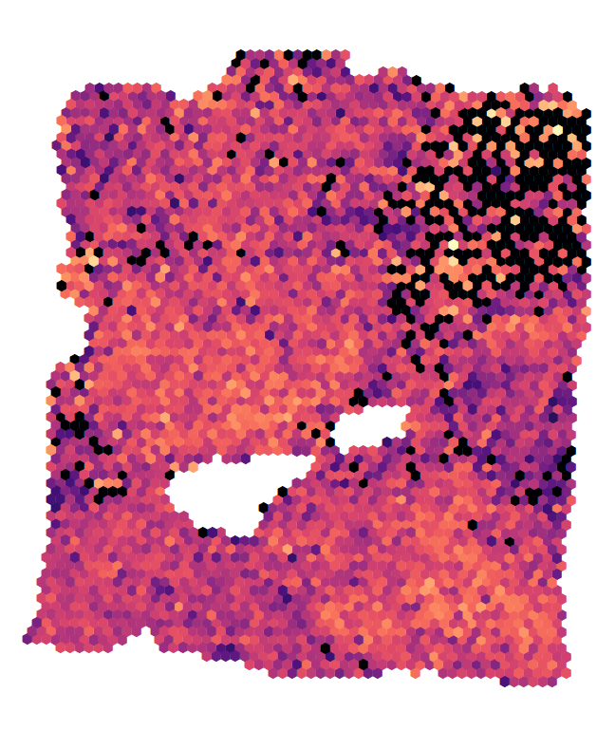
Breast cancer sample biology
CD45
Her2
Louvain clustering,
?? annotation
Spot-level
Label transfer
Histological annotation

Slide 8
Fig 5:
To do: (melanoma and breast cancer)
Integration of ST data and scRNAseq data using Seurat CCA and label transfer, comparing actual ST data vs deconvolved data

Slide 9
Roadmap
Melanoma deconv w/ 4 subspots instead of 9
Melanoma real data and simulation with q=4 clusters
Melanoma clustering simulation (Fig 3)
Add stLearn/Giotto clustering ARI vs. ground truth (Fig 2)
Breast cancer clustering simulation (Fig 3)
2 samples, check stability
Breast cancer deconvolution simulation (Fig 4)
Integration with scRNAseq

