Slide 1
2/21/2020

Slide 2
Deconvolution

Slide 3
Deconvolution
For each original diamond (x,y), divide in four to generate triangles with locations (x +/- 1/3, y +/- 1/3)
Yellow triangle will have L1 distance 2/3 from the green triangle and 4/3 from the blue triangle
Define nearest neighbors (max 3) as triangles that are distance 2/3 away
Update Y* (expression) for 4 triangles at a time, constraining sum to equal original Y for diamond
Sample first 3 Y* using Y/4 + normal(0, e), where e is a fixed tuning parameter
Last triangle is updated so sum equal to original Y
acceptance probability is ratio of conditional distributions
Update z’s one triangle at a time, using same method as original MCMC, but using Y*’s instead of Y.

Slide 4
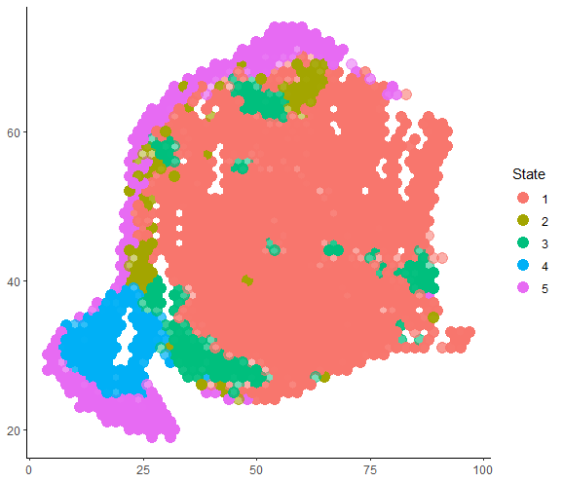
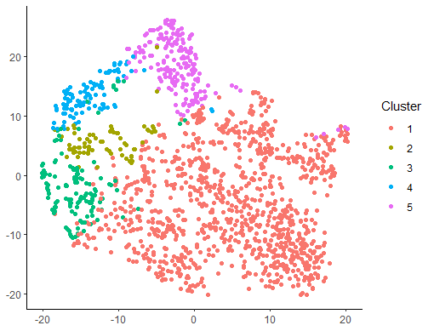
Original MCMC shown on tSNE and spatial

