Slide 1
2/7/2020

Slide 2


Model parameters
MV normal likelihood with known precision matrix
Mean is MV normal distributed with parameters
MV normal likelihood with known mean vector
Precision matrix is Wishart distributed with parameters
For cell states, use Potts model and MV normal likelihood
Nearest neighbors have L1 distance = 2

Slide 3
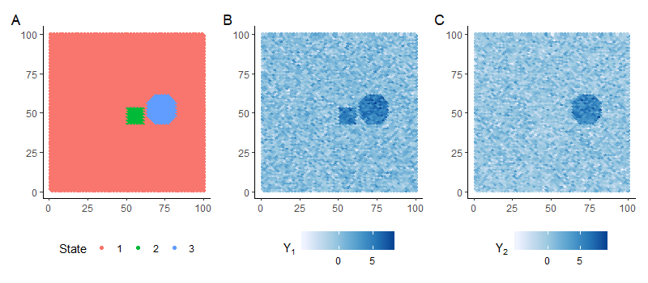
Simulation: 3 states, 2 genes/PCs

Slide 4
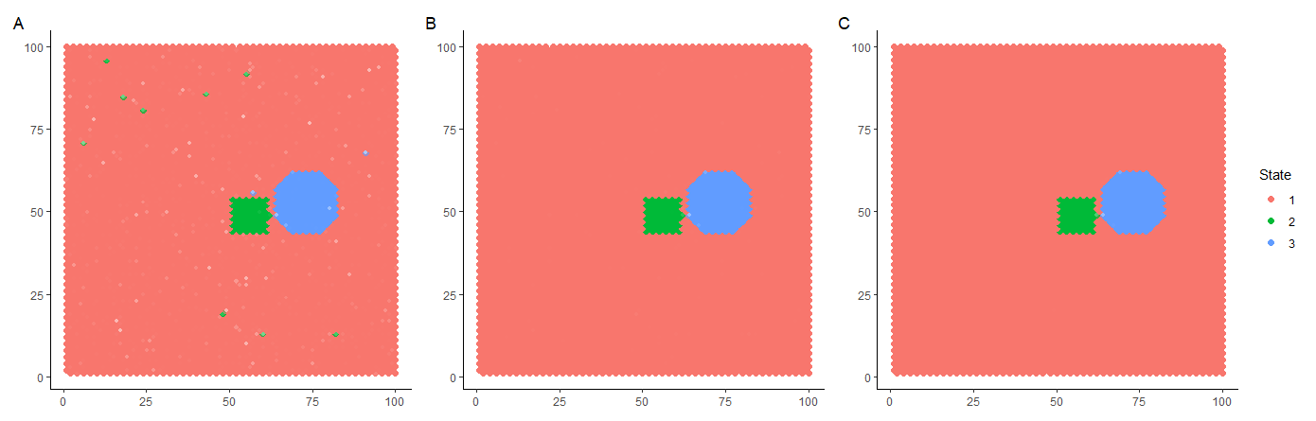
Simulation: MCMC results (gamma = 2, 4, 6)

Slide 5
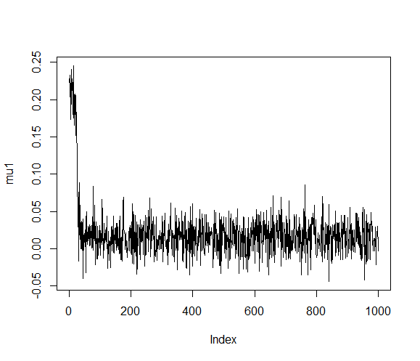
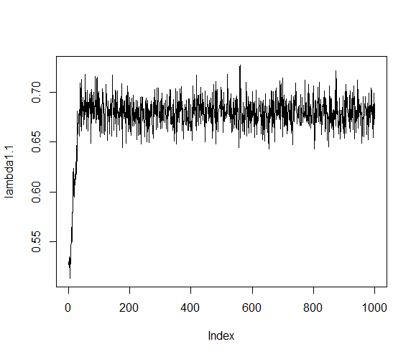
Simulation: MCMC trace plots

Slide 6
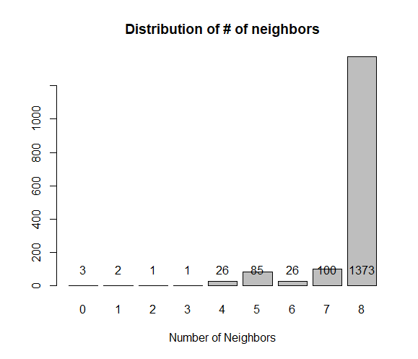
Mouse data:
1617 “cells”
PCA on log-normalized expression of top 10% most variable genes, with PCs corresponding to technical noise removed (denoisePCA in “scran”)
3 cells with no neighbors removed

Slide 7
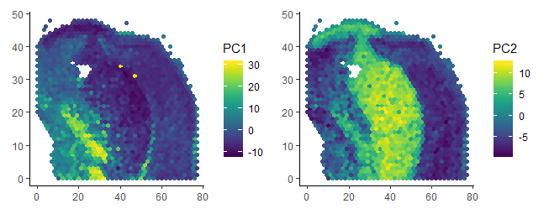
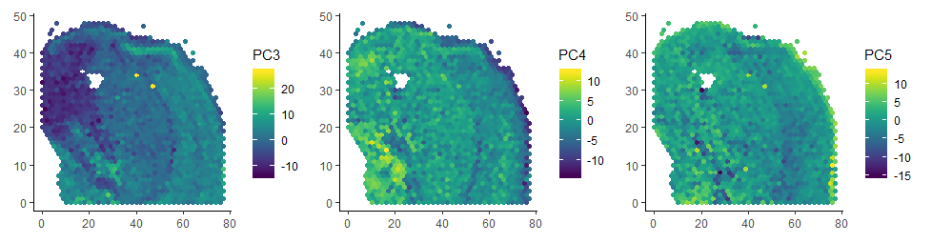
Mouse data: 5 PCs

Slide 8
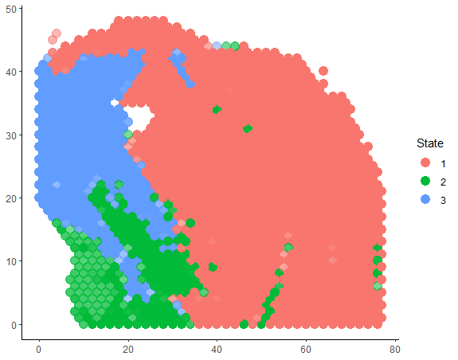
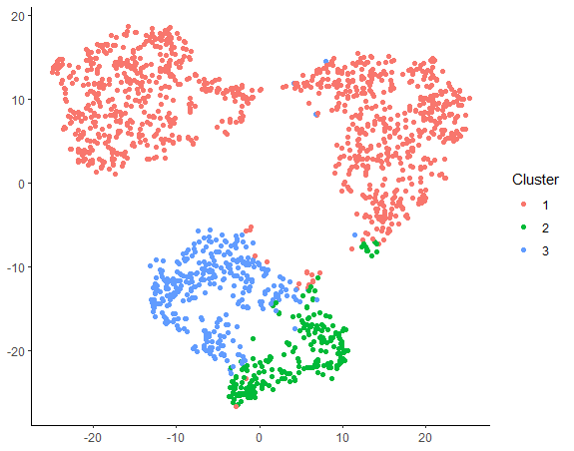
Mouse data: MCMC results
3 states, gamma = 2

Slide 9
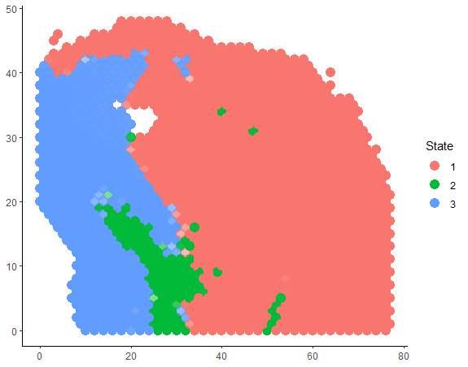
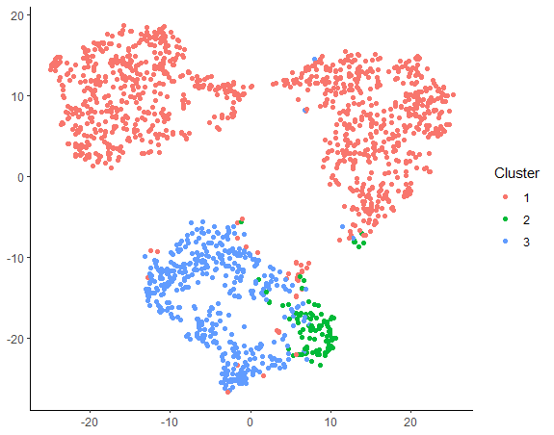
Mouse data: MCMC results
3 states, gamma = 6

Slide 10
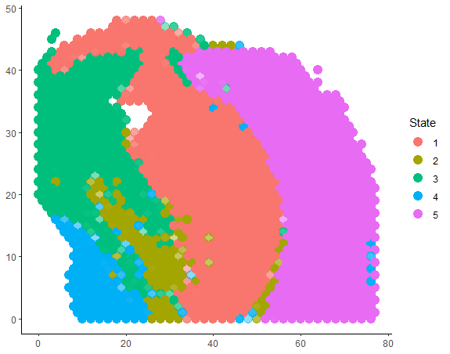
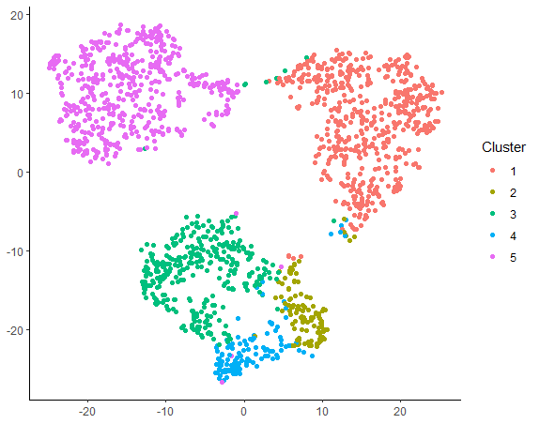
Mouse data: MCMC results
5 states, gamma = 2

Slide 11
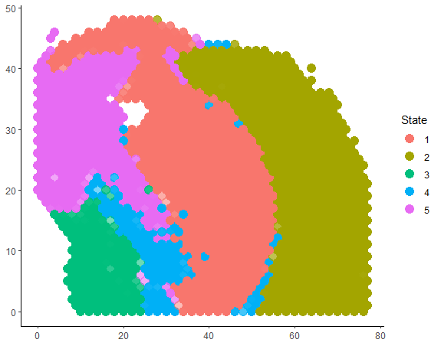
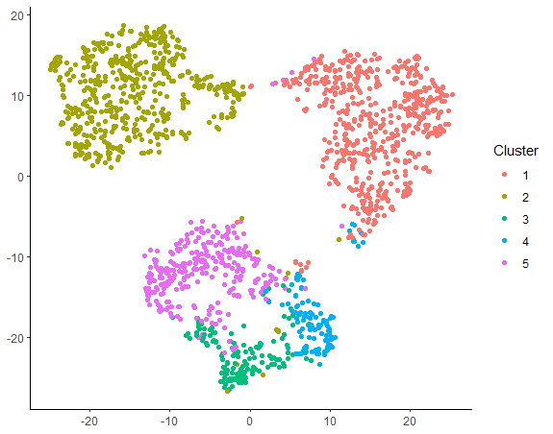
Mouse data: MCMC results
5 states, gamma = 4

Slide 12
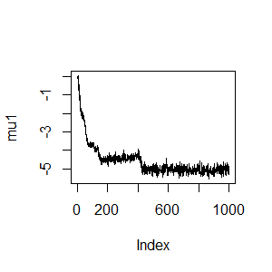
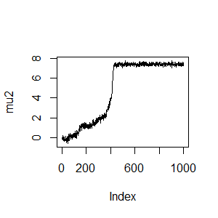
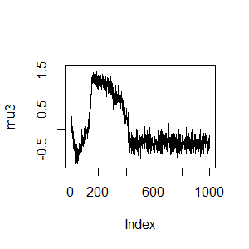
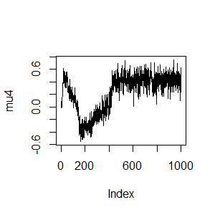
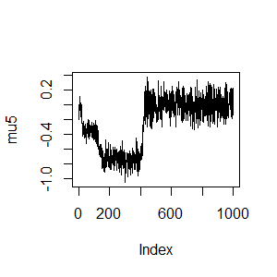
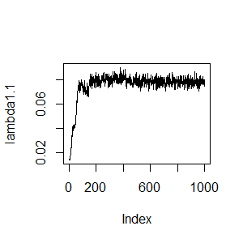
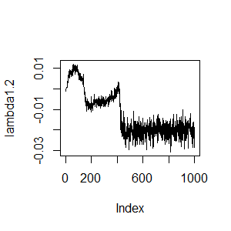
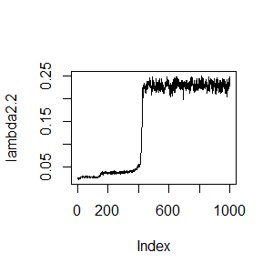
Mouse data: subset of trace plots

