Slide 1
3/17

Slide 2
Hexagonal lattice 1 overlaid on capture locations (left), idealized (right)

Slide 3
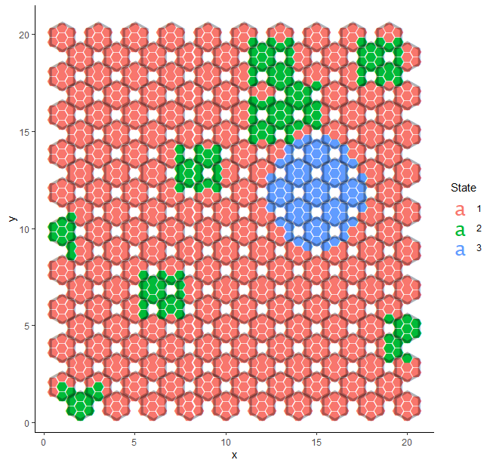
Simulated actual states

Slide 4
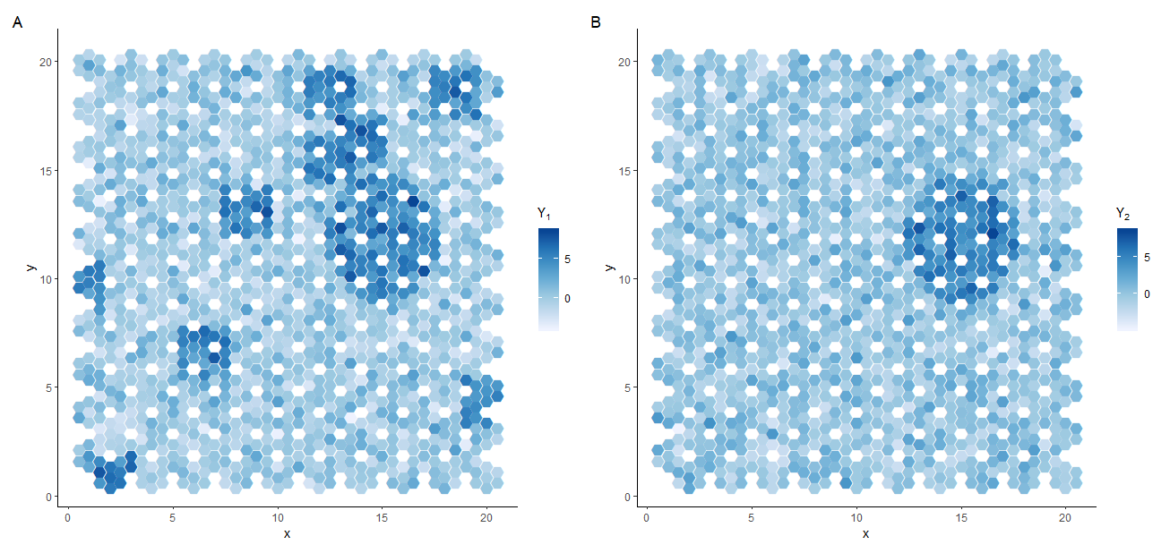
Single-cell resolution expression (Y1, Y2)

Slide 5
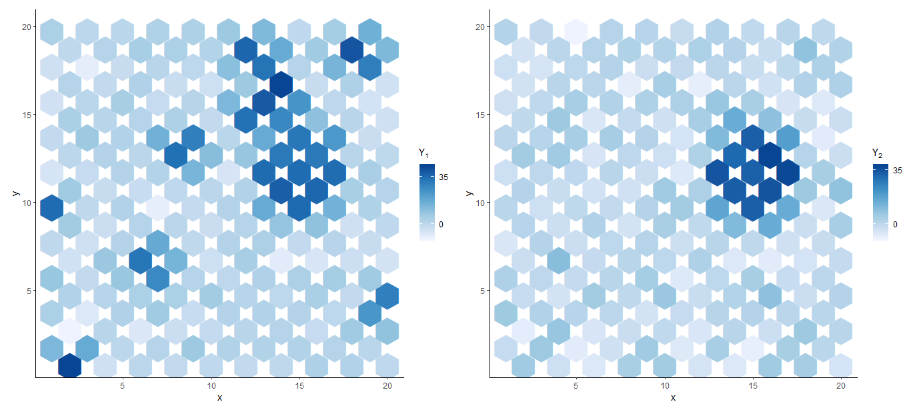
Pooled expression (Y1, Y2)

Slide 6
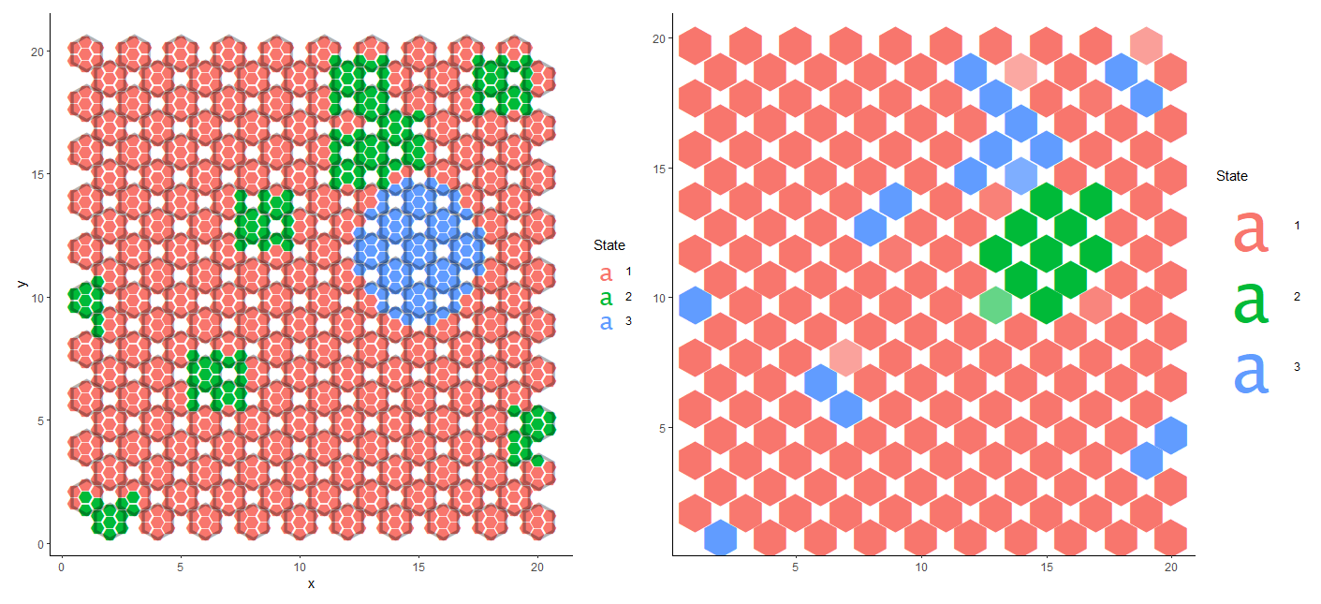
Left: actual, right: predicted(without deconvolution)

Slide 7
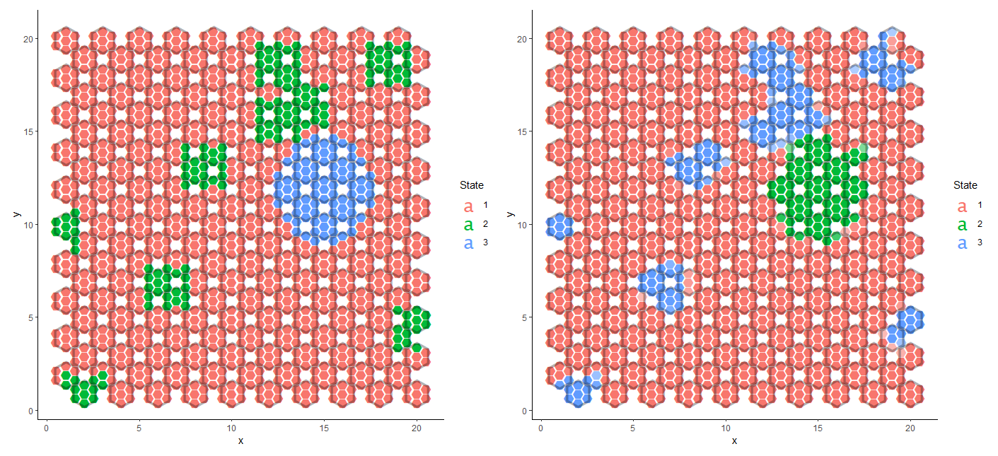
Left: actual, right: predicted (deconvolution)

Slide 8
Deconvolution prediction accuracy
Accuracy: 96.3%
State 2
Sensitivity: 86.7%
Specificity: 97.9%
State 3
Sensitivity: 96.3%
Specificity: 99.3%
 | Actual
Predicted | State | 1 | 2 | 3
 | 1 | 1134 | 20 | 3
 | 2 | 26 | 130 | 0
 | 3 | 9 | 0 | 78
 | Actual
Predicted | State | 1 | 2 | 3
 | 1 | 81.0% | 1.4% | 0.2%
 | 2 | 1.9% | 9.3% | 0.0%
 | 3 | 0.6% | 0.0% | 5.6%

Slide 9
Without deconvolution prediction accuracy
Accuracy: 93.9%
State 2
Sensitivity: 89.9%
Specificity: 96.2%
State 3
Sensitivity: 89.6%
Specificity: 98.6%
 | Actual
Predicted | State | 1 | 2 | 3
 | 1 | 1139 | 10 | 8
 | 2 | 49 | 107 | 0
 | 3 | 16 | 2 | 69
 | Actual
Predicted | State | 1 | 2 | 3
 | 1 | 81.4% | 0.7% | 0.6%
 | 2 | 3.5% | 7.6% | 0.0%
 | 3 | 1.1% | 0.1% | 4.9%

Slide 10
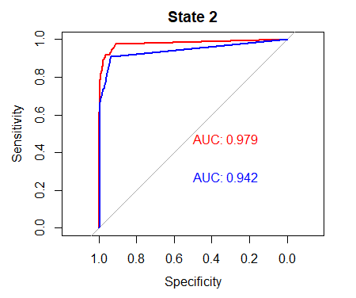
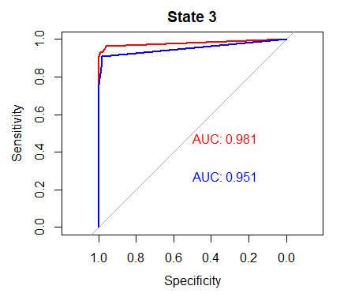
ROC curves
Deconvolution
No Deconvolution

Slide 11
Drawing to scale:
VISIUM capture locations (blue circles) shown on a square lattice
Diameter of capture location: 55μm
Distance between capture locations: 100μm
Grid unit length: 100μm/sqrt(2)

