Slide 1
3/2

Slide 2
Deconvolution
Add iid N(0, s) error terms to each of the four sub-cells
Constrain the sum of error terms to equal 0 by subtracting mean
s = 1/15

Slide 3
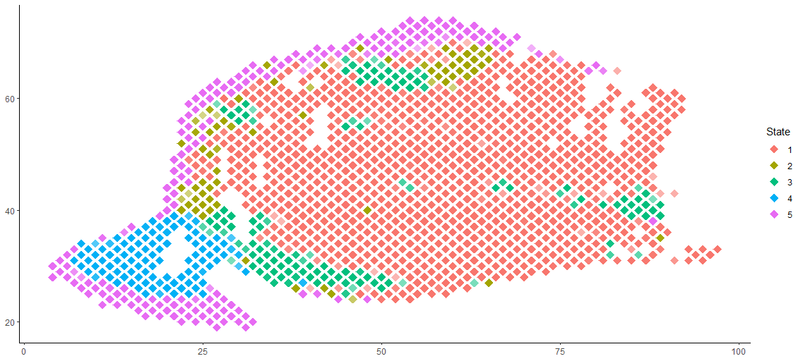
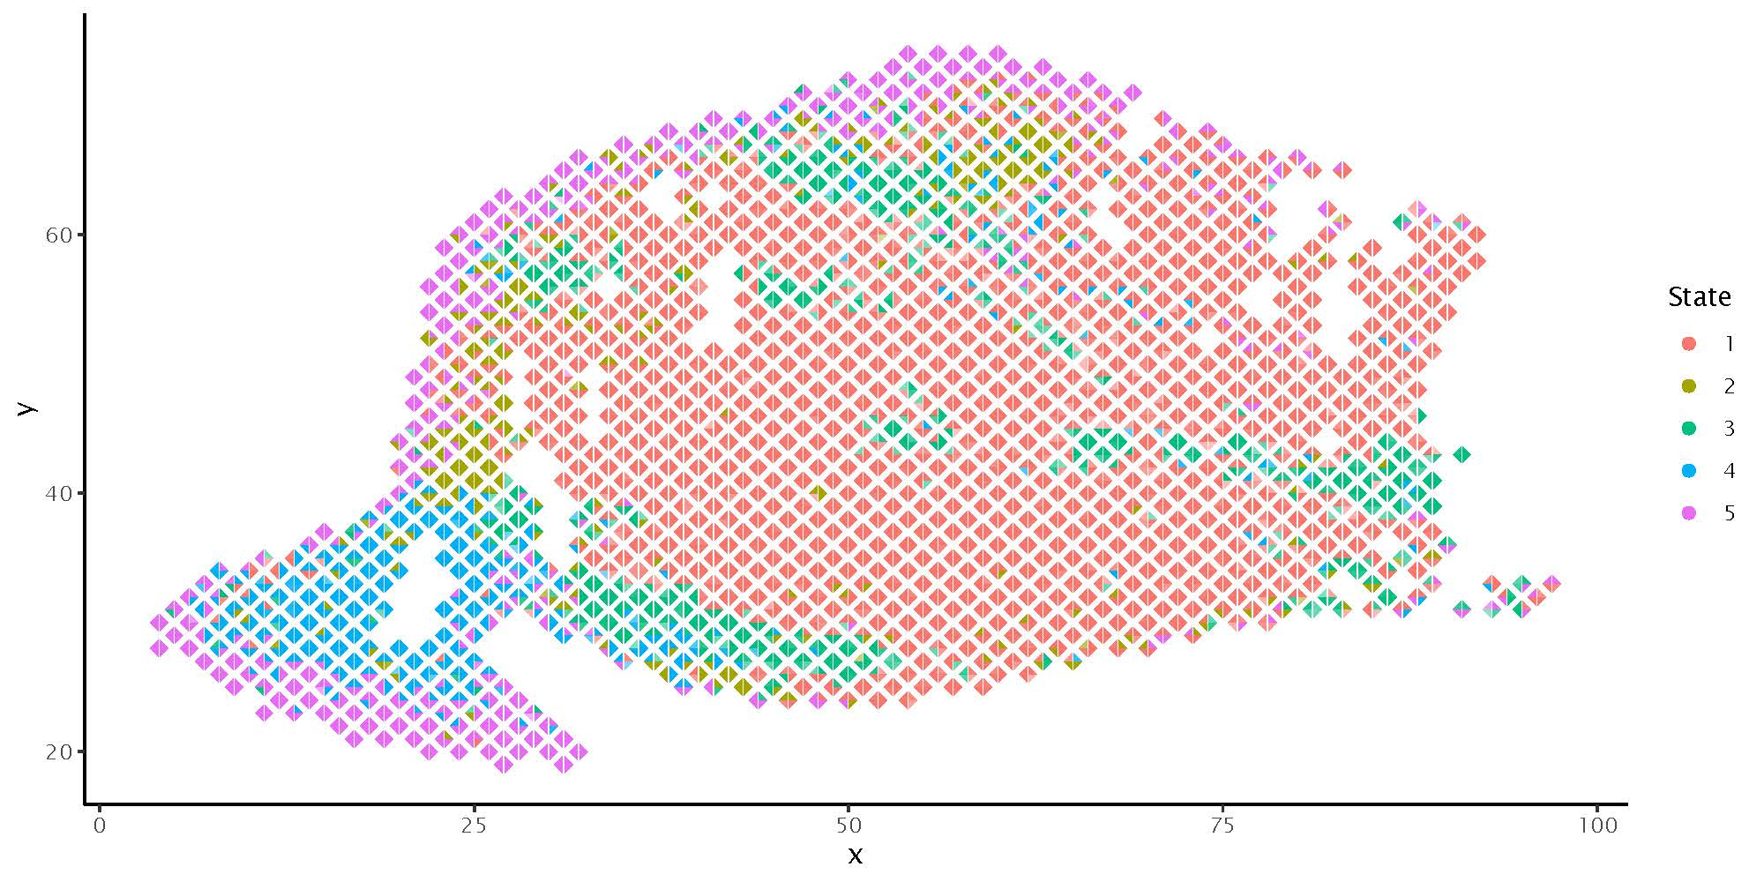
MCMC on Real data:
No deconvolution (top)
Deconvolution (bottom)

Slide 4
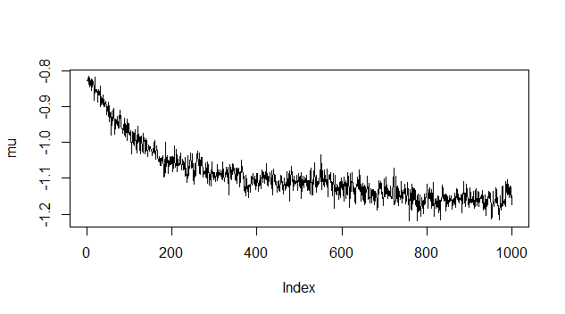
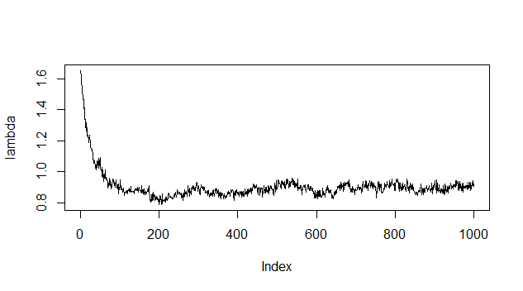
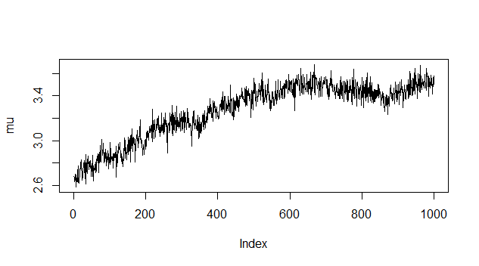
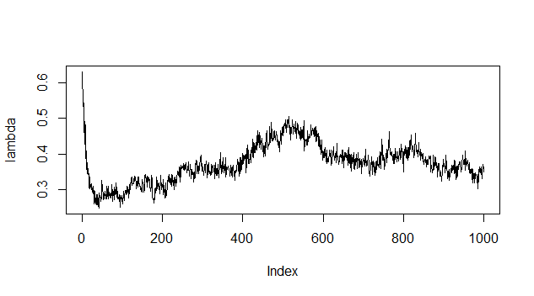
Deconvolution trace plots for real data

Slide 5
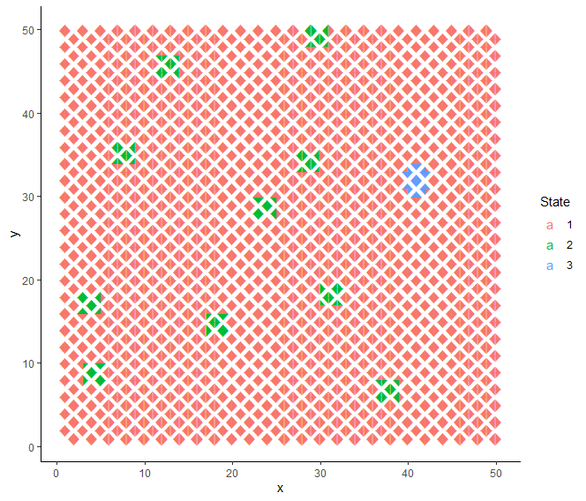
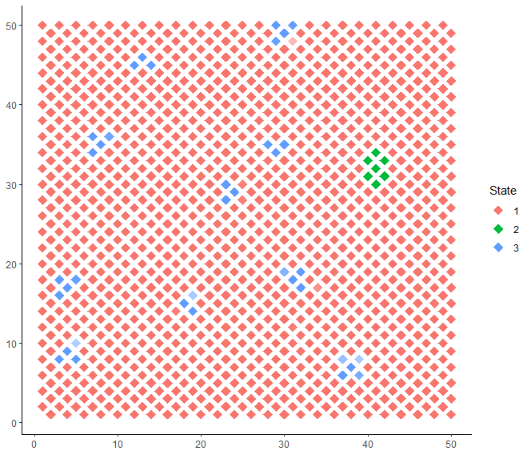
Left: truth, Right: MCMC without deconvolution

Slide 6
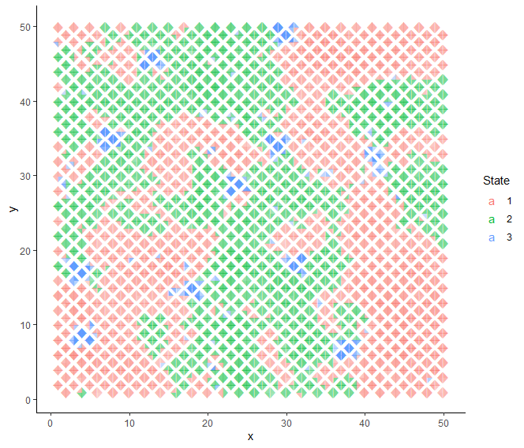
Left: truth, Right: MCMC with deconvolution

Slide 7
