Slide 1
3/9

Slide 2
Deconvolution
Add iid N(0, s) error terms to each of the four sub-cells
Constrain the sum of error terms to equal 0 by subtracting mean
s = 1/15
Acceptance probability for Y* is ratio of likelihood * normal prior centered on Y/4

Slide 3
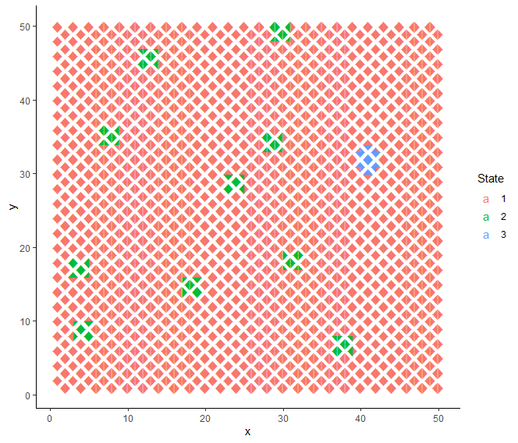
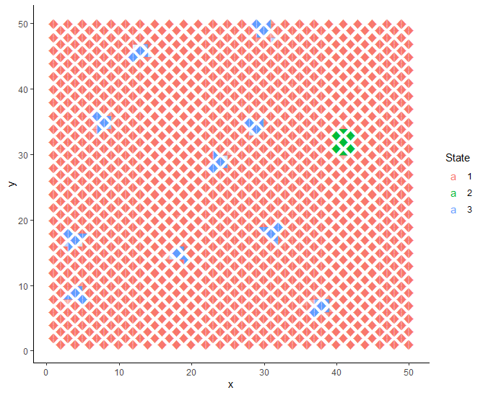
Left: truth, Right: MCMC with deconvolution

Slide 4
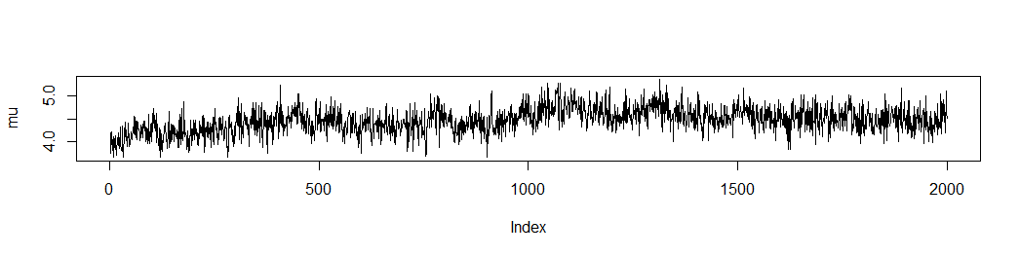
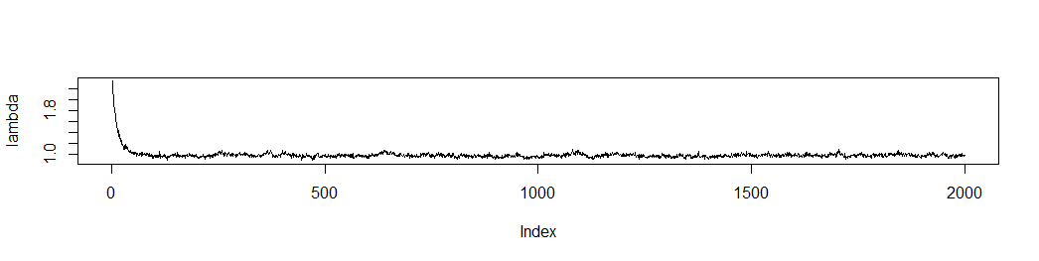

Slide 5
