Slide 1
Analysis of Maynard 2020 brain spatial transcriptomic data
4/1

Slide 2
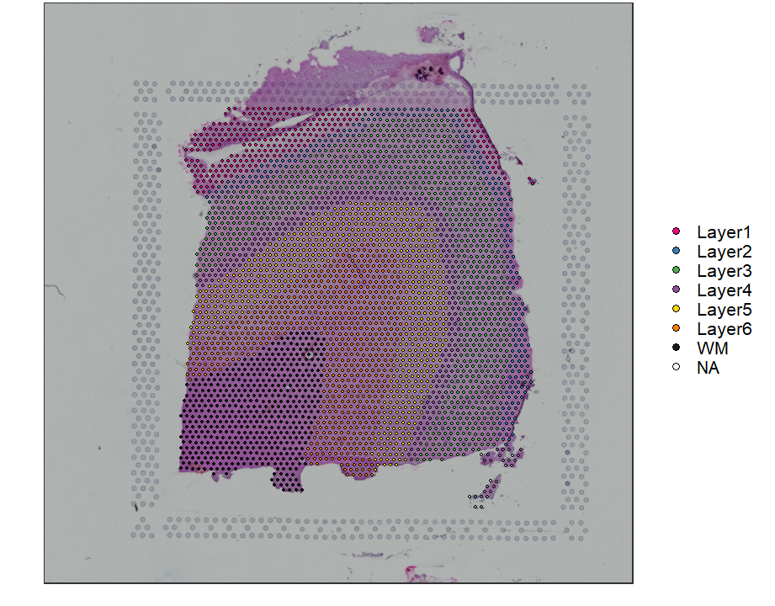
Sample 151673
Dorsolateral prefrontal cortex layers
3639 capture locations

Slide 3
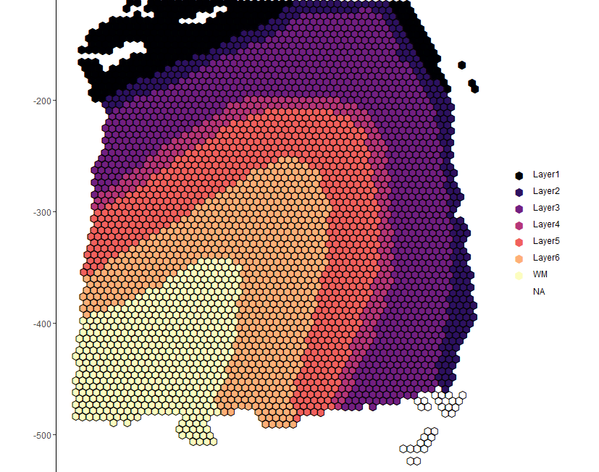
Ground truth
Supervised annotation based on “cytoarchitecture and selected gene markers”

Slide 4
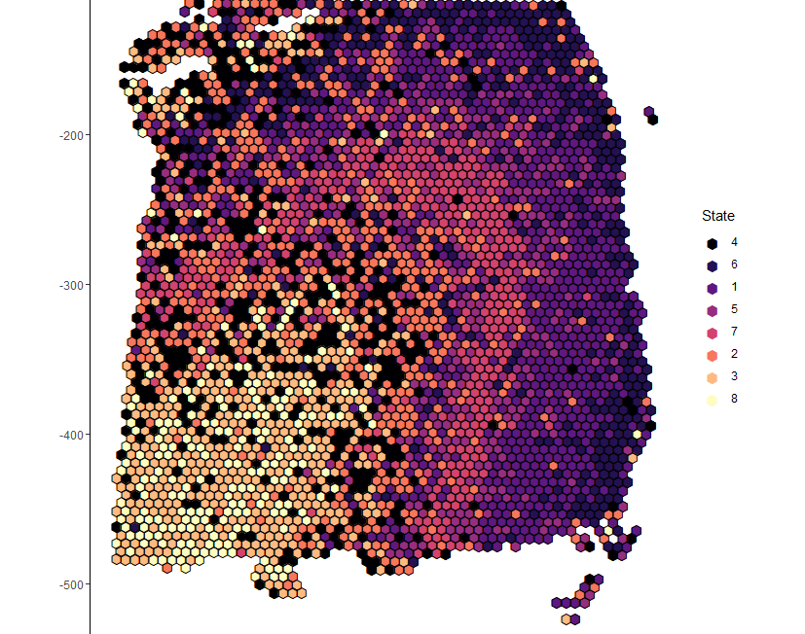
Marker-guided clustering
Unsupervised clustering on PCs from known rodent and human layer marker genes from Zeng et al., 2012 + spatial coordinates
8 clusters since it “gave slightly improved clustering performance”
Adjusted Rand Index (ARI) = 0.197

Slide 5
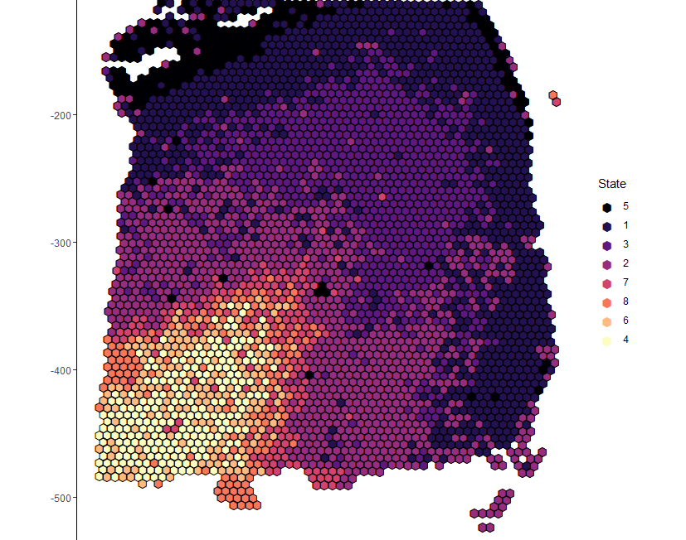
Unsupervised clustering
50 PCs from highly variable genes + spatial coordinates
8 clusters
ARI = 0.274

Slide 6
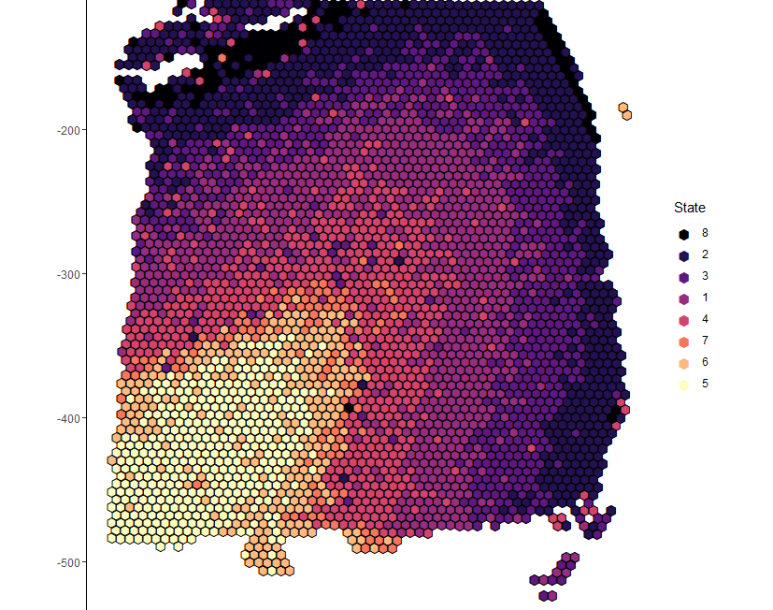
Semi-supervised clustering
Unsupervised clustering on PCs from genes differentially expressed by layer + spatial coordinates
Circular
8 clusters
ARI = 0.380

Slide 7
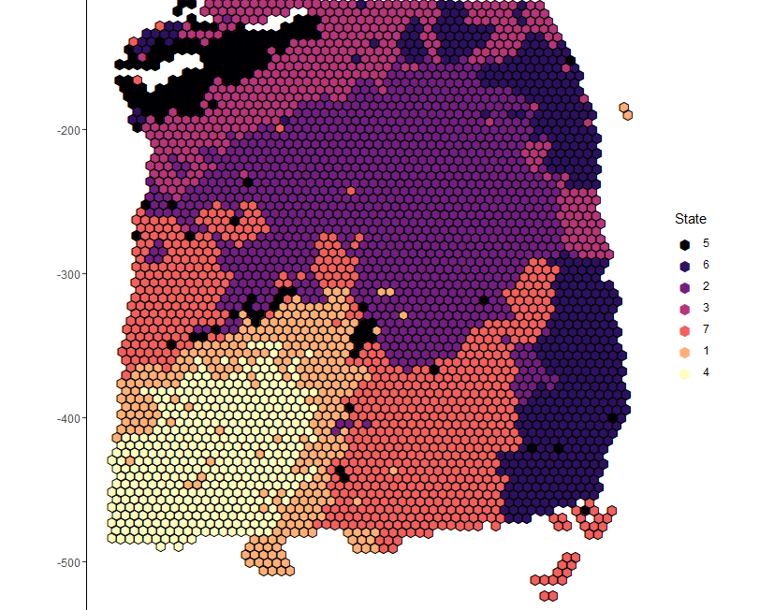
MCMC Clustering
7 clusters
5 PCs
Smoothing parameter = 2
ARI = 0.242

Slide 8
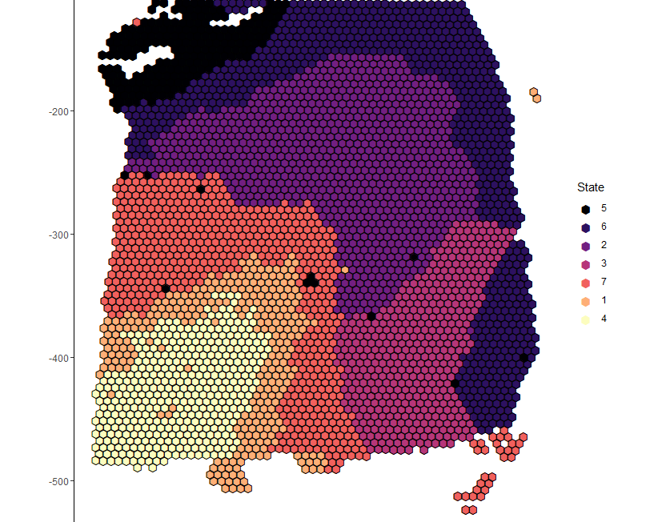
MCMC Clustering
7 clusters
5 PCs
Smoothing parameter = 4
ARI = 0.293

Slide 9
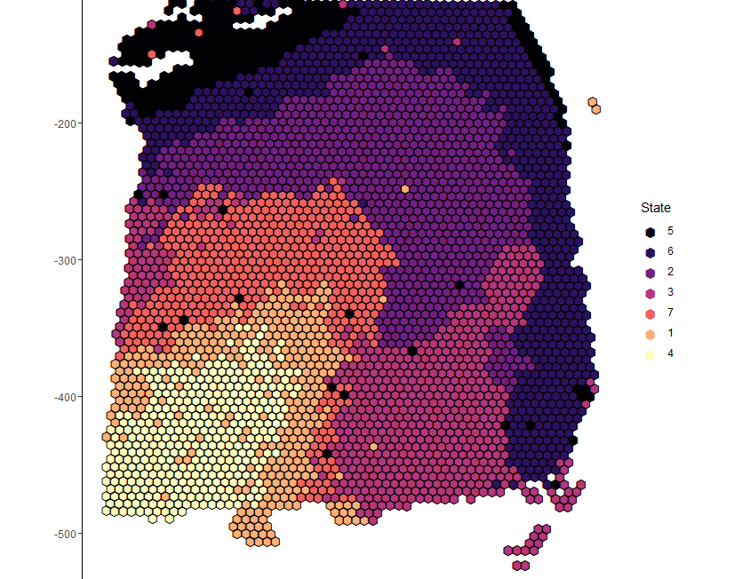
MCMC Clustering
7 clusters
9 PCs
Smoothing parameter = 2
ARI = 0.299

Slide 10

MCMC Clustering
7 clusters
9 PCs
Smoothing parameter = 4
ARI = 0.308

Slide 11

MCMC Clustering
6 clusters
9 PCs
Smoothing parameter = 4
ARI = 0.340

Slide 12
Other things to try
Selecting PCs that have a spatial pattern
Changing number of clusters

Slide 13
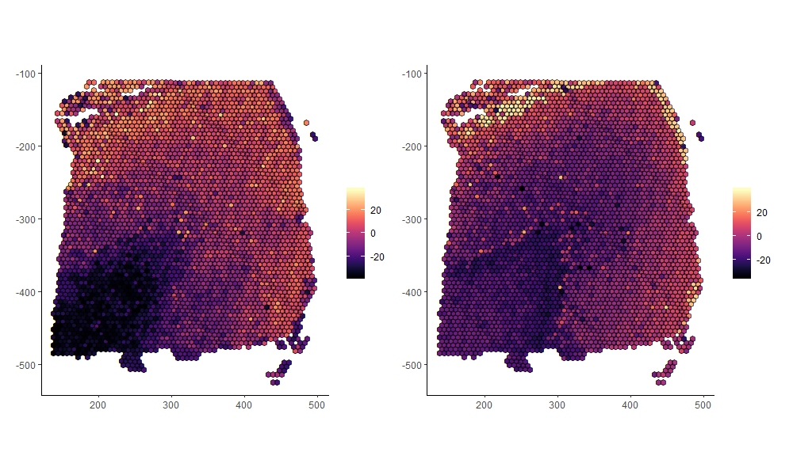
t-SNE

Slide 14
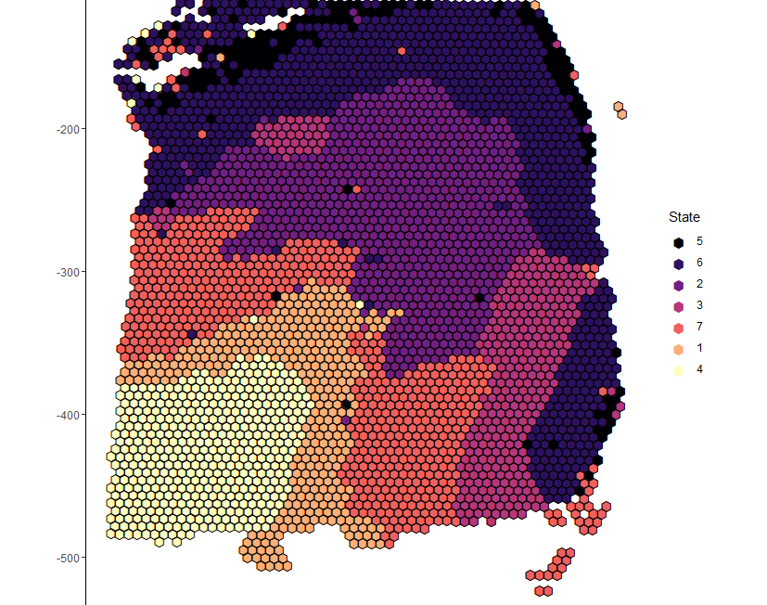
MCMC Clustering
7 clusters
t-SNE
Smoothing parameter = 4
ARI = 0.332

Slide 15
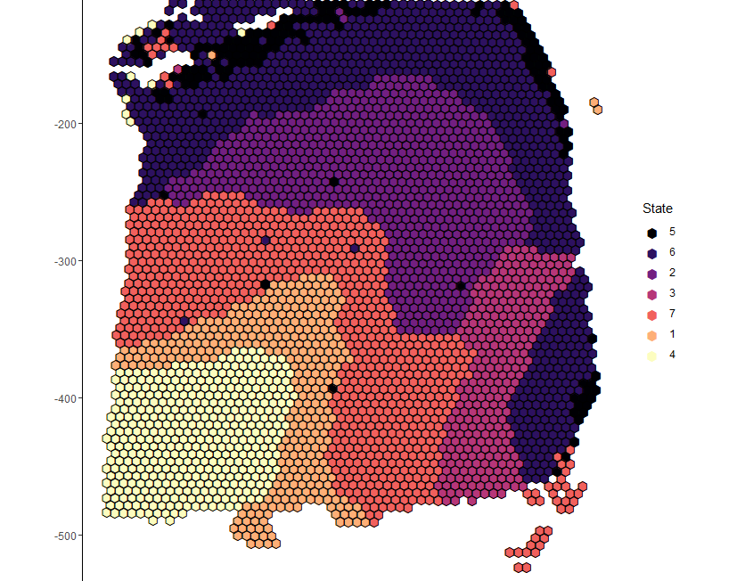
MCMC Clustering
7 clusters
t-SNE
Smoothing parameter = 6
ARI = 0.332

Slide 16
Other things to try
Tuning t-SNE perplexity
UMAP
Changing number of clusters

