Slide 1
MCC sample 044A clustering analysis
4/10

Slide 2
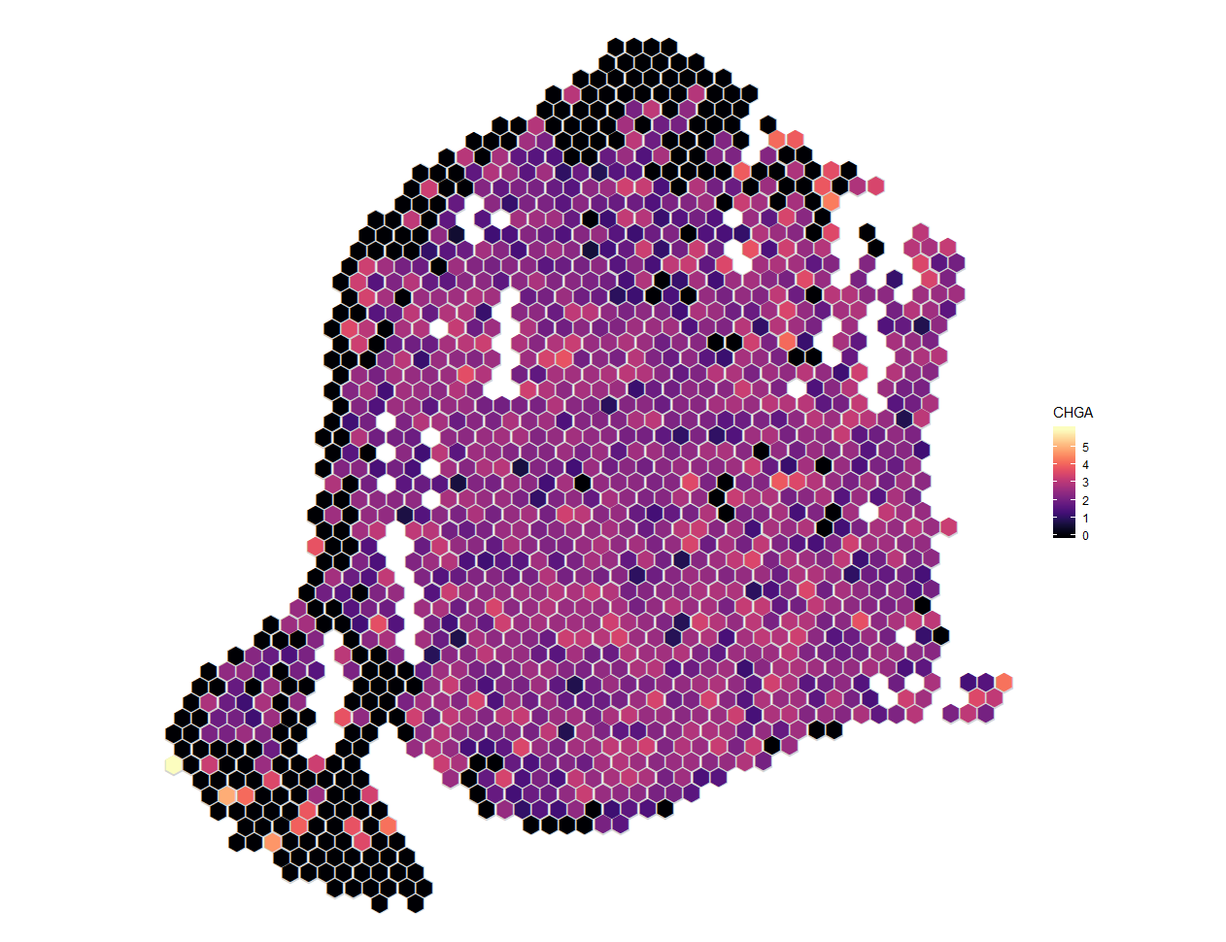
CHGA Expression
Covers most of the slide

Slide 3
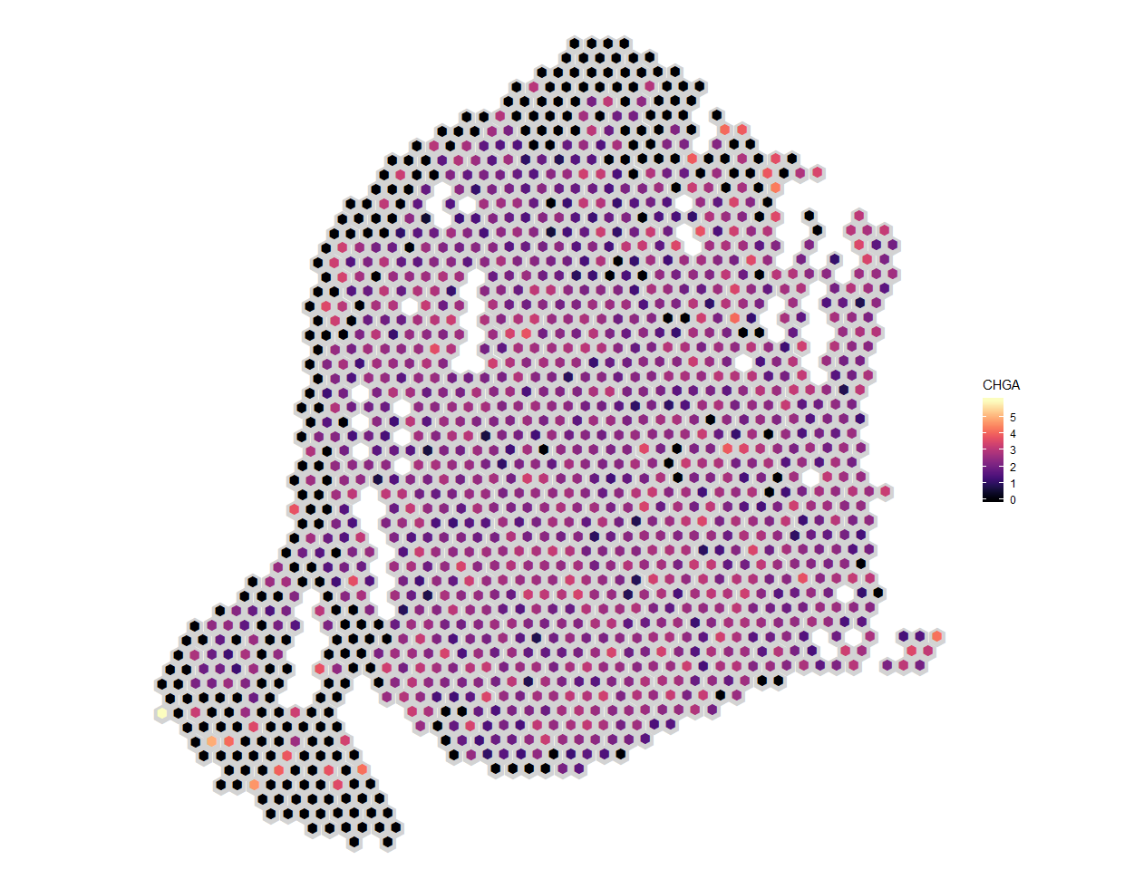
CHGA Expression

Slide 4
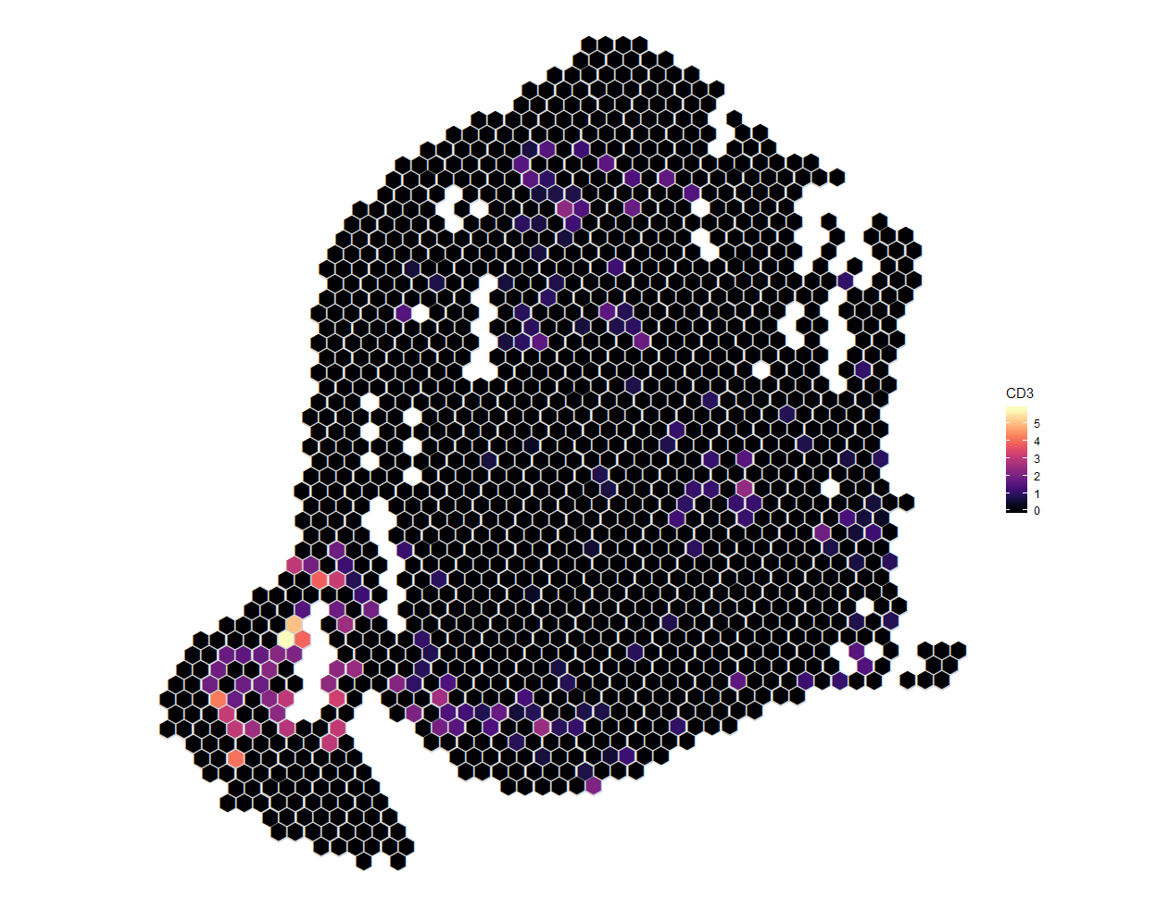
CD3 Expression
Concentrated at the periphery of the tumor
Possibly some tumor infiltration

Slide 5
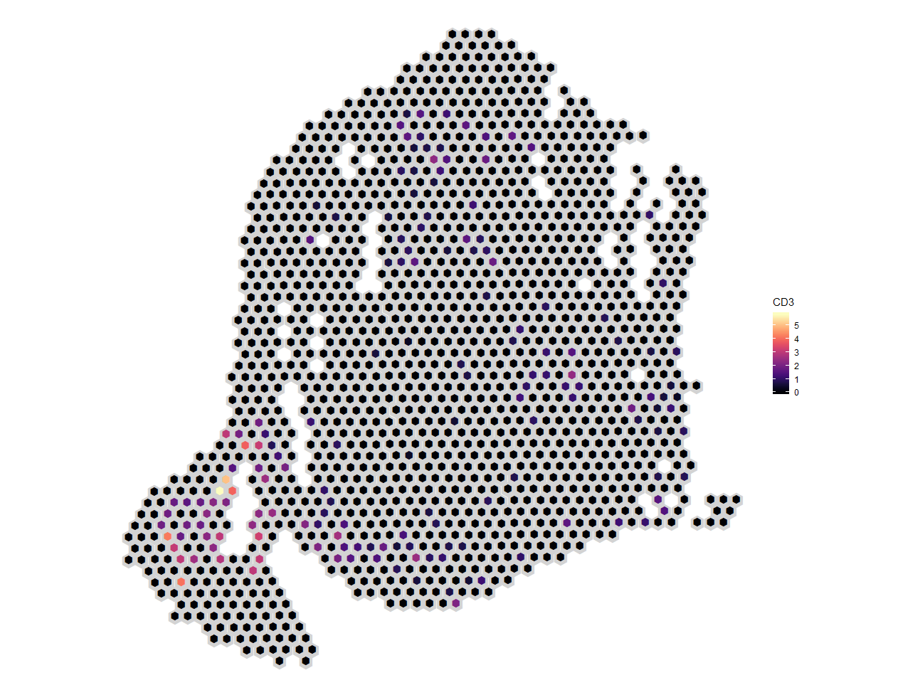
CD3 Expression

Slide 6
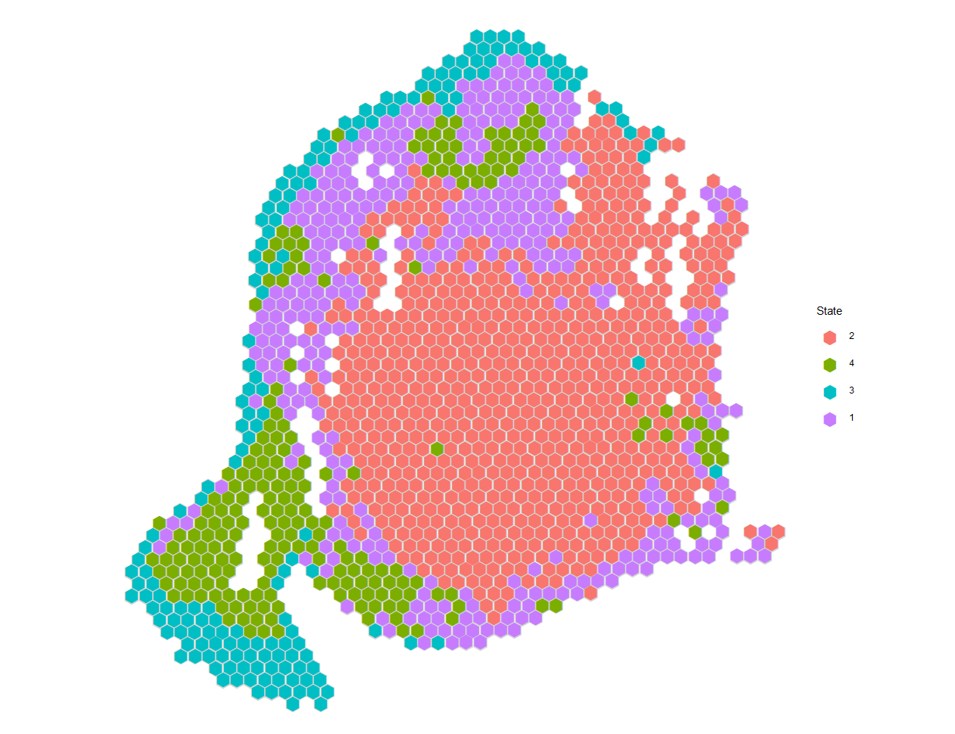
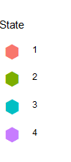
Naïve clustering
K-means clustering into 4 groups
State 3 and possibly 4 are technical artefacts
Green corresponds best to T cell expression

Slide 7
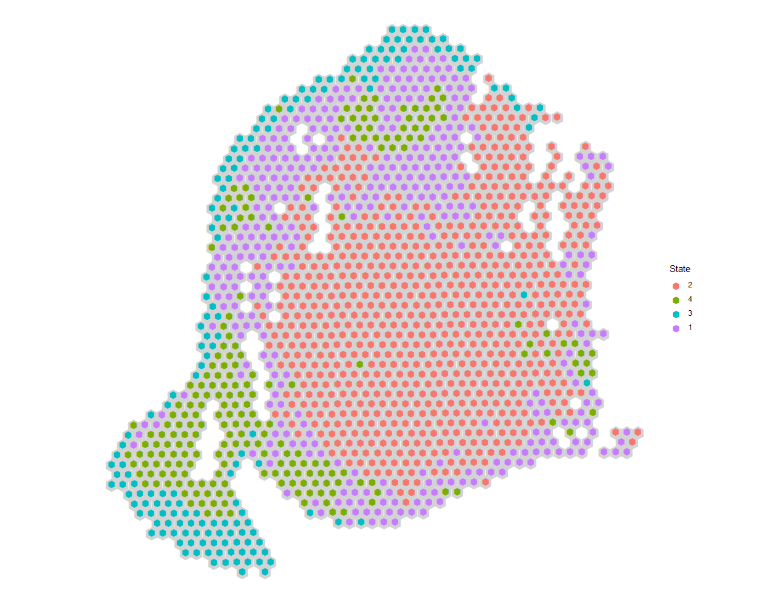
Naïve clustering

Slide 8
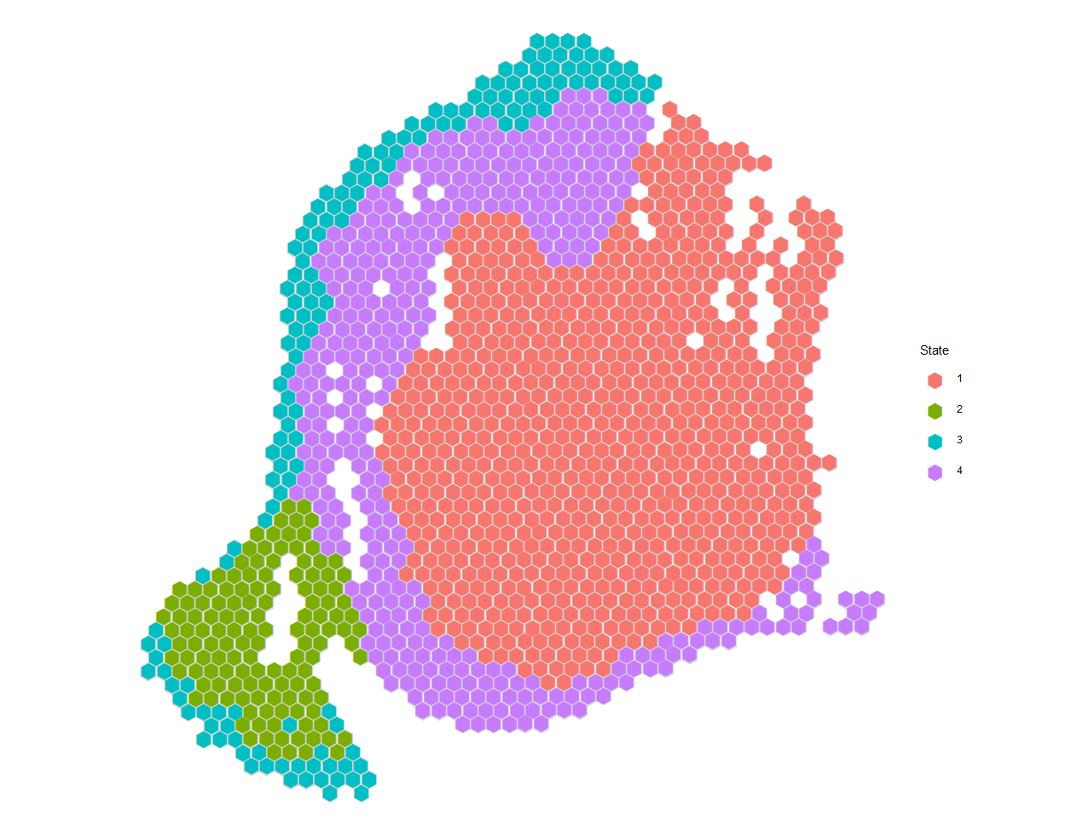
Spatial clustering
Takes into account spatial structure of the data by encouraging neighboring spots to be the same state
Again state 3 and possibly 4 are technical artifacts

Slide 9
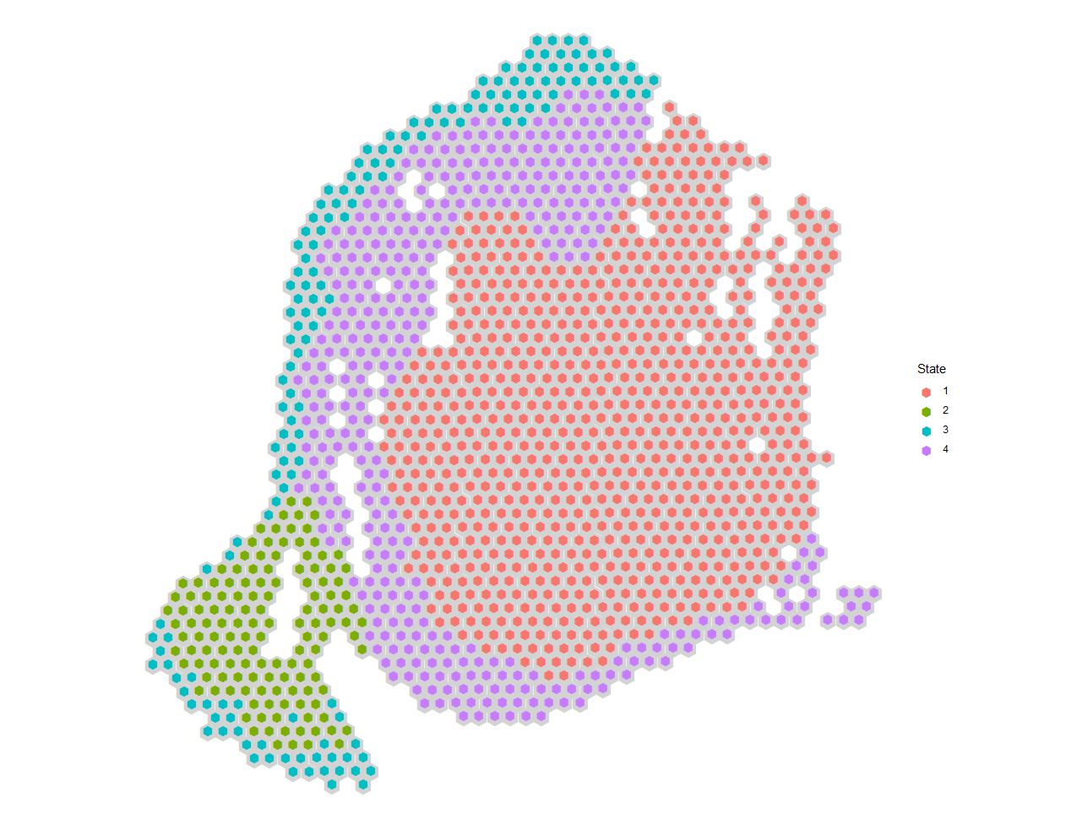
Spatial clustering

Slide 10
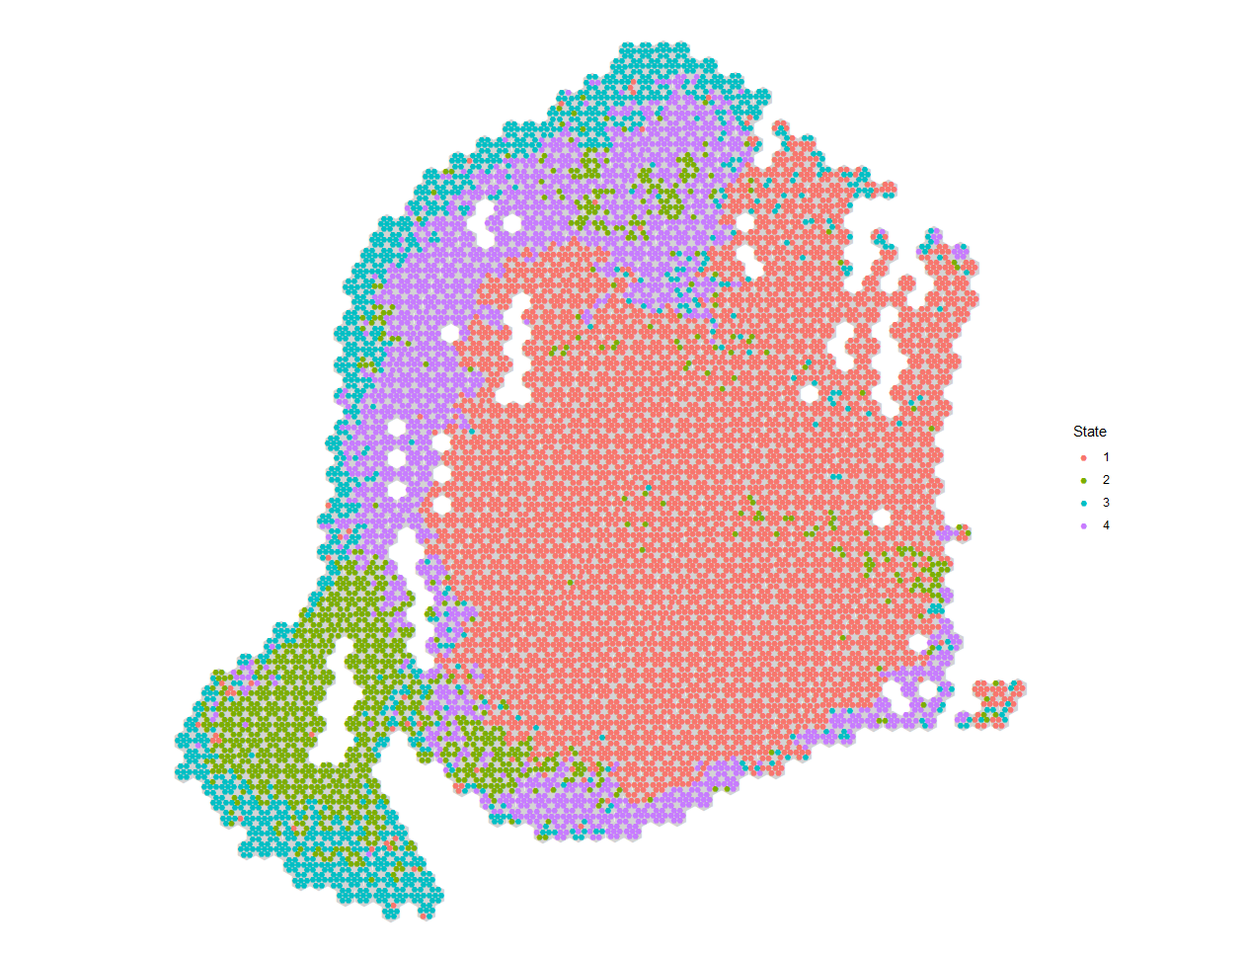

Spatial deconvolution
Adds resolution to help identify where the immune cells are
Provides some evidence of immune infiltration into tumor
However, it also largely recovers the naïve clustering
This is because most of the neighbors are now cells from the same spot
Possible solutions:
Perhaps we should only count cells that are not in the same spot as neighbors?
Impute the missing cells (between capture locations) with the modal state of neighbors

Slide 11

Spatial deconvolution

Slide 12

Spatial deconvolution

