Slide 1
Analysis of Maynard et al., 2020 brain spatial transcriptomic data
4/13

Slide 2
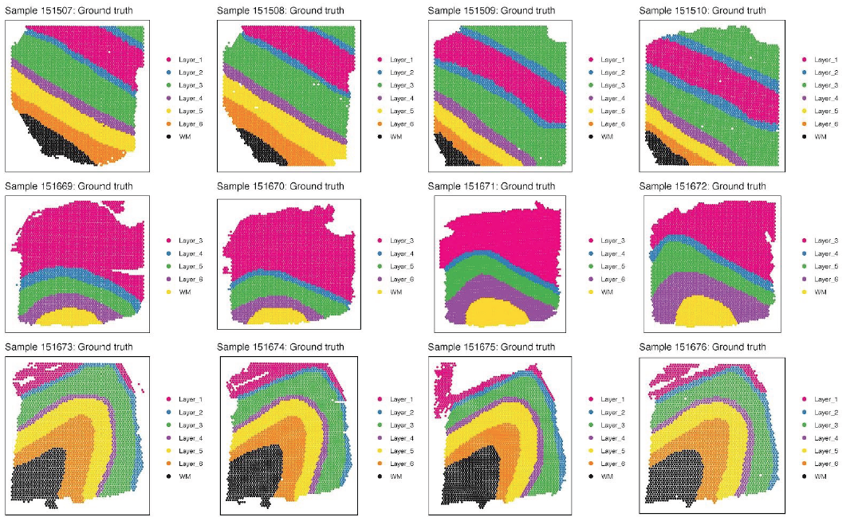
12 samples with layer annotation
3 donors
10 μm apart
300 μm apart
10 μm apart
Maynard et al., 2020

Slide 3
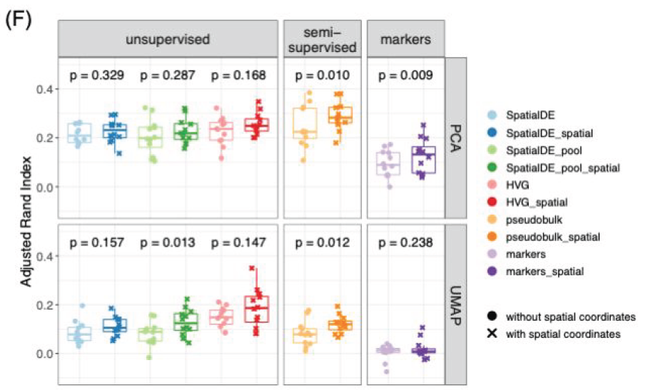
Maynard et al., 2020 clustering analysis
Maynard et al., 2020

Slide 4
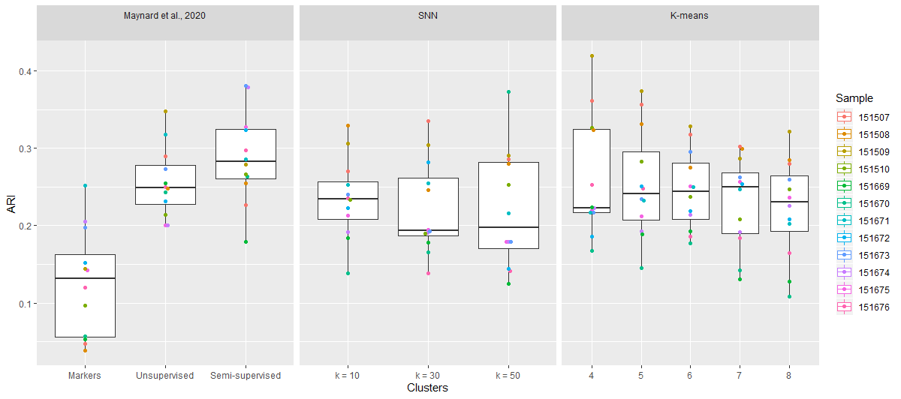
SNN and K-means clustering performance

Slide 5
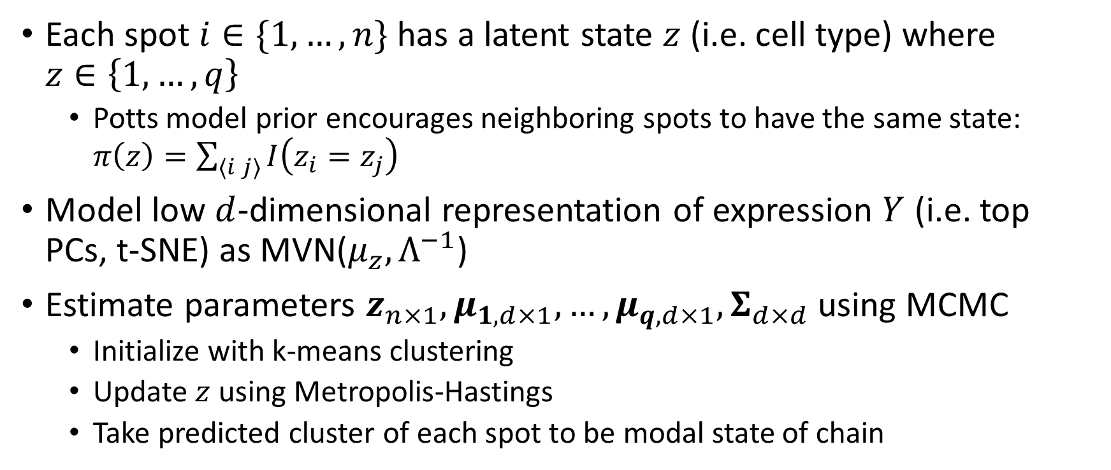
Spatial clustering method
Each spot $i∈\{1,…,n\}$ has a latent state $z$ (i.e. cell type) where $z∈\left\{1,…,q\right\}$
Potts model prior encourages neighboring spots to have the same state: $π\left(z\right)=\sum_{⟨i j⟩}{I\left(z_{i}=z_{j}\right)}$
Model low $d$-dimensional representation of expression $Y$ (i.e. top PCs, t-SNE) as MVN($μ_{z},Λ^{−1}$)
Estimate parameters $z_{n×1},μ_{1,d×1},…,μ_{q,d×1},Σ_{d×d}$ using MCMC
Initialize with k-means clustering
Update $z$ using Metropolis-Hastings
Take predicted cluster of each spot to be modal state of chain

Slide 6
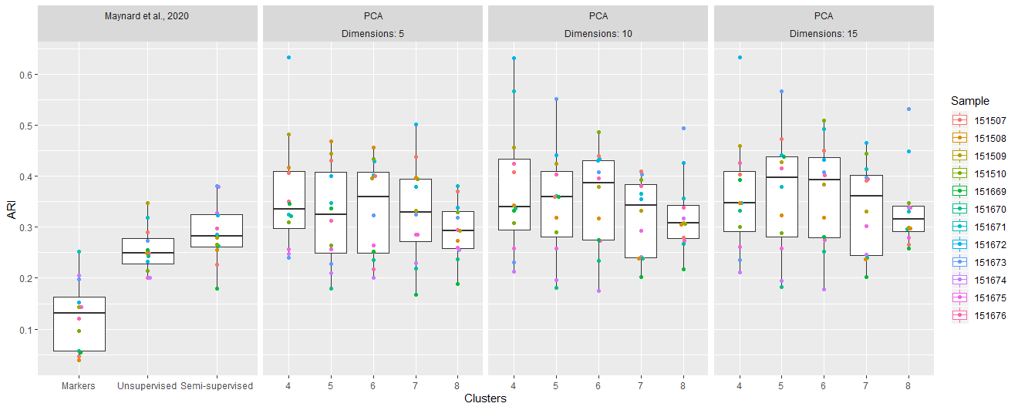
PCA spatial clustering performance

Slide 7
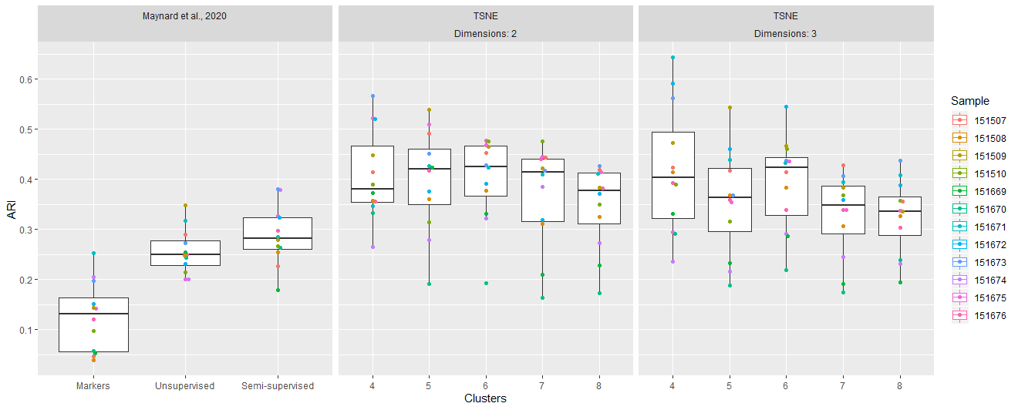
t-SNE spatial clustering performance

Slide 8
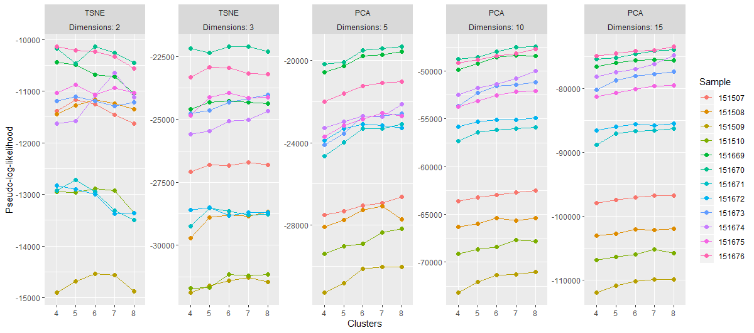
Model comparison

