Slide 1
Spatial clustering
4/24

Slide 2
Performance
R: ~2 iterations per second
Rcpp: ~100 iterations per second
<3 hours to run 1M iterations

Slide 3
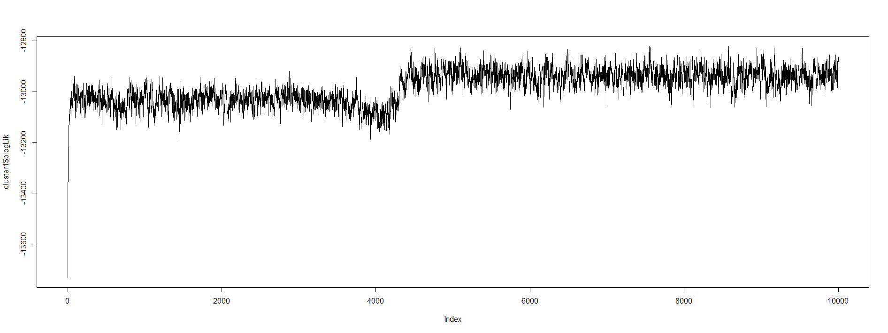
Pseudo-log-likelihood

Slide 4
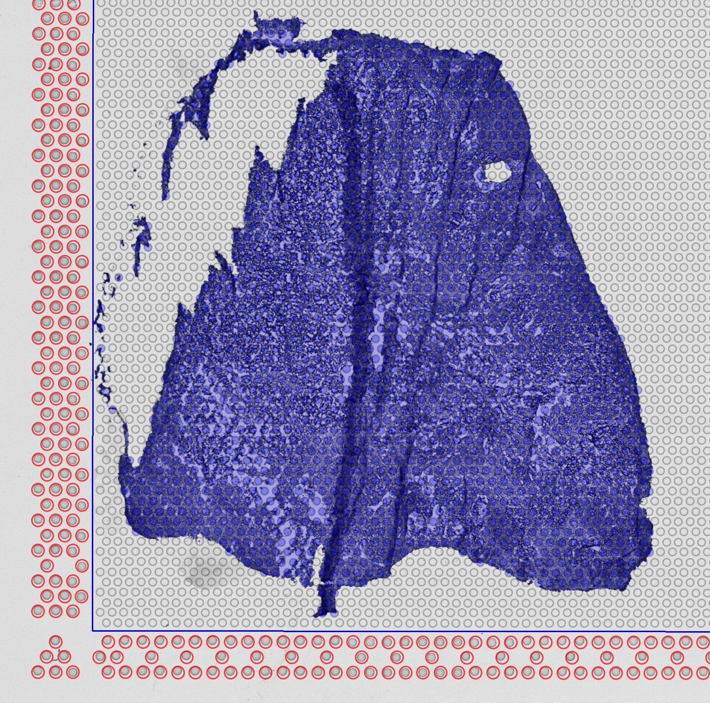
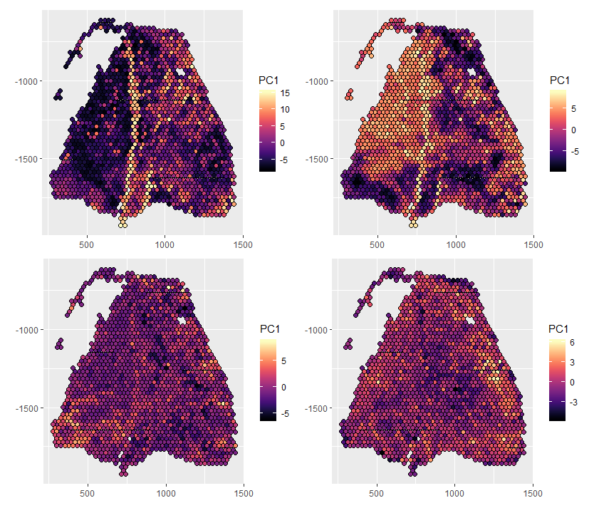
Sample 28C (Immune Infiltrated)

Slide 5
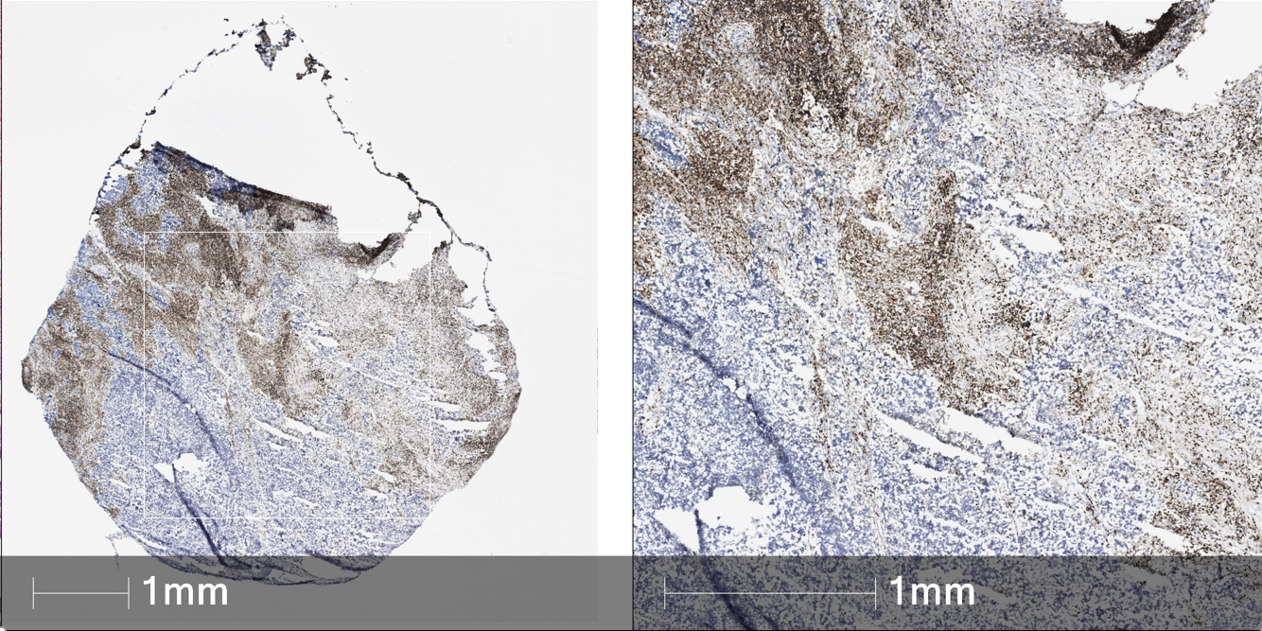
Sample 28C (Immune Infiltrated)

Slide 6
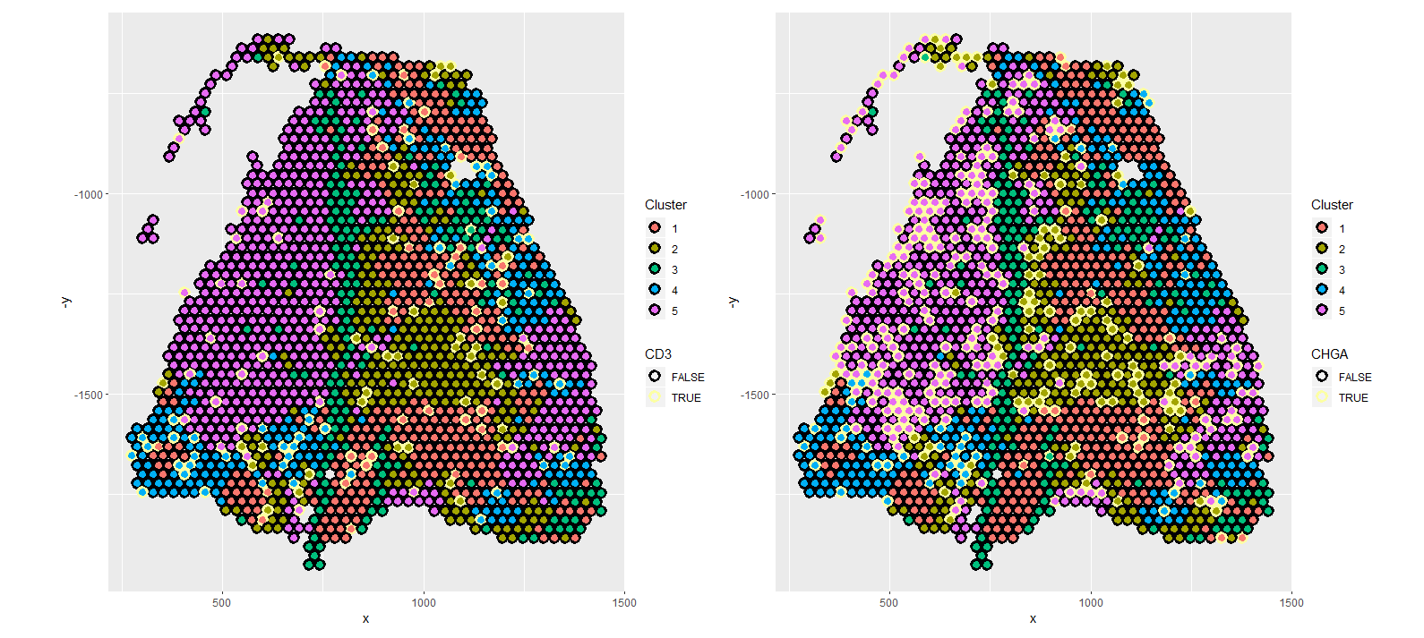
CD3 and CHGA expression by cluster

Slide 7
CD3 and CHGA expression by cluster

Slide 8
Deconvolution
Will run deconvolution on this sample with a range of smoothing parameters

