Slide 1
Analysis of Maynard 2020 brain spatial transcriptomic data
4/6

Slide 2
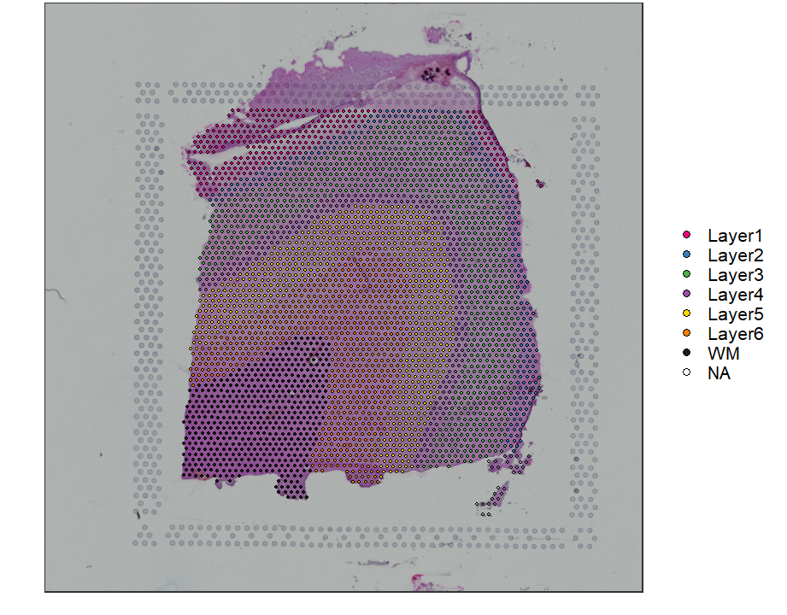
Sample 151673
Dorsolateral prefrontal cortex layers
3639 capture locations

Slide 3
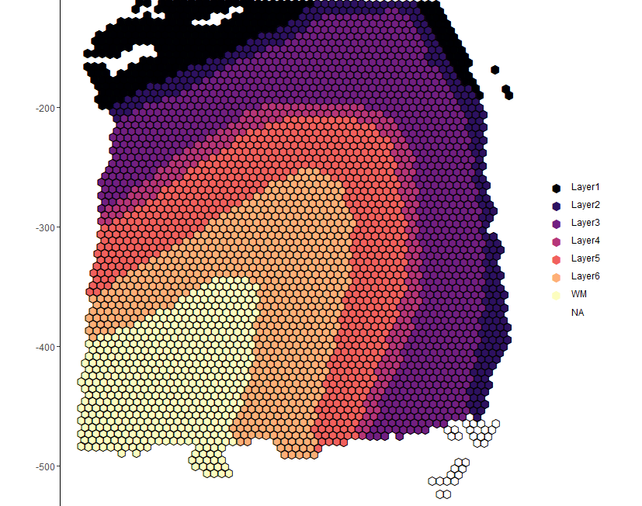
Ground truth
Supervised annotation based on “cytoarchitecture and selected gene markers”
Clustering performance (ARI)
PCA on highly variable genes: 0.274
PCA on known layer makers: 0.197
PCA on differentially expressed genes between true layers: 0.380

Slide 4
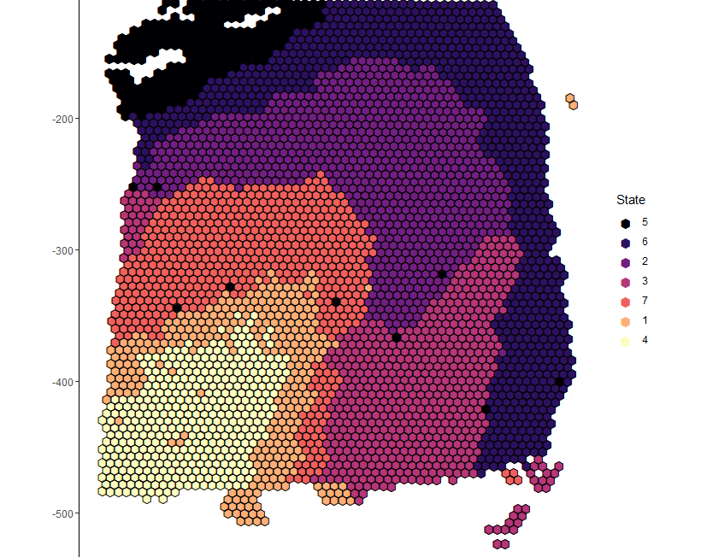
Spatial Clustering
7 clusters
9 PCs
ARI = 0.308

Slide 5
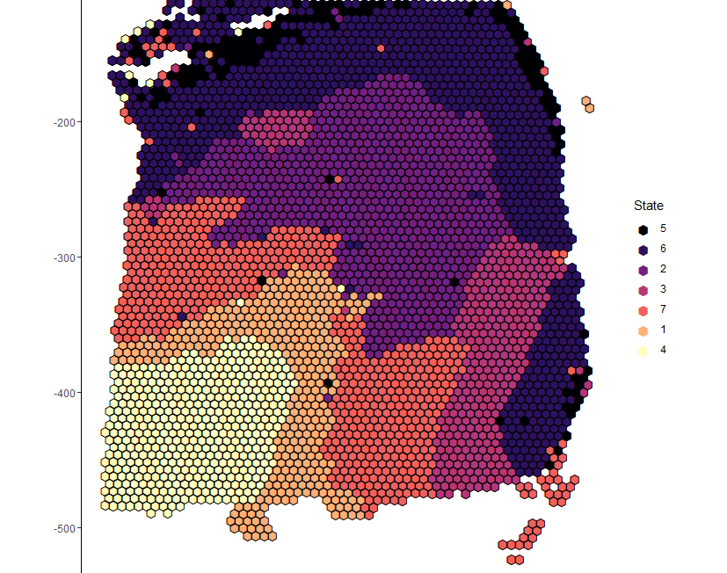
Spatial Clustering
7 clusters
UMAP
ARI = 0.322

Slide 6
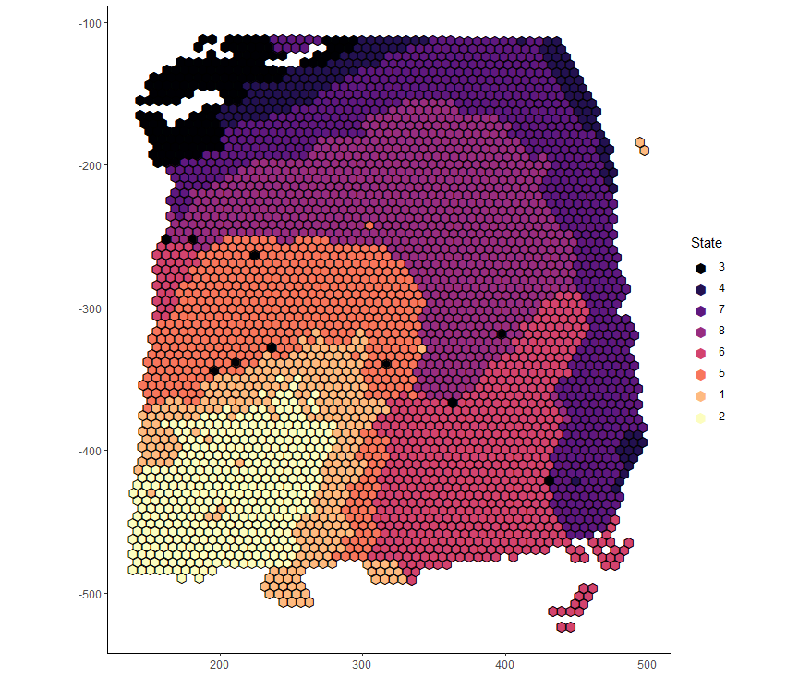
Spatial Clustering
7 clusters
t-SNE
ARI = 0.332

Slide 7
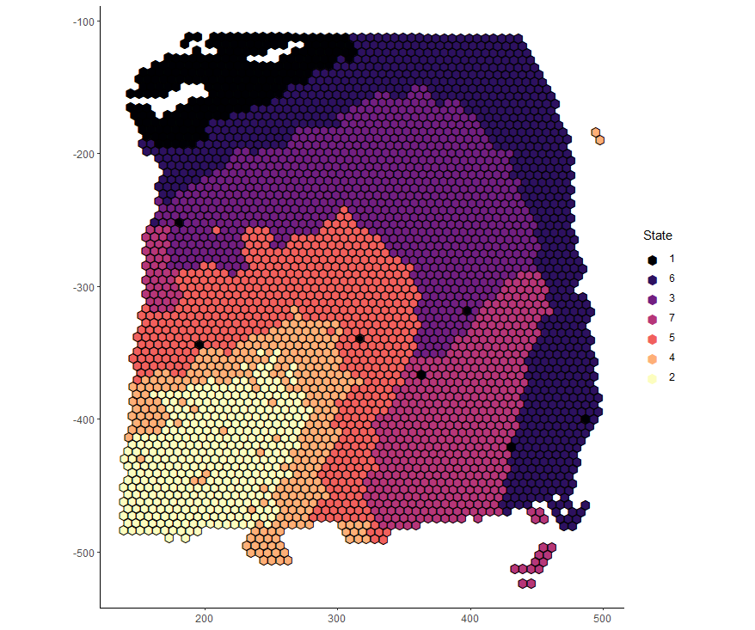
Spatial Clustering
7 clusters
9 PCs using single sample
ARI = 0.352

Slide 8
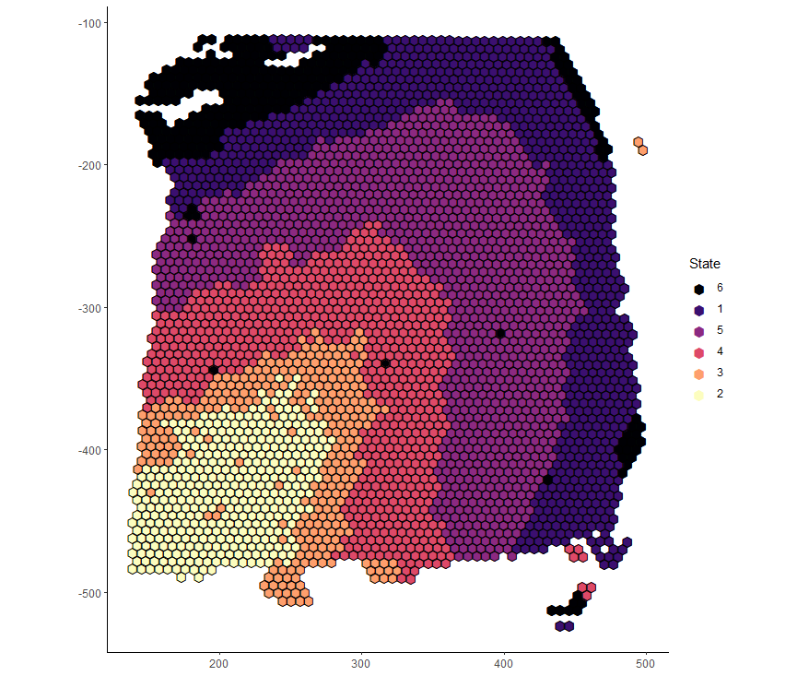
Spatial Clustering
6 clusters
9 PCs using single sample
ARI = 0.403

Slide 9
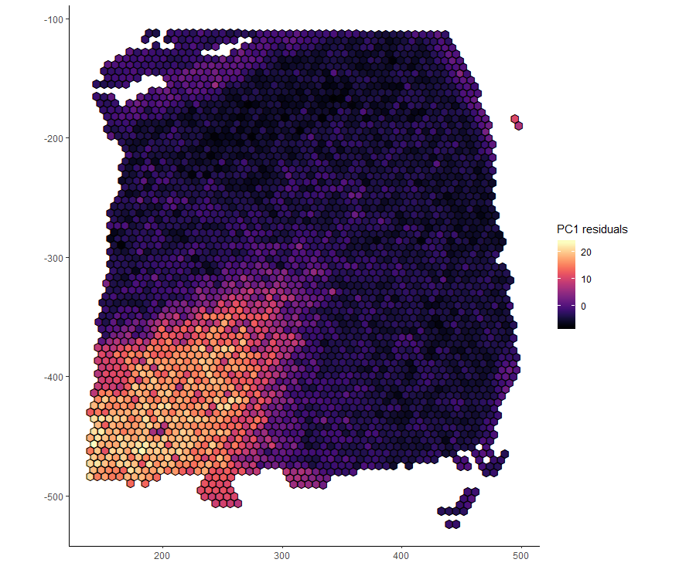
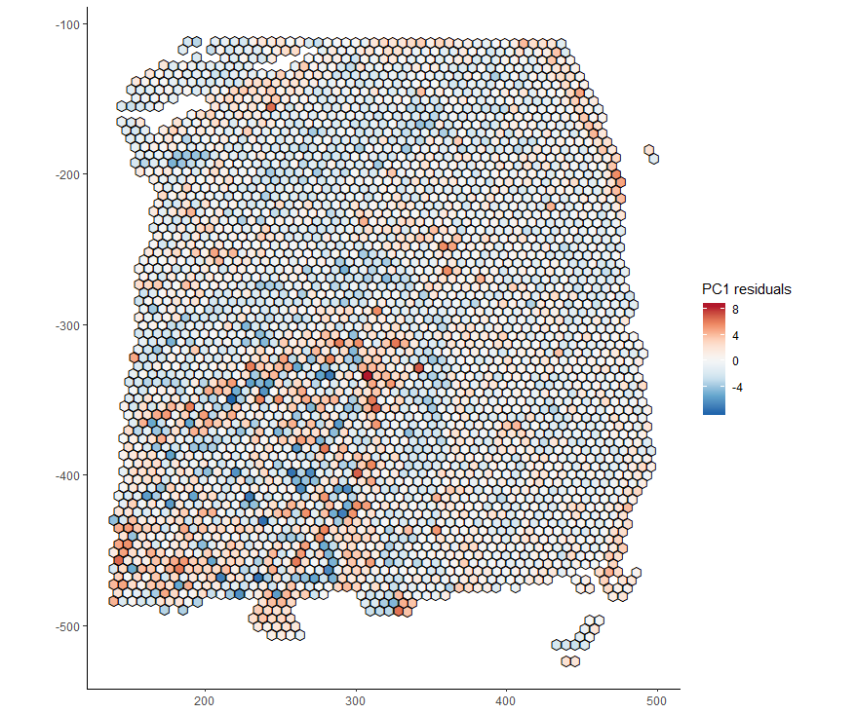
PC1 vs. PC1 residuals

Slide 10
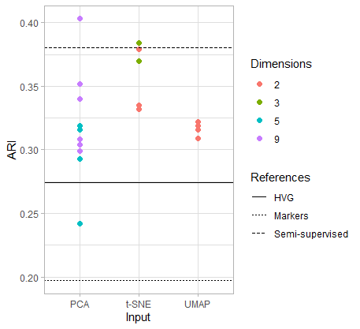
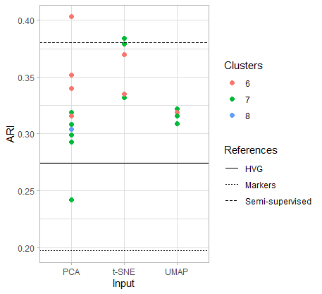
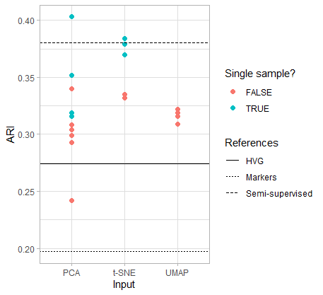
Performance summary

Slide 11
Additional thoughts
Effect of initial seed (using UMAP input)
ARI between k means (2000 iter) vs. truth initialization (2000 iter): 0.566
ARI between k means (2000 iter) vs. truth initialization (20000 iter): 0.652
Joint clustering of samples probably won’t work well

