Slide 1
Update
5-15

Slide 2
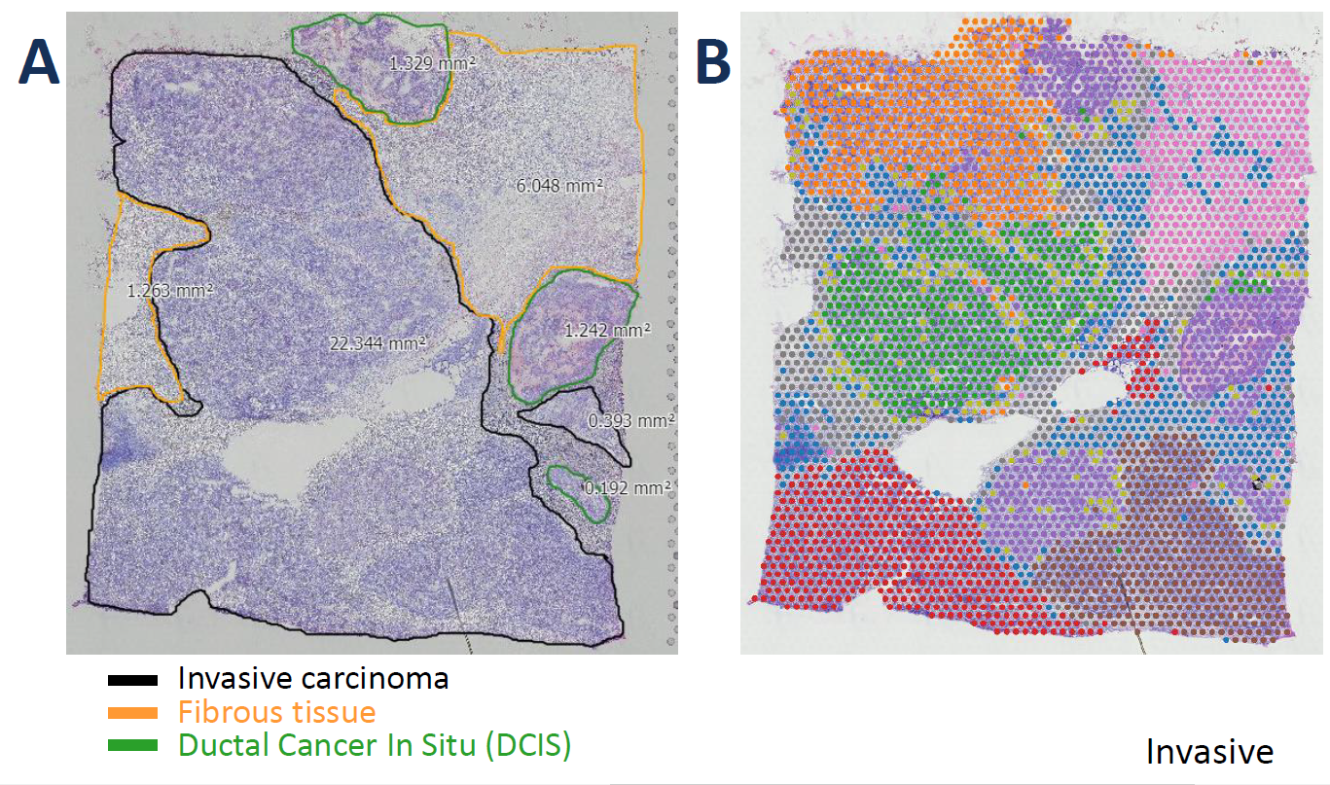
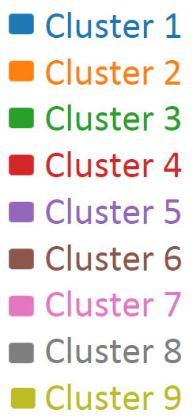
Breast cancer VISIUM data
Manual annotation
Unsupervised clustering

Slide 3
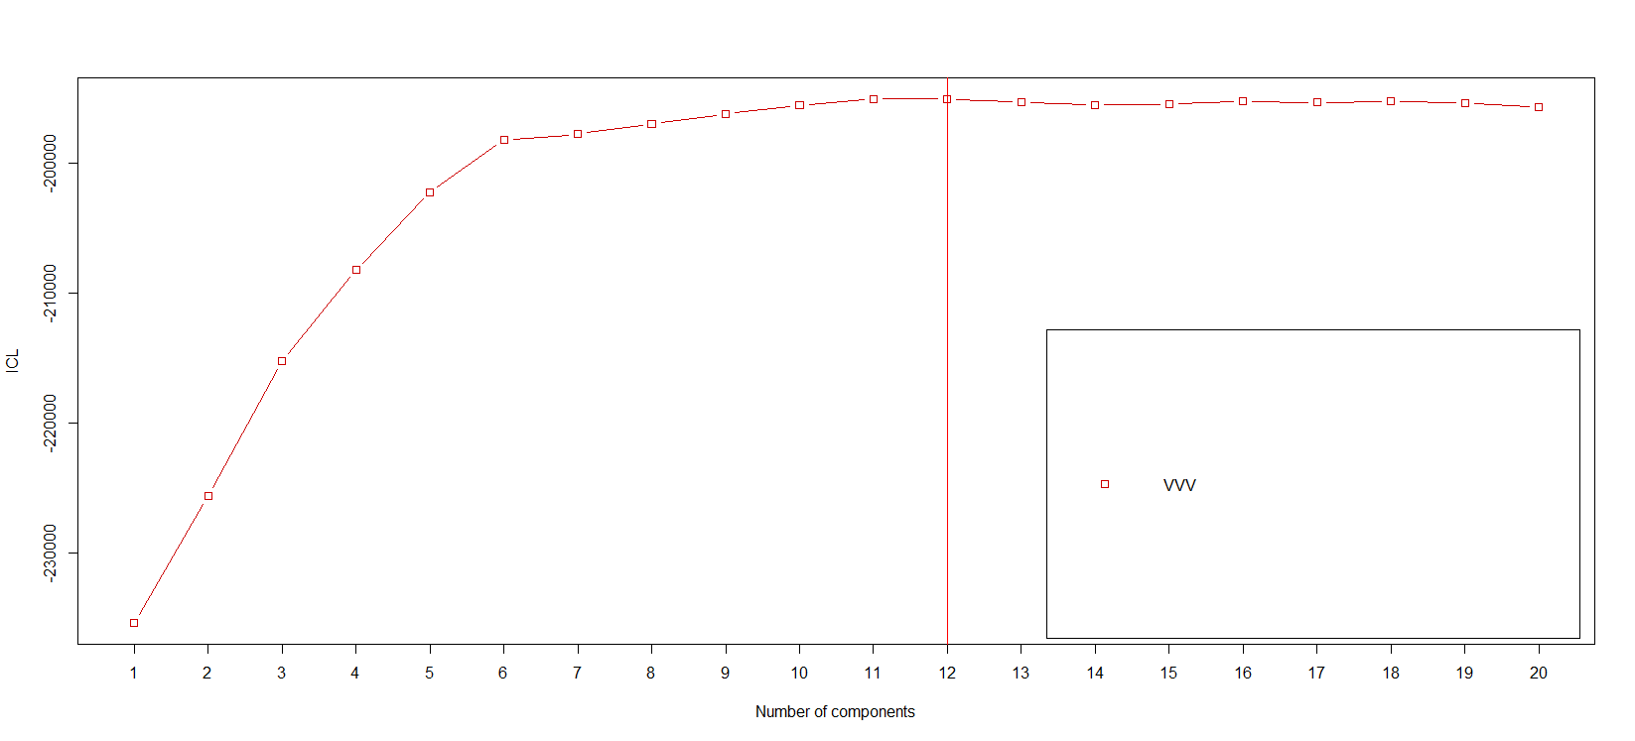
mclustICL: replicate 1

Slide 4
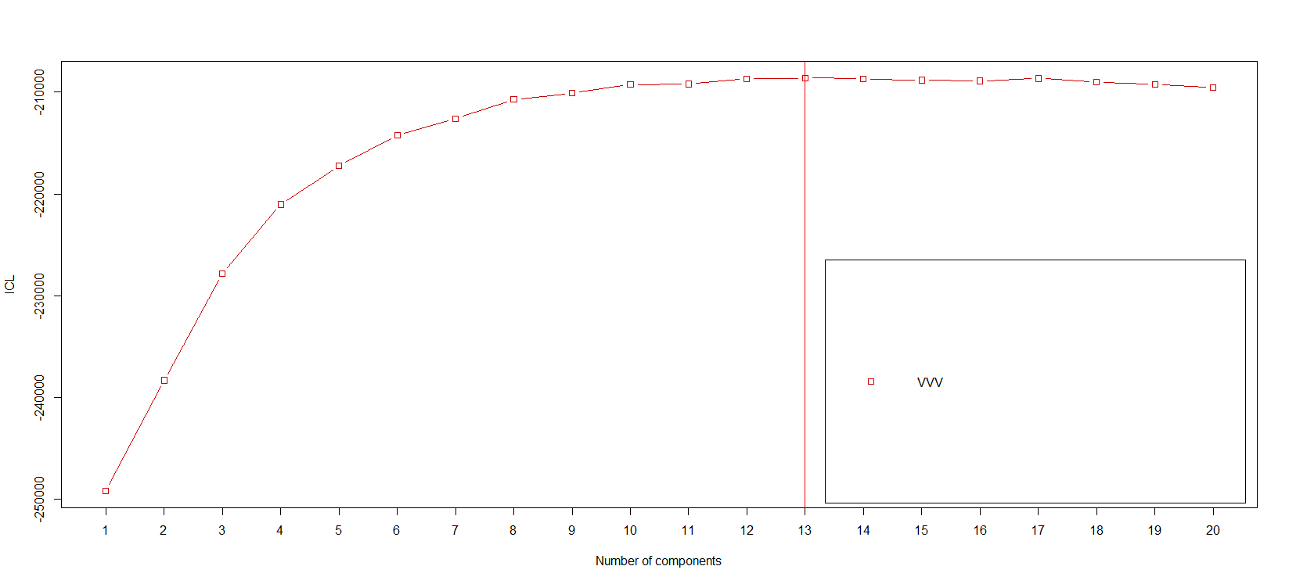
mclustICL: replicate 2

Slide 5
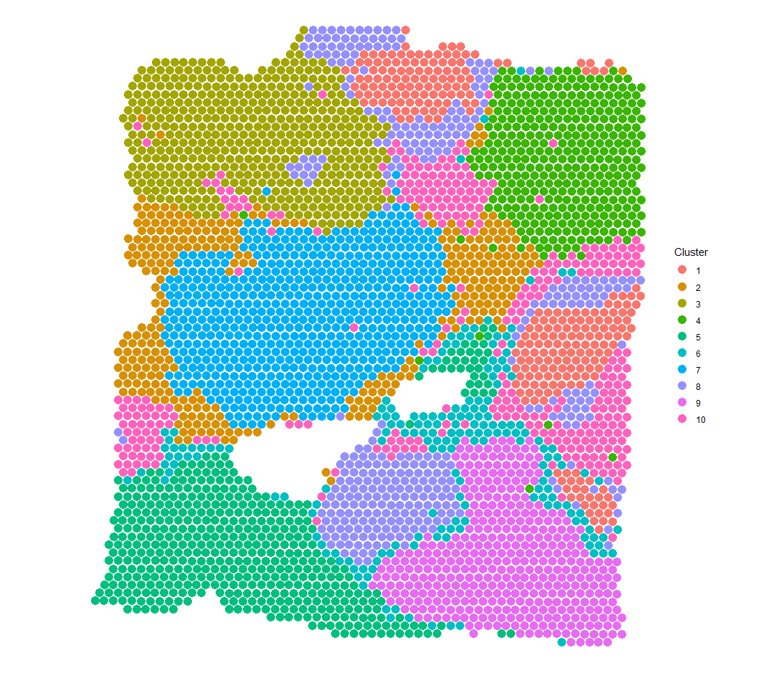
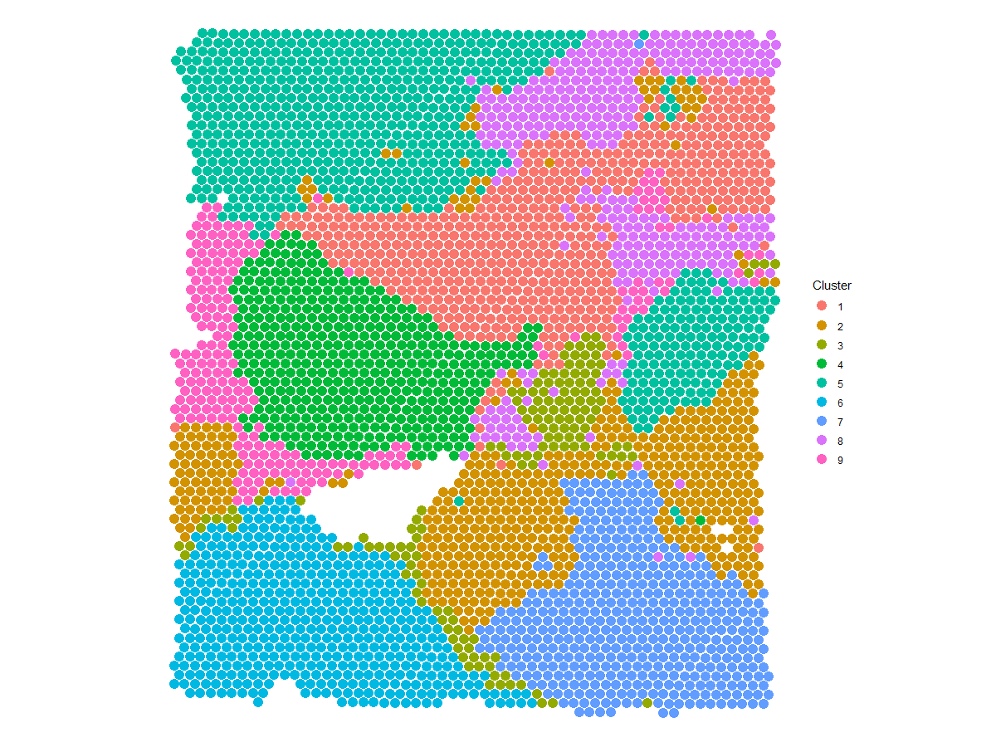
Spatial clustering: 9
Replicate 1
Replicate 2

Slide 6
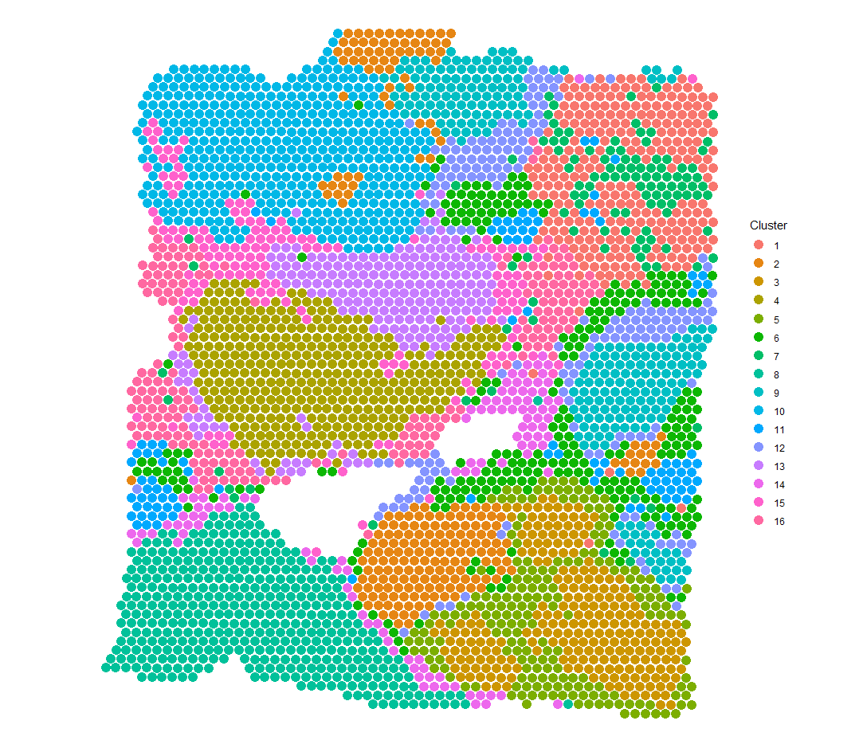
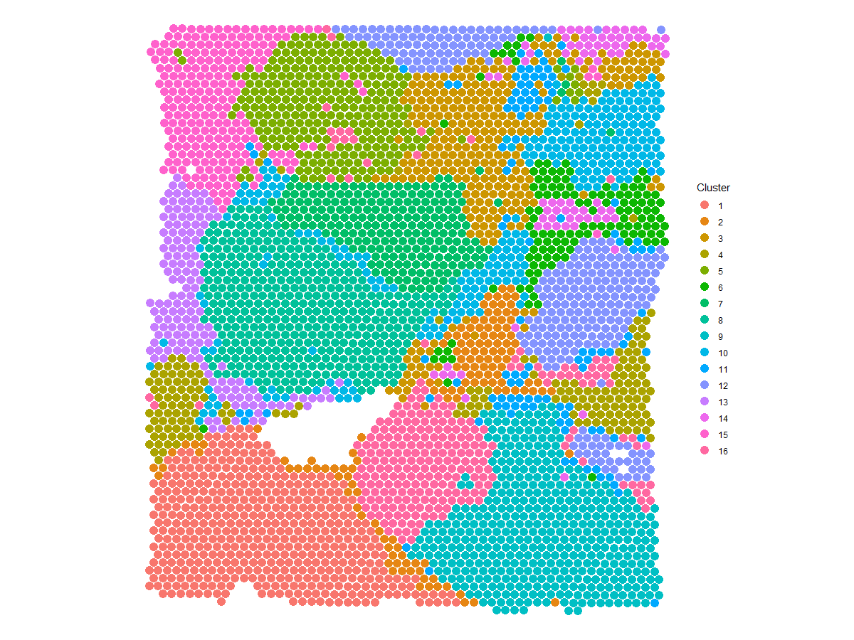
Spatial clustering: 16
Replicate 1
Replicate 2

Slide 7
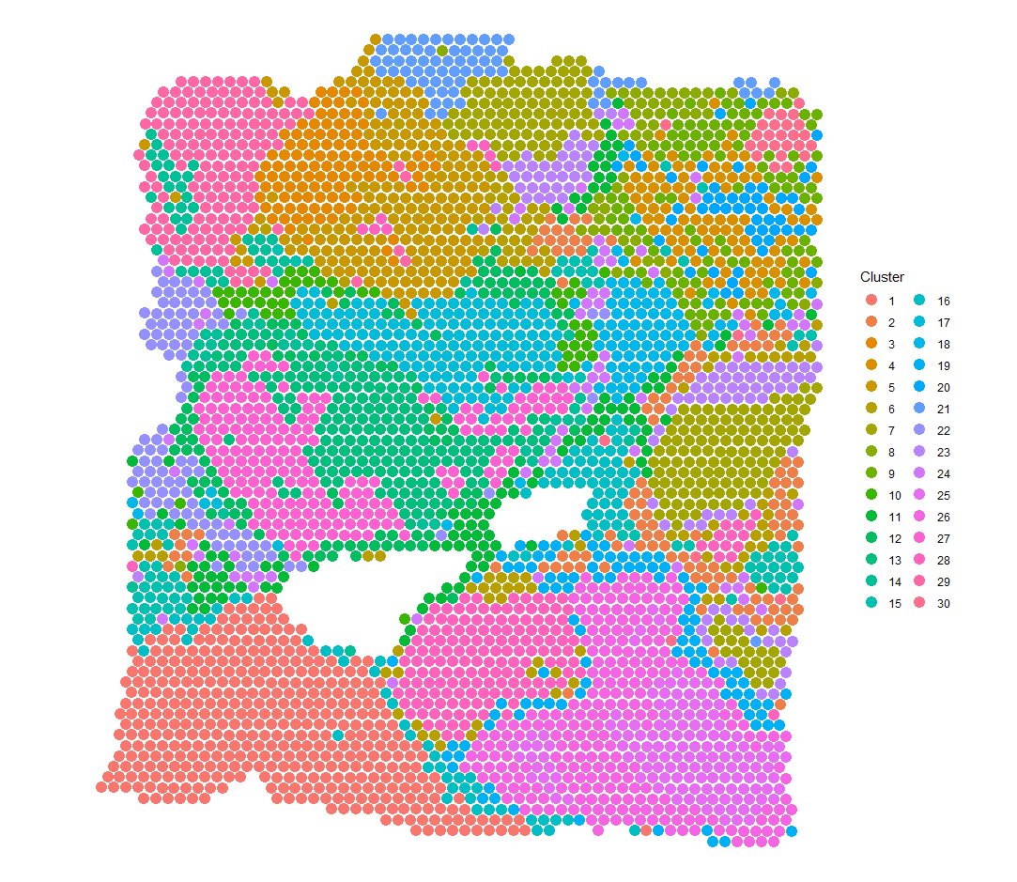
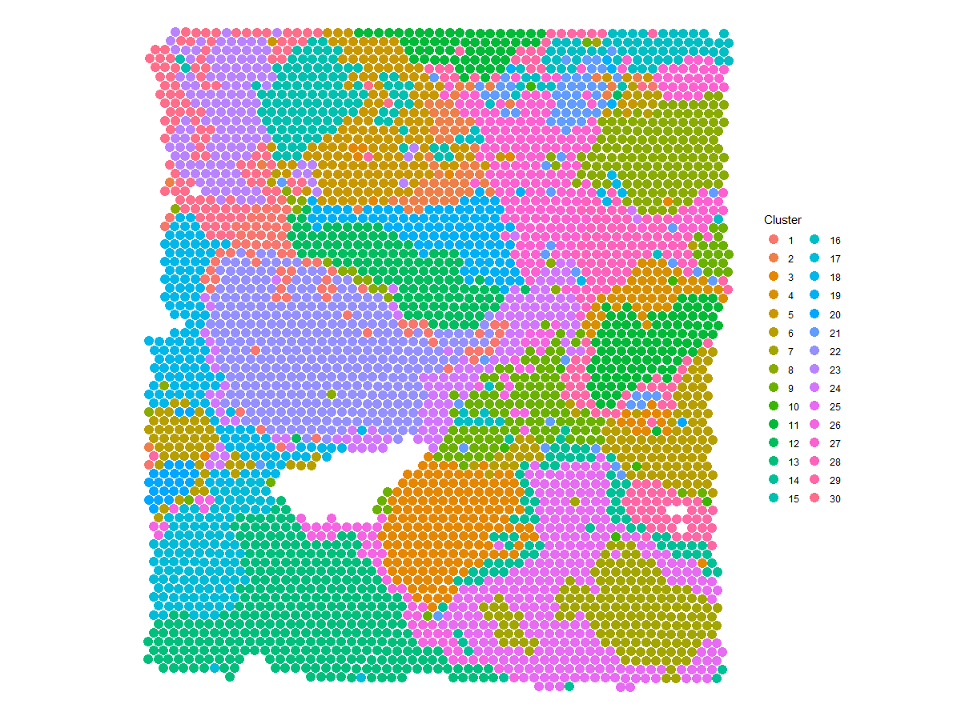
Spatial clustering: 30
Replicate 1
Replicate 2

Slide 8


EEE vs VVV model
Prior
$$Λ\sim W_{d}\left(α,diag {\left(β\right)}_{d}^{−1} \right)$$
Posterior
$$Λ\sim W_{d}\left(n+α,{\left(diag{\left(β\right)}_{d}+\sum_{i}{{\left(y_{i}−μ_{i}\right)}^{T}(y_{i}−μ_{i})}\right)}^{−1} \right)$$
Prior
$$Λ_{k}\sim W_{d}\left(α,diag {\left(β\right)}_{d}^{−1} \right)$$
Posterior
$$Λ_{k}\sim W_{d}\left(n_{k}+α,{\left(diag{\left(β\right)}_{d}+\sum_{{i:\{z}_{i}=k\}}{{\left(y_{i}−μ_{i}\right)}^{T}(y_{i}−μ_{i})}\right)}^{−1} \right)$$

Slide 9




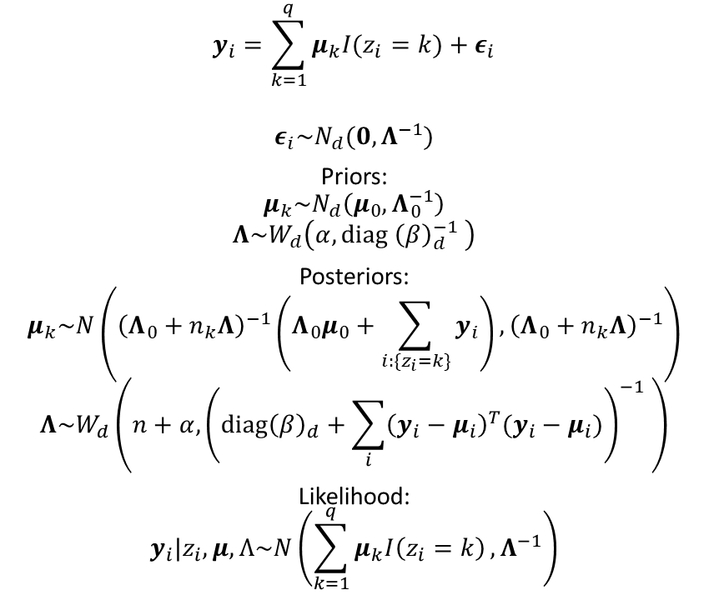
Normal model
$$y_{i}=\sum_{k=1}^{q}{μ_{k}I(z_{i}=k)}+ε_{i}$$
$$ε_{i}\sim N_{d}(0,Λ^{−1})$$
Priors:
$$μ_{k}\sim N_{d}\left(μ_{0},Λ_{0}^{−1}\right)$$
$$Λ\sim W_{d}\left(α,diag {\left(β\right)}_{d}^{−1} \right)$$
Posteriors:
$$μ_{k}\sim N\left({\left(Λ_{0}+n_{k}Λ\right)}^{−1}\left(Λ_{0}μ_{0}+\sum_{{i:\{z}_{i}=k\}}{y_{i}}\right),{\left(Λ_{0}+n_{k}Λ\right)}^{−1}\right)$$
$$Λ\sim W_{d}\left(n+α,{\left(diag{\left(β\right)}_{d}+\sum_{i}{{\left(y_{i}−μ_{i}\right)}^{T}(y_{i}−μ_{i})}\right)}^{−1} \right)$$
Likelihood:
$$y_{i}|z_{i},μ,Λ\sim N\left(\sum_{k=1}^{q}{μ_{k}I\left(z_{i}=k\right)},Λ^{−1}\right)$$

Slide 10
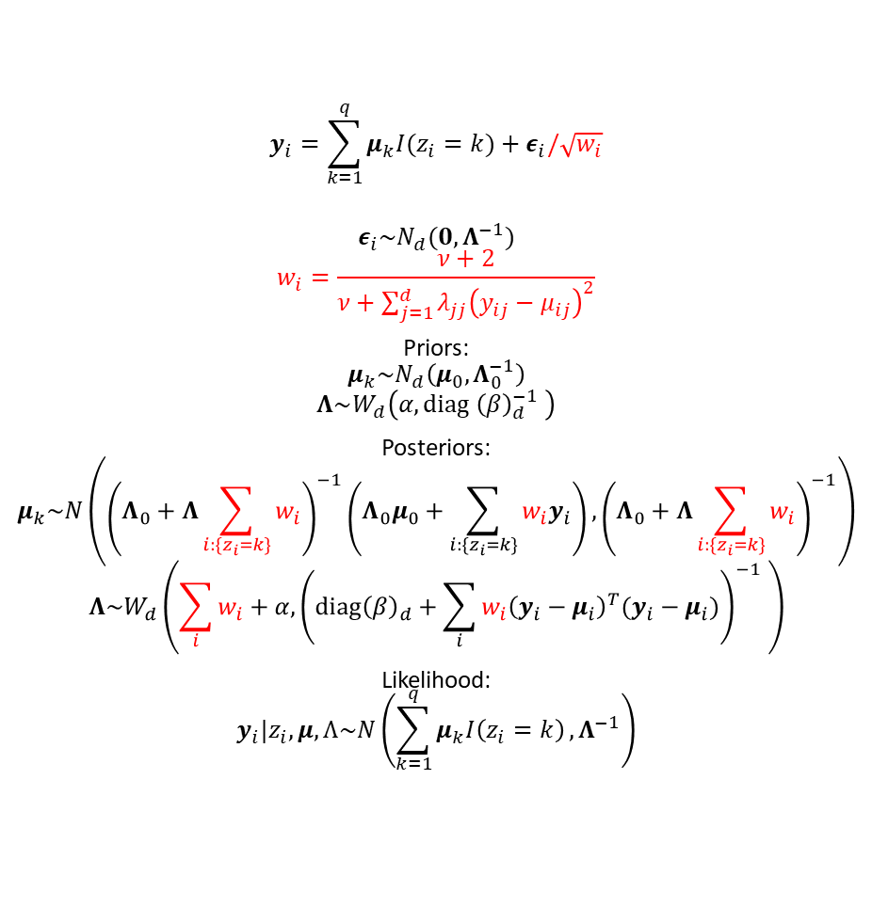
t model (?)
$$y_{i}=\sum_{k=1}^{q}{μ_{k}I(z_{i}=k)}+ε_{i}/\sqrt{w_{i}}$$
$$ε_{i}\sim N_{d}(0,Λ^{−1})$$
$$w_{i}=\frac{ν+2}{ν+\sum_{j=1}^{d}{λ_{jj}{\left(y_{ij}−μ_{ij}\right)}^{2}}}$$
Priors:
$$μ_{k}\sim N_{d}\left(μ_{0},Λ_{0}^{−1}\right)$$
$$Λ\sim W_{d}\left(α,diag {\left(β\right)}_{d}^{−1} \right)$$
Posteriors:
$$μ_{k}\sim N\left({\left(Λ_{0}+Λ\sum_{i:\{z_{i}=k\}}{w_{i}}\right)}^{−1}\left(Λ_{0}μ_{0}+\sum_{{i:\{z}_{i}=k\}}{{w_{i}y}_{i}}\right),{\left(Λ_{0}+Λ\sum_{i:\{z_{i}=k\}}{w_{i}}\right)}^{−1}\right)$$
$$Λ\sim W_{d}\left(\sum_{i}{w_{i}}+α,{\left(diag{\left(β\right)}_{d}+\sum_{i}{{w_{i}\left(y_{i}−μ_{i}\right)}^{T}(y_{i}−μ_{i})}\right)}^{−1} \right)$$
Likelihood:
$$y_{i}|z_{i},μ,Λ\sim N\left(\sum_{k=1}^{q}{μ_{k}I\left(z_{i}=k\right)},Λ^{−1}\right)$$

