Slide 1
Spatial Update
5-22

Slide 2

Posterior distribution for weights
$$Y_{i}\sim T_{ν}\left(μ,Λ^{−1}\right),ε_{i}\sim N_{d}\left(0,Λ^{−1}\right),\left(\frac{ε_{i}}{\sqrt{w_{i}}} | w_{i}\right)\sim N_{d}\left(0,w_{i}^{−1}Λ^{−1}\right)$$
$$w_{i}\sim Gamma\left(\frac{ν}{2},\frac{ν}{2}\right)$$
$p\left(w_{i} | Y_{i},μ_{i},Λ\right)∝{\left|w_{i}Λ\right|}^{\frac{1}{2}}\exp\left(−\frac{{\left(y_{i}−μ_{i}\right)}^{T}w_{i}Λ\left(y_{i}−μ_{i}\right)}{2}\right)×w_{i}^{\frac{ν}{2}−1}$ $exp\left(−\frac{ν}{2}w_{i}\right)$
$={w_{i}^{\frac{d}{2}}\left|Λ\right|}^{\frac{1}{2}}\exp\left(−\frac{w_{i}{\left(y_{i}−μ_{i}\right)}^{T}Λ\left(y_{i}−μ_{i}\right)}{2}\right)×w_{i}^{\frac{ν}{2}−1}$ $exp\left(−\frac{ν}{2}w_{i}\right)$
$$={w_{i}^{\frac{d+ν}{2}−1}\left|Λ\right|}^{\frac{1}{2}}\exp\left(−w_{i}\frac{ν+{\left(y_{i}−μ_{i}\right)}^{T}Λ\left(y_{i}−μ_{i}\right)}{2}\right)$$
$$w_{i}|y_{i},μ_{i},Λ\sim Gamma\left(\frac{d+ν}{2},\frac{ν+{\left(y_{i}−μ_{i}\right)}^{T}Λ\left(y_{i}−μ_{i}\right)}{2}\right)$$

Slide 3
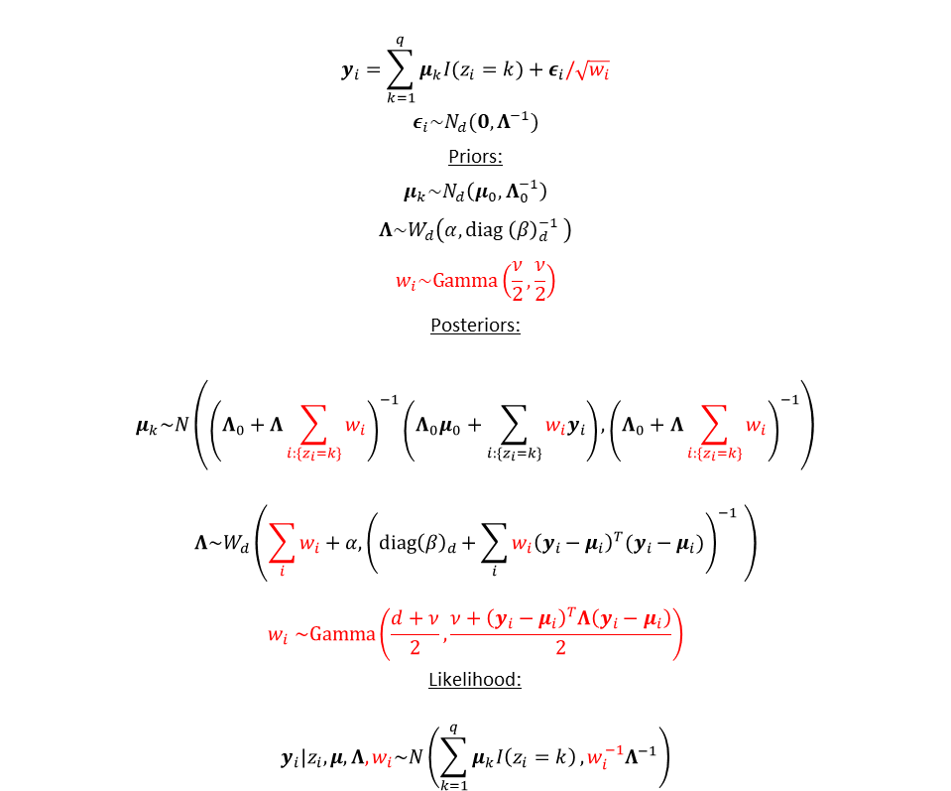

Normal (left) vs. t-distributed (right) error model
$$y_{i}=\sum_{k=1}^{q}{μ_{k}I(z_{i}=k)}+ε_{i}$$
$$ε_{i}\sim N_{d}\left(0,Λ^{−1}\right)$$
Priors:
$$μ_{k}\sim N_{d}\left(μ_{0},Λ_{0}^{−1}\right)$$
$$Λ\sim W_{d}\left(α,diag {\left(β\right)}_{d}^{−1} \right)$$
Posteriors:
$$μ_{k}\sim N\left({\left(Λ_{0}+n_{k}Λ\right)}^{−1}\left(Λ_{0}μ_{0}+\sum_{{i:\{z}_{i}=k\}}{y_{i}}\right),{\left(Λ_{0}+n_{k}Λ\right)}^{−1}\right)$$
$$Λ\sim W_{d}\left(n+α,{\left(diag{\left(β\right)}_{d}+\sum_{i}{{\left(y_{i}−μ_{i}\right)}^{T}(y_{i}−μ_{i})}\right)}^{−1} \right)$$
Likelihood:
$$y_{i}|z_{i},μ,Λ\sim N\left(\sum_{k=1}^{q}{μ_{k}I\left(z_{i}=k\right)},Λ^{−1}\right)$$
$$y_{i}=\sum_{k=1}^{q}{μ_{k}I(z_{i}=k)}+ε_{i}/\sqrt{w_{i}}$$
$$ε_{i}\sim N_{d}(0,Λ^{−1})$$
Priors:
$$μ_{k}\sim N_{d}\left(μ_{0},Λ_{0}^{−1}\right)$$
$$Λ\sim W_{d}\left(α,diag {\left(β\right)}_{d}^{−1} \right)$$
$$w_{i}\sim Gamma\left(\frac{ν}{2},\frac{ν}{2}\right)$$
Posteriors:
$$μ_{k}\sim N\left({\left(Λ_{0}+Λ\sum_{i:\{z_{i}=k\}}{w_{i}}\right)}^{−1}\left(Λ_{0}μ_{0}+\sum_{{i:\{z}_{i}=k\}}{{w_{i}y}_{i}}\right),{\left(Λ_{0}+Λ\sum_{i:\{z_{i}=k\}}{w_{i}}\right)}^{−1}\right)$$
$$Λ\sim W_{d}\left(\sum_{i}{w_{i}}+α,{\left(diag{\left(β\right)}_{d}+\sum_{i}{{w_{i}\left(y_{i}−μ_{i}\right)}^{T}(y_{i}−μ_{i})}\right)}^{−1} \right)$$
$$w_{i} \sim Gamma\left(\frac{d+ν}{2},\frac{ν+{\left(y_{i}−μ_{i}\right)}^{T}Λ\left(y_{i}−μ_{i}\right)}{2}\right)$$
Likelihood:
$$y_{i}|z_{i},μ,Λ,w_{i}\sim N\left(\sum_{k=1}^{q}{μ_{k}I\left(z_{i}=k\right)},{w_{i}^{−1}Λ}^{−1}\right)$$

Slide 4
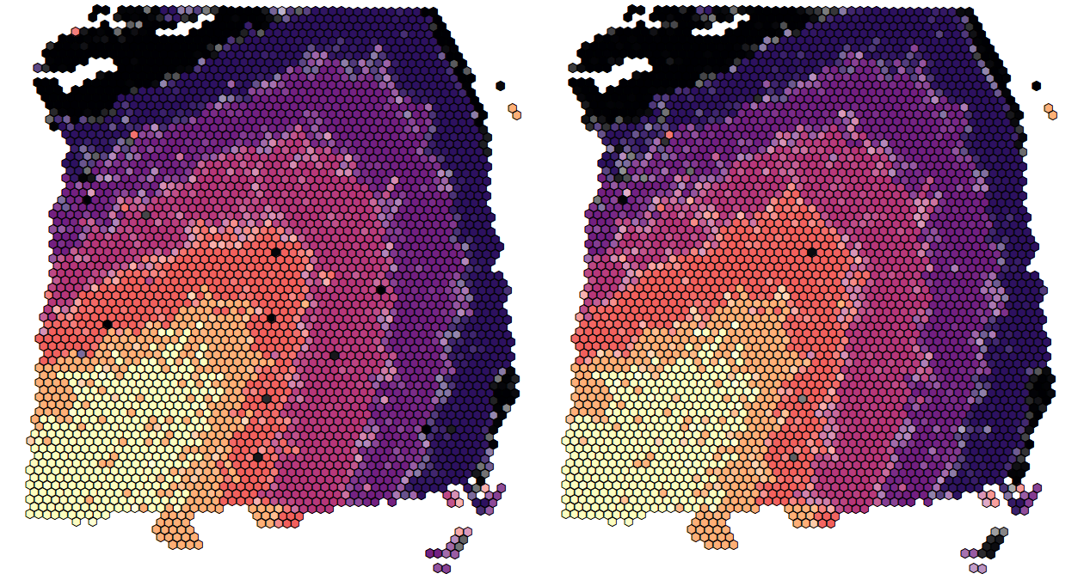
Normal (left) vs. t-distributed (right) error model
ARI with truth = 0.469
6 min runtime
ARI with truth = 0.478
7 min runtime
ARI normal vs t = 0.873

Slide 5
ARI as a function of chain length
ARI | Truth | Kmeans | Mode of 1:500 (21sec) | Mode of 1:1000 (42s) | Mode of 1000:2000 (84s) | Mode of 1000:10000 (420s)
Truth | 1 | 0.281 | 0.480 | 0.481 | 0.479 | 0.479
Kmeans |  | 1 | 0.459 | 0.458 | 0.457 | 0.458
Mode of 1:500 |  |  | 1 | 0.984 | 0.959 | 0.967
Mode of 1:1000 |  |  |  | 1 | 0.967 | 0.979
Mode of 1000:2000 |  |  |  |  | 1 | 0.981
Mode of 1000:10000 |  |  |  |  |  | 1

Slide 6


EEE vs VVV model
Prior
$$Λ\sim W_{d}\left(α,diag {\left(β\right)}_{d}^{−1} \right)$$
Posterior
$$Λ\sim W_{d}\left(n+α,{\left(diag{\left(β\right)}_{d}+\sum_{i}{{\left(y_{i}−μ_{i}\right)}^{T}(y_{i}−μ_{i})}\right)}^{−1} \right)$$
Prior
$$Λ_{k}\sim W_{d}\left(α,diag {\left(β\right)}_{d}^{−1} \right)$$
Posterior
$$Λ_{k}\sim W_{d}\left(n_{k}+α,{\left(diag{\left(β\right)}_{d}+\sum_{{i:\{z}_{i}=k\}}{{\left(y_{i}−μ_{i}\right)}^{T}(y_{i}−μ_{i})}\right)}^{−1} \right)$$

Slide 7
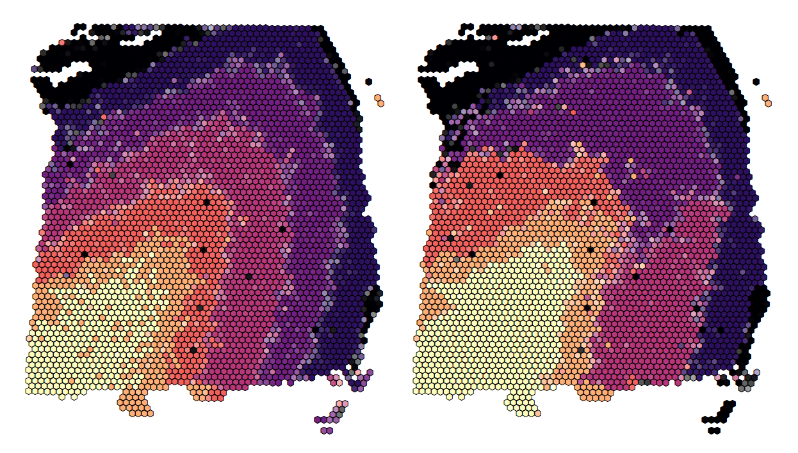
EEE Gaussian model (left) vs. VVV Gaussian model (right)
ARI with truth = 0.469
ARI with truth = 0.349
ARI EEE vs VVV = 0.430

Slide 8
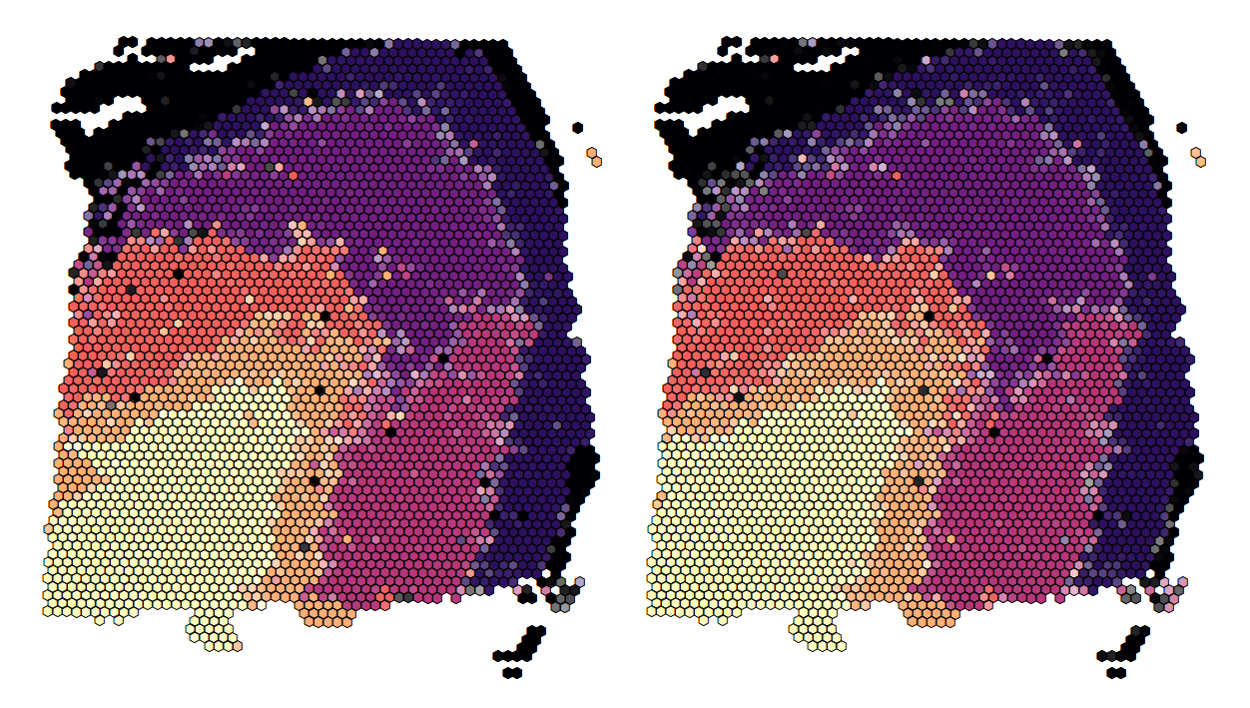
VVV Gaussian model (left) vs. VVV t model (right)
ARI with truth = 0.349
ARI with truth = 0.367
ARI normal vs T = 0.898

Slide 9
Next steps
Simulations
Clustering
Deconvolution
Aggregate spots
Use subspot labels as truth

