Slide 1
Analysis of Prostate Cancer data from Berglund et al., 2018
4/29

Slide 2
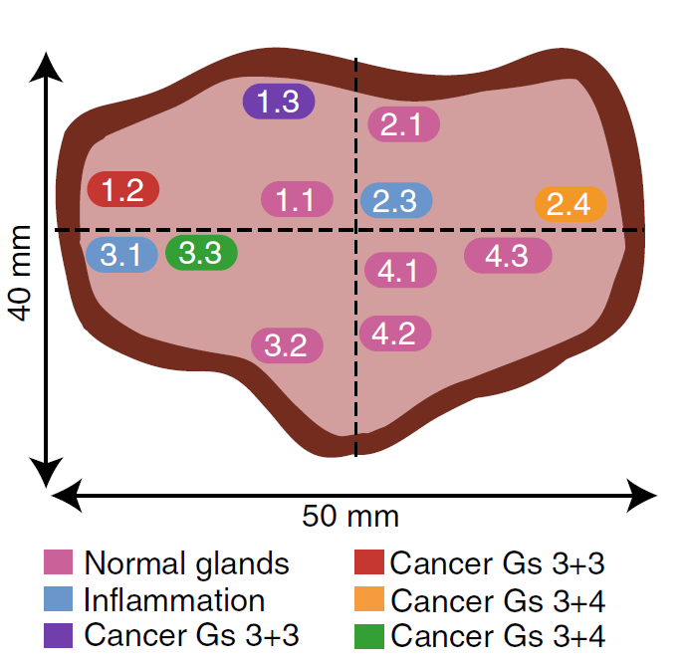
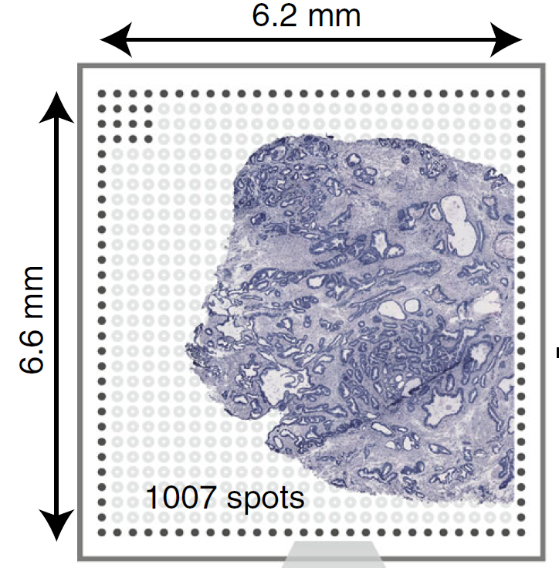
Prostate cancer sample 1.2
Berglund, et al. 2018

Slide 3
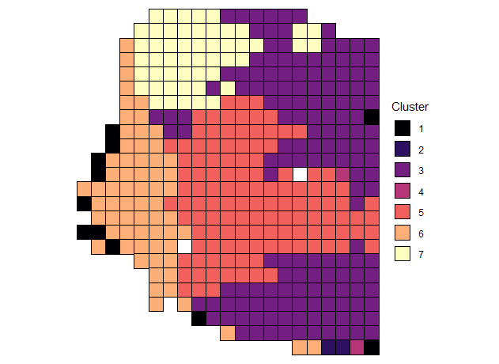
Spatial Clustering

Slide 4
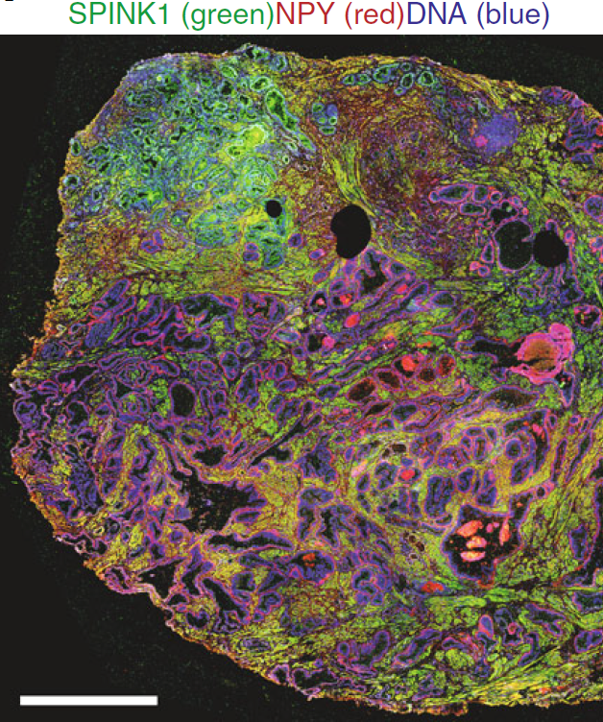
Spatial Clustering
SPINK1 = cancer marker
NPY = PIN marker

Slide 5
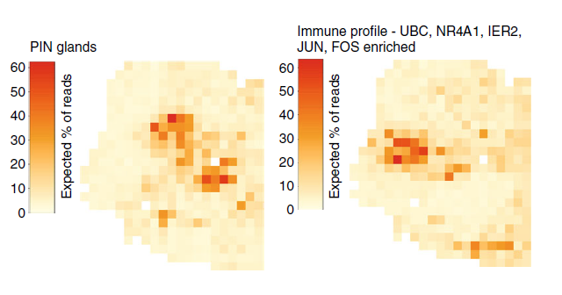
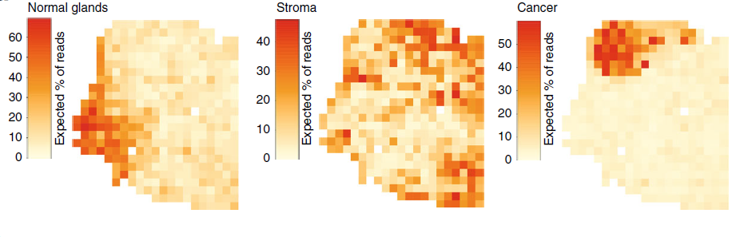
Spatial Clustering
N/A
N/A
Stroma
N/A
PIN glands
Normal glands
Cancer
Berglund, et al. 2018

Slide 6
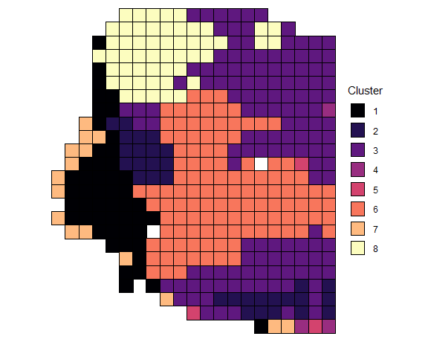
Spatial Clustering
Normal glands
Immune
Stroma
N/A
N/A
PIN glands
N/A
Cancer
Berglund, et al. 2018

Slide 7
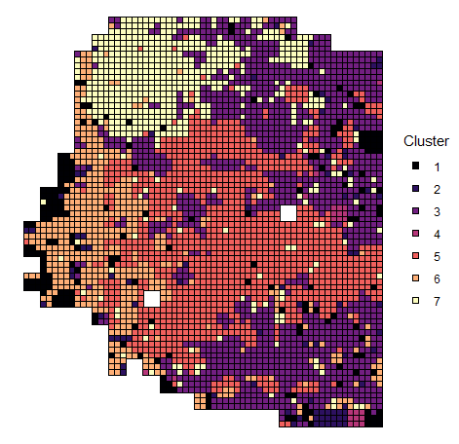
Deconvolution
Can deconvolution increase resolution?
Berglund et al. suggest the center and periphery of the cancer have different gene expression (metabolic alteration in center, stress/inflammation in periphery)

Slide 8
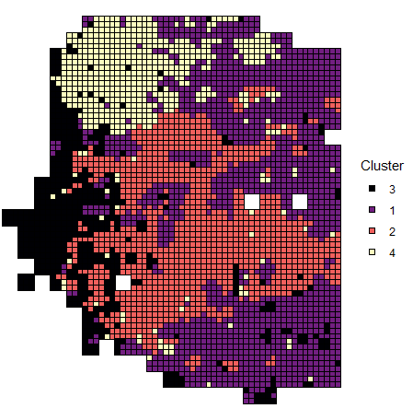
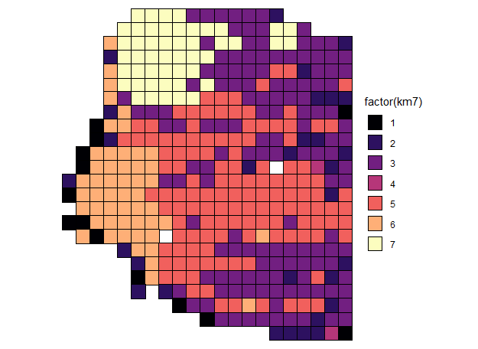
Deconvolution

Slide 9
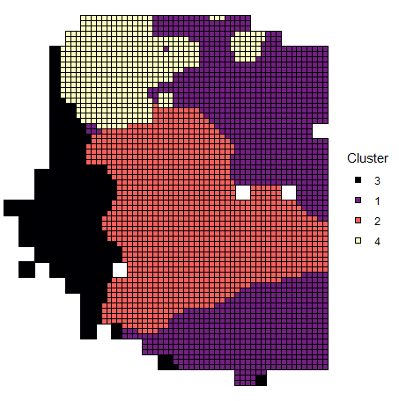
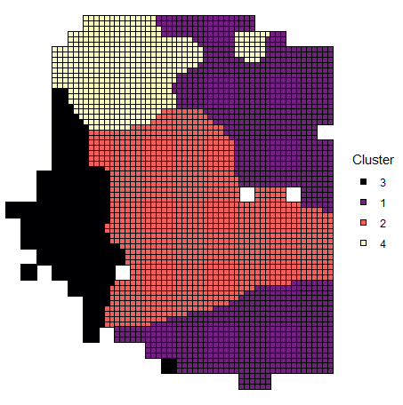
Deconvolution
γ = 4
γ = 6

Slide 10
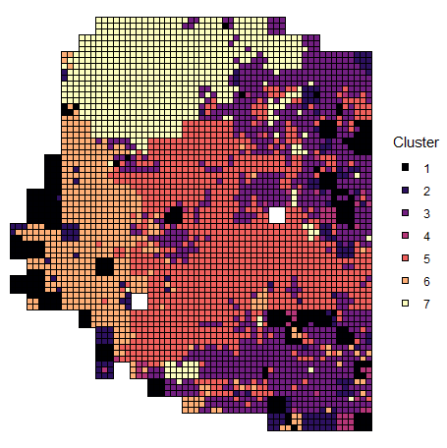
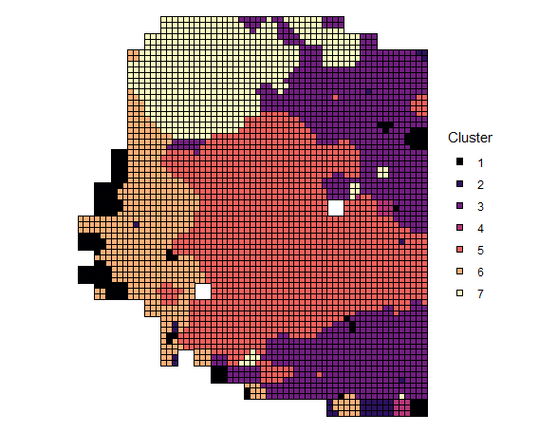
Deconvolution following Ripley 1991
γ = 1
γ = 2

Slide 11
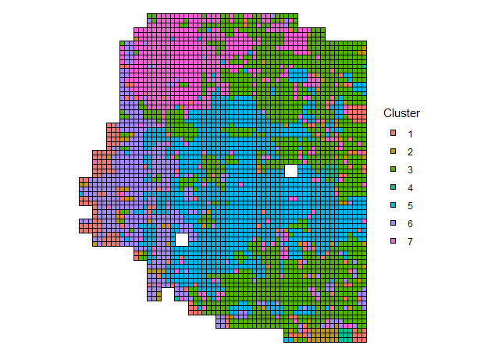
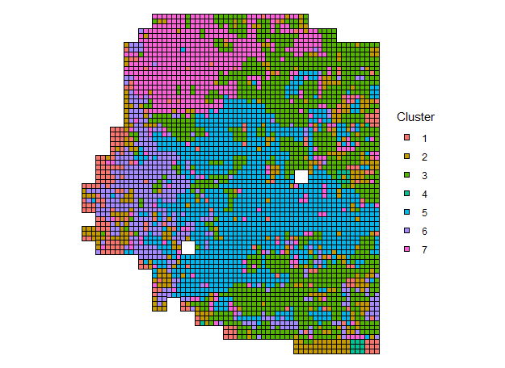
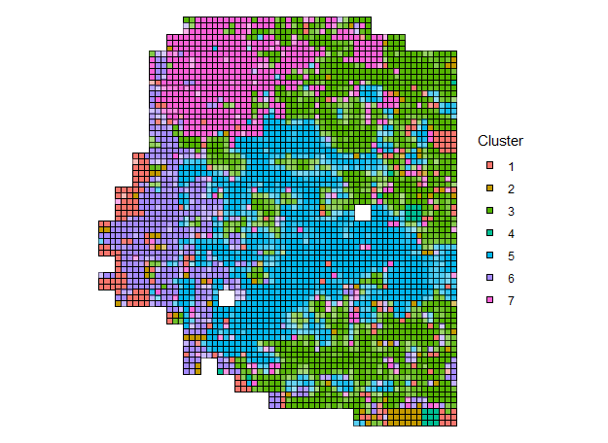

Slide 12
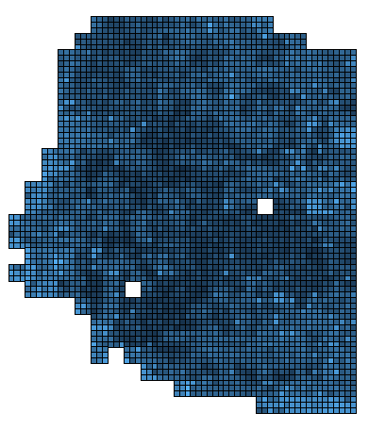
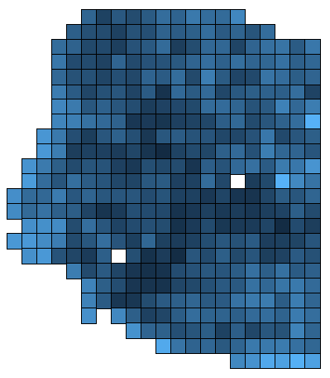
PC1
Deconvolution labels
Jittered Y’s
Actual Y’s

Slide 13
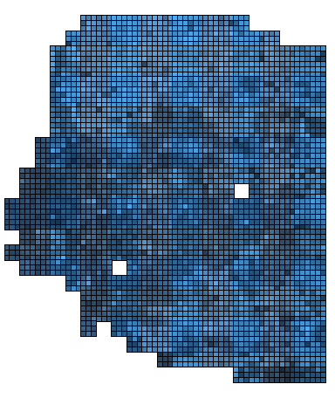
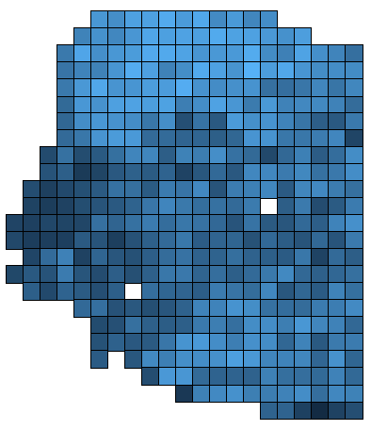
PC2
Deconvolution labels
Jittered Y’s
Actual Y’s

Slide 14
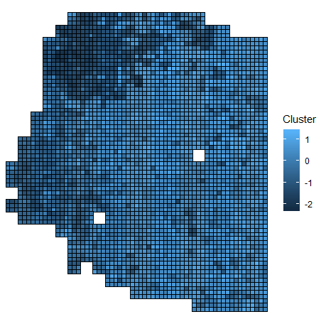
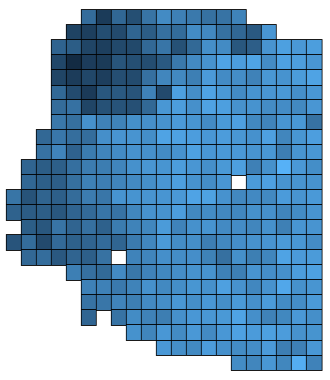
PC3
Deconvolution labels
Jittered Y’s
Actual Y’s

