Slide 1
Cluster size selection
5-12

Slide 2
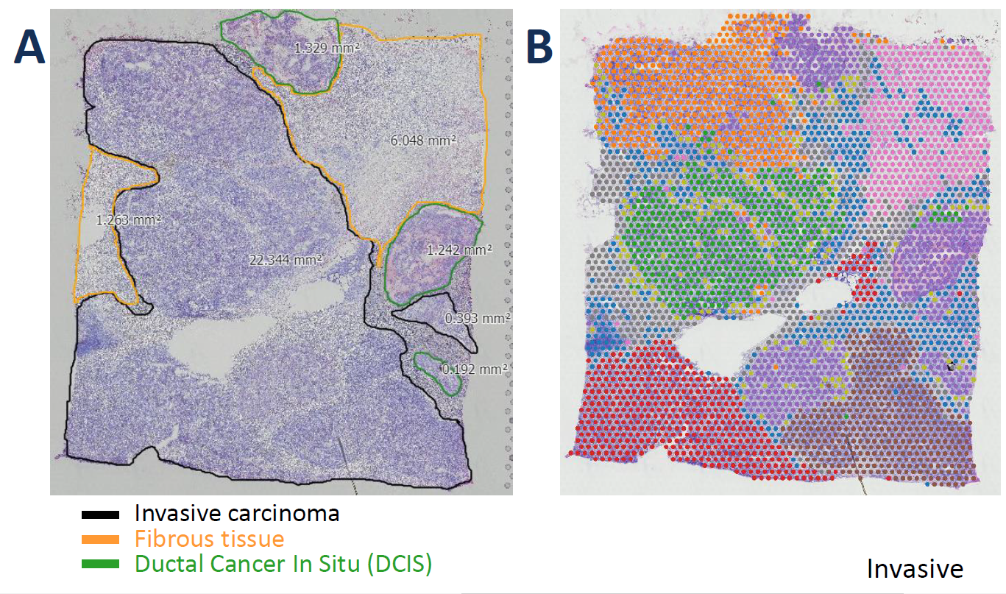
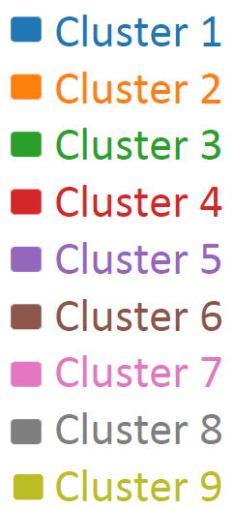
Breast cancer VISIUM data
Manual annotation
Unsupervised clustering

Slide 3
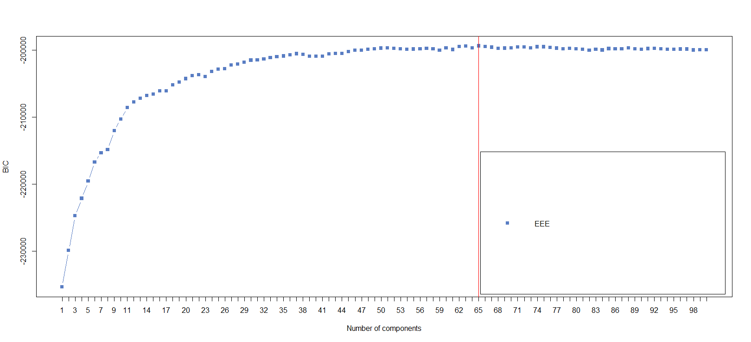
Finite mixture model BIC (Mclust)

Slide 4
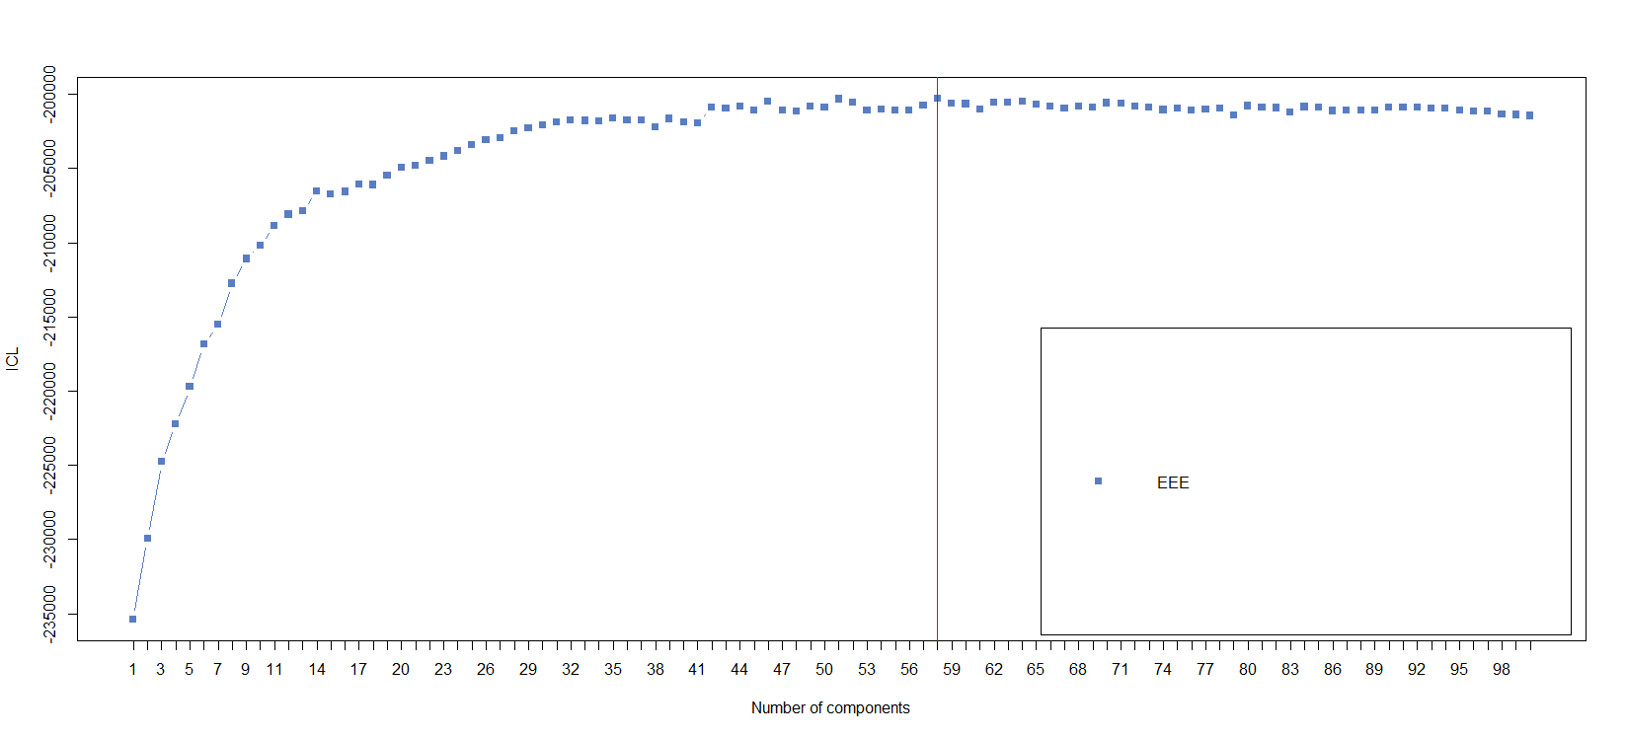
Finite mixture model ICL (mclustICL)

Slide 5
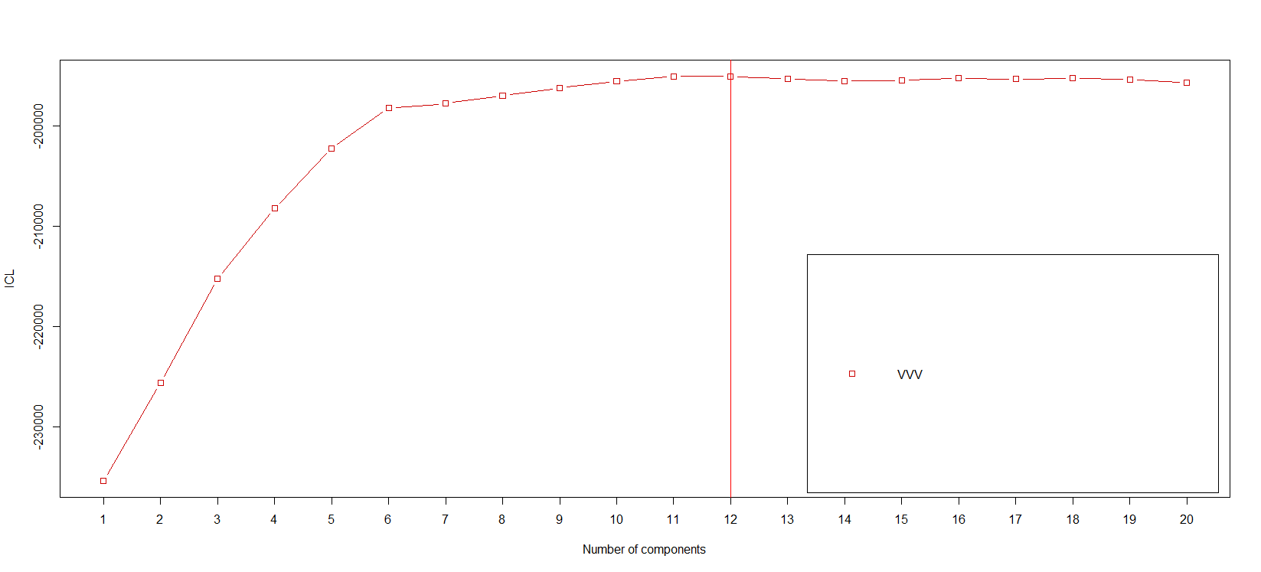
Finite mixture model ICL (mclustICL)

Slide 6
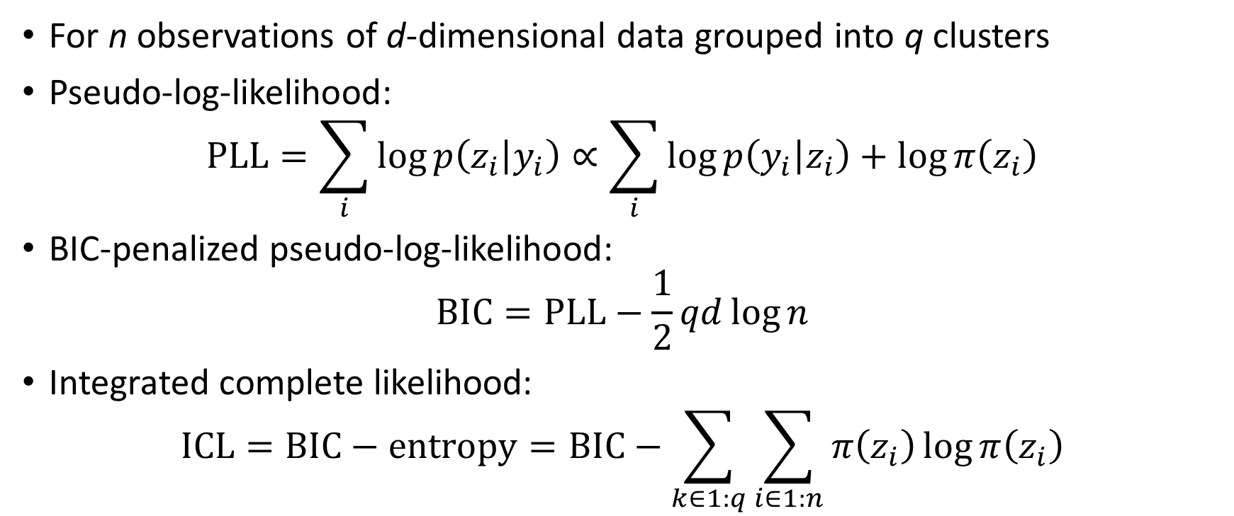
Pseudolikelihood
For n observations of d-dimensional data grouped into q clusters
Pseudo-log-likelihood:
$$PLL=\sum_{i}{\log{p\left(z_{i} | y_{i}\right)}}∝\sum_{i}{\log{p\left(y_{i} | z_{i}\right)}+\log{π\left(z_{i}\right)}}$$
BIC-penalized pseudo-log-likelihood:
$$BIC=PLL−\frac{1}{2}qd\log{n}$$
Integrated complete likelihood:
$$ICL=BIC−entropy=BIC−\sum_{k∈1:q}{\sum_{i∈1:n}{π\left(z_{i}\right)\log{π\left(z_{i}\right)}}}$$

Slide 7
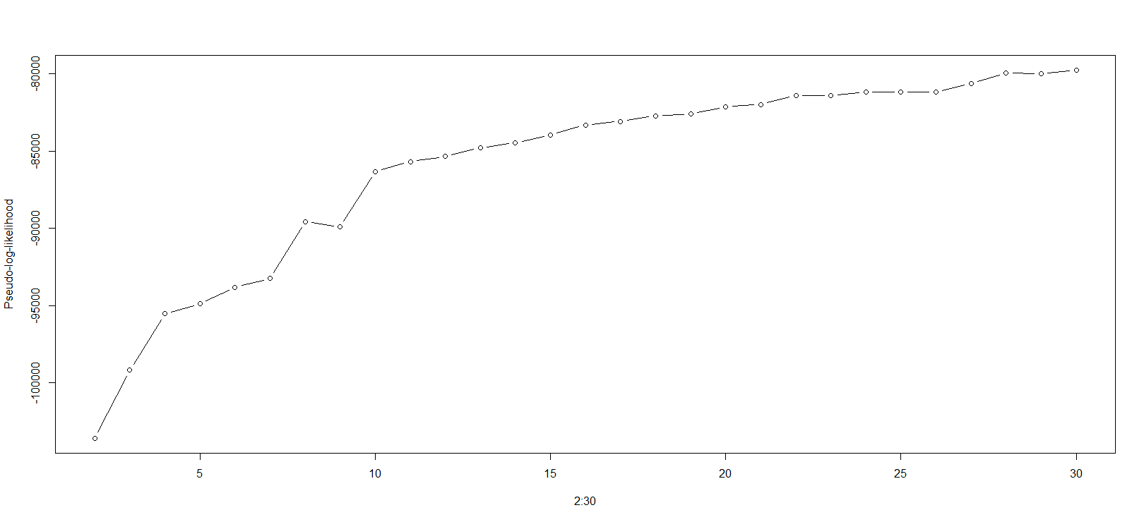
Pseudo-log-likelihood

Slide 8
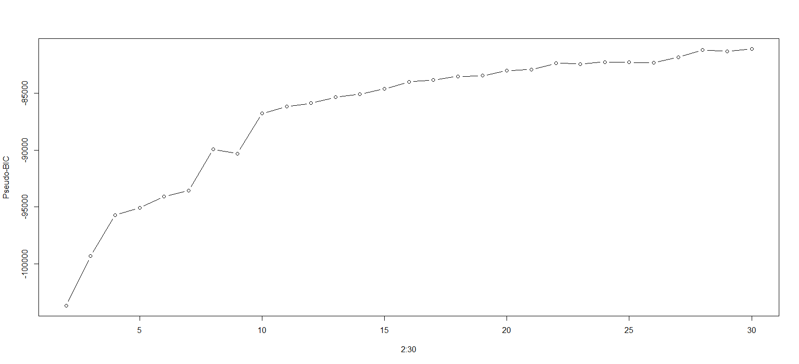
BIC-penalized pseudo-log-likelihood

Slide 9
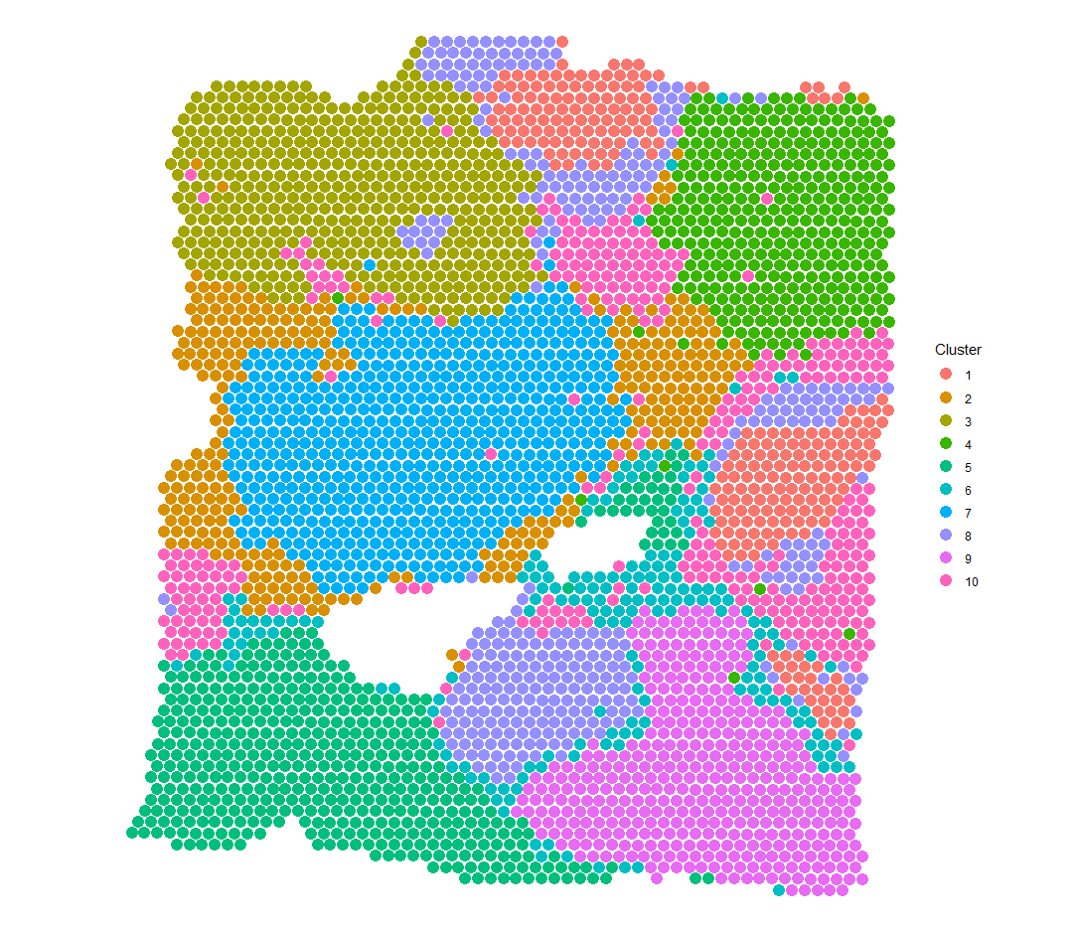
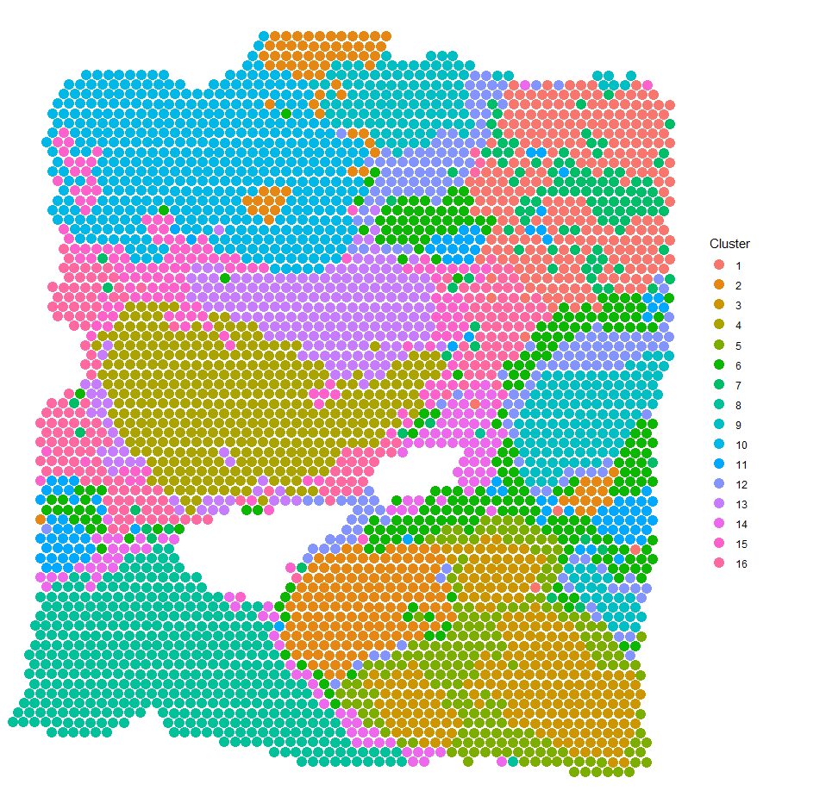
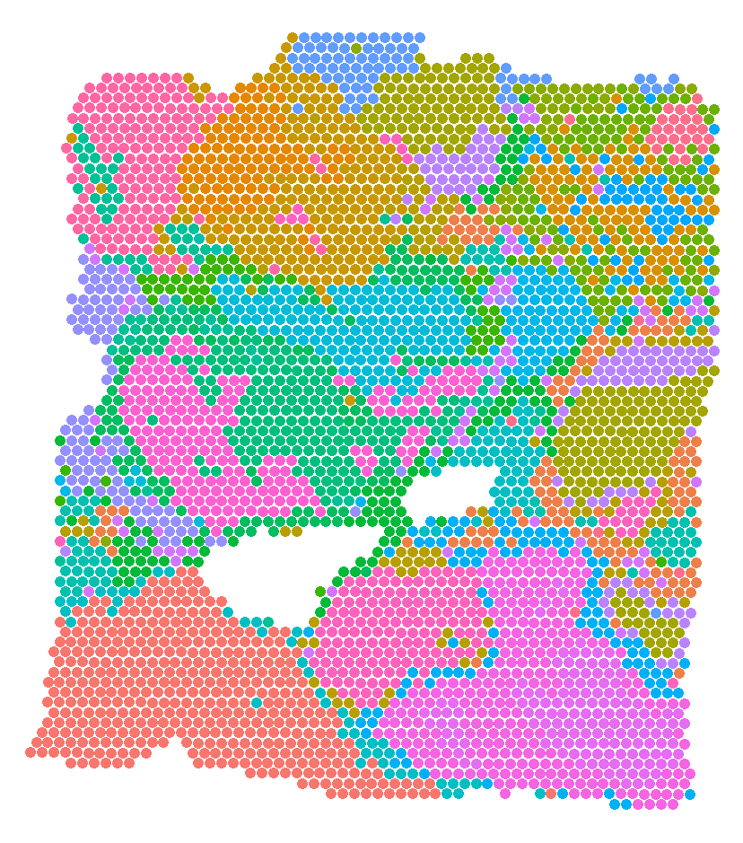
Spatial clustering: 9 vs. 16 vs. 30

