Slide 1
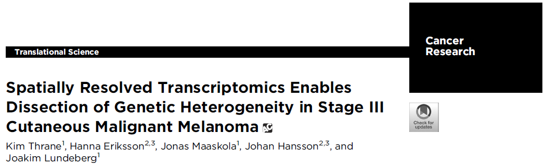
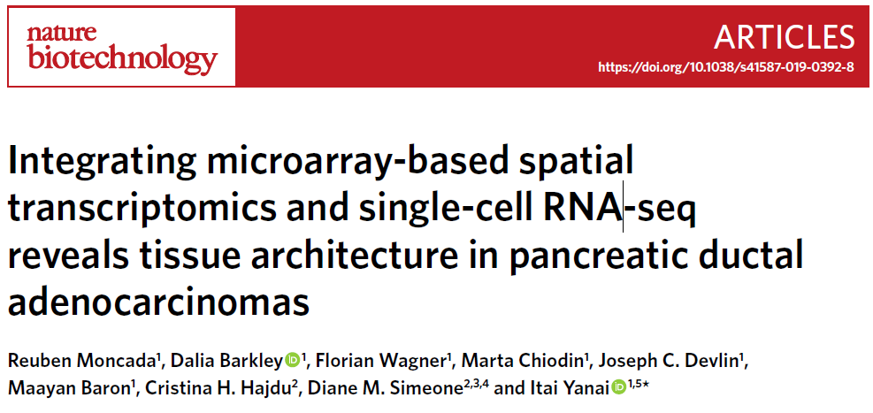
Analysis of melanoma and pancreatic ductal adenocarcinoma (PDAC) spatial transcriptomics data
5/4

Slide 2
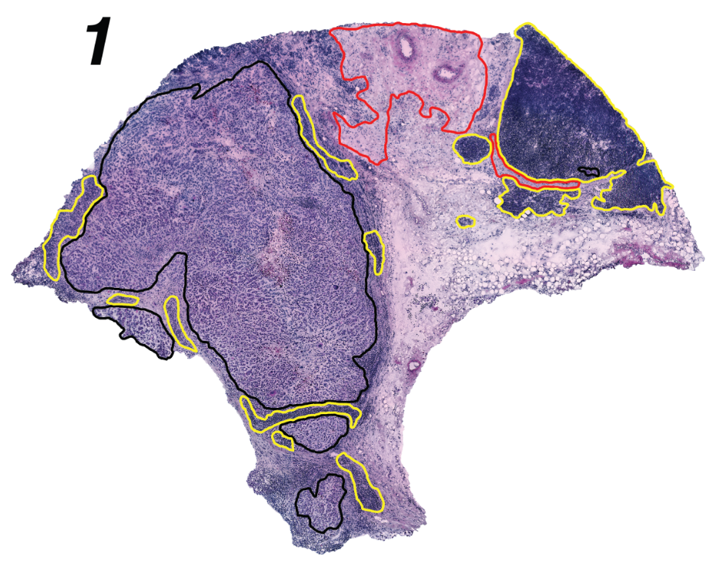
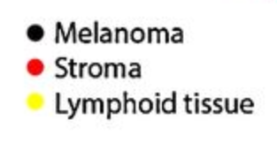
Sample Melanoma 1
H&E staining image annotated for histological features (left)
Each spot (100μm diameter) on spatial transcriptomics (ST) data contains 5-40 cells
New VISIUM technology is 55μm diameter
Hierarchical clustering on top PCs derived from highly variable genes (right)
Thrane et al., 2020

Slide 3
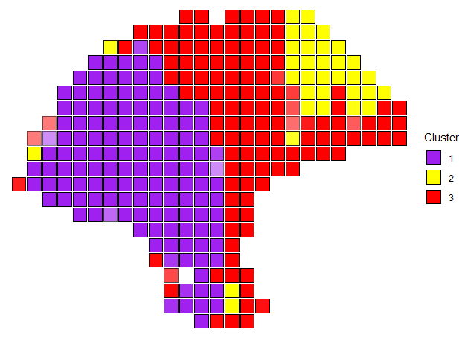
Spatial clustering

Slide 4
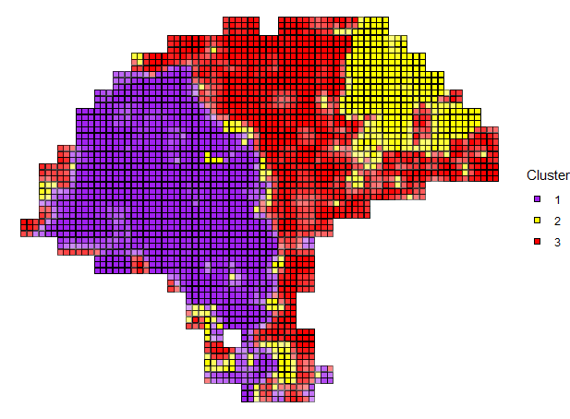
Spatial deconvolution

Slide 5
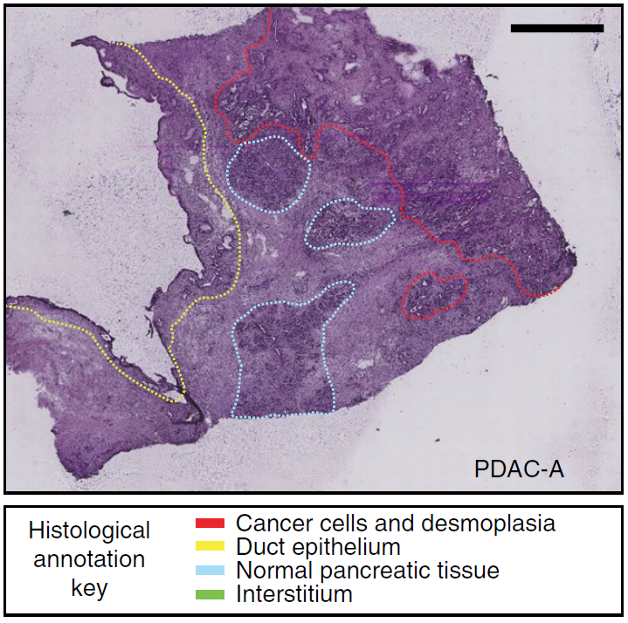
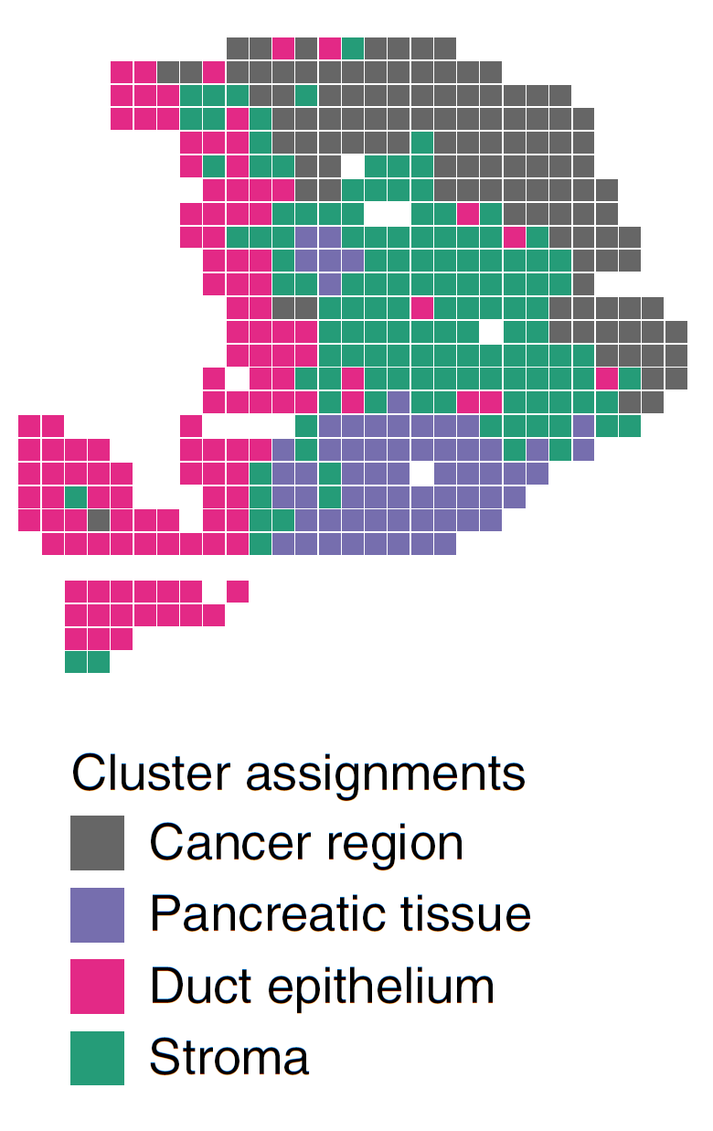
Sample PDAC-A
H&E staining image annotated for histological features (left)
Each spot (100μm diameter) on spatial transcriptomics (ST) data contains 20-70 cells
New VISIUM technology is 55μm diameter
Hierarchical clustering on top PCs derived from highly variable genes (right)
Moncada et al., 2020

Slide 6
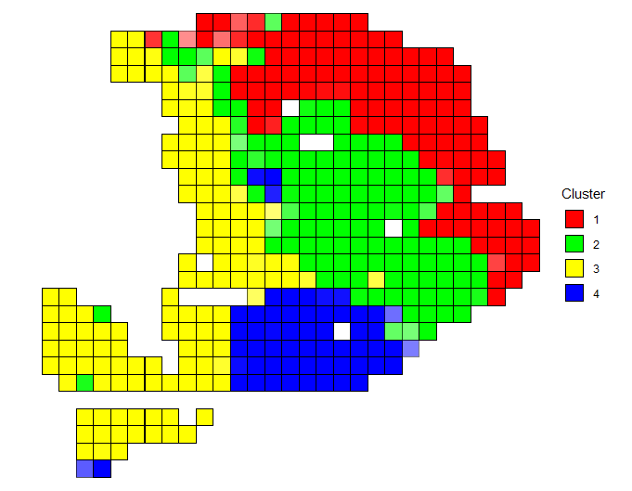
Spatial Clustering

Slide 7
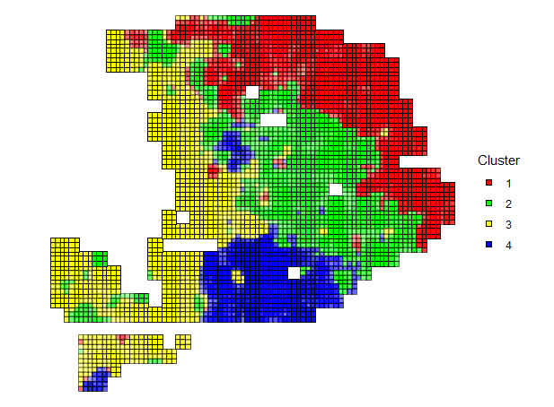
Spatial Deconvolution

Slide 8
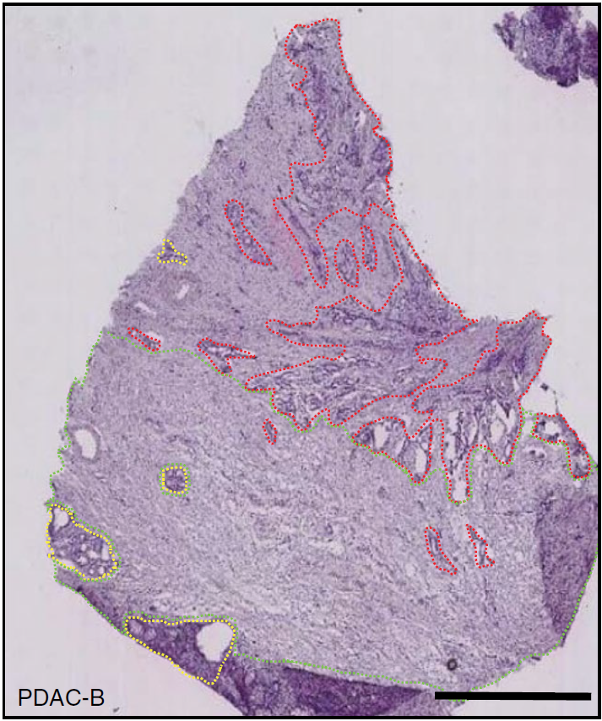
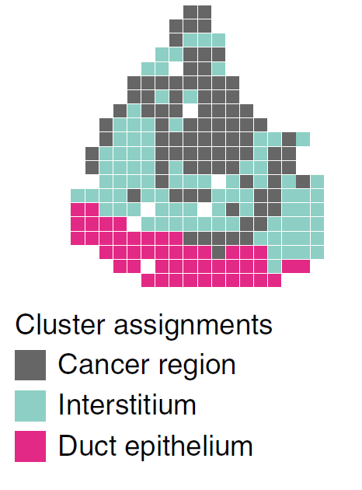
Sample PDAC-B
H&E staining image annotated for histological features (left)
Each spot (100μm diameter) on spatial transcriptomics (ST) data contains 20-70 cells
New VISIUM technology is 55μm diameter
Hierarchical clustering on top PCs derived from highly variable genes (right)
Moncada et al., 2020

Slide 9
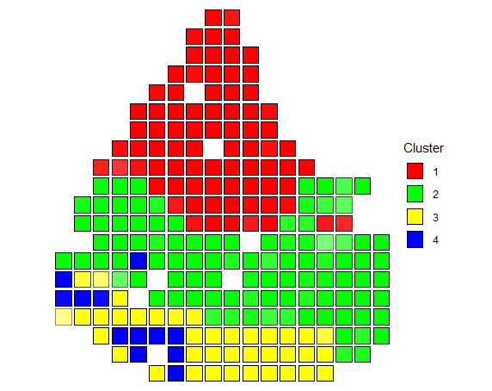
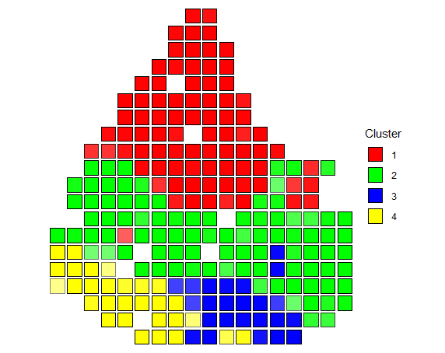
Spatial clustering

Slide 10
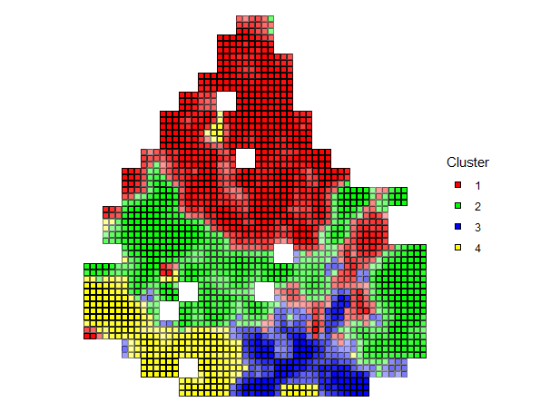
Spatial Deconvolution

Slide 11
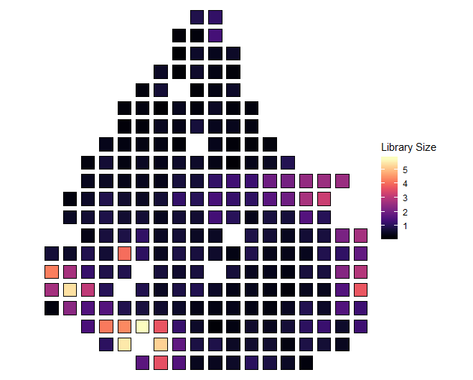
Library size

Slide 12
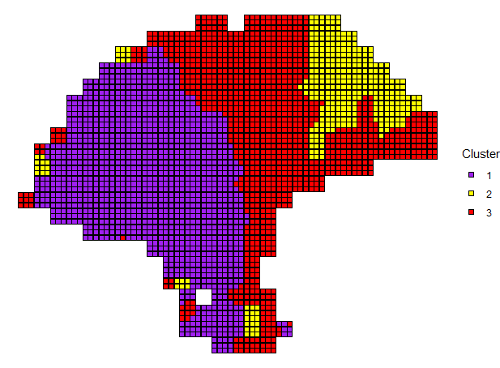
Spatial edge refinement

Slide 13
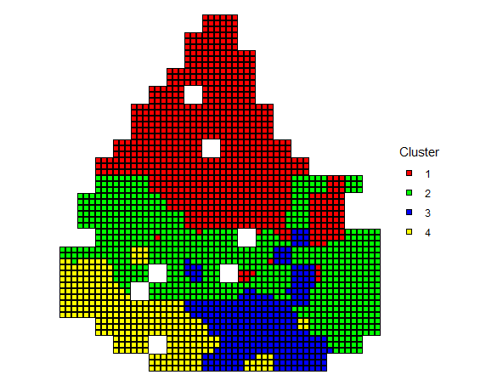
Spatial Deconvolution

Slide 14
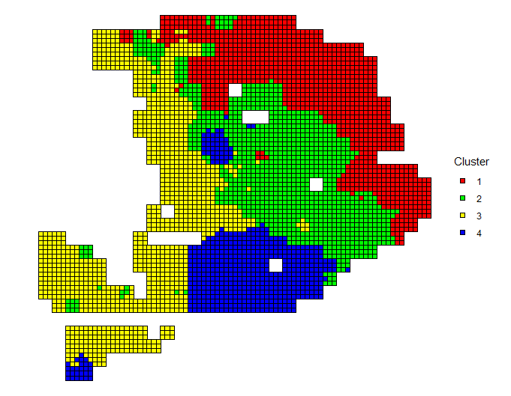
Spatial Deconvolution

