Slide 1
Spatial clustering and deconvolution
5/8

Slide 2
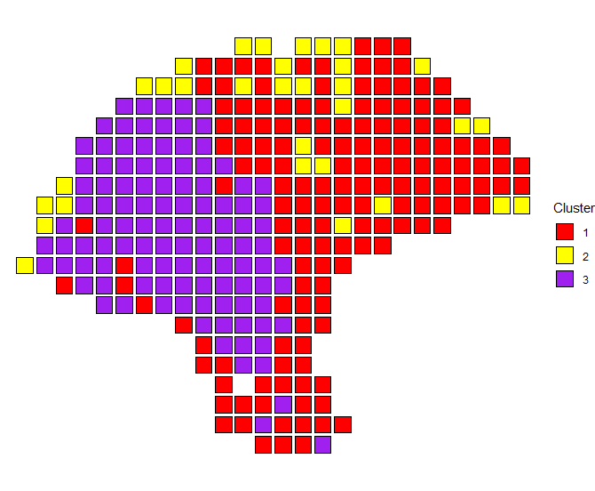
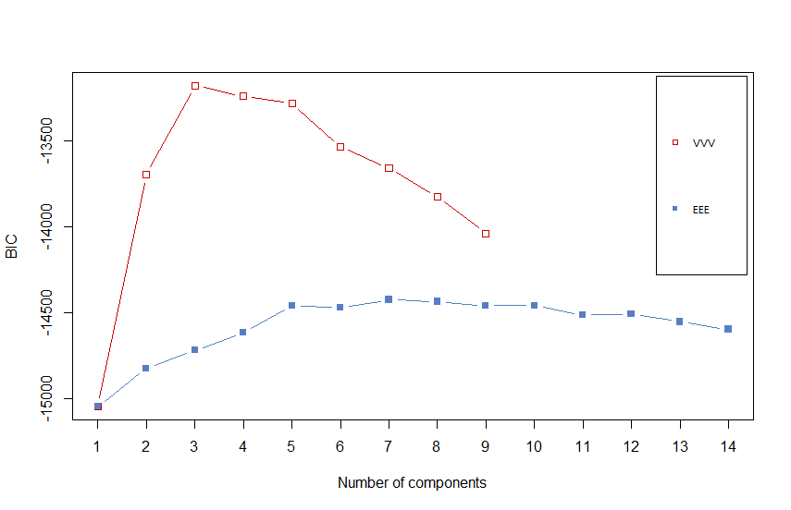
Mclust, VVV, 3 clusters

Slide 3
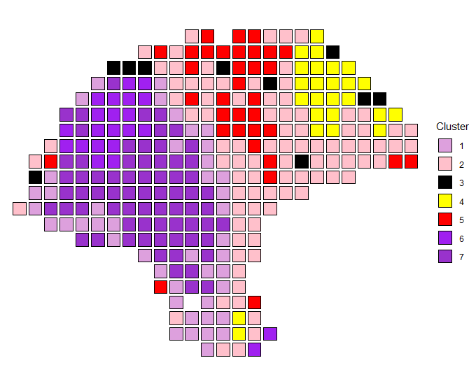
Mclust, EEE, 7 clusters

Slide 4
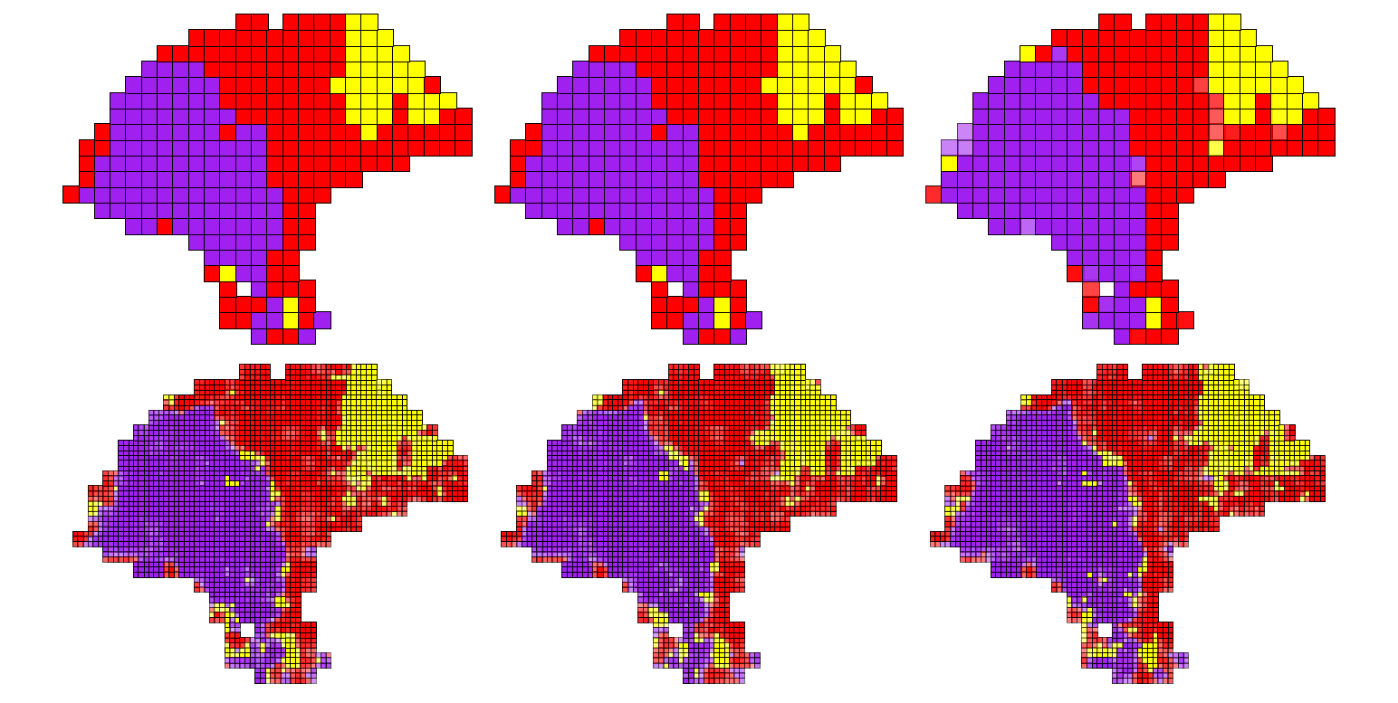
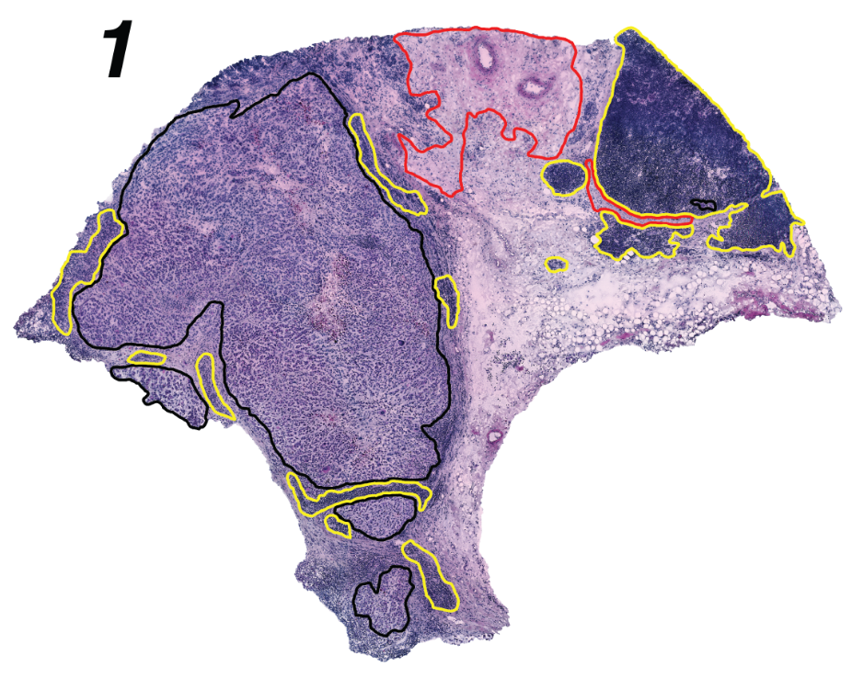
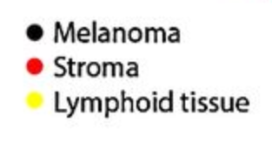
Deconvolution with multiple chains, ARI = 0.8
K-means
Spatial clustering
Deconvolution w/ spatial clustering init
Deconvolution w/ k-means init
Deconvolution w/ Mclust init

Slide 5
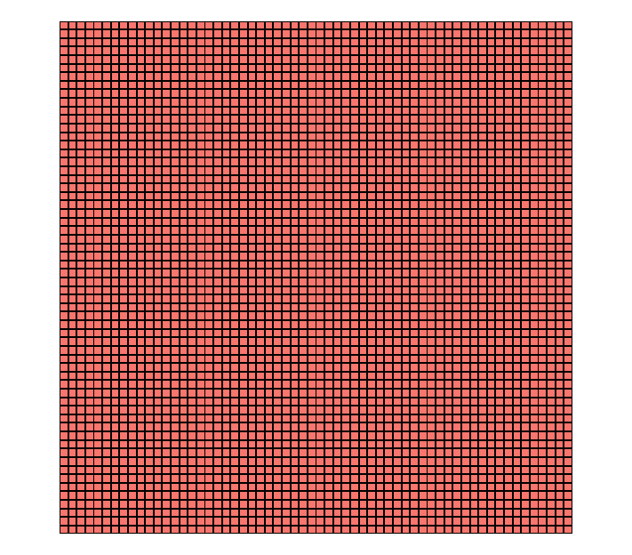
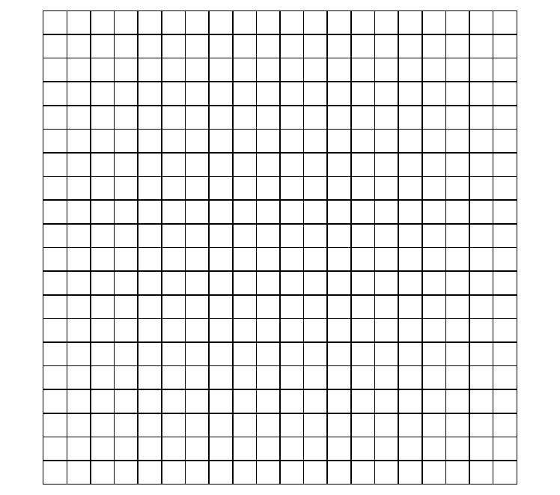
Simulating clusters

Slide 6
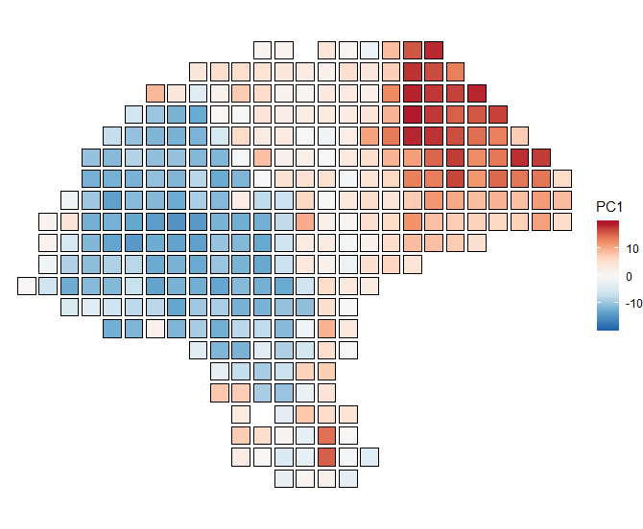
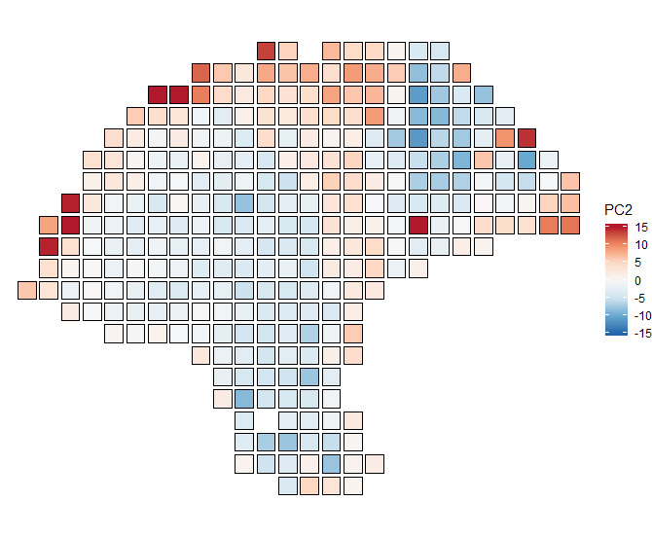
Principal components
Means | Cluster 1 | Cluster 2 | Cluster3
PC1 | -8.3 | 4.7 | 15.1
PC2 | -1.6 | 2.5 | -2.7

